Slide 1
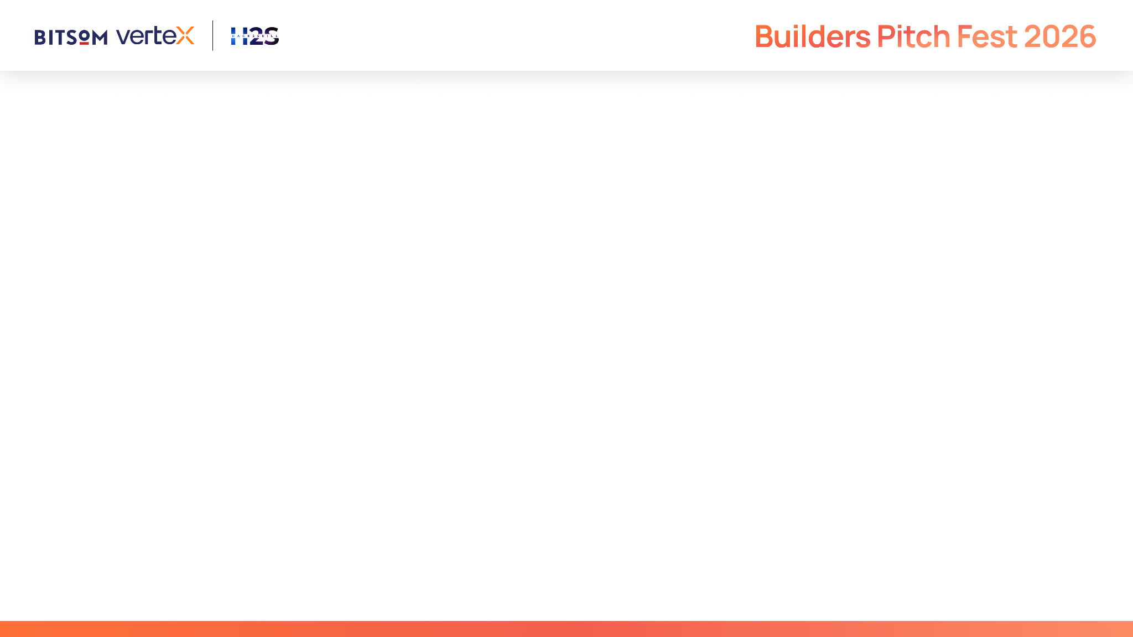
Aaranya Care Intelligence
Whole-person care intelligence with human authority
WORKING PROTOTYPE
37
10.0/10
Human
automated tests
350 quality checks
final authority
Innovation AI Agents Builders Pitch Fest 2026
Notes:
[Sources]
- Test figures reproduce the current software repository results. They do not represent clinical or customer validation.
- Prototype: https://aaranya-care-intelligence.trilogy-1207.chatgpt.site

Slide 2
One observation creates four coordination problems
CAREGIVER
Repeats the same observation across notes, calls and handover
NURSE IN CHARGE
Balances urgency against medication rounds and resident requests
FACILITY OPERATOR
Cannot see whether every concern received an owner and response
FAMILY
Calls repeatedly when a factual update does not arrive
Customer hypotheses to validate during design-partner discovery
Notes:
[Sources]
- The four customer jobs are hypotheses for structured interviews. No validated customer claims are made.

Slide 3
Beachhead customer and buying trigger
153M
INITIAL CUSTOMER
India-based assisted-living and senior-care operators with multiple shifts or sites
people aged 60 or older in India in 2022
ECONOMIC BUYER
347M
Facility owner, COO or head of care
UNFPA projection for 2050
BUYING TRIGGER
Inconsistent escalation, weak handovers or repeated family follow-up
Notes:
[Sources]
- UNFPA India, India Ageing Report 2023: https://india.unfpa.org/en/publications/caring-our-elders-institutional-responses-india-ageing-report-2023
- Customer segment, buyer and buying triggers remain hypotheses to validate.

Slide 4
The care-signal workflow
1
2
3
4
5
6
Observe
Understand
Guard
Plan
Approve
Follow up
Caregiver records one change
Baseline plus seven wellness signals
Safety policy runs before planning
Owner and practical next step
Staff accepts, edits or rejects
Task and family draft stay held
The product coordinates work. Staff retains authority.
Notes:
[Sources]
- Workflow reflects the implemented Aaranya prototype: https://aaranya-care-intelligence.trilogy-1207.chatgpt.site

Slide 5
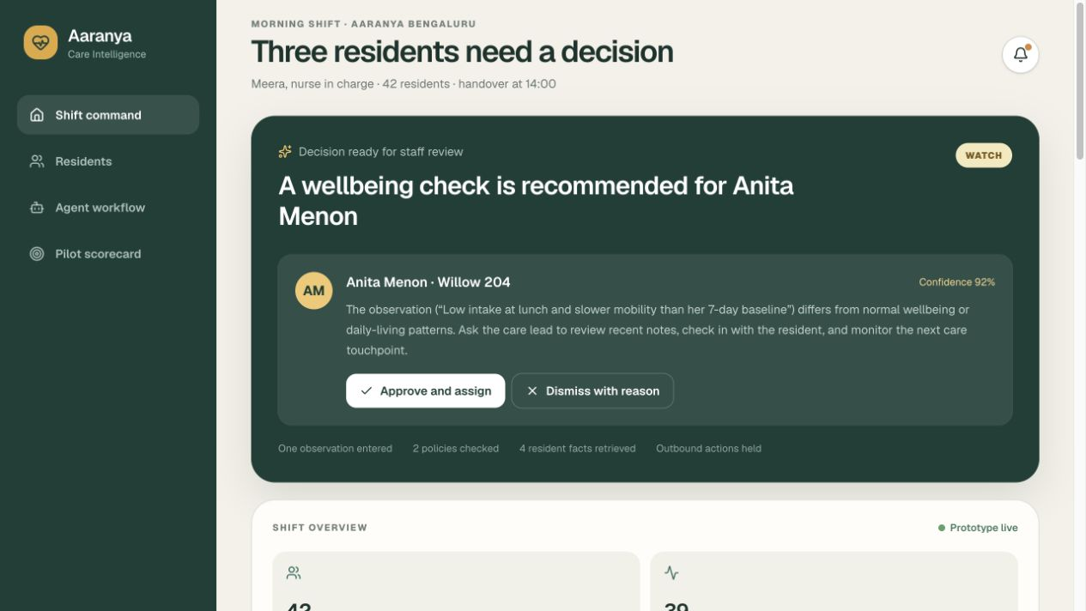
Working prototype and WholeLife Pulse
SEVEN DIMENSIONS
Sleep, energy, stress, movement, nourishment, connection and purpose
SUPERVISED AGENTS
Evidence, critic and safety stages end at a human approval gate
37 tests 350/350 checks
Notes:
[Sources]
- Product image captured from the Aaranya prototype on 6 September 2026.
- Test results reproduce the current repository. Clinical validation remains pending.

Slide 6
Ninety-day pilot scorecard
30%
≥95%
<30m
≥80%
FASTER
COMPLETE
MEDIAN
WEEKLY
Observation to owner
Required care-note fields
Approved family update
Invited staff adoption
versus week-one baseline
for escalated events
after a care event
during the pilot
Week one establishes the baseline. Weeks two to twelve measure improvement and adoption.
Notes:
[Sources]
- Every figure is a proposed pilot success threshold. No pilot results or customer traction are claimed.

Slide 7
Pilot-led business model
01
DESIGN PARTNER
Two facilities test one escalation workflow and review outcomes each week
02
PRICING HYPOTHESIS
Facility platform fee plus a charge per occupied bed
03
EXPANSION
Policy packs, family communication and multi-site oversight after adoption
Market sizing starts with beds managed by the target operator segment, not India’s entire older population.
Notes:
[Sources]
- Pilot design, pricing and expansion path are hypotheses to validate through discovery and procurement conversations.

Slide 8
Defensibility grows through approved workflow data
WholeLife context
Seven wellness dimensions plus resident baselines
Evidence and policy
Stable sources linked to each decision
Action control
Typed tools and explicit human approval
Outcome learning
Evidence from approved actions and follow-through
Aaranya connects whole-person context, policy, ownership, approval and family communication in one trace.
Notes:
[Sources]
- Differentiation reflects the implemented prototype and intended strategy. Competitive validation remains part of discovery.

Slide 9
Founder fit and the BITSoM ask
20
GOWTHAM RAMACHANDRA
Product leadership across Texmed, Trilogy, JPMorgan Chase, IBM and Harman. PGPEM from IIM Bangalore.
years in software and IT
12
WHAT BITSoM CAN UNLOCK
Operator introductions for discovery and two design partnerships
Guidance on enterprise pricing, evidence design and compliance readiness
years in product management
Notes:
[Sources]
- Founder biography and program objectives supplied by the founder.

Slide 10
Pilot invitation and live demo
WE NEED
YOU RECEIVE
One care lead
Two frontline users
One escalation workflow
A configured prototype
Weekly findings
A final outcome report
LIVE PROTOTYPE
aaranya-care-intelligence.trilogy-1207.chatgpt.site
GITHUB
github.com/gowtham66867/aaranya-care-intelligence
Gowtham Ramachandra gowtham66866@gmail.com
Notes:
[Sources]
- Live prototype: https://aaranya-care-intelligence.trilogy-1207.chatgpt.site
- Pilot scope and deliverables are proposed terms for a design partnership.

Slide 11

Notes:
[Sources]
- Official BITSoM Vertex prototype-submission template closing bumper.

