Slide 1
MerchantLens
Tell the story once.
Carry every useful detail forward.
A merchant support teammate for clearer cases
and reviewed handoffs
Gowtham Ramachandra
Solo participant / Track 3: Autonomous AI Teammates
Working prototype
Public source
MerchantLens / Paytm Build for India / Stage 1
1/7
Notes:
Stage 1 submission for Paytm Build for India AI Hackathon, Bengaluru. Sole participant Gowtham Ramachandra. A working support-intake and continuity prototype. The current version prepares a reviewed handoff but does not execute Paytm operations or create real support tickets. Reuses a foundation built at an earlier Paytm-office voice buildathon in October 2026. New work adds eight optional support stages and reviewed photo evidence. No production deployment by Paytm is claimed.

Slide 2
Problem: unclear evidence and repeated explanations
“The customer paid, but my Soundbox stayed silent.”
Three separate questions
Context gets fragmented
Did the app record the payment?
Was bank settlement checked?
Did the device announce it?
Earlier checks and support contacts may not travel with the case. The next reviewer needs the unresolved question and its source.
A screenshot or a silent device cannot establish financial loss.
Design hypothesis: better continuity reduces repeated clarification. Merchant impact remains to be measured.
MerchantLens / Paytm Build for India / Stage 1
2/7
Notes:
Fictional scenario, not an independently verified payment. Paytm receipt guidance distinguishes app transaction history, Soundbox audio and bank records, and cautions against relying on screenshots: https://paytm.com/support/paytm-soundbox/how-merchants-can-verify-payment-receipts . Published support channels: https://business.paytmpayments.com/contact-us . The builder reported a leader mentioning five layers before support. Exact internal names and policies were not supplied, so the eight prototype stages are illustrative and optional. Do not claim a measured Paytm support failure or a confirmed financial loss.

Slide 3
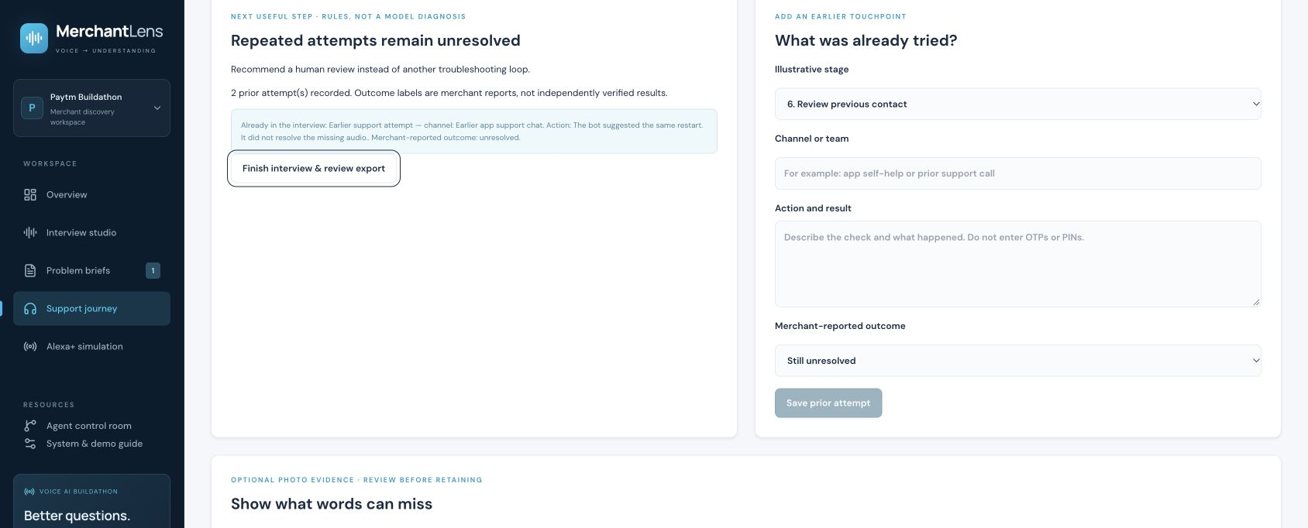
Solution: a case that keeps its context
Voice or text intake, optional photos and reviewed next steps
Eight optional support stages
1 Clarify the report
2 Review payment evidence
3 Add a supporting photo
4 Review visual findings
5 Record self-service checks
6 Capture previous contact
7 Prepare human handoff
8 Follow up on the outcome
Human help stays available immediately.
Every stage can be skipped.
MerchantLens / Paytm Build for India / Stage 1
3/7
Notes:
Implemented: eight optional stages, manual support history, human-help request, source-linked reviewed image notes and separate export approval. Two unresolved entries recommend human review, subject to manual-history limitations. A human-help request does not connect a person or create a ticket. Photo workflow: choose JPEG/PNG/WebP up to 4 MB, resize/re-encode, manually cover private areas, consent to Google analysis, review/edit provisional observations, save only the note and digest, discard raw image. No authenticity or settlement verification. Source: lib/support-journey.ts, components/photo-evidence.tsx and docs/PHOTO-EVIDENCE.md. Screenshot shows actual captured UI with synthetic data.

Slide 4
Technology and agent execution
Interface and voice
Bounded agent workflow
React, TypeScript and Vinext
Gemini transcription and speech
English, Hindi, Kannada, Hinglish
Extractor proposes source-linked claims.
Critic challenges interpretation.
Planner selects the next question.
Code controls authority
Runtime and review
Exact quote and source checks
Up to 4 model calls and 3 local tools
One repair and a 55-second deadline
Node on Google Cloud Run
Browser-local cases in public demo
Edits invalidate both export approvals
67 automated tests pass. Seven guided probes are separate from live-model accuracy testing.
MerchantLens / Paytm Build for India / Stage 1
4/7
Notes:
Architecture: browser recording becomes editable text before Send. The Node interview endpoint orchestrates separately scoped Gemini extractor, critic and planner calls. The source verifier rejects missing/mismatched transcript references. Critic and read-only tools run in parallel, then the planner receives ranked topics, tool results and critic summary. Tools are local coverage, evidence inspection and curated knowledge cards, not live Paytm APIs or web RAG. Same model backend means correlated errors remain possible. Max 14 merchant turns and 55-second graph deadline. No A2A protocol. MediaRecorder prefers supported browser formats such as WebM/Opus; generated voice endpoint returns validated WAV. Tests cover contracts and failure paths, not field speech accuracy. Working checkout: 67 tests passed 23 October 2026. The 21 October synthetic provider smoke test observed 26,094 ms across three calls, a single observation rather than a benchmark. Physical mobile-camera and noisy-shop voice validation remain outstanding.

Slide 5
USP: useful evidence survives the handoff
Traceable observations
Pictures with merchant control
Each claim links to received words.
Unknowns remain explicit.
Corrections supersede earlier claims.
Cover details before external analysis.
Review the provisional note.
Retain no raw image in the case.
Prior attempts stay attached
Different audiences, fresh approval
Record the previous action and result.
Recommend review after repeated failure.
Carry history into the internal brief.
Internal brief includes reviewed history.
Public export omits image notes.
Changes invalidate previous approvals.
MerchantLens / Paytm Build for India / Stage 1
5/7
Notes:
Paytm already offers an AI Soundbox assistant with business insights in 11 languages, so voice alone is not the claimed novelty. Source: https://paytm.com/document/ir/press-release/AI-SB.pdf . MerchantLens proposes evidence-aware support continuity that complements existing products. These features are implemented in the prototype but have not been compared with Paytm internal tooling. An exact quote establishes provenance, not the truth of the reported event. Merchant review does not establish image authenticity. Public anonymized output omits reviewed image notes and detailed support history. Do not describe manual covering as guaranteed automatic PII removal.

Slide 6
Impact and pilot measurement
Primary goal: less merchant effort, with useful human handoffs
Merchant outcomes
Operations outcomes
Fewer repeated explanations
Less time spent on the case
Clear status and remaining unknowns
Reviewer handling time
Handoff completeness
Incorrect routing and recontacts
Proposed pilot: 10 consenting merchants with operations reviewers
Compare matched cases with the existing flow. Record voice failures, corrections, cost and whether improvement lasts.
MerchantLens / Paytm Build for India / Stage 1
6/7
Notes:
All impact improvements are hypotheses. Proposed pilot size is 10 consenting merchants, not an existing customer count or measured adoption. Compare case type/severity and reviewer experience, avoiding selection bias. Candidate targets for a larger evaluation: reduce repeat questions and reviewer time by 20%, with no worsening of recontacts or erroneous closure. Targets require baseline agreement and an adequate case sample. Do not optimize only for fewer human contacts, because merchant abandonment can resemble successful deflection. Establish unsupported financial assertions, confidential-data leakage and unauthorized actions as critical failure categories. Current 67 tests and seven guided probes are not a live multilingual accuracy benchmark.

Slide 7
Business model and integration plan
Proposed internal capability for Paytm merchant operations
Value and cost model
Pilot before system execution
Value comes from saved reviewer time
and lower repeat-contact effort.
Costs include inference, hosting,
maintenance and human review.
First validate handoff usefulness.
Then add authorized read-only records.
Add approved ticket creation with
idempotency and durable receipts.
Illustrative monthly capacity value, not measured savings
10,000 cases × 2 minutes × ₹8/minute = ₹1.6 lakh gross
Less ₹30,000 assumed AI/hosting cost = ₹1.3 lakh before other costs
Live support prototype
Source and architecture
MerchantLens / Paytm Build for India / Stage 1
7/7
Notes:
The internal-capability model is a proposal, not an agreed Paytm commercial arrangement. Example inputs are assumptions: 10,000 eligible cases/month, two reviewer minutes saved/case and loaded cost of INR 8/minute produce INR 160,000 gross capacity value. Subtract INR 30,000 assumed incremental AI/hosting cost for INR 130,000 before implementation, maintenance and other costs. Capacity value only becomes cash savings if staffing or outsourcing spend changes. Avoid adding speculative retention revenue to the same figure. Production prerequisites: identity, tenant isolation, server-side canonical case state, retention/deletion, approved knowledge ownership, distributed quotas, source freshness, scoped history/payment/device adapters, and idempotent ticket creation. Current implementation has no Paytm APIs, real tickets, financial execution or verified closure. Website source and demo disclose reuse of an October 2026 buildathon foundation. Product release and ROI remain subject to pilot validation.

