Slide 1
SEBI SECURITIES MARKET TECHSPRINT 2026
AI-Driven Detection of Synthetic Media and Phishing Attacks
A Dual Protection Framework: detect AI-generated fraud, and let genuine
communications prove they're genuine.
LIVE DEMO
sebi-synthetic-media-detector-564262191703.asia-south1.run.app
SOURCE
github.com/gowtham66867/sebi-synthetic-media-detector

Slide 2
THE PROBLEM
AI-Generated Threats to Securities Markets
Generative AI has increased the sophistication, scale, and impact of fraud targeting securities markets — extending beyond phishing into synthetic media that impersonates trusted market participants. Current controls detect conventional attacks; they weren't built to verify whether a communication itself is authentic or AI-generated.
THREAT
SECURITIES MARKET EXAMPLE
IMPACT
AI Phishing Emails
Fake SEBI/broker emails requesting KYC updates
Credential theft
Voice Cloning
Fraudster impersonates a Relationship Manager
Fund diversion
Deepfake Videos
Fake CEO recommending a stock purchase
Market manipulation
Synthetic Social Posts
AI-generated “breaking news” on listed companies
Investor misinformation
Fake Circulars
Fraudulent regulatory announcements
Investor panic

Slide 3
THE SOLUTION
A Dual Protection Framework
Detection alone only ever tells you something was fake after the damage. Authentication alone does nothing about the fraud already circulating. The brief asks for both — this build implements both.
LAYER 1 — AI THREAT DETECTION
LAYER 2 — AUTHENTICITY VERIFICATION
1
Deepfake video / cloned voice detection
1
Real Ed25519 digital signature over content
2
Fake investment advertisement detection
2
QR code encoding a public verification link
3
AI phishing email / message detection
3
Public portal: Authenticity Confirmed / Not Verified
Built with: LLM structured extraction, audio/video signal-
processing forensics, fuzzy registry grounding, scam/phishing
lexicons — every score explainable, not a black box.
Built with: SHA-256 content hash + Ed25519 signing,
Firestore-backed records (shared across instances), a
/verify/:id page reachable directly from a QR scan.

Slide 4
ARCHITECTURE
Three Pipelines, Shared Infrastructure
A video clip, a text message, and a signing request don't share stages — so each gets its own pipeline. All three share the same Firestore job store, the same Gemini client with a rule-based fallback, and the same rate limiter.
LAYER 1A — MEDIA (DEEPFAKE / VOICE-CLONE) PIPELINE
Extract
(ffmpeg)
→
Transcribe
(Whisper)
→
Claims Agent
(LLM)
→
Forensics
(audio+video)
→
Registry
Cross-Check
→
Lexicon
Scan
→
Risk Synthesis
(LLM)
LAYER 1B — PHISHING PIPELINE
LAYER 2 — AUTHENTICITY
Claims Agent
(LLM)
→
Phishing
Lexicon Scan
→
Risk Synthesis
(LLM)
Ed25519
Sign
→
Firestore +
QR Code
→
Re-verify on
/verify/:id
Every LLM call in every pipeline has a deterministic regex/lexicon fallback — a live demo degrades gracefully instead of failing outright.

Slide 5
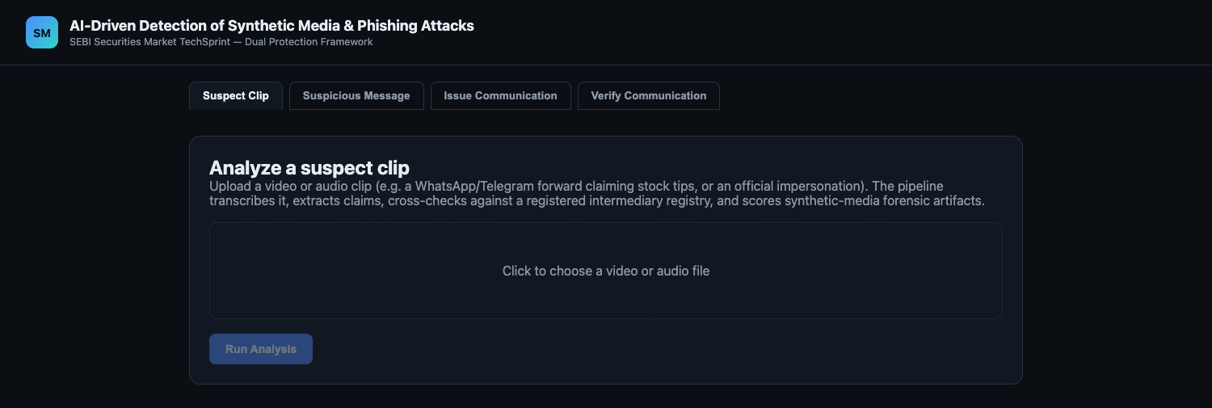
LIVE DEMO — LAYER 1A
Suspect Clip: Deepfake & Voice-Clone Detection
WHAT IT DOES
Upload a video/audio clip claiming to be an official, advisor, or public figure. The pipeline transcribes it, scores audio/video forensic artifacts (pitch jitter, blink rate, frequency stability), cross-checks any claimed identity against a registered-intermediary registry, and scans for scam language — then synthesizes one explainable risk score.
VALIDATED
A small honest check against 5 real (public-domain) human-speech clips vs. 5 TTS clips showed real directional separation (mean 0.133 vs 0.219) — reported with its overlap, not oversold as a validated classifier.

Slide 6
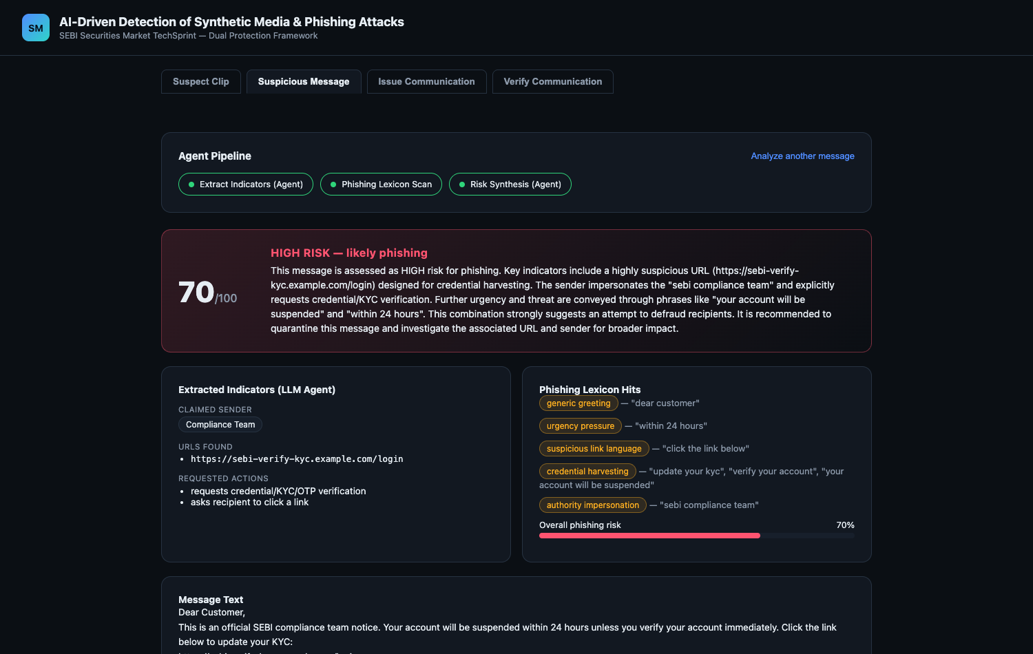
LIVE DEMO — LAYER 1B
Suspicious Message: Phishing Detection
WHAT IT DOES
Paste a suspicious email, SMS, or WhatsApp message. An LLM agent extracts the claimed sender, URLs, and requested actions; a deterministic lexicon scan flags credential-harvesting, urgency, and authority-impersonation language.
THIS RUN
A message impersonating “SEBI compliance” requesting urgent KYC verification via a suspicious link scored 70/100 — HIGH risk, likely phishing — with every contributing signal shown, not just a number.

Slide 7
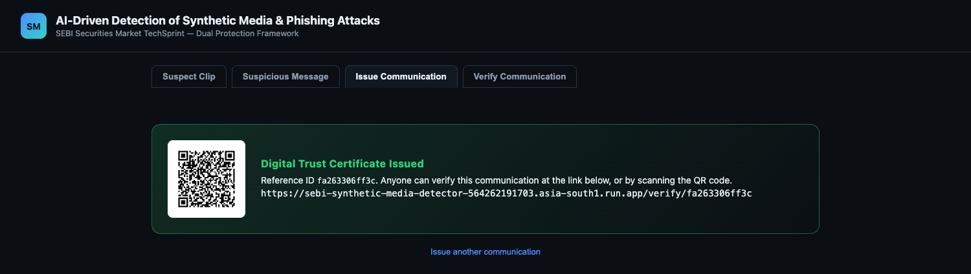
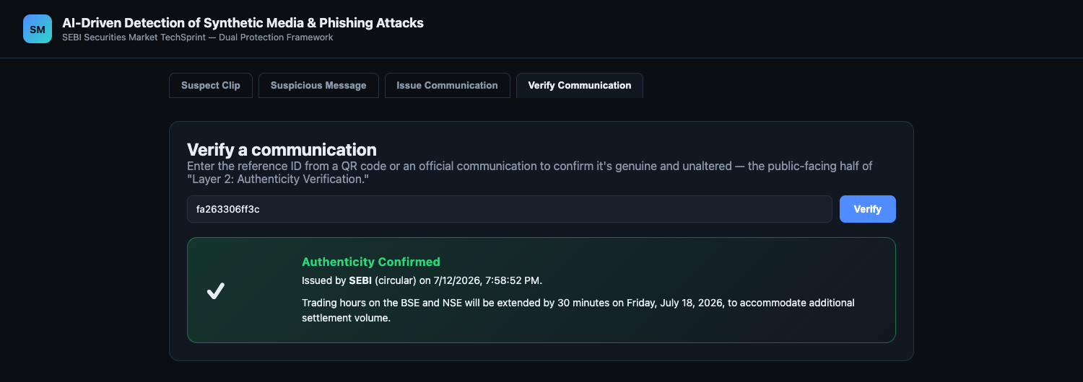
LIVE DEMO — LAYER 2
Issue a Communication, Then Verify It
An issuer (SEBI, an exchange, a broker) signs a genuine communication once and gets a QR code + reference ID. Anyone who receives it — an investor, a journalist, another broker — scans the QR (or types the reference ID) and lands directly on /verify/:id, which re-checks the Ed25519 signature against the stored content and returns Authenticity Confirmed or Not Verified. No app install, no account, on the verifying side.

Slide 8
ENGINEERING RIGOR
Verified, Not Just Claimed
56
3
0.219 vs 0.133
AUTOMATED TESTS
REAL BUGS FOUND & FIXED
FORENSICS VALIDATION
Forensics edge cases, lexicon scanning, registry fuzzy-match thresholds, risk-engine scoring/caps, LLM fallback, Ed25519 tamper detection, rate limiting — all offline, no real API calls needed to run the suite.
A regex over-capture in the fallback extractor, a Firestore-reserved document ID that silently broke the exact fix meant to prevent job loss, and a whisper crash on silent audio — each caught by actually testing against real data, not assumed away.
Mean synthetic-voice score across 5 real human-speech clips vs. 5 TTS clips. Real separation, honestly reported with its overlap — not proof, but real evidence where there was none.
Deployed on Cloud Run with Firestore-backed job/record state (survives multi-instance scaling), Secret-Manager-held keys, per-IP rate limiting on compute-triggering endpoints, and secret redaction on error responses.

Slide 9
TECHNOLOGY
Tech Stack by Layer
Media & Phishing Detection
Authenticity & Platform
●
Python, FastAPI — threaded orchestrators per pipeline
●
cryptography (Ed25519) — real digital signatures
●
ffmpeg, faster-whisper — extraction & speech-to-text
●
qrcode — QR generation
●
librosa, OpenCV — audio/video forensic signal processing
●
Google Firestore — shared job/record state across instances
●
Google Gemini (2.5-flash) — schema-constrained extraction + grounded synthesis
●
Google Secret Manager — production keys
●
rapidfuzz — fuzzy registry grounding
●
React + TypeScript (Vite) — live pipeline UI, public /verify/:id route

Slide 10
COMMERCIAL POTENTIAL
Two Layers, Sold Together
Detection without authentication only tells you something was fake after the damage. Authentication without detection does nothing about the fraud already in circulation. They're one product, not two.
SEBI / Exchanges
Surveillance-augmentation triage tool
Layer 1
Brokerages
Brand-protection: detect deepfakes/phishing impersonating own staff
Layer 1
SEBI / Exchanges / Brokers
Sign outgoing circulars & advisories once; every recipient verifies instantly
Layer 2
Media / fact-checkers
Verify financial communications before reporting on them
Layer 2
Standard Ed25519 cryptography and a model-agnostic LLM layer (with a deterministic fallback) — no proprietary scheme or single-vendor lock-in.

Slide 11
DETECT • AUTHENTICATE • RESPOND
Building Trust in the AI Era
A working, tested, deployed Dual Protection Framework — not a slide deck pretending to be one.
LIVE DEMO
sebi-synthetic-media-detector-564262191703.asia-south1.run.app
SOURCE
github.com/gowtham66867/sebi-synthetic-media-detector
SEBI Securities Market TechSprint 2026

