Slide 1
Cutnell & Johnson
Physics
Twelfth Edition
David Young and Shane Stadler
CHAPTER 6
Work and Energy

Slide 2
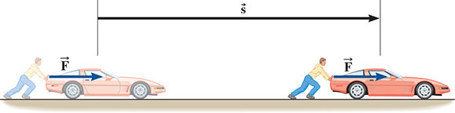
6.1 Work Done by a Constant Force
Learning Objective 6.1 – Determine the work done by a constant force.
Work is a familiar concept. In everyday life, we often associate work with effort or something strenuous.
We say things like, "I have to go to work," or "I have a lot of work to do."
In physics, however, work has a much more precise meaning. Work is done when a force acts on an object and causes it to undergo a displacement.
For example, if I push a stalled car, I do work on the car. The farther I push it, the more work I do.

Slide 3
6.1 Work Done by a Constant Force
magnitude
Both the of the force and the . the object moves determine how much work is done.
distance
DEFINITION OF WORK DONE BY A CONSTANT FORCE
The work done on an object by a constant force F is
Work = (Component of the force along the direction of the displacement)×(Displacement), or
W = (Fcosθ)(s),
(6.1)
where F is the magnitude of the force, s is the magnitude of the displacement, and θ is the angle between the force and the displacement.
.
SI Unit of Work: newton meter = joule (J)
*Note: No matter how large the applied force is, the object must undergo a displacement for work to be done.
If the object does not move, the work is zero.

Slide 4
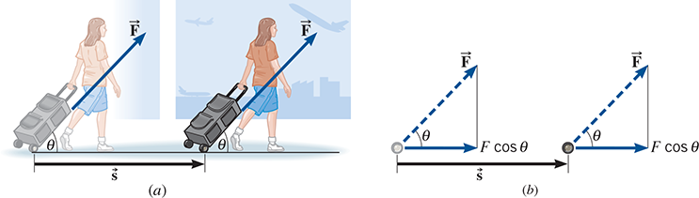
6.1 Work Done by a Constant Force
Work is a . It can be either positive or negative.
scalar
Problem-Solving Insight
If the force performing the work is in the direction as the object’s displacement, then work is done. If it’s in the direction, then work is done.
same
positive
opposite
negative
Example – Pulling a Suitcase-on-Wheels
Find the work done by a 45.0-N force in pulling the suitcase in the figure at an angle θ = 50.0º for a distance s = 75.0 m.
Equation 6.1 can be used to calculate the work done:
W = (Fcosθ)(s)
Notice that Fcosθ is the component of the force F along the direction of the displacement.
W =
(Fcosθ)s
= [(45.0 N) cos50^{ο} ](75.0 m)
= 2170 J

Slide 5
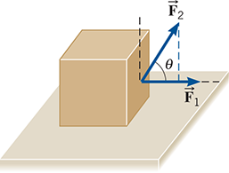
6.1 Work Done by a Constant Force
CYU/TPS – Two forces F₁ and F₂ are acting on the box shown in the figure, causing the box to move across the floor. The two force vectors are drawn to scale. Which one of the following statements is correct? (a) F₂ does more work than F₁ does. (b) F₁ does more work than F₂ does. (c) Both forces do the same amount of work. (d) Neither force does any work.
  (a)
  (b)
  (c)
  (d)
Discuss!

Slide 6
6.2 The Work–Energy Theorem and Kinetic Energy
Learning Objective 6.2 – Relate work and kinetic energy.
We are all familiar with the word energy, but what exactly is it?
Energy exists in many forms, including mechanical, chemical, electrical, thermal, light, and nuclear energy, but at its most fundamental level, it can be classified into two broad categories:
Kinetic energy
, the energy associated with .
motion
, the energy associated with .
Potential energy
position
In this chapter, we will discover that energy obeys a set of powerful .
conservation laws
We will also see that many problems that are difficult to solve using Newton's laws become much simpler when approached from the perspective of energy.
It is the concept of work that ties these two approaches together.

Slide 7
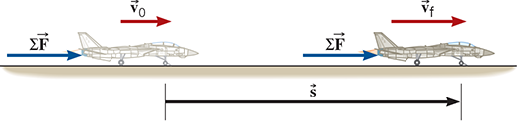

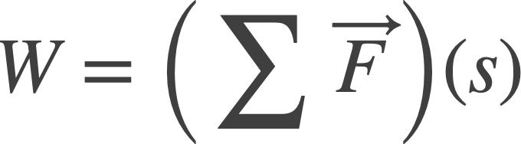
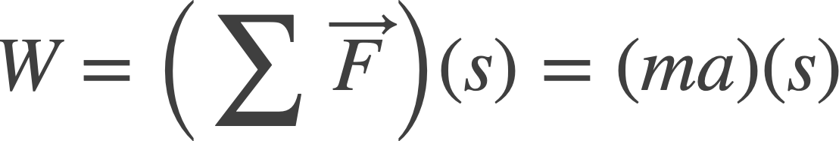
6.2 The Work–Energy Theorem and Kinetic Energy
Consider the work being done on an object by a net external force...
For example, a fighter jet being accelerated down a runway.
Here, represents the that is
net external force
performing the work on the fighter jet. Some forces could be doing positive work on the jet, like the thrust from its engine, and some of the forces could be doing negative work on the jet, like air resistance.
If the net force is constant, and the fighter jet moves through a distance s, then the work done by the net force is given by Equation 6.1:
But, we know from Newton’s second law that the net force acting on an object must be equal to its mass times its acceleration:

Slide 8
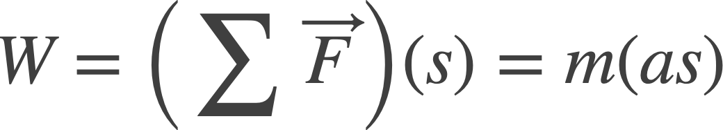
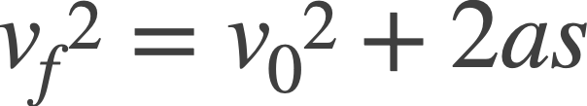
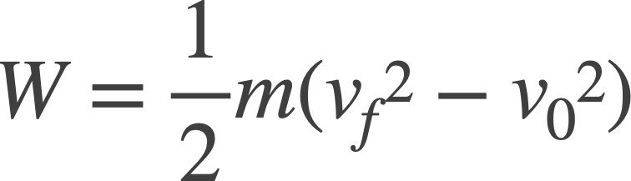
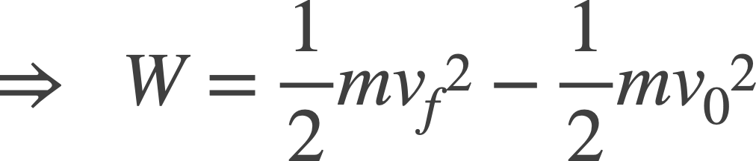
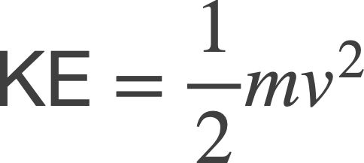
6.2 The Work–Energy Theorem and Kinetic Energy
The right side of this expression depends on the product of as, which is constant acceleration times displacement.
We can use kinematics Equation 2.9 to write this product in terms of the change in speed of the jet, where we replaced x with s:
Solving for as and plugging into the expression for the work above, we find:
The term ½(mass)(speed)² is known as
Kinetic Energy (KE)
DEFINITION OF KINETIC ENERGY
The kinetic energy KE of an object with mass m and speed v is given by:
(6.2)
SI Unit of Kinetic Energy: joule (J)

Slide 9
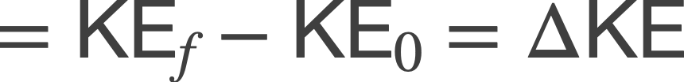
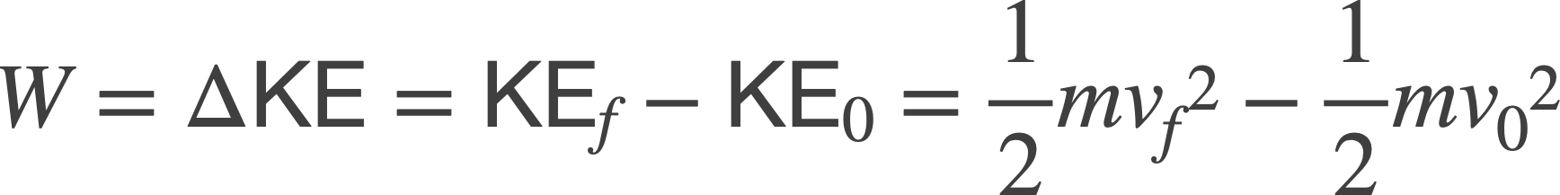
6.2 The Work–Energy Theorem and Kinetic Energy
From this expression, we see that the work done is equal to the change in the jet’s kinetic energy.
KE_{f}
KE₀
Clearly, Work and Kinetic Energy are closely related concepts:
Work is
energy transferred by a force.
*Both quantities are scalars, and both are measured in joules (J).
Kinetic energy is
energy associated with motion.
THE WORK-ENERGY THEOREM
When a net external force does work W on an object, the kinetic energy of the object changes from its initial value of KE₀ to a final value of KE_{f}, the difference between the two values being equal to the work:
(6.3)

Slide 10
6.2 The Work–Energy Theorem and Kinetic Energy
Problem-Solving Insight
The work–energy theorem shows that a moving object possesses kinetic energy because work was done on the object to change its speed from one value to another. Conversely, an object with kinetic energy can do work by exerting a force (a push or pull) on another object as it moves – transferring some of its kinetic energy in the process.

Slide 11
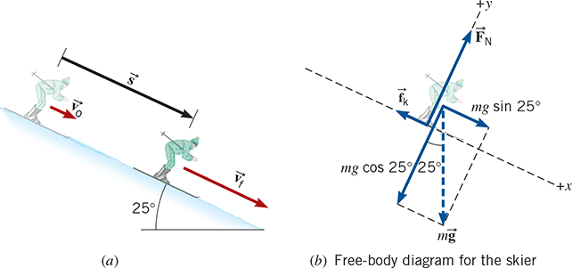
6.2 The Work–Energy Theorem and Kinetic Energy
Example – Downhill Skiing
A 58-kg skier is coasting down a 25° slope, as the figure shows. Near the top of the slope, her speed is 3.6 m/s. She accelerates down the slope because of the gravitational force, even though a kinetic frictional force of opposes her motion. The coefficient of kinetic friction is μ_{k} = 0.14. Ignoring air resistance, determine the speed at a point that is displaced 57 m downhill.
*We have solved problems like this before in Chapter 04. This is a nonequilibrium problem, where we could apply Newton’s second law and the equations of kinematics to solve for the skier’s final speed.
Here, we use the work–energy theorem. As the skier's speed changes, so does her kinetic energy. According to the work–energy theorem, this change in kinetic energy equals the net work done on her by the net force acting along the direction of her displacement.

Slide 12
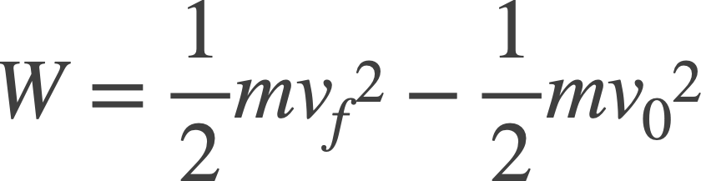
6.2 The Work–Energy Theorem and Kinetic Energy
Example – Downhill Skiing
+y
We begin by drawing the FBD showing the forces that act on the skier. Since we are on an incline, we rotate our coordinate system, so that the x axis is along the incline, and the y perpendicular to it.
+x
There are 3 forces that act on the skier: Weight, Normal Force, and Kinetic Friction.
Applying the work-energy theorem (Equation 6.3):
To calculate the work done, we use Equation 6.1:
W = (Fcosθ)(s)
*Note: θ is not the angle of the incline, but the angle between the doing the work and the displacement.
net force

Slide 13
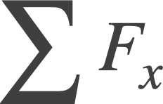
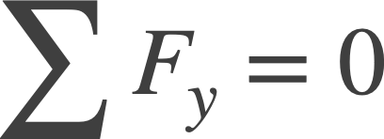
6.2 The Work–Energy Theorem and Kinetic Energy
Example – Downhill Skiing
+y
The skier is accelerating down the slope. This tells us two things:
The net force is along the direction of the displacement: F =
The angle θ in Equation 6.1 is = 0º.
+x
1
W = (Fcosθ)(s)
=
(cos 0º)(s)
= (mgsin25^{ο} – f_{k})(s)
We can replace f_{k} with μ_{k}F_{N} (Equation 4.8):
W = (mgsin25^{ο} – μ_{k}F_{N})(s)
To deal with the normal force (F_{N}), we must analyze the forces in the y direction.
There is no acceleration in the y direction, i.e. equilibrium:

Slide 14
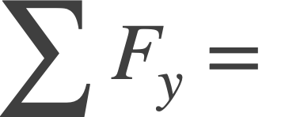
6.2 The Work–Energy Theorem and Kinetic Energy
Example – Downhill Skiing
F_{N} – mgcos25^{ο}
= 0
⇒ F_{N} = mgcos25^{ο}
+y
We can now substitute F_{N} back into our expression for the work:
+x
W = (mgsin25^{ο} – μ_{k}F_{N})(s)
= (mgsin25^{ο} – μ_{k}mgcos25^{ο})(s)
Or...
W = mg(sin25^{ο} – μ_{k}cos25^{ο})(s)
Now with our expression for the work, we can apply the work-energy theorem:
mg(sin25^{ο} – μ_{k}cos25^{ο})(s) =

Slide 15
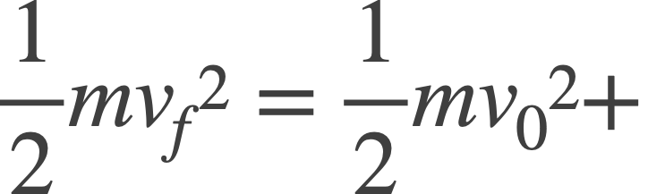
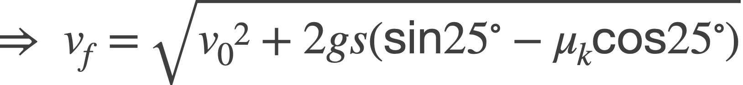
6.2 The Work–Energy Theorem and Kinetic Energy
Example – Downhill Skiing
Work through the algebra to solve for v_{f}:
+y
mgs(sin25^{ο} – μ_{k}cos25^{ο})
+x
*Note: The mass (m) of the skier drops out.
⇒ v_{f}² = v₀² + 2gs(sin25^{ο} – μ_{k}cos25^{ο})
= 19 m/s

Slide 16
6.2 The Work–Energy Theorem and Kinetic Energy
Example – Downhill Skiing
+y
The skier’s final speed is greater than her initial speed, because the skier gains kinetic energy. Remember that the work is done by the , and here, the positive work done by gravity was larger than the negative work done by friction!
+x
net force
Problem-Solving Insight
If the net work done on an object is positive (W > 0), then the object speeds up.
If the net work done on an object is negative (W < 0), then the object slows down.
If the net work done on an object is zero (W = 0), then the object’s speed remains unchanged.

Slide 17
6.2 The Work–Energy Theorem and Kinetic Energy
CYU/TPS – A net external force acts on a particle that is moving along a straight line. This net force is not zero. Which one of the following statements is correct?
(a) The velocity, but not the kinetic energy, of the particle is changing. (b) The kinetic energy, but not the velocity, of the particle is changing. (c) Both the velocity and the kinetic energy of the particle are changing.
Discuss!

Slide 18
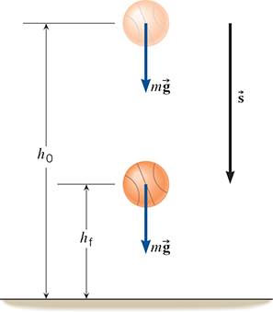
6.3 Gravitation Potential Energy
Learning Objective 6.3 – Use gravitational potential energy.
Work Done by the Force of Gravity
Take an object – say a basketball – and let’s drop it near the surface of the earth.
The force on the ball – its weight due to gravity – accelerates it downward toward the earth.
An interesting question to ask is the following: How much work did gravity do in moving the ball from its initial position (height), h₀, to its final position (height), h_{f}?
We can use Equation 6.1 to calculate the work:
W = (Fcosθ)(s),
The force F is just the weight (mg), and since it is directed along the displacement [s = (h₀ – h_{f})], θ = 0º.

Slide 19
6.3 Gravitation Potential Energy
Work Done by the Force of Gravity
W_{Gravity} = mg(h₀ – h_{f})
Thus, .
(6.4)
*Note: If the ball is falling downward, then h₀ > h_{f}, which means that W_{Gravity} is positive, and the ball speeds up!
If the ball is rising upward, then h₀ < h_{f}, which means that W_{Gravity} is negative, and the ball slows down!
We know this from experience!
But what if the ball doesn’t fall straight downward but instead takes an arbitrary path between its initial and final positions?
How would we calculate the work done by gravity then?

Slide 20
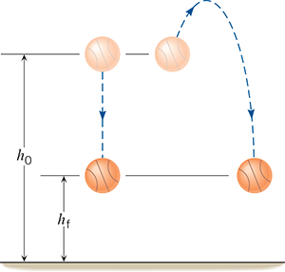
6.3 Gravitation Potential Energy
Work Done by the Force of Gravity
The path on the right in the figure shows one such example.
mg
But gravity (the weight of the ball) always acts .
vertically downward
mg
mg
Thus, only the vertical component of the displacement contributes to the work.
As such, the work only depends on the change in the vertical distance (h₀ – h_{f}), which is the same for the two paths shown.
mg
Problem-Solving Insight
Only the needs be considered when calculating the work done by gravity.
change in height (h₀ – h_{f})

Slide 21
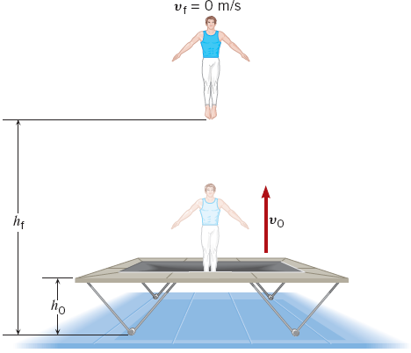
6.3 Gravitation Potential Energy
Example – A Gymnast on a Trampoline
A gymnast springs vertically upward from a trampoline as shown in the figure. The gymnast leaves the trampoline at a height of h₀ = 1.20 m and reaches a maximum height of h_{f} = 4.80 m before falling back down. All heights are measured with respect to the ground. Ignoring air resistance, determine the initial speed v₀ with which the gymnast leaves the trampoline.
The initial speed of the gymnast is related to her initial kinetic energy. We can use the work-energy theorem (6.3) to find this, assuming we can calculate the work down by the net external force:
0
The final speed of the gymnast will be 0 m/s, since they instantaneously come to rest at max height.
Thus,

Slide 22
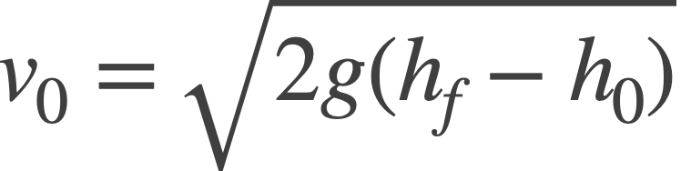
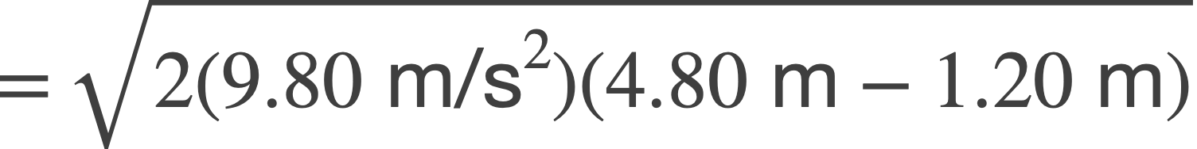

6.3 Gravitation Potential Energy
Example – A Gymnast on a Trampoline
Only the gravitational force acts on the gymnast. Thus, it is the force doing work.
We can use Equation 6.4 to calculate the work:
W_{Gravity} = mg(h₀ – h_{f})
*Note that the mass of the gymnast drops out.
We can now solve for v₀:
*Here, the force and displacement are in opposite directions – negative work is being done by gravity (the weight).
Therefore, the gymnast must be slowing down.

Slide 23
6.3 Gravitation Potential Energy
Gravitational Potential Energy
Let’s write out Equation 6.4 again:
= mgh₀ – mgh_{f}
W_{Gravity} = mg(h₀ – h_{f})
Recall that work is energy transferred to an object by a force (here gravity).
Thus, the two terms on the right side of the expression above represent the energy added to an object (if positive work by gravity is done) or lost by the object (if negative work by gravity is done).
Notice that each term is an “mgh”. In other words, the value of the energy depends on the position of the object relative to some origin.
We call this .
Potential energy is energy of position!
Gravitational Potential Energy
The an object is, the greater its gravitational potential energy.
higher

Slide 24
6.3 Gravitation Potential Energy
Gravitational Potential Energy
DEFINITION OF GRAVITATIONAL POTENTIAL ENERGY
The gravitational potential energy PE is the energy that an object of mass m has by virtue of its position relative to the surface of the earth. That position is measured by the height h of the object relative to an arbitrary zero level:
PE = mgh (6.5)
SI Unit of Gravitational Potential Energy: joule (J)
Note that the gravitational potential energy is intrinsic to the object, because it depends on its mass m.
It also depends on g. We can calculate gravitational potential energies on other planets, but of course, “g” would be different.

Slide 25
6.3 Gravitation Potential Energy
CYU/TPS – In a simulation on earth, an astronaut in his space suit climbs up a vertical ladder. On the moon, the same astronaut makes the exact same climb. Which one of the following statements correctly describes how the gravitational potential energy of the astronaut changes during the climb?
It changes by a greater amount on the earth.
It changes by a greater amount on the moon.
The change is the same in both cases.

Slide 26
6.4 Conservative Versus Nonconservative Forces
Learning Objective 6.4 – Identify conservative and nonconservative forces.
The work done by gravity being independent of the path taken is much more than a mathematical curiosity.
It reveals a profound fundamental property of nature:
Gravity is a conservative force.
In fact, it is this property that allowed us to define gravitational potential energy in the previous section.
If the work done by gravity did depend on the path taken, then the gravitational potential energy of an object would not be uniquely defined.

Slide 27
6.4 Conservative Versus Nonconservative Forces
DEFINITION OF A CONSERVATIVE FORCE
Version 1 – A force is conservative when the work it does on a moving object is
of the path between the object’s initial and final positions.
Version 2 – A force is conservative when it does no net work on an object moving around a , starting and finishing at the same point.
independent
closed path
Version 1 of this definition centers around path independence, which we have already discussed.
But what about Version 2?
As an example of a closed path, consider a roller coaster car that travels along a track filled with hills and loops. The car begins at some location, moves around the track, and then returns to its starting position.

Slide 28
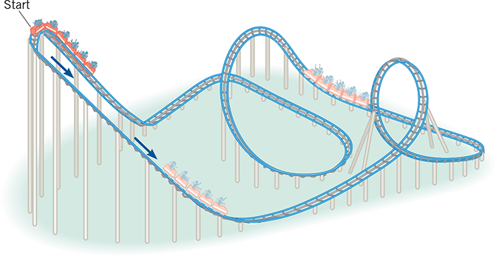
6.4 Conservative Versus Nonconservative Forces
If we neglect all frictional effects with the track and air resistance, then the only forces that act on the car are its weight and the normal force from the track.
However, the normal force is always perpendicular to the track, and thus perpendicular to the car’s displacement. Therefore, the normal force does no work.
Work is only done by the car’s weight (gravity).
Whenever the car goes downhill, work is done by gravity.
positive
(The car speeds up.)
Whenever the car goes uphill, work is done by gravity.
negative
(The car slows down.)
We find that over the entire trip gravity does just as much positive work as it does negative work, so the
total work done by gravity over the closed loop is 0 J!

Slide 29
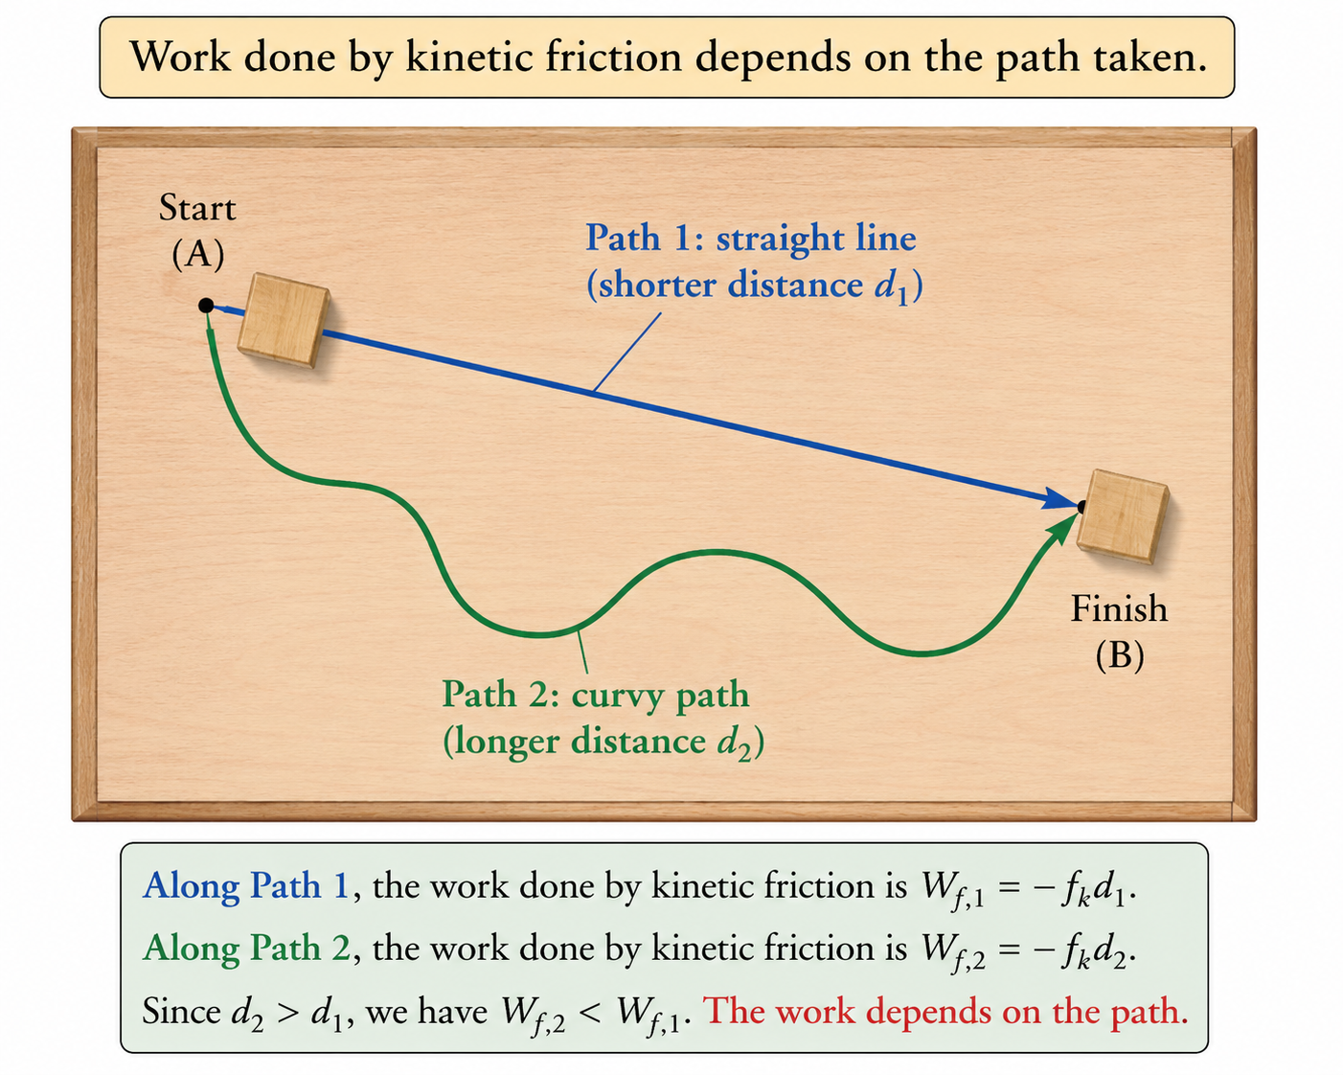
6.4 Conservative Versus Nonconservative Forces
In addition to gravity, we will encounter other conservative forces later, like the elastic restoring force, and the electrostatic force.
And for each conservative force, we will be able to define a potential energy, although it will look different than that from gravitational potential energy (Equation 6.5).
However, other forces are nonconservative.
The work done by nonconservative forces
does depend on the path taken.
Kinetic friction is one example of a nonconservative force.
When sliding a block between points A and B, longer paths will result in greater work being done by kinetic friction!

Slide 30
6.4 Conservative Versus Nonconservative Forces
Other nonconservative forces include:
static friction, air resistance, tension, normal force, rocket thrust.
In general, both conservative and nonconservative forces can do work on an object simultaneously.
Therefore, we write the work done by the net external forces acting on an object as:
W = W_{C} + W_{NC}
Work done by net external force
Work done by
conservative forces
Work done by
nonconservative forces
However, the work-energy theorem (Equation 6.1) tells us that: W = .
And, to this point, we will assume that W_{C} is solely due to gravity, such that:
W_{C} = W_{Gravity} = mg(h₀ – h_{f}) = mgh₀ – mgh_{f}
Let’s make these substitutions above...

Slide 31
6.4 Conservative Versus Nonconservative Forces
= mgh₀ – mgh_{f} + W_{NC}
Let’s do a little rearranging...
W_{NC} = + mgh_{f} – mgh₀
⇒
W_{NC} = KE_{f} – KE₀ + PE_{f} – PE₀
(6.7a)
KE_{f}
KE₀
PE_{f}
PE₀
Net work done
by nonconservative
forces
Change in
kinetic energy
Change in
gravitational
potential energy
Or...
W_{NC} = ΔKE + ΔPE
(6.7b)
Equations 6.7a and 6.7b are alternative forms of the Work-Energy Theorem, which can be useful, for example, in extracting information about the work done by the nonconservative forces acting on an object.

Slide 32
6.5 The Conservation of Mechanical Energy
Learning Objective 6.5 – Use the law of conservation of mechanical energy.
To this point, we accept that objects can possess two types of energy:
Kinetic (KE)
Gravitational Potential (PE)
It then follows that the total energy of an object (referred to as the Total Mechanical Energy, or E) is just the sum of these two:
E = KE + PE
This allows us to rewrite the work-energy theorem in Equation 6.7b in terms of the Total Mechanical Energy:
W_{NC} = ΔKE + ΔPE
= KE_{f} – KE₀ + PE_{f} – PE₀
Now let’s group the initial and final terms:
W_{NC} = KE_{f} + PE_{f} – (KE₀ + PE₀)
The first two terms represent the total final mechanical energy, and the last two terms the total initial mechanical energy.
Thus,
W_{NC} = E_{f} – E₀
(6.8)

Slide 33
6.5 The Conservation of Mechanical Energy
We know it has taken a little bit of algebra to get to Equation 6.8, but the result is well worth it!
W_{NC} = E_{f} – E₀
(6.8)
Why? Because in many of the problems we’ll encounter, only conservative forces will act on an object.
That means that in many problems, W_{NC} = 0.
According to Equation 6.8 then, 0 = E_{f} – E₀.
Or...
E_{f} = E₀
(6.9a)
This is profound, and it highlights one of the most important principles of physics. In words:
In the absence of work done by nonconservative forces, the total mechanical energy is a constant of the motion.
A quantity that remains constant throughout the motion is said to be .
conserved

Slide 34
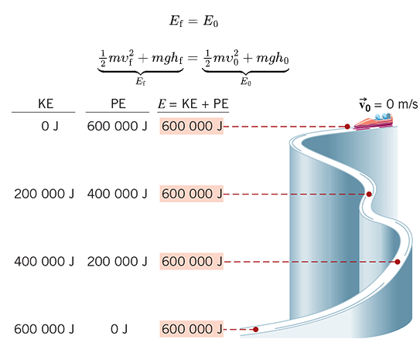
6.5 The Conservation of Mechanical Energy
THE PRINCIPLE OF CONSERVATION OF MECHANICAL ENERGY
The total mechanical energy (E = KE + PE) of an object remains constant as the object moves, provided that the net work done by external nonconservative forces is zero, W_{NC} = 0 J.
Consider a bobsled on its run down a track.
If we neglect friction and air resistance, then the only force that does work on the bobsled is gravity, and gravity is a .
conservative force
Thus, W_{NC} = 0 and E_{f} = E₀.
Notice at the top of the track, the bobsled starts from rest. All of its mechanical energy is potential energy.
As it moves farther down the track, it converts more of its initial gravitational PE into KE.

Slide 35
6.5 The Conservation of Mechanical Energy
But at every point along the track, the total mechanical energy (E) is a constant.
Once the sled has reached the bottom of the track, all of its initial gravitational PE has been converted into KE. The total mechanical energy is still the same.
This conversion is shown formally from Equation 6.7b:
W_{NC} = ΔKE + ΔPE
= 0
⇒ ΔKE = – ΔPE
*Any change (increase) in KE corresponds to an equal change (decrease) in PE and vice versa.
Problem-Solving Insight
Energy is continuously exchanged between kinetic energy and potential energy without any loss or gain. Consequently, any decrease in gravitational potential energy is accompanied by an equal increase in kinetic energy, and vice versa, so that the total mechanical energy remains unchanged.

Slide 36
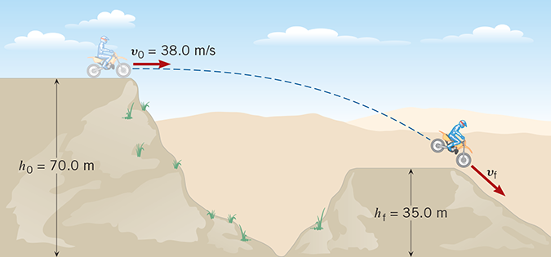
6.5 The Conservation of Mechanical Energy
Example – A Daredevil Motorcyclist
A motorcyclist is trying to leap across the canyon shown in the figure by driving horizontally off the cliff at a speed of 38.0 m/s. Ignoring air resistance, find the speed with which the cycle strikes the ground on the other side.
We solved problems like this in Chapter 03, using the equations of 2D projectile motion.
+y
y = 0 m
+x
But here, conservation of mechanical energy makes this problem relatively simple.
We are ignoring air resistance, so once the motorcyclist is in the air, the only force that does any work is gravity, and gravity is a conservative force.
Thus, we can apply Equation 6.9a:
E_{f} = E₀
We choose our origin by placing y = 0 m at the
ground, so that our heights are measured relative to that.

Slide 37
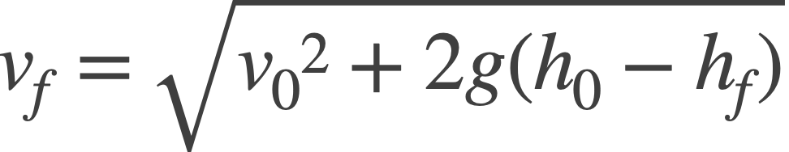
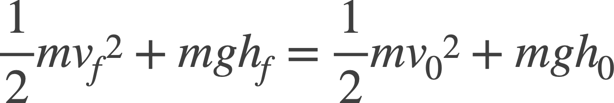
6.5 The Conservation of Mechanical Energy
Example – A Daredevil Motorcyclist
At the initial position, when the motorcyclist leaves the cliff, and at the final position, when the motorcyclist lands, he has both KE and PE at each location. Thus:
E_{f} = E₀
⇒ KE_{f} + PE_{f} = KE₀ + PE₀
+y
Each KE is equal to a “½mv²”,
and each PE is equal to an mgh.
+x
*Note that the mass of the motorcyclist drops out.
v_{f} = 46.2 m/s
We now solve for the final speed, v_{f}:

Slide 38
6.5 The Conservation of Mechanical Energy
REASONING STRATEGY
Applying the Principle of Conservation of Mechanical Energy
1. Identify the external conservative and nonconservative forces that act on the object. For this principle to apply, the total work done by nonconservative forces must be zero, W_{NC} = 0. A nonconservative force that is perpendicular to the displacement of the object does no work, for example.
Choose the location where the gravitational potential energy is taken to be zero. This location is arbitrary but must not be changed during the course of solving a problem.
Set the final total mechanical energy of the object (E_{f}) equal to the initial total mechanical energy (E₀), as in Equations 6.9a and 6.9b. The total mechanical energy is the sum of the kinetic and potential energies.

Slide 39
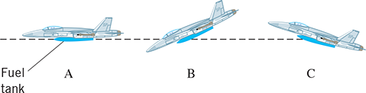
6.5 The Conservation of Mechanical Energy
CYU/TPS – The figure shows an empty fuel tank about to be released by three different jet planes. At the moment of release, each plane has the same speed, and each tank is at the same height above the ground. However, the directions of the velocities of the planes are different. Which tank has the largest speed upon hitting the ground? Ignore friction and air resistance.
  (a) A
  (b) B
  (c) C
  (d) Each tank hits the ground with the same speed.
Explain!

Slide 40
6.6 Nonconservative Forces and the Work–Energy Theorem
Learning Objective 6.6 – Solve problems involving nonconservative forces.
It is not uncommon for objects to experience nonconservative forces, such as friction or air resistance.
In these cases where W_{NC} ≠ 0, we can still use the Equation 6.8 form of the Work-Energy Theorem:
W_{NC} = E_{f} – E₀
(6.8)
*Notice now that E_{f} ≠ E₀. Therefore, when nonconservative forces act on an object
total mechanical energy is not conserved!

Slide 41
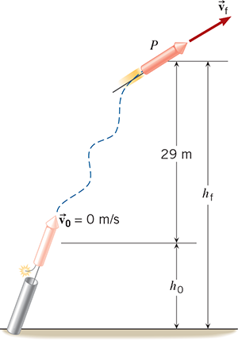
6.6 Nonconservative Forces and the Work–Energy Theorem
Example – Fireworks
A 0.20-kg rocket in a fireworks display is launched from rest and follows an erratic flight path to reach the point P, as the figure shows. Point P is 29 m above the starting point. In the process, 425 J of work is done on the rocket by the nonconservative force generated by the burning propellant. Ignoring air resistance and the mass lost due to the burning propellant, find the speed of the rocket at the point P.
The final speed of the rocket will be determined by its kinetic energy at point P.
W_{NC} = E_{f} – E₀
We can directly apply Equation 6.8:
Each energy term (E) can be written as the sum of a KE and PE:
W_{NC} = E_{f} – E₀
= KE_{f} + PE_{f} – KE₀ – PE₀

Slide 42

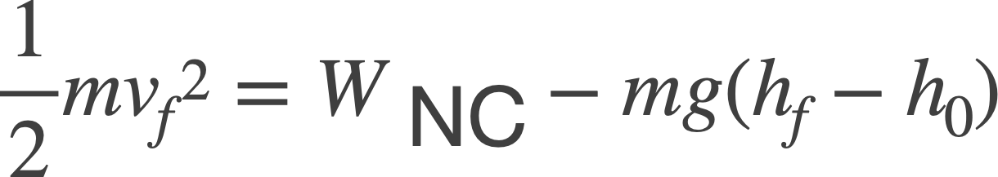
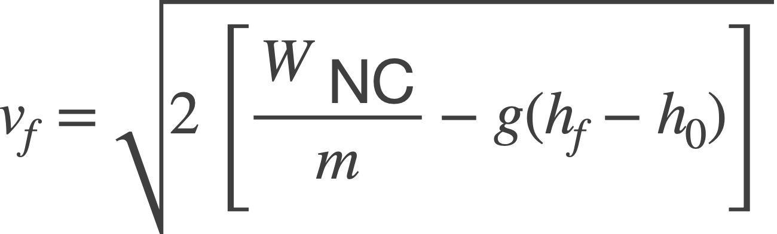
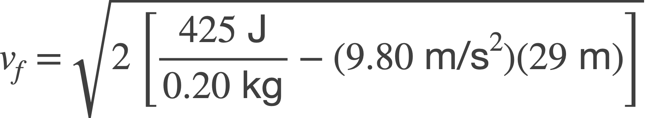
6.6 Nonconservative Forces and the Work–Energy Theorem
Example – Fireworks
Each KE term is equal to a “½mv²”, and each PE term is equal to an “mgh”.
0
*Note: Since the firework starts from rest, v₀ = 0 m/s.
We can now solve for v_{f}:
⇒
⇒
= 61 m/s

Slide 43
6.6 Nonconservative Forces and the Work–Energy Theorem
CYU/TPS – A net external nonconservative force does positive work on a particle. Based solely on this information, you are justified in reaching only one of the following conclusions. Which one is it?
  (a) The kinetic and potential energies of the particle both decrease.
  The kinetic and potential energies of the particle both increase.
  Neither the kinetic nor the potential energy of the particle changes.
  The total mechanical energy of the particle decreases.
  The total mechanical energy of the particle increases .
Discuss!

Slide 44
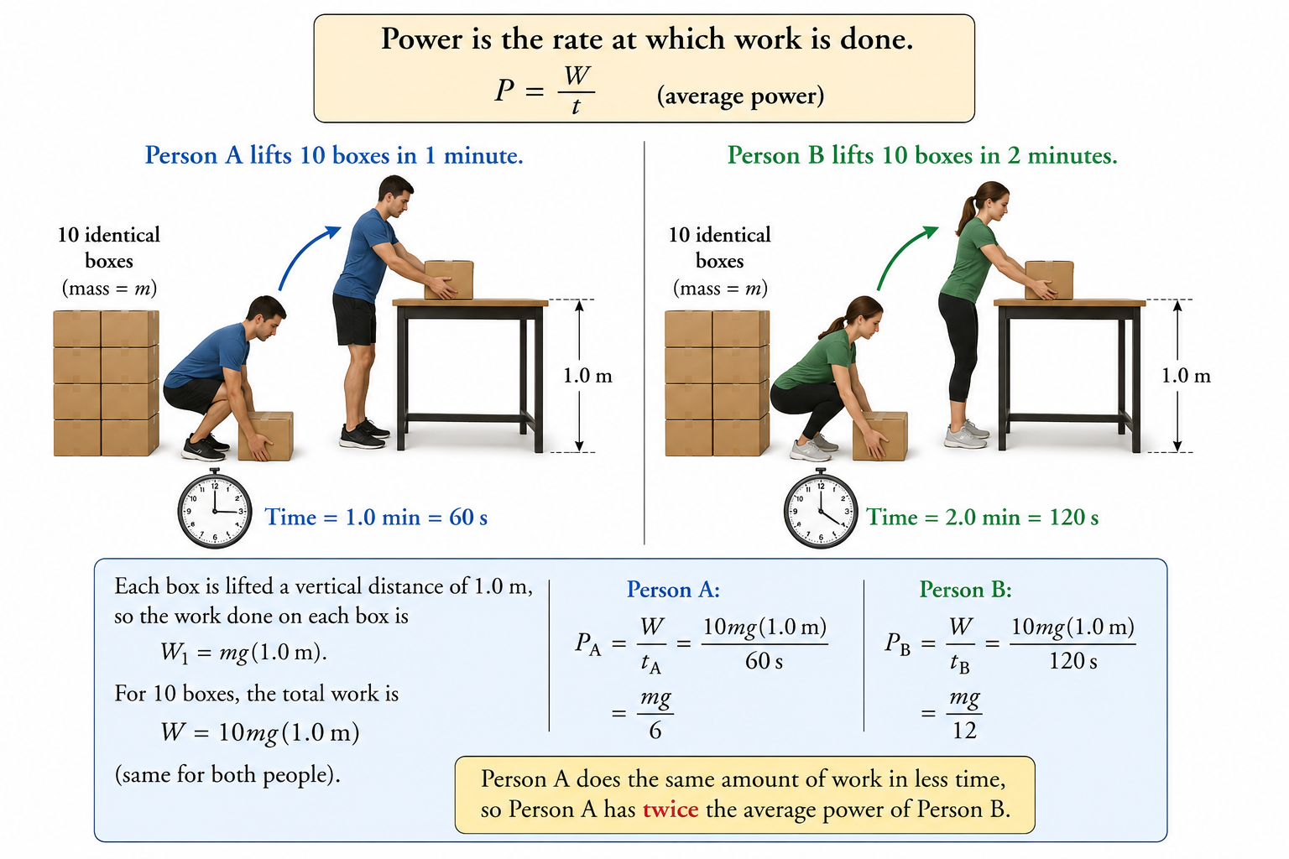
6.7 Power
Learning Objective 6.7 – Solve problems involving power.
A
Person A lifts 10 identical boxes onto a table – lifting each of them a height of 1 m.
She completes this task in 2 minutes, or 120 s.
Person B lifts the same 10 identical boxes onto the same table, but he completes the task in just 1 minute, or 60 s.
B
Each person has done the same amount of work, but Person B has completed it in half the time. There must be a way to quantify this...
It’s called .
Power is the rate at which work is done.
Power

Slide 45
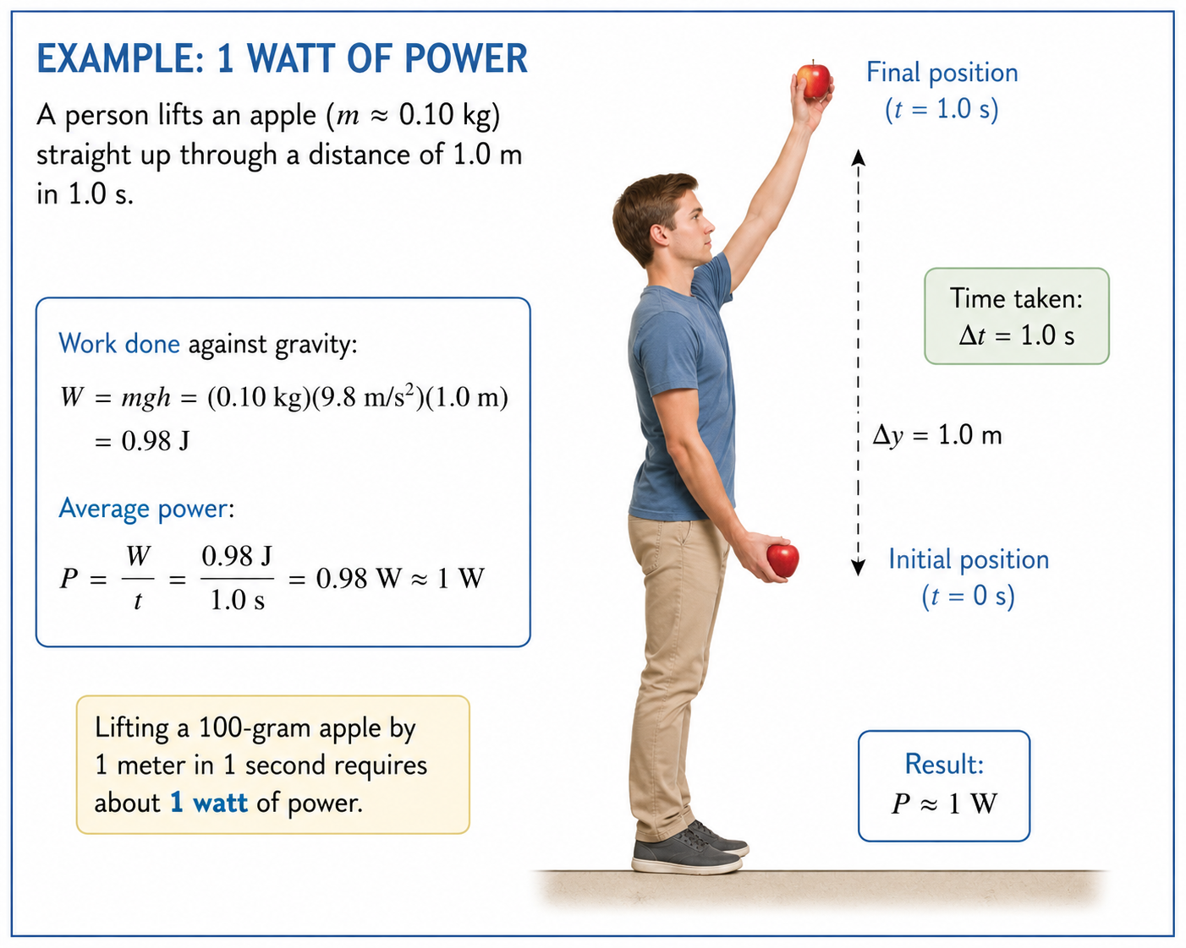
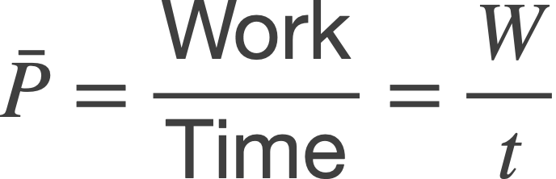
6.7 Power
DEFINITION OF AVERAGE POWER
–
Average power P is the average rate at which work W is done, and it is obtained by dividing W by the time t required to perform the work:
SI Unit of Power: joule/s = watt (W)
(6.10a)
One watt is a fairly small power, as the graphic above illustrates.
horsepower (hp)
Engines and motors commonly use a different unit of power known as:
1 hp = 745.7 W

Slide 46
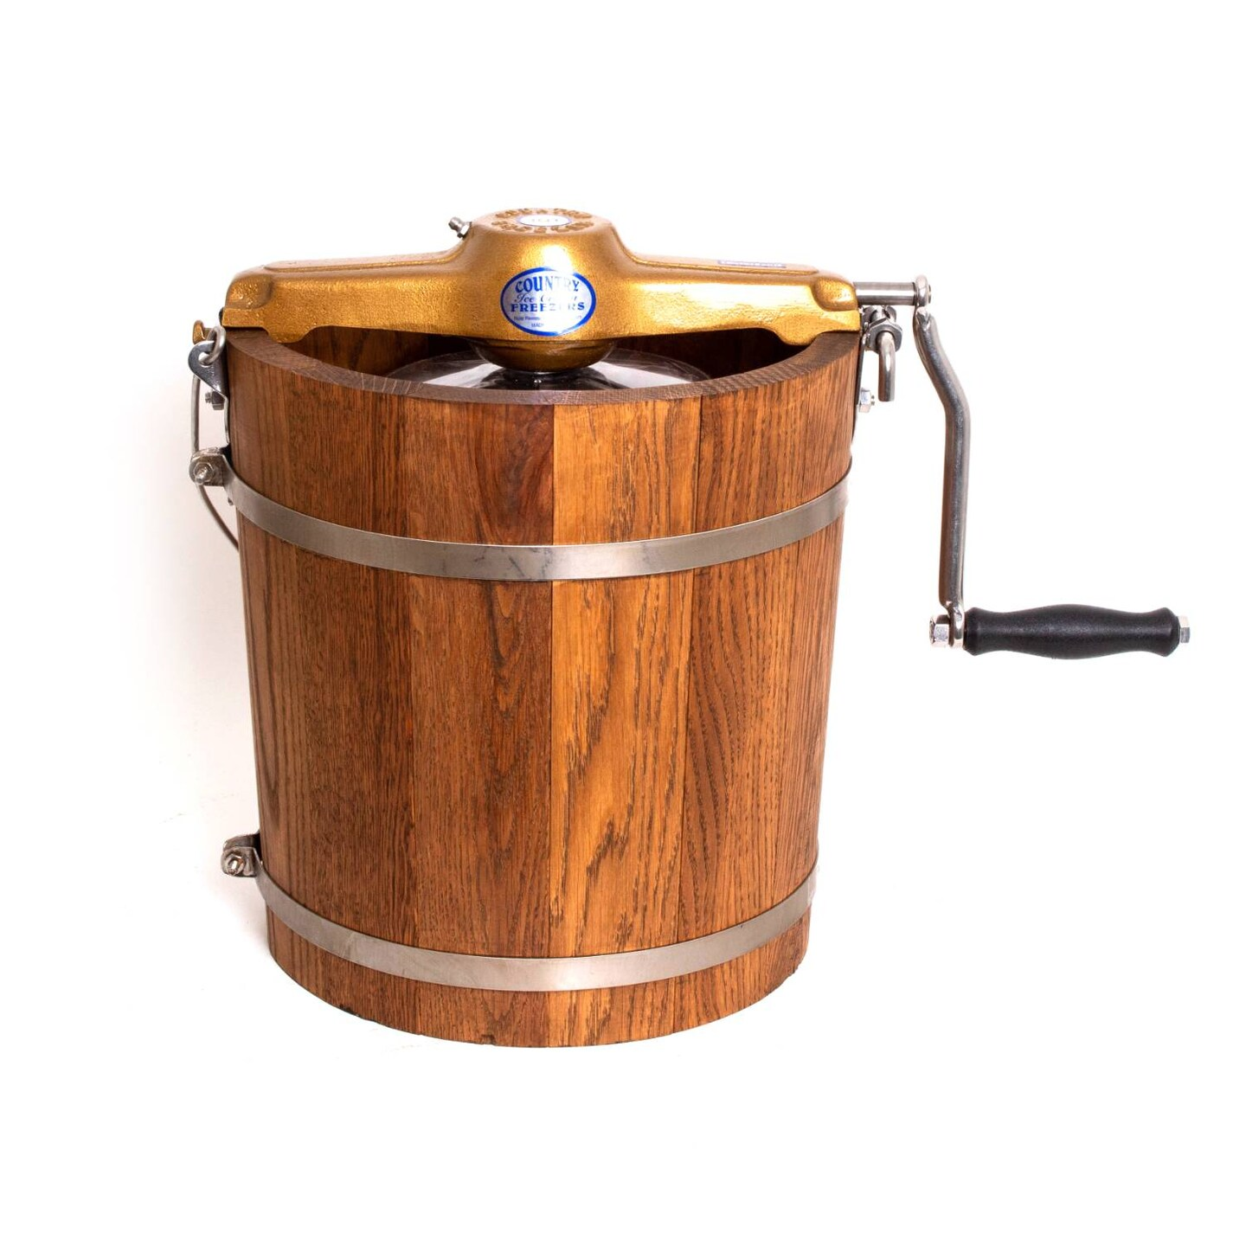
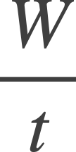
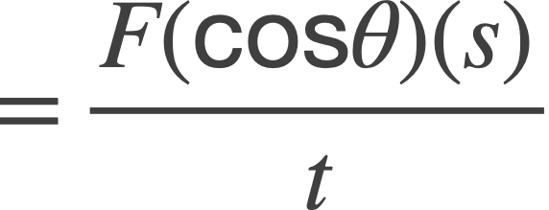
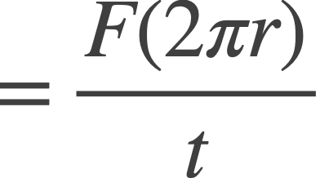
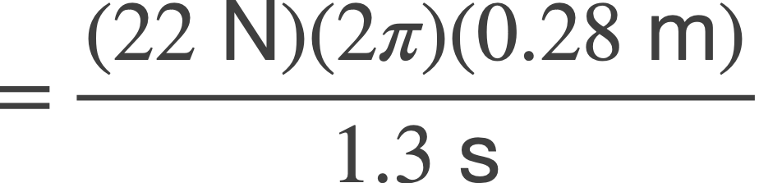

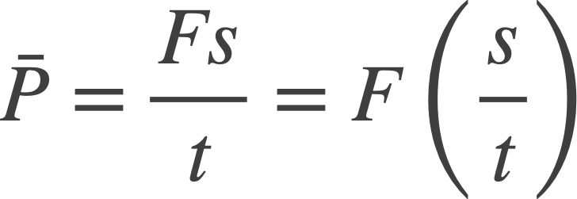


6.7 Power
Example – Making Ice Cream
A person is making homemade ice cream. She exerts a force of magnitude 22 N on the free end of the crank handle on the ice-cream maker, and this end moves on a circular path of radius 0.28 m. The force is always applied parallel to the motion of the handle. If the handle is turned once every 1.3 s, what is the average power being expended?
r
F
The average power can be determined from Equation 6.10a:
1
Since the force is always applied parallel to the motion, θ = 0º.
The distance s, for one revolution, is just the circumference.
*Note: We just showed the average power can be written as:
This provides another way to calculate the average power by a constant force:

Slide 47
6.8 Other Forms of Energy and the Conservation of Energy
Learning Objective 6.8 – Employ the law of conservation of energy.
So far, we have studied kinetic energy and gravitational potential energy, but many other forms of energy exist.
Thermal (heat) energy, chemical energy, electrical energy are other forms that we will study.
E = mc²
Mass itself is also a form of energy, as described by Einstein’s famous equation, . Here, c is the speed of light, and since it is such a large number (c = 3.00 × 10⁸ m/s), a small amount of mass is equivalent to a tremendous amount of energy.
We have shown that kinetic energy can be converted into gravitational potential energy and vice versa. However, in general, energy of all types can be converted from one form to another.
*Whenever energy is transformed from one form to another, it is found that no energy is gained or lost in the process. This observation leads to the following important principle:
THE PRINCIPLE OF CONSERVATION OF ENERGY
Energy can neither be created nor destroyed, but can only be converted from one form to another.

Slide 48
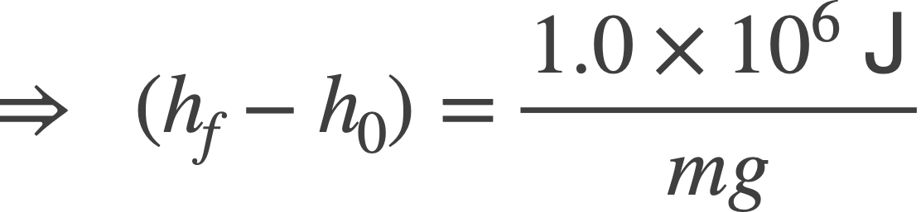
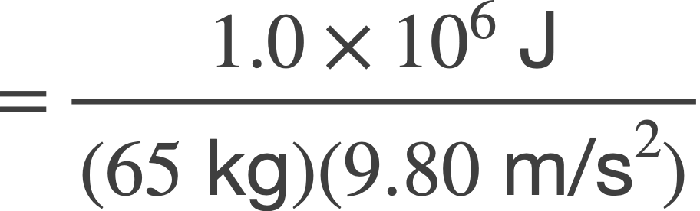

6.8 Other Forms of Energy and the Conservation of Energy
Example – Transforming Chemical Energy In Food Into Mechanical Energy
Part of the chemical energy stored in food, for example, is transformed into gravitational potential energy when a hiker climbs a mountain. Suppose a 65-kg hiker eats a 250-Calorie snack (a typical candy bar, for example), which contains 1.0 × 10⁶ J of chemical energy. If this were 100% converted into potential energy mg(h_{f} – h₀), what would be the change in the hiker’s height?
Chemical Energy = Gravitational Potential Energy
1.0 × 10⁶ J = mg(h_{f} – h₀)
*Although actual metabolic efficiency (converting chemical energy into mechanical work) is around 25-30% (with the rest released as heat), there is a tremendous amount of stored energy in food.

Slide 49
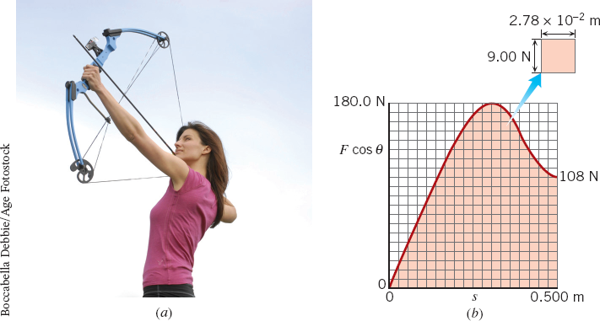
6.9 Work Done by a Variable Force
Learning Objective 6.9 – Determine the work done by a variable force.
Equation 6.1 gives us the work done by a constant force:
W = (Fcosθ)(s).
But what if the force is not constant, but rather it varies with displacement?
Consider a compound bow as an example:
The graph shows how the force to draw the string back varies with displacement.
Here, we can use a
graphical method,
where we divide the displacement into small segments and calculate the work using the average force for that segment.

Slide 50
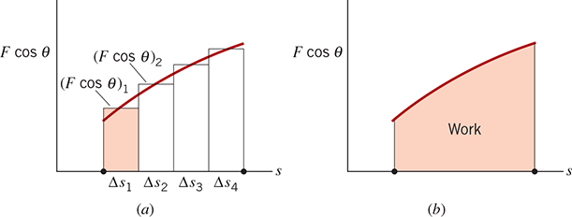
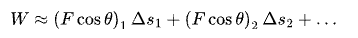
6.9 Work Done by a Variable Force
The total work done is just the sum of these segments:
The sum of these areas is approximately equal to the total area under the force curve (right figure above).
Problem-Solving Insight
The work done by a variable force in moving an object is equal to the area under the graph of Fcos𝛳 versus s .

