Slide 1


Slide 2

DAY-5
FULL-STACK JAVA

Slide 3
Spring MVC Architecture and Thymeleaf
Overview of MVC (Model – View – Controller) architecture.
Introduction to Thymeleaf templating engine.
Setting up Thymeleaf with spring boot.
Rendering dynamic content using Thymeleaf.
Handling forms and form validation with Thymeleaf.
Spring MVC integration with Thymeleaf

Slide 4
Spring Boot MVC
What is MVC?
The Spring Boot framework leverages the Model-View-Controller (MVC) architectural pattern to structure web applications, promoting a clear separation of concerns.
1. Model:
The Model represents the application's data and business logic.
It interacts with the data source (e.g., database) to retrieve, store, and manipulate data.
In a Spring Boot application, this often involves entities, repositories (for data access), and service classes (for business logic).
2. View:
The View is responsible for presenting the data to the user.
It renders the user interface based on the data provided by the Model.
Common view technologies in Spring Boot include Thymeleaf, JSP, or even returning JSON/XML for RESTful APIs.
3. Controller:
The Controller acts as an intermediary between the Model and the View.
It receives user requests, processes them, interacts with the Model to fetch or update data, and then selects the appropriate View to display the result.
In Spring Boot, controllers are typically Java classes annotated with @Controller or @RestController (for RESTful services).

Slide 5
Spring Boot MVC Flow and Benefits
This structure ensures that the presentation logic (View), business logic (Model),
and request handling (Controller) are distinct, making the application more modular, maintainable, and scalable.
Flow in MVC
User interacts with the View (e.g., submits a form)
Controller receives the user’s action
Controller interacts with the Model if necessary (e.g., to save data)
Controller selects and updates the appropriate View
Updated View is presented to the user
Benefits of MVC
Separation of Concerns: Each component has a specific role, making the application easier to develop and maintain
Modularity: Components can be developed and tested independently
Flexibility: Easy to modify or replace individual components without affecting the entire system
Reusability: Models can be reused across different interfaces

Slide 6
MVC simplify implementation
Spring Boot simplifies the implementation of MVC:
Models are typically JPA entities and repositories
Controllers are annotated with @Controller or @RestController
Views can be Thymeleaf templates, or in the case of RESTful APIs, the View layer might be handled by a separate front-end application
By leveraging Spring Boot’s auto-configuration and dependency injection, developers can focus on writing application logic rather than boilerplate code.

Slide 7
Thymeleaf Introduction
Thymeleaf is a server-side Java template engine used for creating dynamic web pages within Spring Boot applications. It acts as the view layer in the Spring MVC architecture, responsible for rendering data from the backend to the user interface.
Integration:
To use Thymeleaf, the spring-boot-starter-thymeleaf dependency is added to the project's build file (e.g., pom.xml for Maven). This starter dependency includes all necessary components, including the core Thymeleaf library and its integration with Spring.
Auto-configuration:
Spring Boot automatically configures Thymeleaf when the starter dependency is present in the classpath. This includes setting up a view resolver for Thymeleaf and defining the default location for templates (typically src/main/resources/templates).
Template location:
Thymeleaf templates (e.g., .html files) are by default placed within the src/main/resources/templates directory. Static resources like CSS and JavaScript files are typically located in src/main/resources/static.
Dynamic content rendering:
Thymeleaf uses special attributes and expressions within HTML templates to display data passed from Spring controllers. For example, th:text can be used to render text content, and th:each for iterating over collections.
Model integration:
Spring controllers place data into the Model object, which is then accessible within Thymeleaf templates. Spring copies this model data into request attributes that Thymeleaf can process.
Features:
Thymeleaf supports various template modes (HTML, XML, TEXT, JAVASCRIPT, CSS, RAW) and offers features like fragment inclusion, layout dialects, and integration with Spring Security.

Slide 8
Setting up Thymeleaf with Spring Boot
To insert the Thymeleaf dependency into an existing Spring Boot Maven project, modify the pom.xml file.
Open pom.xml: Locate the pom.xml file in the root directory of your Spring Boot project.
Add the Dependency: Inside the <dependencies> section of your pom.xml, add the spring-boot-starter-thymeleaf dependency. This starter conveniently pulls in all necessary Thymeleaf and Spring integration libraries.
<dependency> <groupId>org.springframework.boot</groupId> <artifactId>spring-boot-starter-thymeleaf</artifactId> </dependency>
Note: You do not need to specify a <version> for this dependency if your project uses a Spring Boot parent POM. The parent POM will manage the version automatically, ensuring compatibility.
Reload Maven Project: After adding the dependency, save the pom.xml file. Your IDE (e.g., IntelliJ IDEA, Eclipse) should detect the change and prompt you to reload the Maven project to download the new dependency. If it does not, manually trigger a Maven reload or rebuild the project.
Once these steps are completed, your Spring Boot project will have Thymeleaf integrated and ready for use in rendering web templates.

Slide 9
Thymeleaf attribute
Explanation of Thymeleaf Attributes:
th:text="${variableName}": Replaces the element's text content with the value of the variableName from the model.
th:each="item : ${collection}": Iterates over a collection (e.g., a List) and renders the enclosed element for each item. You can then access properties of each item within the loop.
th:if="${condition}": Renders the element only if the condition evaluates to true.
th:href="@{/path}": Creates dynamic URLs.
th:value="${variableName}": Sets the value attribute of input fields.
By following these steps, you can effectively integrate Thymeleaf with Spring Boot to create dynamic web pages that display data from your backend.

Slide 10
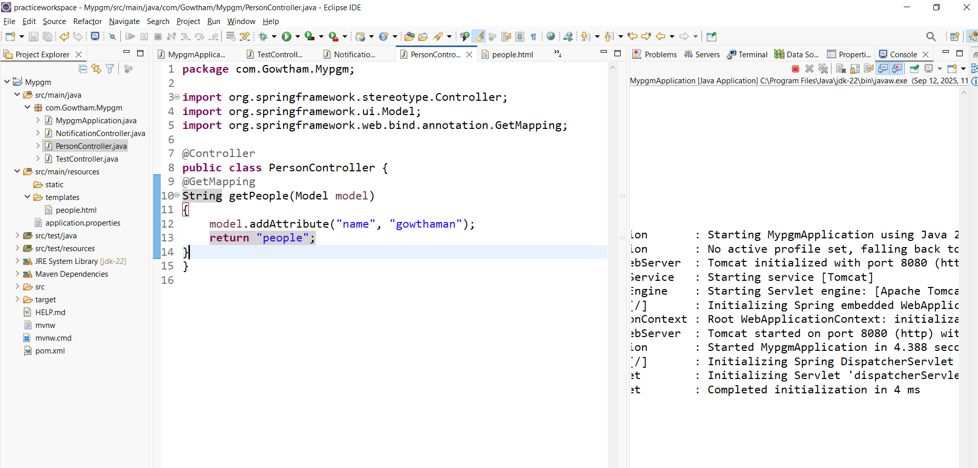
Rendering Dynamic Content

Slide 11
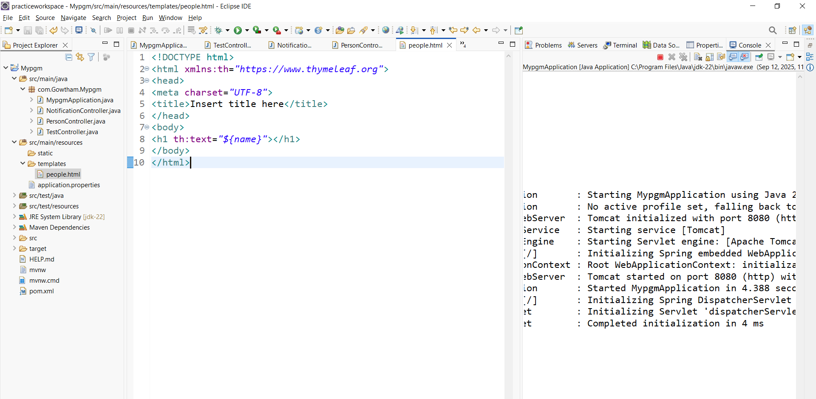
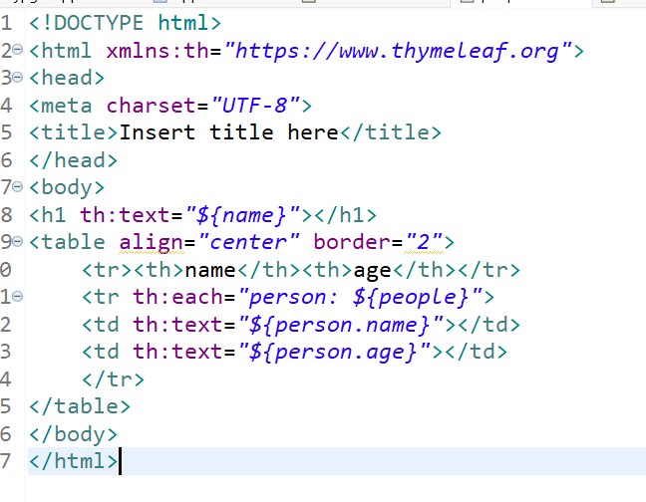
Thymeleaf Template
Note: th: attribute to display dynamic content

Slide 12
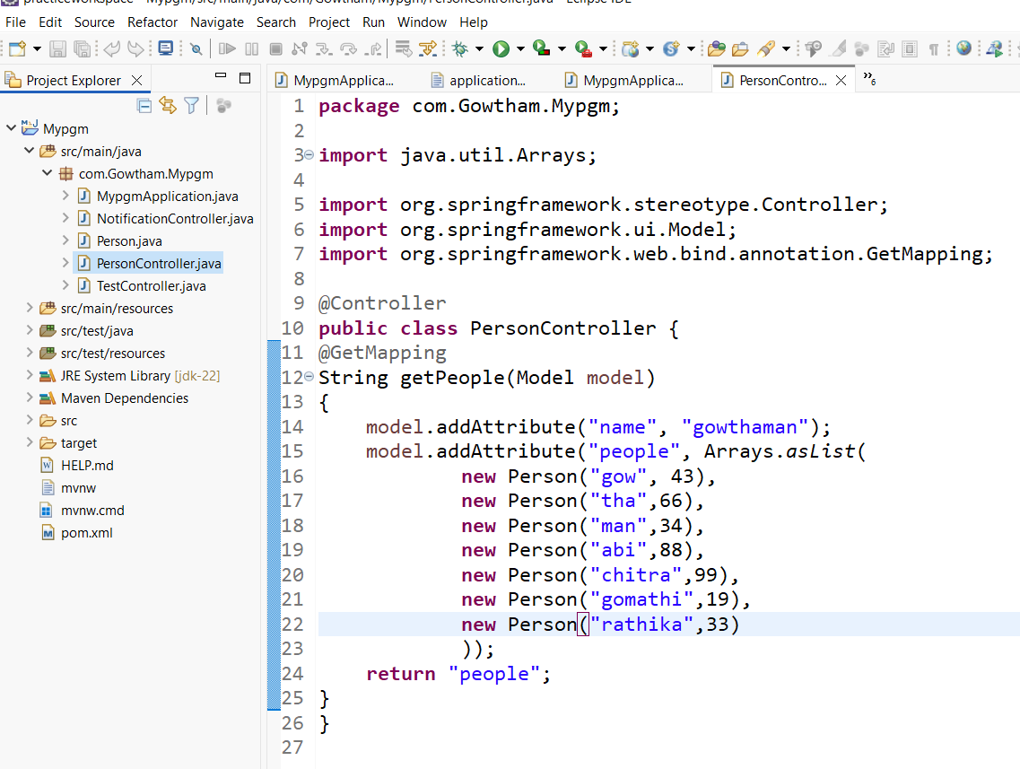
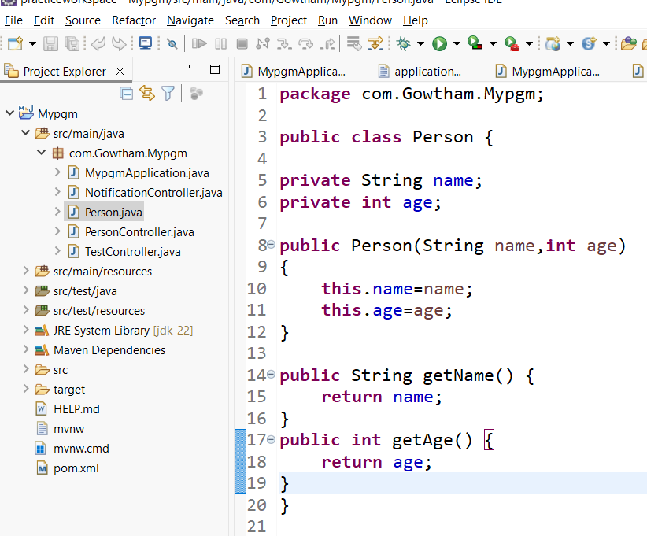
Controller using Entity
Note: retrun “people” refers people.html template file

Slide 13
Handling Forms and Form Validation with thymeleaf
1. Form-Backing Bean (Command Object):
Create a Java class that represents the data collected by your form. This class will have fields corresponding to the form inputs and appropriate getters and setters.
For validation, annotate the fields of this class with Bean Validation annotations (e.g., @NotNull, @Size, @Min, @Max, @Pattern, @Future,@Past).
2. Controller:
GET Request:
A controller method handles the initial display of the form. It typically creates an instance of the form-backing bean and adds it to the Model for Thymeleaf to access using model.addAttribute("objectName", new ObjectName()).
POST Request:
Another controller method handles the form submission. This method takes the form-backing bean as a @ModelAttribute parameter and includes a BindingResult parameter immediately after it to capture validation errors.
Validation Logic:
Within the POST method, check for validation errors using bindingResult.hasErrors(). If errors exist, re-render the form view, which will now display the error messages. If no errors, process the form data (e.g., save to database) and then redirect to a success page or another appropriate view (Post-Redirect-Get pattern).

Slide 14
Handling Forms and Form Validation with thymeleaf
3. Thymeleaf Template:
Form Declaration:
Use th:action to specify the form's submission URL and th:object to bind the form to your form-backing bean
(e.g., <form th:action="@{/submit}" th:object="${objectName}" method="post">).
Input Fields:
Bind input fields to properties of the form-backing bean using th:field (e.g., <input type="text" th:field="*{fieldName}" />). This automatically sets the name and id attributes.
Displaying Errors:
  Use th:errors="*{fieldName}" to display specific error messages for a field.
  Use th:errorclass="error-css-class" to apply a CSS class to an input field if it has validation errors.
  Use th:if="${#fields.hasErrors('fieldName')}" or th:if="${#fields.hasAnyErrors()}" to conditionally display error messages or styling.

Slide 15
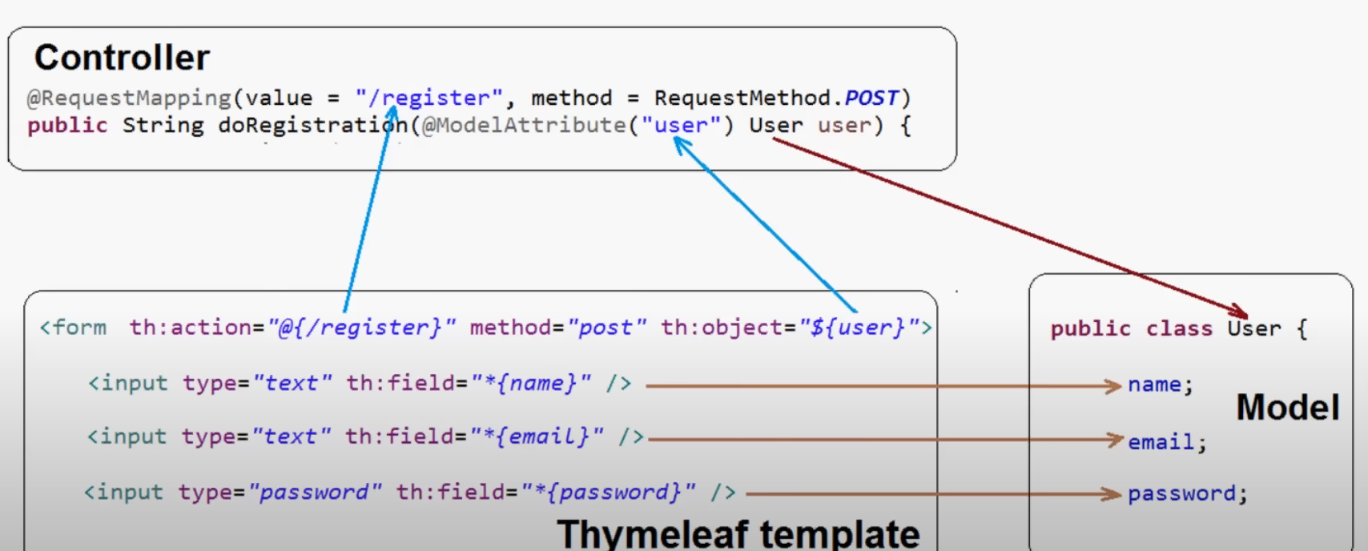
Handling Forms and Form Validation with thymeleaf

Slide 16
Example form handling with validation
Java model:
==========
public class UserForm {
@NotNull
@Size(min = 1, max = 50)
private String username;
@NotNull
@Size(min = 6)
private String password;
// Getters and Setters
}
@Controller
Public class UserController {
@GetMapping("/register")
public String showRegistrationForm(Model model) {
model.addAttribute("userForm", new UserForm());
return "register";
}
@PostMapping("/register")
public String processRegistration(@ModelAttribute("userForm")
@Valid UserForm userForm,
BindingResult bindingResult) {
if (bindingResult.hasErrors()) {
return "register"; // Re-display form with errors
} // Process userForm data (e.g., save to database)
return "redirect:/success"; }
}
<form th:action="@{/register}" th:object="${userForm}" method="post">
<label for="username">Username:</label>
<input type="text" id="username" th:field="*{username}" th:errorclass="field-error" />
<span th:if="${#fields.hasErrors('username')}" th:errors="*{username}" class="error-message"></span>
<label for="password">Password:</label>
<input type="password" id="password" th:field="*{password}" th:errorclass="field-error" />
<span th:if="${#fields.hasErrors('password')}" th:errors="*{password}" class="error-message"></span>
<button type="submit">Register</button></form>

Slide 17
DevTools (auto restart)
To include Spring Boot DevTools in a Maven-based Spring Boot project, the spring-boot-devtools dependency needs to be added to the pom.xml file. This dependency enables features like automatic application restarts upon code changes and LiveReload.
<dependencies>
<dependency> <groupId>org.springframework.boot</groupId> <artifactId>spring-boot-devtools</artifactId> <optional>true</optional>
</dependency>
</dependencies>
Note: When using Spring Boot DevTools, it is also important to ensure that your IDE (e.g., IntelliJ IDEA, Eclipse) is configured to automatically build or compile changes to trigger the restart functionality. Additionally, for features like LiveReload, a corresponding browser extension might be required.

Slide 18
Model class
package com.Gowtham.Mypgm;
import java.sql.Date;
public class User {
private String name;
private String email;
private String password;
private String gender;
private String note;
private String profession;
private boolean married;
private Date birthday;
public String getName() {
return name;
}
public void setName(String name) {
this.name = name;
}
public String getEmail() {
return email;
}
public void setEmail(String email) {
this.email = email;
}
public String getPassword() {
return password;
}
public void setPassword(String password) {
this.password = password;
}
public String getGender() {
return gender;
}
public void setGender(String gender) {
this.gender = gender;
}
public String getNote() {
return note;
}
public void setNote(String note) {
this.note = note;
}
public String getProfession() {
return profession;
}
public void setProfession(String profession) {
this.profession = profession;
}
public boolean isMarried() {
return married;
}
public void setMarried(boolean married) {
this.married = married;
}
public Date getBirthday() {
return birthday;
}
public void setBirthday(Date birthday) {
this.birthday = birthday;
}
@Override
public String toString() {
return "User [name=" + name + ", email=" + email + ", password=" + password + ", gender=" + gender + ", note="
+ note + ", profession=" + profession + ", married=" + married + ", birthday=" + birthday + "]";
}
}

Slide 19
Controller Class
package com.Gowtham.Mypgm;
import java.util.Arrays;
import java.util.List;
import org.springframework.stereotype.Controller;
import org.springframework.ui.Model;
import org.springframework.web.bind.annotation.GetMapping;
import org.springframework.web.bind.annotation.ModelAttribute;
import org.springframework.web.bind.annotation.PostMapping;
@Controller
public class MainController {
@GetMapping("/register")
public String showForm(Model model)
{
User user=new User();
model.addAttribute("user", user);
List<String> professionlist=Arrays.asList("developer","designer","architect","tester");
model.addAttribute("professionlist",professionlist);
return "register_form";
}
@PostMapping("/register")
public String submitForm(@ModelAttribute("user") User user)
{
System.out.println(user);
return "register_success";
}
}

Slide 20
Thymeleaf register form
<!DOCTYPE html>
<html xmlns:th="https://www.thymeleaf.org">
<head>
<meta charset="UTF-8">
<title>user registration</title>
</head>
<body>
<div align="center">
<h1>User Registration Form</h1>
<form action="#" th:action="@{/register}" th:object="${user}" method="post">
<label>Full Name:</label>
<input type="text" th:field="*{name}">
<br/>
<label>Email:</label>
<input type="text" th:field="*{email}">
<br/>
<label>Password:</label>
<input type="password" th:field="*{password}">
<br/>
<label>Birthday:</label>
<input type="text" th:field="*{birthday}">
<br/>
<label>Profession:</label>
<select th:field="*{profession}">
<option th:each="pl:${professionlist}" th:value="${pl}" th:text="${pl}"/>
</select>
<br>
<label>Married?</label>
<input type="checkbox" th:field="*{married}"/>
<br/>
<label>Gender</label>
<input type="radio" th:field="*{gender}" value="Male"/> Male
<input type="radio" th:field="*{gender}" value="FeMale"/> FeMale
<br/>
<label>Note:</label>
<textarea rows="5" cols="20" th:field="*{note}"></textarea>
<br/>
<button type="submit">Register</button>
</form>
</div>
</body>
</html>

Slide 21
Success Form
<!DOCTYPE html>
<html xmlns:th="https://www.thymeleaf.org">
<head>
<meta charset="UTF-8">
<title>Registration Success!!</title>
<style type="text/css">
span
{
display:inline-block;
width:200px;
text-align:left;
}
</style>
</head>
<body>
<div align="center">
<h1>Success Registration </h1>
<span>Full Name:</span><span th:text="${user.name}"></span><br/>
<span>Email Id:</span><span th:text="${user.email}"></span><br/>
<span>Password:</span><span th:text="${user.password}"></span><br/>
<span>Birthday:</span><span th:text="${user.birthday}"></span><br/>
<span>profession:</span><span th:text="${user.profession}"></span><br/>
<span>Married:</span><span th:text="${user.married}"></span><br/>
<span>Gender:</span><span th:text="${user.gender}"></span><br/>
<span>Note:</span><span th:text="${user.note}"></span><br/>
</div>
</body>
</html>

Slide 22
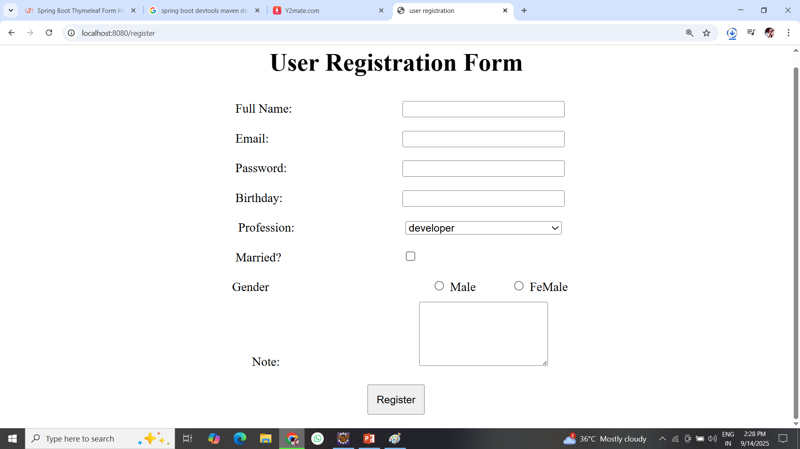
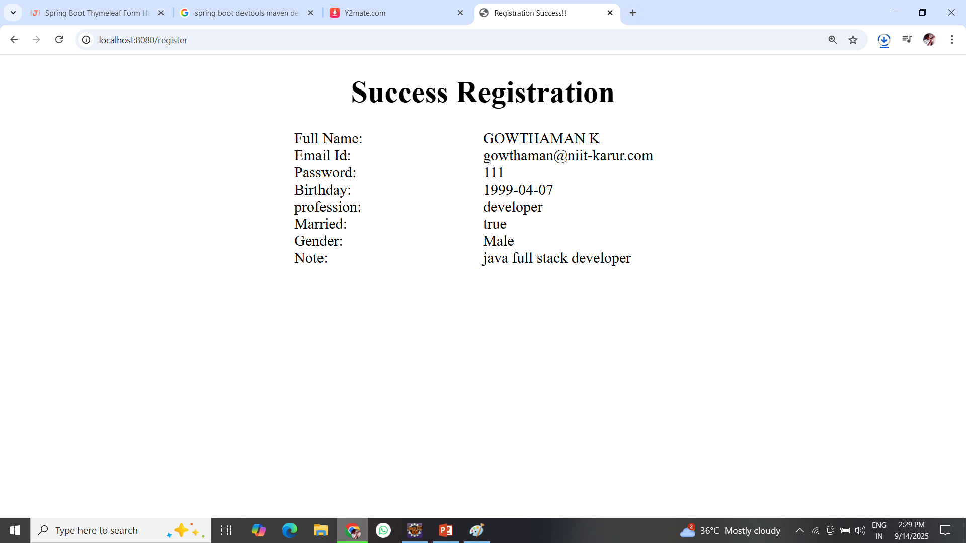
Output

Slide 23
Form validation setup
Form validation in Spring Boot with Thymeleaf typically leverages Spring's built-in Bean Validation API (JSR 380) for server-side validation. This involves defining constraints in your model and displaying error messages in your Thymeleaf template.
Include the spring-boot-starter-validation dependency in your pom.xml (for Maven)
<dependency> <groupId>org.springframework.boot</groupId> <artifactId>spring-boot-starter-validation</artifactId> </dependency>

Slide 24
Form validation program
@Controller
public class EmpController {
@GetMapping("/empform")
public String empmethod(Model model)
{
Emp e=new Emp();
model.addAttribute("e",e);
return "emp_form";
}
@PostMapping("/empform")
public String emppostmethod(@Valid @ModelAttribute("e") Emp e,BindingResult bindingresult)
{
if(bindingresult.hasErrors())
{
return "emp_form";
}
else
return "emp_success";
}
}
public class Emp {
@Size(message="4 chars only",min=4,max=4)
private String eno;
@Size(min = 4, max = 10, message = "Name must be between 4 and 10 characters")
private String ename;
@Min(message="minimum 5", value = 5)
private int age;
// .. Setter getter
}

Slide 25
Form validation program
<form action="#" th:action="@{/empform}" th:object="${e}" method="post">
<label>emp no:</label>
<input type="text" th:field="*{eno}">
<span th:if="${#fields.hasErrors('eno')}" th:errors="*{eno}" class="error"></span>
<br/>
<label>emp name:</label>
<input type="text" th:field="*{ename}">
<span th:if="${#fields.hasErrors('ename')}" th:errors="*{ename}" class="error"></span>
<br/>
<label>age:</label>
<input type="text" th:field="*{age}">
<span th:if="${#fields.hasErrors('age')}" th:errors="*{age}" class="error"></span>
<br/>
<button type="submit">Register</button>
</form>
<body>
<div align="center">
<h1>Success Registration </h1>
<span>eno:</span><span th:text="${e.eno}"></span><br/>
<span>ename</span><span th:text="${e.ename}"></span><br/>
<span>age:</span><span th:text="${e.age}"></span><br/>
</div>
</body>

Slide 26
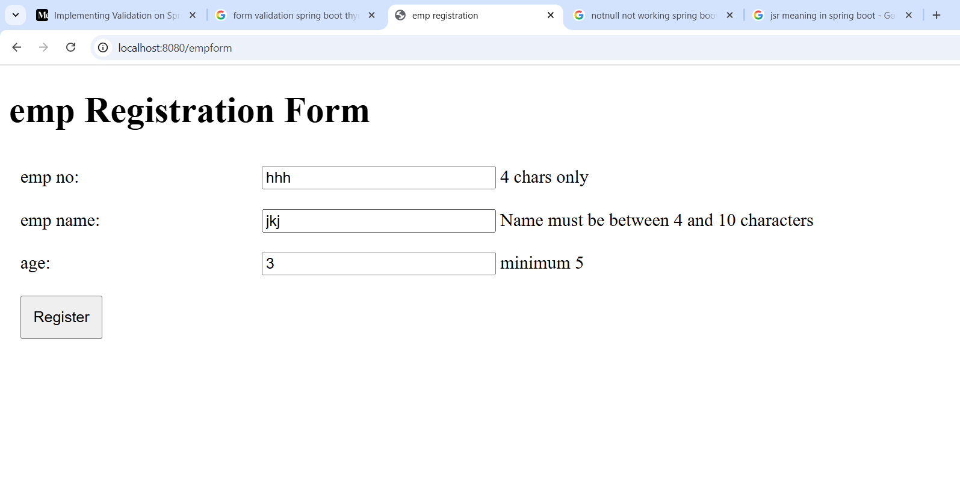
Output

Slide 27
Day 6 End
Thank you

