Slide 1


Slide 2

DAY-7
FULL-STACK JAVA

Slide 3
Spring Data JPA and Database Integration
-Introduction to database and Spring Data JPA.
-Configuring a relational database (eg. MySQL).
-Performing CRUD operations with Spring Data JPA.
-Introduction to Entity, Repository, and Spring Data Features.
-Introduction to Flyway for database migrations.
-Introduction to RESTful web Services.

Slide 4
Introduction Database
A database is an organized collection of data, typically stored and accessed electronically from a computer system. Databases are designed to manage large amounts of information efficiently, allowing for easy storage, retrieval, modification, and deletion of data. They can be broadly categorized into two main types:
Relational Databases (SQL databases):
These databases store data in tables with predefined schemas, where relationships between tables are established using foreign keys. Examples include MySQL, PostgreSQL, Oracle, and SQL Server.
NoSQL Databases:
These databases offer more flexible data models and are designed for specific data access patterns and scalability needs. Examples include MongoDB (document-oriented), Cassandra (column-family), and Redis (key-value).
Spring Data JPA
Spring Data JPA is a module within the larger Spring Data project that simplifies the implementation of data access layers for applications using the Java Persistence API (JPA). It significantly reduces boilerplate code and streamlines interaction with relational databases in Spring-based applications.
In essence, Spring Data JPA acts as an abstraction layer over JPA, further simplifying database interactions in Spring applications by automating repository implementation and providing convenient features for common data access patterns.

Slide 5
Configuring RDBMS (MySQL)
Download and install mysql-work bench.
Create database.
https://dev.mysql.com/downloads/workbench/
https://dev.mysql.com/downloads/mysql/8.0.html
Query:
Create database databasename;
Ex:
Create database student;
Add dependencies in POM.xml file
<dependency>
<groupId>org.springframework.boot</groupId>
<artifactId>spring-boot-starter-data-jpa</artifactId>
</dependency>
<dependency>
<groupId>com.mysql</groupId>
<artifactId>mysql-connector-j</artifactId>
<scope>runtime</scope>
</dependency>

Slide 6
Configure RDBMS
Database Configuration:
Configure your database connection details in application.properties
spring.application.name=dbdemo
#database configuration
spring.datasource.url=jdbc:mysql://localhost:3306/gowtham
spring.datasource.username=root
spring.datasource.password=12345
#hibernate configuration
spring.jpa.hibernate.ddl-auto=update
# Database connection spring.datasource.url=jdbc:mysql://localhost:3306/your_database_name?useSSL=false&serverTimezone=UTC spring.datasource.username=your_username
spring.datasource.password=your_password
spring.datasource.driver-class-name=com.mysql.cj.jdbc.Driver
# Hibernate DDL Auto
spring.jpa.hibernate.ddl-auto=update # Or 'create', 'create-drop', 'validate', 'none'

Slide 7
Introduction: Entity
Entities:
Definition:
An entity in Spring Data (specifically Spring Data JPA) represents a persistence-aware domain object that directly maps to a table in a relational database. Each instance of an entity corresponds to a row in that table.
Annotations:
Entities are typically marked with the @Entity annotation. Key properties within the entity are annotated with @Id to designate the primary key and @GeneratedValue for automatic ID generation.
Purpose:
Entities allow developers to interact with database data using object-oriented principles, abstracting away direct SQL interactions.

Slide 8
Definition:
Repositories are interfaces in Spring Data that act as data access objects (DAOs). They provide a layer of abstraction over the underlying persistence mechanism, allowing you to perform CRUD (Create, Read, Update, Delete) operations without writing explicit SQL or boilerplate code.
Inheritance Hierarchy:
Spring Data provides a hierarchy of repository interfaces. Repository is the base marker interface, followed by CrudRepository (offering basic CRUD operations) and JpaRepository (extending PagingAndSortingRepository and CrudRepository with JPA-specific features like flushing and batch operations).
Derived Query Methods:
A key feature of Spring Data repositories is the ability to define custom query methods simply by declaring methods with specific naming conventions (e.g., findByNameAndEmail(String name, String email)). Spring Data automatically generates the corresponding queries.
Introduction: Repository

Slide 9
Key features and concepts of Spring Data JPA
Repository abstraction:
Spring Data JPA automatically generates repository implementations at runtime based on defined interfaces, eliminating the need to manually write CRUD (Create, Read, Update, Delete) operations.
Derived query methods:
Developers can define custom query methods in repository interfaces by simply following specific naming conventions (e.g., findByLastNameAndFirstName(String lastName, String firstName)), and Spring Data JPA will automatically generate the corresponding queries.
Pagination and sorting:
It provides built-in support for pagination and sorting of query results, making it easy to handle large datasets.
Integration with JPA providers:
While it works with any JPA provider, it commonly uses Hibernate as the default.
Reduced boilerplate:
It significantly reduces the amount of code required for data access, allowing developers to focus more on business logic.

Slide 10
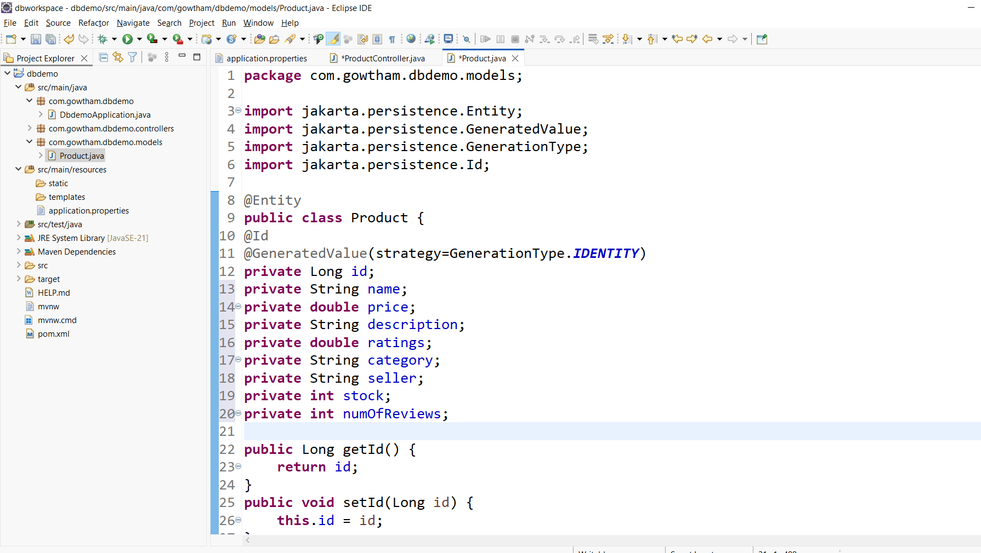
Perfoming CURD: Model File (Entiry)
Changing table name in mysql
@Table(name=“products”)
@Column(name = "username", unique = true, nullable = false)
private String username;
@Column(name = "email", nullable = false)
private String email;

Slide 11
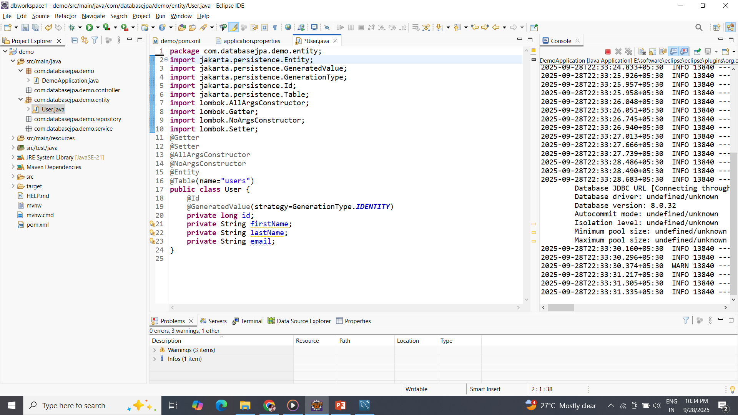
Perfoming CURD: Model File (Entiry)

Slide 12
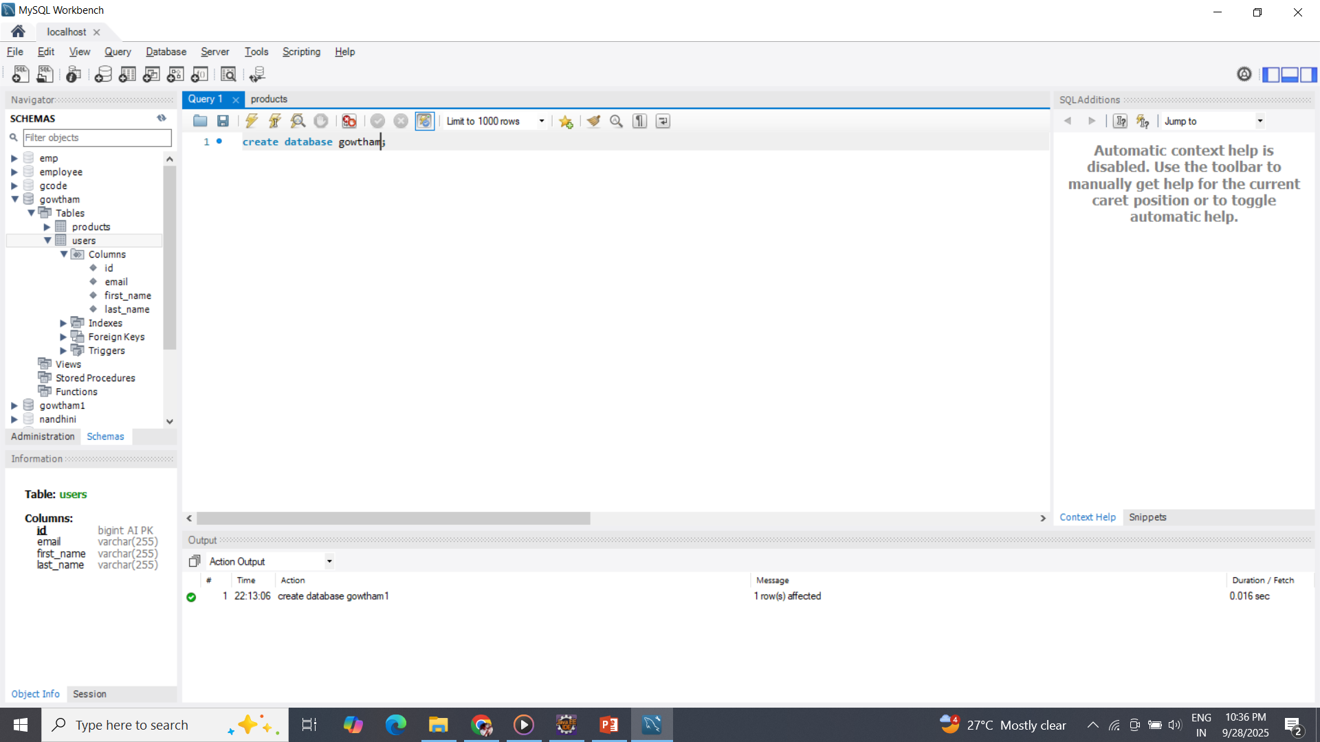
MySQL database Creation

Slide 13
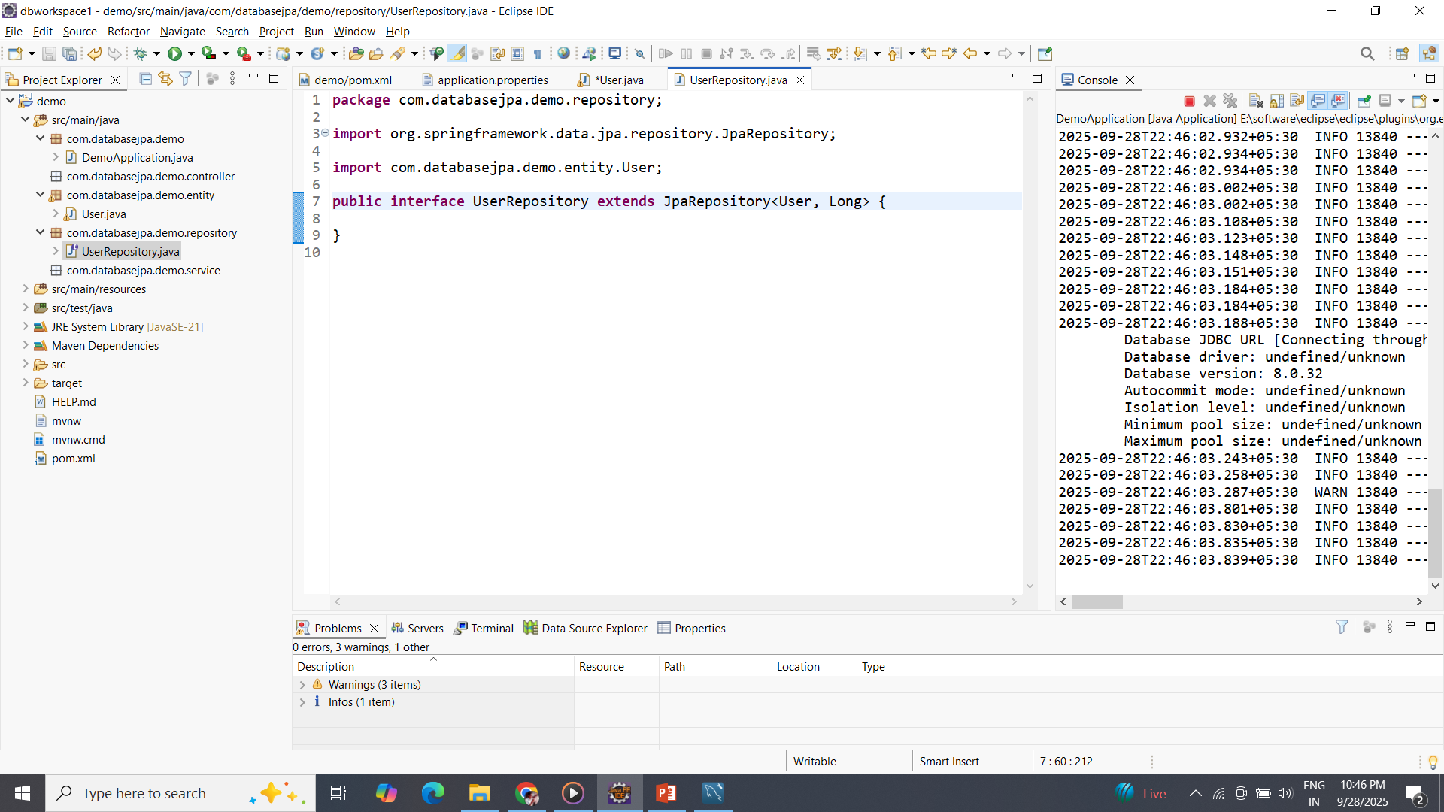
Repository Interface

Slide 14
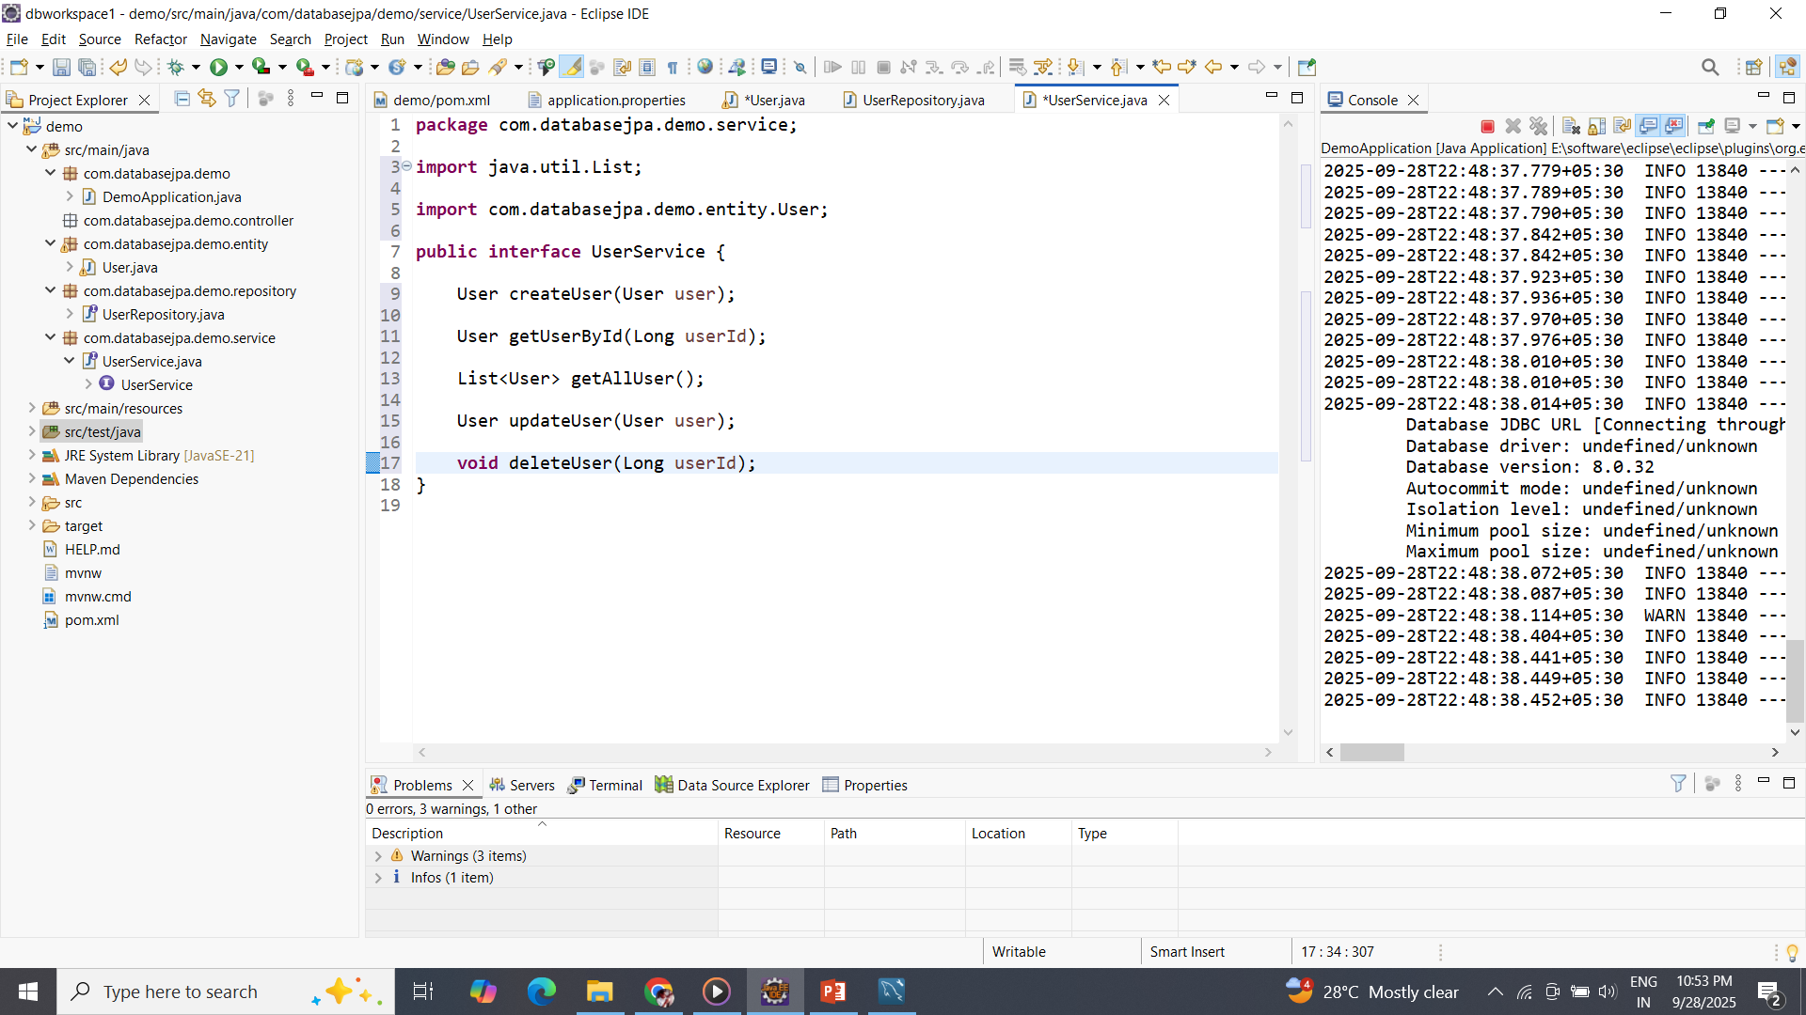
Service

Slide 15
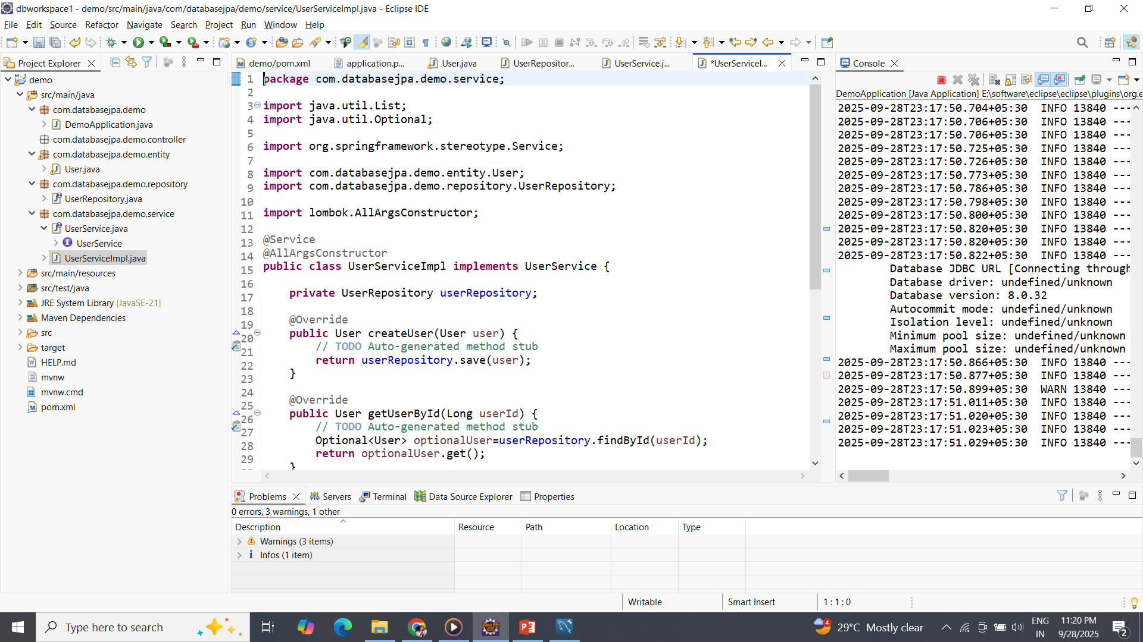
Service

Slide 16
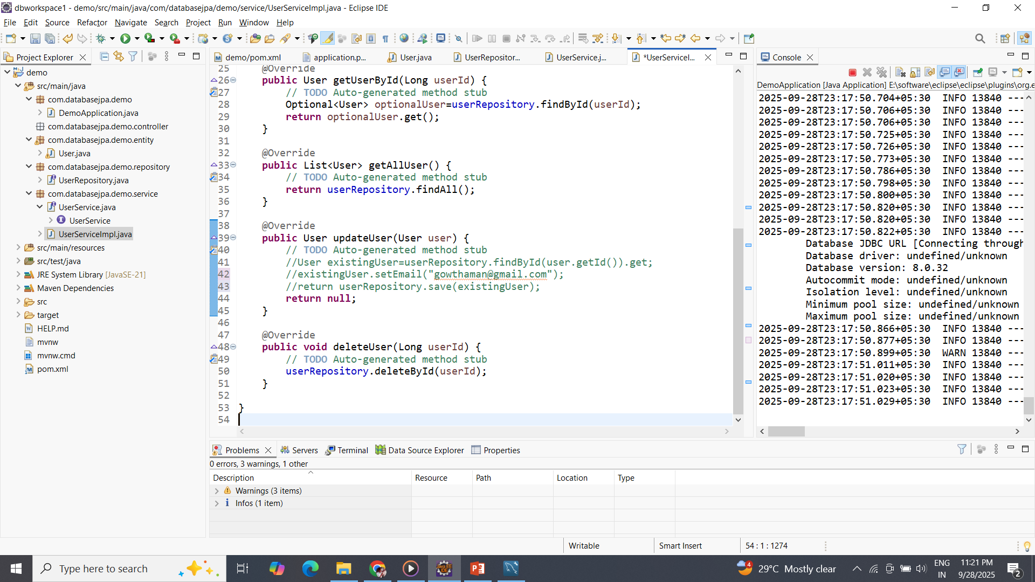
Service

Slide 17
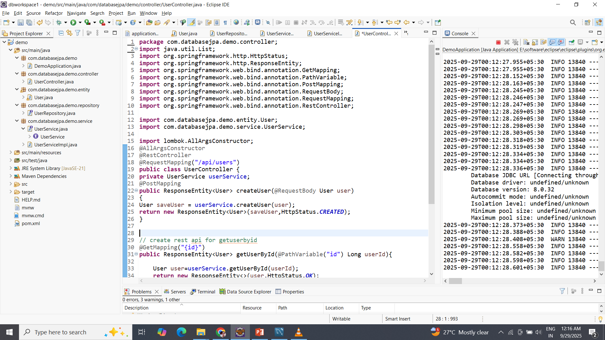
Controller – request Management

Slide 18
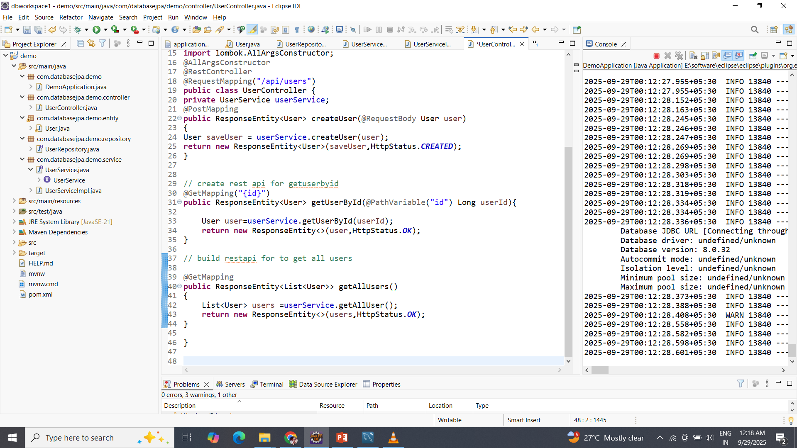

Slide 19
Controller

Slide 20
Performing CURD Operation with Spring JPA
3. Performing CRUD Operations:
Inject the repository into your service or controller and use its methods:
Create (Save): Use save() to persist a new entity or update an existing one.
MyEntity newEntity = new MyEntity();
newEntity.setName("New Item");
myEntityRepository.save(newEntity);
Read (Retrieve):
Find by ID: findById(id) returns an Optional<MyEntity>.
Find all: findAll() returns a List<MyEntity>.
Custom finders: Use methods defined in your repository (e.g., findByName("Item Name")).
Java
Optional<MyEntity> foundEntity = myEntityRepository.findById(1L);
List<MyEntity> allEntities = myEntityRepository.findAll();
Update: Modify an existing entity and then call save() again.
Optional<MyEntity> entityToUpdate = myEntityRepository.findById(1L);
entityToUpdate.ifPresent(entity -> {
entity.setName("Updated Name");
myEntityRepository.save(entity);
});
Delete:
Delete by ID: deleteById(id).
Delete an entity: delete(entity).
myEntityRepository.deleteById(1L);
myEntityRepository.delete(existingEntity);

Slide 21
Day 7 End
Thank you

