Slide 1


Slide 2

DAY-4
FULL-STACK JAVA

Slide 3
HTML, CSS & JavaScript – Foundations of Web Development
overview of front-end essentials

Slide 4
Web Development
What is the Web? :
Client (browser) ↔ Server (via HTTP/HTTPS)
Front-End = HTML + CSS + JS (runs in browser)
Back-End = APIs, databases, logic
Files are parsed top-to-bottom

Slide 5
Web Development
HTML Basics
HTML = Hypertext Markup Language
Structure the content of web pages
Example: <h1>Hello</h1>
HTML Skeleton
<!doctype html>
<html>
<head>
<title>My Page</title>
</head>
<body>
<h1>Hello World!</h1>
</body>
</html>

Slide 6
Web Development
1. Basic Structure Tags
<!DOCTYPE html> → Defines document type (HTML5)
<html> → Root element
<head> → Metadata, title, links, scripts
<title> → Title of the page (shown in browser tab)
<body> → Main visible content
2. Headings & Text
<h1> to <h6> → Headings (h1 = biggest, h6 = smallest)
<p> → Paragraph
<br> → Line break
<hr> → Horizontal line
<span> → Inline text container
<strong> → Bold (semantic importance)
<em> → Italics (semantic emphasis)

Slide 7
Web Development
3. Links & Media
<a href="url"> → Hyperlink
<img src="image.jpg" alt="description"> → Image
<video controls> → Video
<audio controls> → Audio
<iframe> → Embed external page (like YouTube video)
4. Lists
<ul> → Unordered list (bullets)
<ol> → Ordered list (numbers)
<li> → List item
<dl> → Definition list
<dt> → Term
<dd> → Definition

Slide 8
Web Development
5. Tables
<table> → Table container
<tr> → Table row
<th> → Table header cell
<td> → Table data cell
<caption> → Table title
<thead>, <tbody>, <tfoot> → Sections of a table
6. Forms & Input
<form> → Form container
<input type="text"> → Text box
<input type="radio">, <input type="checkbox">
<textarea> → Multi-line input
<select>, <option> → Dropdown menu
<button> → Button
<label> → Label for input

Slide 9
Web Development
7. Semantic Structure
<header> → Top section (logo, nav)
<nav> → Navigation links
<main> → Main page content
<section> → Section of content
<article> → Independent article/post
<aside> → Sidebar/extra info
<footer> → Bottom of page
8. Scripting & Styles
<script> → JavaScript code
<link> → Link external CSS
<style> → Internal CSS

Slide 10
Web Development
Form Example:
<form action="/subscribe" method="post">
<label>Email</label>
<input type="email" required>
<button>Subscribe</button>
</form>

Slide 11
Web Development
CSS(Cascading Style Sheets)
CSS = Cascading Style Sheets
Style HTML elements
Syntax: selector { property: value; }
Cascade + Specificity decide styles
Inline CSS
<h1 style="color:red;">Hello</h1>
Internal CSS
<style>
h1 { color: blue; }
</style>
External CSS
<link rel="stylesheet" href="style.css">

Slide 12
Web Development
body {
font-family: Arial, sans-serif;
margin: 0;
background: #f9f9f9;
}
h1 {
color: darkblue;
text-align: center;
}
button {
background: green;
color: white;
padding: 10px 15px;
border-radius: 5px;
}

Slide 13
Web Development
JavaScript (JS)
Definition:
JavaScript is a scripting language used to add interactivity and logic to web pages.
Uses of JavaScript
Handle events (click, input, hover)
Manipulate the DOM (update text, images, styles dynamically)
Validate forms before submission
Fetch data from APIs / Servers
Build dynamic applications (games, dashboards, etc.)

Slide 14
Web Development
Inline JS
<button onclick="alert('Hello!')">Click Me</button>
Internal JS
<script>
alert("Page loaded!");
</script>
External JS
<script src="script.js"></script>

Slide 15
Web Development
<!DOCTYPE html>
<html>
<head>
<title>Demo</title>
<link rel="stylesheet" href="style.css">
</head>
<body>
<h1>Hello CSS & JS</h1>
<button id="btn">Click Me</button>
<p id="out"></p>
<script src="script.js"></script>
</body>
</html>

Slide 16
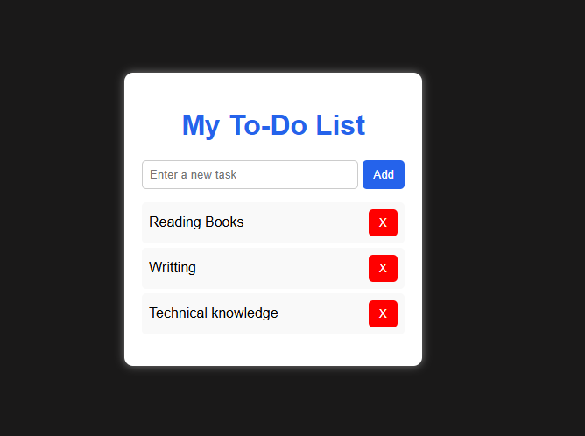
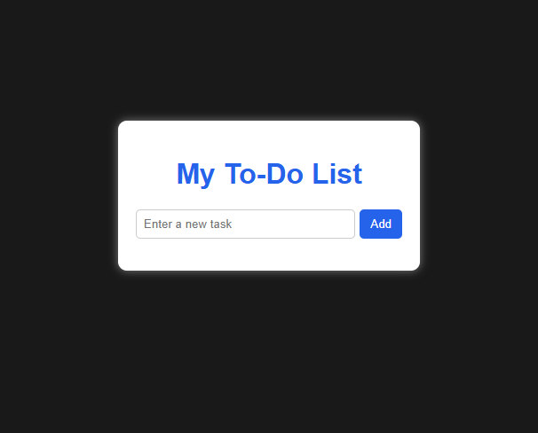
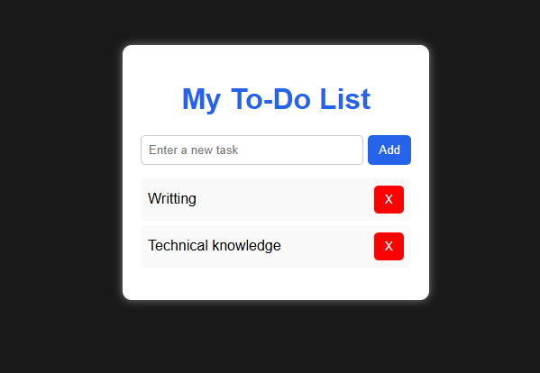
Web Development
Simple Hands-on

