Slide 1


Slide 2

DAY-5
FULL-STACK JAVA

Slide 3
Spring Boot Framework
Introduction to Spring Boot and its Features
Setting up a Spring Boot application
Spring Boot Architecture: Dependency Injection, Controller
& services
Building a simple REST API with Spring Boot

Slide 4
Introduction
What is Spring Boot?
Spring Boot provides a good platform for Java developers to develop a stand-alone and production-grade spring application that you can just run.
It is open source
Development Year : 2013
Advantages of Spring Boot:
*) Easy to understand and develop spring applications
*) Increases productivity
*) Reduces the development time

Slide 5
Spring Boot Features
Goals:
Spring Boot is designed with the following goals:
*) To avoid complex XML configuration in Spring
*) To develop a production ready Spring applications in an easier way
*) To reduce the development time and run the application independently
*) Offer an easier way of getting started with the application
Why Spring Boot?
You can choose Spring Boot because of the features and benefits it offers as given here:
It provides a flexible way to configure Java Beans, XML configurations, and Database Transactions.
It provides a powerful batch processing and manages REST endpoints.
In Spring Boot, everything is auto configured; no manual configurations are needed.
It offers annotation-based spring application
Eases dependency management
It includes Embedded Servlet Container

Slide 6
How does it work?
Spring Boot automatically configures your application based on the dependencies you have added to the project by using @EnableAutoConfiguration annotation.
For example,
if MySQL database is on your classpath, but you have not configured any database connection, then Spring Boot auto-configures an in-memory database.
The entry point of the spring boot application is the class contains @SpringBootApplication annotation and the main method.
Spring Boot automatically scans all the components included in the project by using @ComponentScan annotation.

Slide 7
Spring Boot Starters
Handling dependency management is a difficult task for big projects. Spring Boot resolves this problem by providing a set of dependencies for developers convenience.
For example,
if you want to use Spring and JPA for database access, it is sufficient if you include spring-boot-starter-data-jpa dependency in your project.
Note that all Spring Boot starters follow the same naming pattern spring-boot-starter- *, where * indicates that it is a type of the application.
Spring Boot Starter Actuator dependency is used to monitor and manage your application.
Its code is shown below:
<dependency>
<groupId>org.springframework.boot</groupId>
<artifactId>spring-boot-starter-actuator</artifactId>
</dependency>

Slide 8
Spring Boot Starters
Example:
Spring Boot Starter Security dependency is used for Spring Security. Its code is shown
below:
<dependency>
<groupId>org.springframework.boot</groupId>
<artifactId>spring-boot-starter-security</artifactId>
</dependency>
Spring Boot Starter web dependency is used to write a Rest Endpoints. Its code is
shown below:
<dependency>
<groupId>org.springframework.boot</groupId>
<artifactId>spring-boot-starter-web</artifactId>
</dependency>
Example:
Spring Boot Starter Thyme Leaf dependency is used to create a web application. Its
code is shown below:
<dependency>
<groupId>org.springframework.boot</groupId>
<artifactId>spring-boot-starter-thymeleaf</artifactId>
</dependency>
Spring Boot Starter Test dependency is used for writing Test cases. Its code is shown
below:
<dependency>
<groupId>org.springframework.boot</groupId>
<artifactId>spring-boot-starter-test</artifactId>
</dependency>

Slide 9
Auto Configuration
Auto Configuration Spring Boot Auto Configuration automatically configures your Spring application based on the JAR dependencies you added in the project.
For example, if MySQL database is on your class path, but you have not configured any database connection, then Spring Boot autoconfigures an in-memory database.
For this purpose, you need to add @EnableAutoConfiguration annotation or @SpringBootApplication annotation to your main class file. Then, your Spring Boot application will be automatically configured.
import org.springframework.boot.SpringApplication;
import org.springframework.boot.autoconfigure.EnableAutoConfiguration;
@EnableAutoConfiguration or @SpringBootApplication
public class DemoApplication {
public static void main(String[] args) {
SpringApplication.run(DemoApplication.class, args);
}
}

Slide 10
pom.xml
It refers to the pom.xml file, which is the fundamental configuration file used by Maven, a popular build automation tool commonly used with Spring projects.
Build Configuration:
Specifies plugins, build directories, and other settings related to the project's build process.
Repositories:
Defines where Maven should look for dependencies (e.g., remote repositories like Maven Central).
Profiles:
Allows for different build configurations for various environments (e.g., development, testing, production).
The pom.xml file defines:
Project Information:
Details like groupId, artifactId, version, packaging, and name that uniquely identify the project.
Dependencies:
Lists all external libraries and frameworks (including Spring modules) that the project relies on, along with their versions.
In essence, the pom.xml file acts as the blueprint for your Spring project when using Maven, providing all the necessary information for Maven to build, manage dependencies, and execute various tasks within the project lifecycle.

Slide 11
Setting up Spring Boot Application
Download eclipse ide for java web developers
Use Spring Initializer to preconfigure a Spring Boot Application, then import into your IDE Eclipse.
Official web site: https://start.spring.io
Open your workspace in Eclipse and import Spring boot project

Slide 12
Dependency Injection
Dependency injection (DI) in Spring Boot is a core mechanism for managing the dependencies between components, such as controllers and services. It promotes loose coupling and improves testability and maintainability.
Controllers: classes annotated with @RestController or @Controller handle incoming HTTP Requests, process then, and return responses. They typically delegate business logic to service layers.
Services: Classes annotated with @Service encapsulate the business logic of an application. The interact with repositories (for data access) and other services to perform operations.

Slide 13
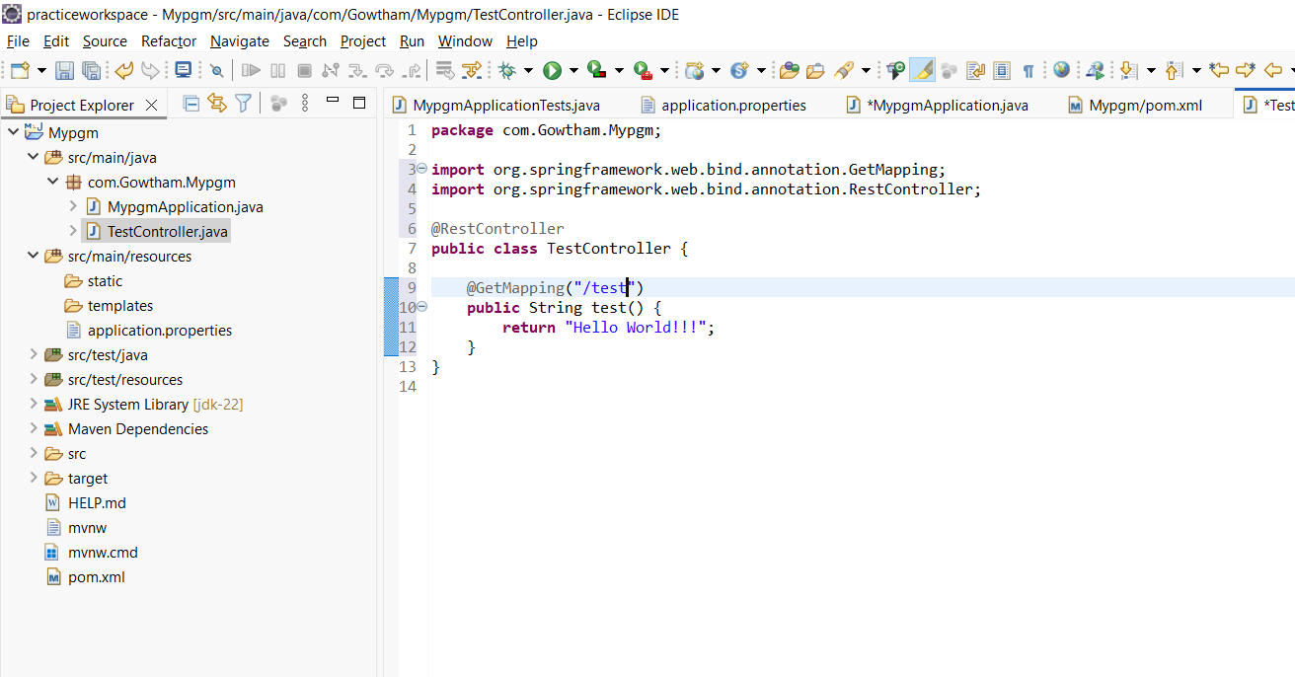
Create Controller and run
Note: Ctrl + Shift + o
Automatically add header file

Slide 14
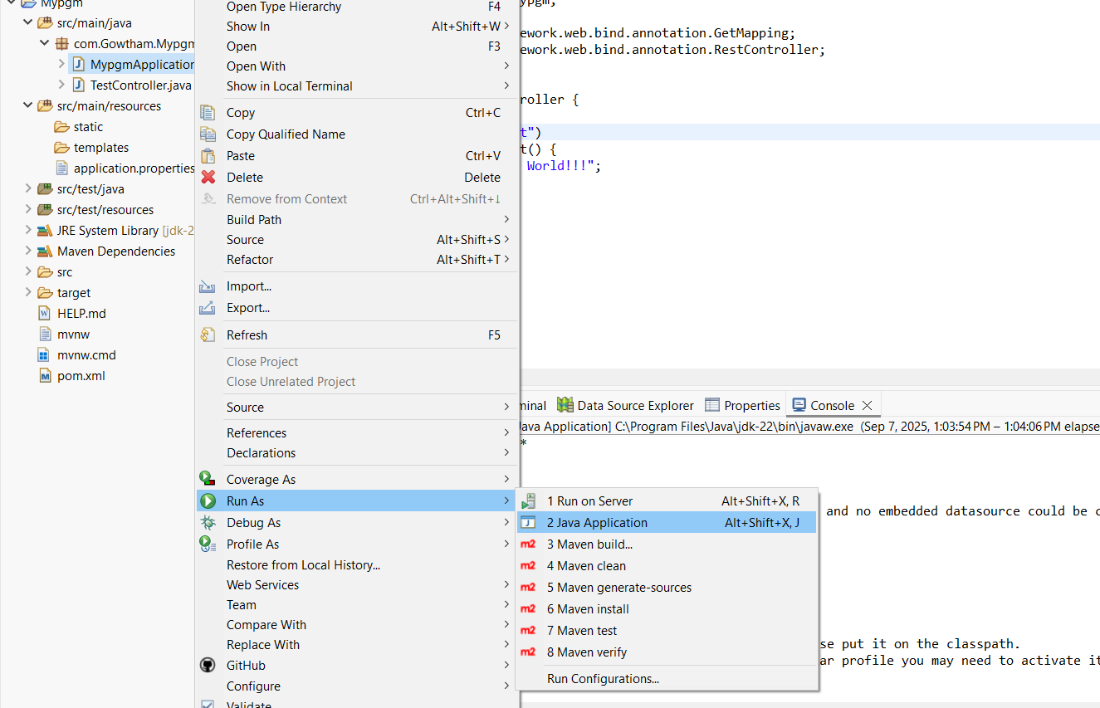
Running Project

Slide 15
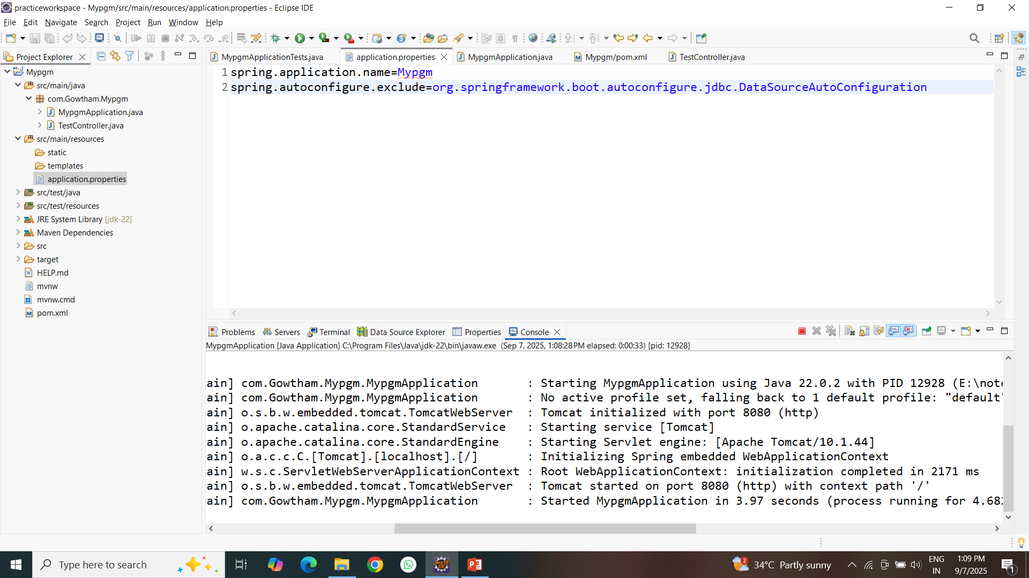
Exclude Database Configuration

Slide 16
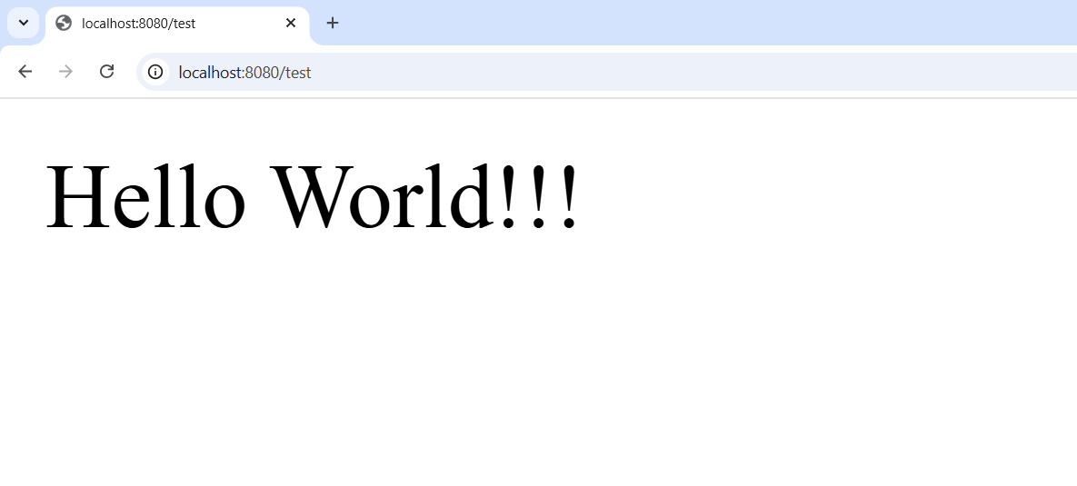
Output

Slide 17
Annotation
@SpringBootApplication -------→ Main Application File → Start point
contains:
→ SpringBootConfiguration
→ EnableAutoConfiguration
→ComponentScan
@RestController -----------------→ showing output
containts:
→Controller --→ request handle purpose
→ResponseBody→
send your data into http response data
Know about controller process in browser ?
Ctrl+shift+I → network tab → click your controller → see response headers and preview

Slide 18
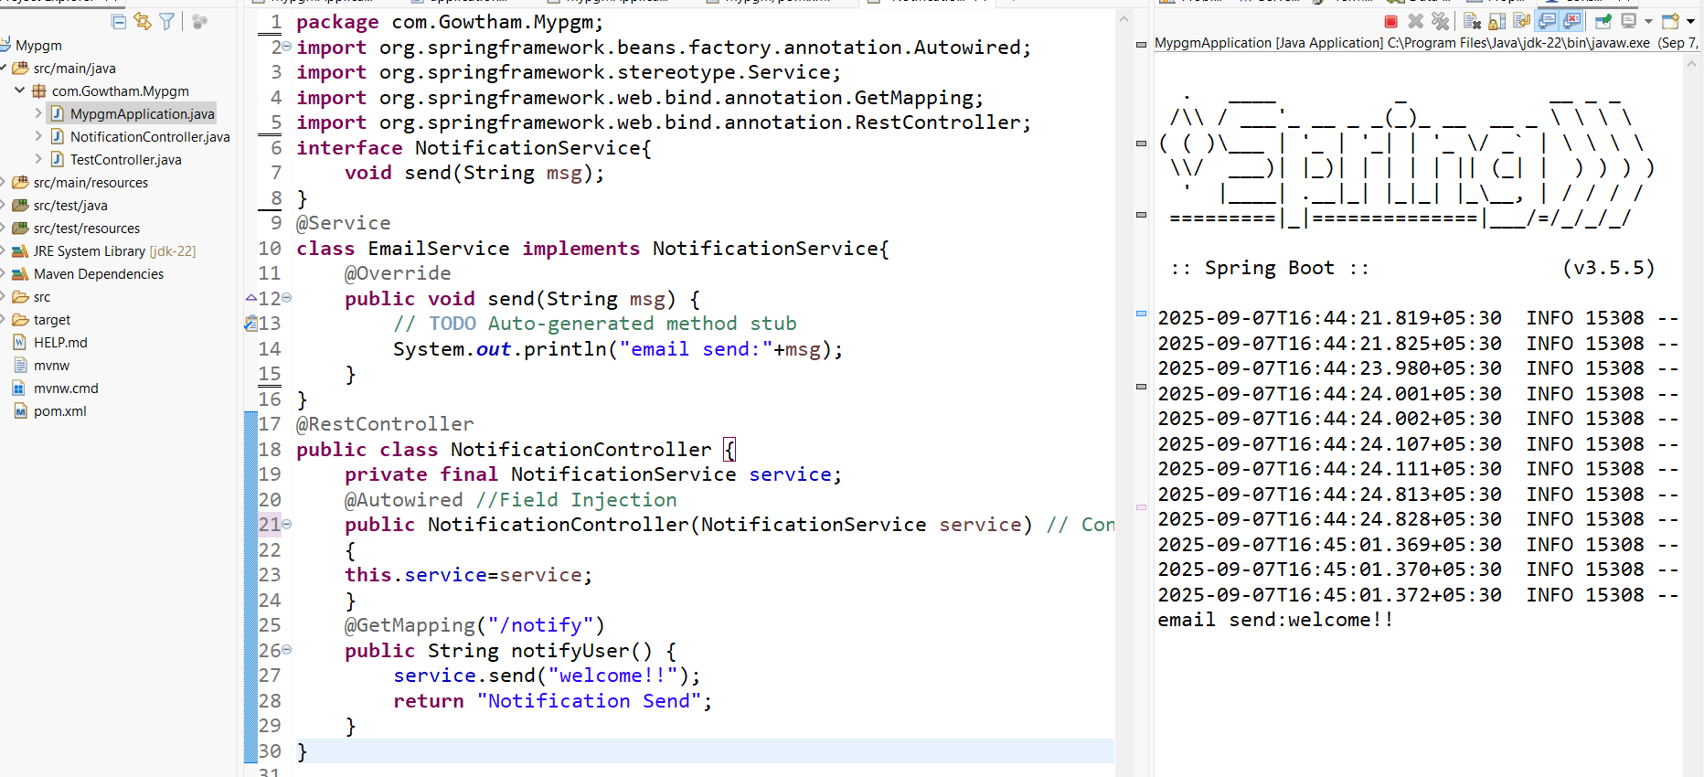
Controller & Services (Dependency Injection)

Slide 19
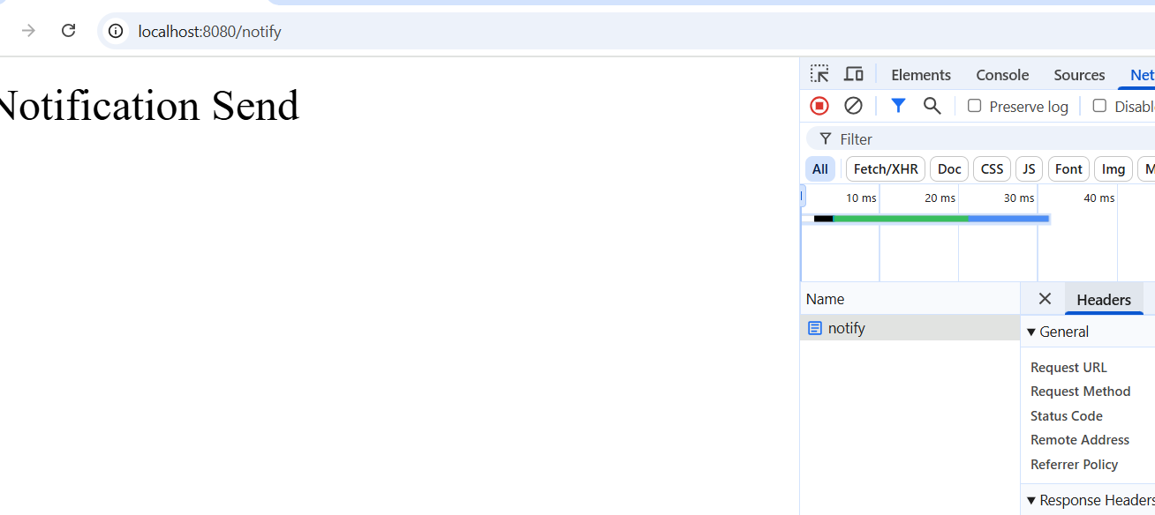
Output

Slide 20
Day 5 End
Thank you

