Slide 1
心athena

Slide 2
Problem statement
IA3-Damage Identification to belts or machinery: The constant use of heavy raw materials and equipment in industries causes the formation of cracks on industrial belts or even damage to the machinery.Expected Deliverables: A system to identify the points of cracks on the industrial belt. Further, even damage to machinery must be identified.

Slide 3
Common faults
Typical machines include motors, pumps, fans, gear boxes, compressors, turbines, conveyors, rollers, engines, and machine tools that have rotational elements.

Slide 4
1-Vibration analysis
Vibration analysis - each vibration will have a signature along with it. Hence, we match the vibration with the signature we already have. The rotating elements of these machines generate vibrations at specific frequencies that identify the rotating elements. The amplitude of the vibration indicates the performance or quality of machine. An increase in the vibration amplitude is a direct result of failing rotational elements such as bearings or gears. Based on the machine speed, the rotational frequencies can be calculated and compared to the measurements to identify the failure mode.

Slide 5
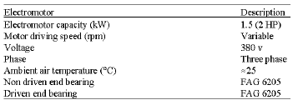
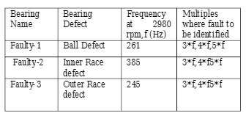
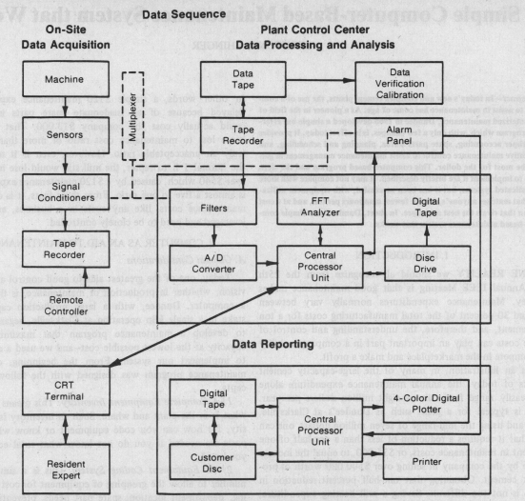
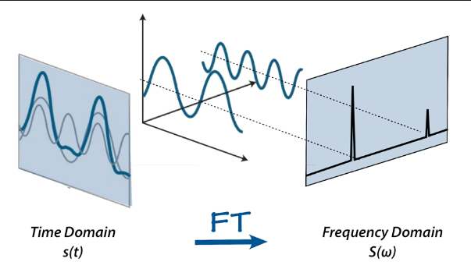

Slide 6
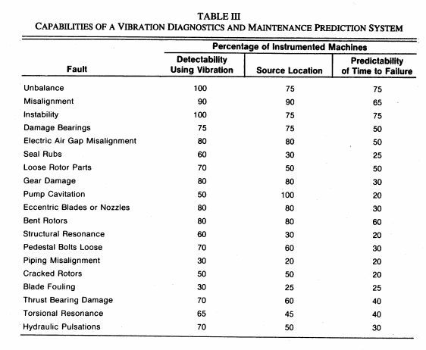

Slide 7
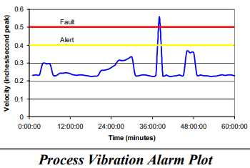

Slide 8
2-sound/Noise
a fault detection system based on a noise signal which is obtained through microphone from a electrical machinery. The noise signal of rotating machinery is utilized for early fault diagnostic. Fault detection system with automated noise signal processing consist of: a measured data is divided down by short time duration parts. Fault carrying frequencies are extracted from digitalized signal. Envelope detector and demodulation were utilized for identifying fault frequencies with their harmonics and sidebands. Automated noise analysis is dedicated to detect and report a machinery abnormal condition. Implementation was conducted with noise signals which were obtained from an electric motors, turbine generators and bearing fault motors

Slide 9
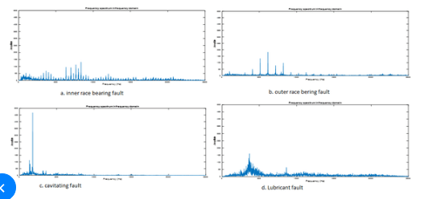

Slide 10
3-Computer Vision
1) remove the inhomogeneous background illumination apply a big gaussian bluring and substract the original image from the blured one.
2) Apply e.g. e Sobel edge detection and a morphological close
3) remove the noise using blob analysis (e.g. remove regions with small areas) Best Edit: In principle you have to convert the image between 0 and 1 before GaussianBlur.
Additionally to get better results you also can apply a non-maximal suppression after sobel.

Slide 11
4- Open/Short
Open/Short - for the parts which are deep inside, we will stick a sheet of conducting material and will check the continuity of the sheets.
1. It can be done by using RF transmission method
2. It can be done by using a series of the conductor along with a source and Small leads.
Phenolic polymer + aluminium

Slide 12
Belt analysis – wear-and-tear
We use OpenCV for this,
we read the image
take the template to be matched
do the blur
match the template
apply the threshold to decrease the noise

Slide 13
References
https://www.researchgate.net/publication/236330286_VIBRATION_ANALYSIS_OF_MACHINE_FAULT_SIGNATURE
https://www.ctconline.com/pdf/pubTechPapers/21-Industrial%20Vibration%20Analysis.pdf
https://www.researchgate.net/publication/317401564_Automated_Noise_Analysis_for_Fault_Detection

