Slide 1
SCIO – Data Analysis on Inpatient Claim
Gowtham Balachandhiran

Slide 2
Part 1
We loose our identity if we don’t know our history

Slide 3
What we already know about the data?
Data Entrepreneurs’ Synthetic Public Use File (DE-SynPUF)
Random Sample 1
Random Sample 2
Random Sample 3
…
Random Sample 20
File type | CSV File name | Number of Years of Data
Beneficiary Summary DE-SynPUF | DE1_0_2008_Beneficiary_Summary_File_Sample_# DE1_0_2009_Beneficiary_Summary_File_Sample_# DE1_0_2010_Beneficiary_Summary_File_Sample_# | 1
Inpatient Claims DE-SynPUF | DE1_0_2008_to_2010_Inpatient_Claims_Sample_# | 3
Outpatient Claims DE-SynPUF | DE1_0_2008_to_2010_Outpatient_Claims_Sample_# | 3
Prescription Drug Events (PDE) DE-SynPUF | DE1_0_2008_to_2010_Prescription_Drug_Events_Sample_# | 3
Carrier Claims DE-SynPUF | DE1_0_2008_to_2010_Carrier_Claims_Sample_#A DE1_0_2008_to_2010_Carrier_Claims_Sample_#B | 3

Slide 4
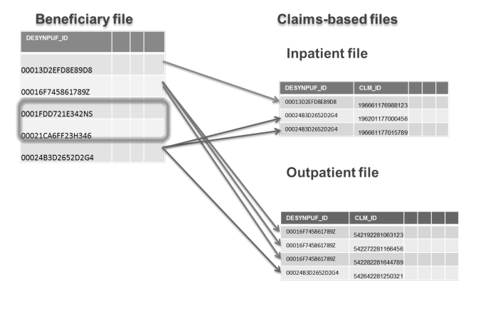
But? Are we missing something?
The big elephant in the room when it comes to medical health record is security. How security is handled
What is the tool used here? Anonymity

Slide 5
How Anonymity is maintained?
The variables of the seed beneficiary profile were changed by taking characteristics from similar but different “donor” beneficiaries within the source data. The claims from the seed beneficiary were then replaced with claims from other donor beneficiary claims sets. There were processes in place to ensure that a synthetic claim set was created from at least three different donors.
Following methods were applied to protect the identity of the seed beneficiary
■ Variable Reduction: The number of variables in each table was limited to a set that was useful and appropriate for development users.
■ Suppression: Records, whether beneficiary or claim, that were rare in the data and that had disclosure risk even in a synthetic file were removed by applying appropriate k-anonymity rules based on either population- or sample-specific counts.
■ Substitution: Variable values were altered by replacing them with values from a similar donor record based on key variables (i.e., conditional on matching certain variables).
■ Imputation: Values of single variables were altered by drawing values from empirical distributions conditioned on key variables. The empirical distributions were first coarsened and truncated, removing potentially identifying values.
■ Date Perturbation: Timelines were altered by changing dates and intervals between events.
■ Coarsening: Continuous variables (e.g., year of birth or expenditures) were coarsened enough to limit disclosure but remain realistically useful.

Slide 6
Part -2
Mining the data in hopes of getting gold

Slide 7
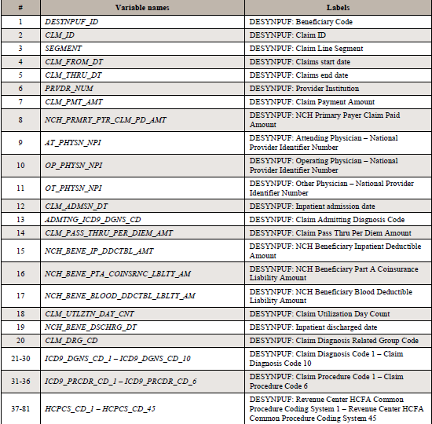
How can we explore the data?
Structure of key Data set(66773 rows × 81 columns)

Slide 8
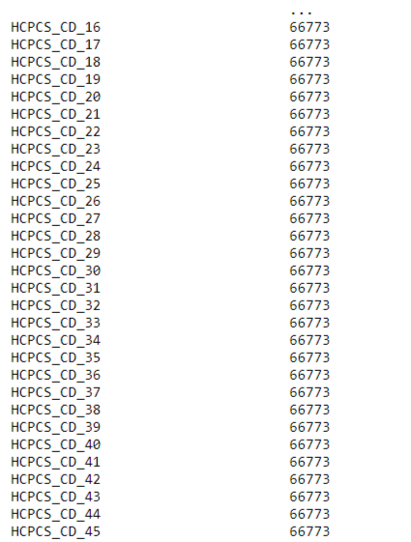

Cleaning Data for analysis
Step 1 – Remove columns makes less or no contribution

Slide 9
Imputing the data that has less missing values
We first thought of filling the value with mean or zero. However most of the features where categorical. For example DAY_CNT only be a whole day and cannot contain mean. We removes data which has contributions lesser than 1%. If it has more than 10 % we filled it with most frequent values.

Slide 10
What did we analyze in the data
Most of the data we analyzed was with respect to money which ends with _AMT.
We analyzed the amount payed to the claims with respect to years.
We split the amount with each category that has dense values . We gave more weightage to dense fields rather than sparse fields.
Dense fields = Fields that as valid cell values
Sparse Fields = Fields that as trivial/null/mostly filled with zeros

Slide 11
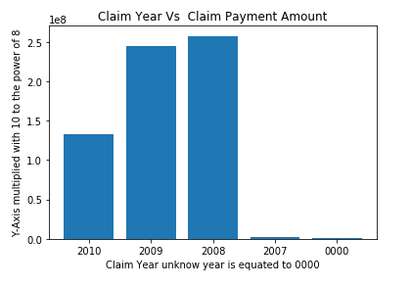
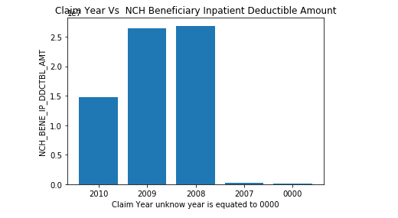
Claim Year vs Claim Payment Amount and Claim Year vs NCH Beneficiary Inpatient Deductible Amount

Slide 12
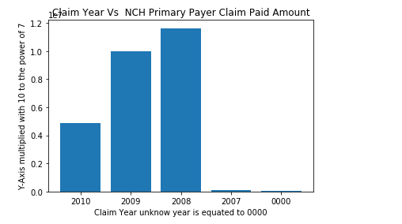
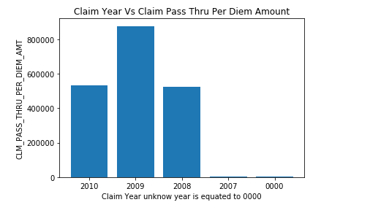
Claim Year Vs NCH Primary Payer Claim Paid Amount and Claim Year Vs Claim Pass Thru Per Diem Amount

Slide 13
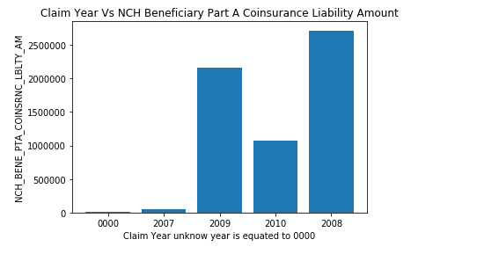
Claim Year Vs NCH Beneficiary Blood Deductible Liability Amount and Claim Year Vs NCH Beneficiary Part A Coinsurance Liability Amount

Slide 14
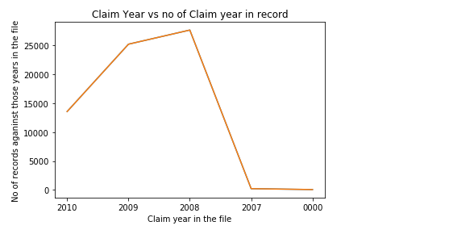
Do we have equal number of records?
Claim year – 0000 – No of Records - 68
Claim year – 2007 – No of Records - 224
Claim year – 2008 – No of Records - 27678
Claim year – 2009 – No of Records - 25231
Claim year – 2010 – No of Records- 13572

Slide 15
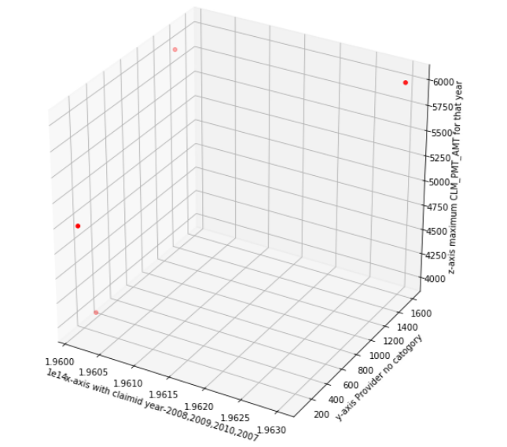
Whoz paid whom more?
X-Axis claim id with year - 2008 -196011176974619 2009- 196011176975901 2010- 196011176991776 2007-19630117698109
Y-Axis Provider category - 8.200000e+01 2.540000e+02 1.283000e+03 1.603000e+03
Z-Axis CLM_PMT_AMT 5000 4000 6000 6000

Slide 16
Part - 3
If you torture data long enough it will confess!!!

Slide 17
Can we make any predictions on data and not just analysis?
We need to select features making prediction.
If we need to make prediction which model should we use and which features should we use.
How can we select features and model for the same.
There are 31 features and 66773 records in the data set. However gleaning through all the records manually is a big trouble. Also that will only take lot of time and efforts.

Slide 18
How to handle features that are alphanumeric or alphabet? Sadly model accepts only numbers
We changed all the alphabet features or alphanumeric features to categorical features.
Now categorical features are numerical features upon which we can run correlation .

Slide 19
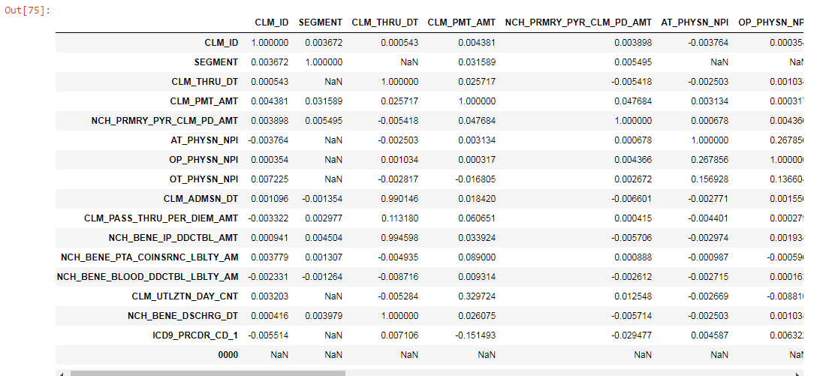
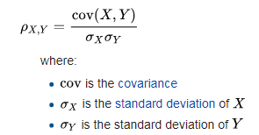
How did we choose features?
We took Pearson correlation on data and saw which features had correlation with the other

Slide 20
Attempt 1 for Algo selection
Since the data set included both years month and date we thought of using time series analysis.
First choice of algorithm was ARIMA(Auto regressive integrated moving average).
However there is no equal distribution of this data with respect to years. Hence prediction is not going go well.

Slide 21
Attempt 2 for Algo Selection
We thought of using Artificial neural network for regression to predict CLM_PMT_AMT and NCH_BENE_IP_DDCTBL_AMT.
The reason for choosing these features is they had high correlation with other features.
However the loss was too huge and prediction was not very good. Lastly the training took very long time.

Slide 22
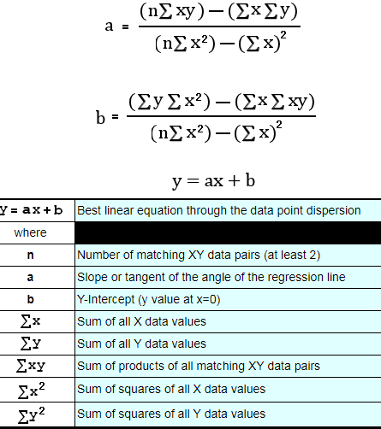
Finally an algorithm that can predict
We then chose algorithm of linear regression coupled with gradient boosting.
The algorithm will then use gradient boosting which will strengthen weak learner to learn from previous mis-predictions.
Following hyper-parameters where used
'n_estimators': 4000, 'max_depth': 5, 'min_samples_split':2, 'learning_rate': 0.01, 'loss': 'ls'

Slide 23
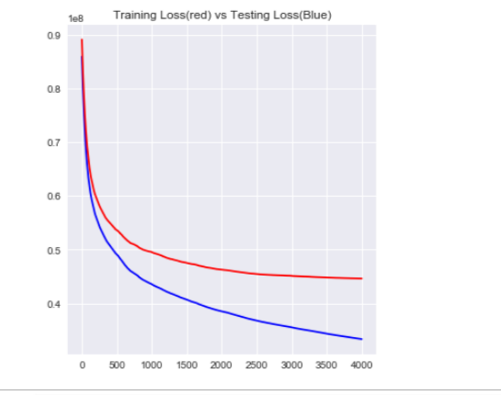
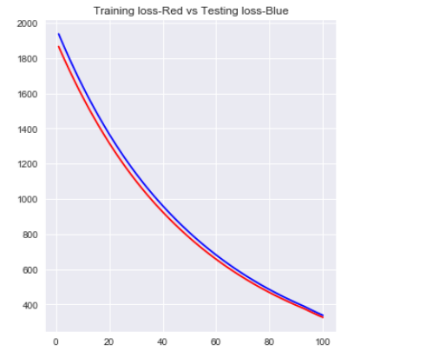
Training Loss vs Testing Loss
CLM_PMT_AMT - Predictor
NCH_BENE_IP_DDCTBL_AMT - Predictor

Slide 24
Demo
Model prediction and key data set .
Future enhancement – we could host the predictor as web app. People can consume from an end point.

Slide 25

Climax

Slide 26




How we actually got the data set
Vipin could not find much online
Sig sigma cert holder
Inference : Very numbers person
Inference : Very good in Sql and analytical thinking.
Inference: Very good in health care domain, book writer and into research with respect to healthcare

Slide 27



How we actually got the data set –(cont)
Inference : Has a lot of study on entrepreneurship and analytics
Or

Slide 28
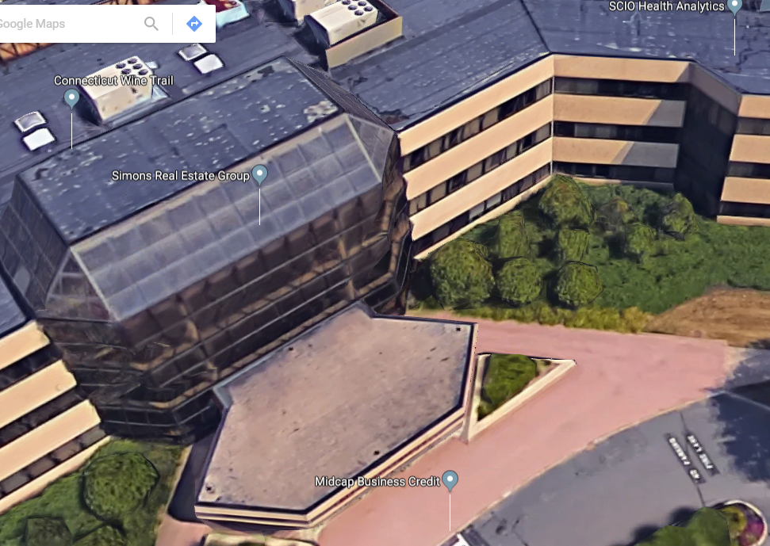
Place of origin!!

Slide 29
Thank you!!!

