Slide 1

CFG Parser and Syntax Tree Generator
PRESENTED BY:
Ch. Gowtham Reddy(192365064)
CSA1303 Theory of Computation with Finite Automata
Course Faculty : Dr. K. Vijaya Bhaskar and Dr. S. Christy Melwyn, Professor, Department of CSE , SIMATS Engineering, SIMATS

Slide 2

AGENDA
Abstract
Introduction
Objectives
Flow chart
Module -1
Module -2
Conclusion
Future Scope
References

Slide 3
ABSTRACT
Developed a tool to parse and visualize Context-Free Grammars (CFGs).
Used Recursive Descent Parser in Python to check strings against grammar rules.
Created Syntax Trees using Graphviz for valid strings.
Displayed step-by-step parsing process including backtracking.
Achieved accurate parsing, clear visualization, and detailed derivation logs for learning.

Slide 4
INTRODUCTION
In computer science, Context-Free Grammars (CFGs) provide the rules for a language's syntax.
Understanding these theoretical rules apply to a string of text is often abstract and challenging.
Manually tracing how a computer parses a string is slow and difficult.
This project aims to bridge that gap by creating a tool that automates the parsing process and visualizes the results, making these concepts easier to learn.

Slide 5
OBJECTIVES
To implement a parser that can read and understand user-defined CFG rules.
To validate input strings using the Recursive Descent parsing technique.
To generate a visual Syntax Tree for any string that is successfully parsed.
To provide a step-by-step derivation trace to show how the parser reached its conclusion.
To build an intuitive User Interface for grammar input, string testing, and viewing the visual output.

Slide 6
PROPOSED METHODOLOGY
Step 1: Provide CFG Rules & Input String
Step 2: Parse Grammar & Tokenize String
Step 3: Recursive Descent Parser Engine
Step 4: Is String Valid?
Start: User Input
Yes
End: Display Visual Output
(Syntax Tree & Derivation Trac)
Step 5: Generate
Derivation Steps
Step 4: Construct
Syntax Tree
No
End: Display Rejection Message

Slide 7
MODULE-1 –Grammar Design and Parsing
Defined CFG rules with non-terminals, terminals, and production rules.
Used Recursive Descent and LL(1) parsing to check if input strings are valid.
LL(1) parsing is faster as it uses a parse table to choose rules.
Output:
Valid string → shows full derivation steps.
Invalid string → clear rejection message.
Tools used: Python, PLY, and ANTLR parsing libraries.

Slide 8
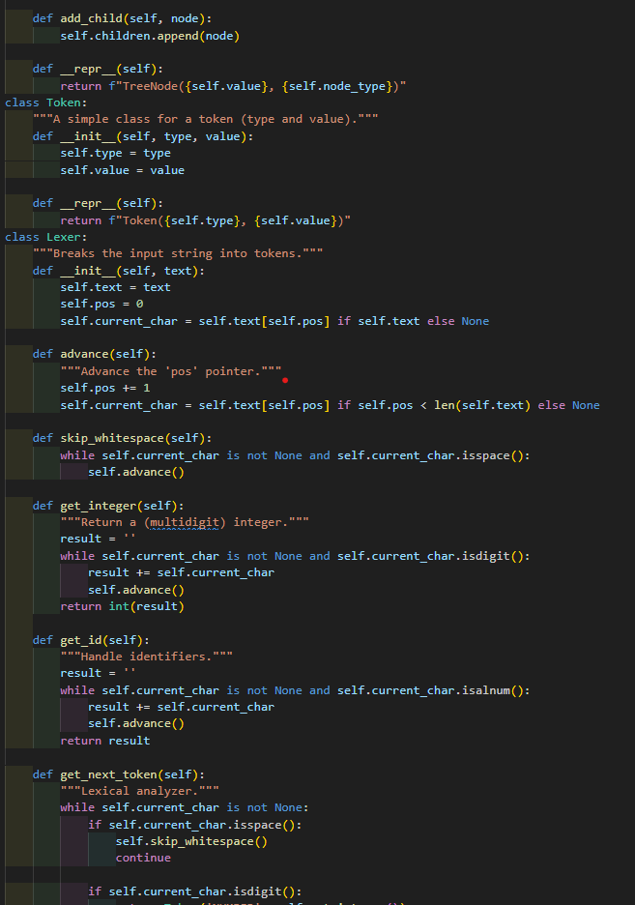
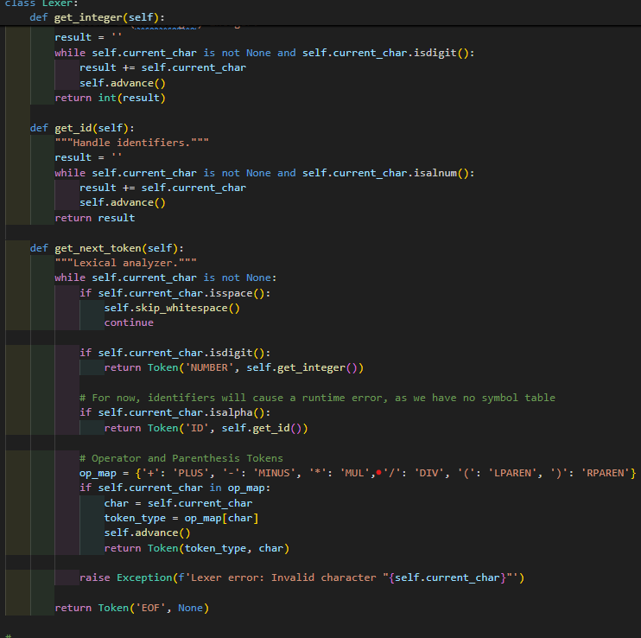
IMPLEMENTATION MODULE-1
🔒 Module 1 – Grammar Design and Parsing.
Language: Python
Library: PLY and ANTLR
Use Case:
PLY → Helps split input into tokens and parse them.
ANTLR → Quickly creates parsers from grammar rules.

Slide 9
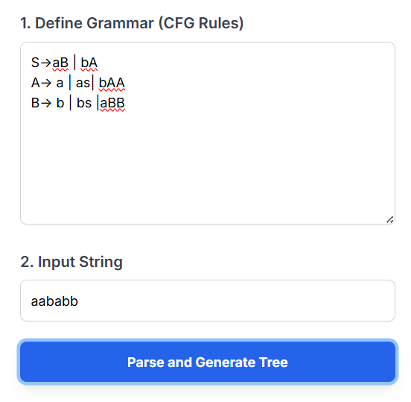
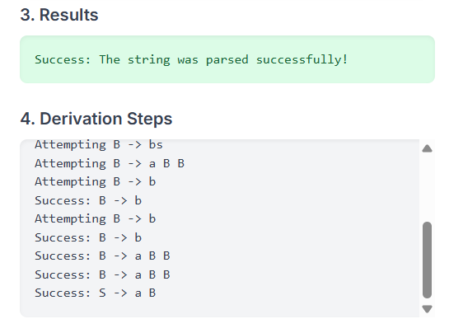
OUTPUT

Slide 10
MODULE-2 – Syntax Tree Construction and Visualization
Builds on the successful parse from Module 1 to create a visual representation.
Generates a Concrete Syntax Tree (CST) to show the string's full grammatical structure.
The tree shows the derivation from the start symbol (root) down to the input string (leaves).
Output:
A graphical image (.png) of the complete syntax tree.
Tools used: Python and the Graphviz library.

Slide 11
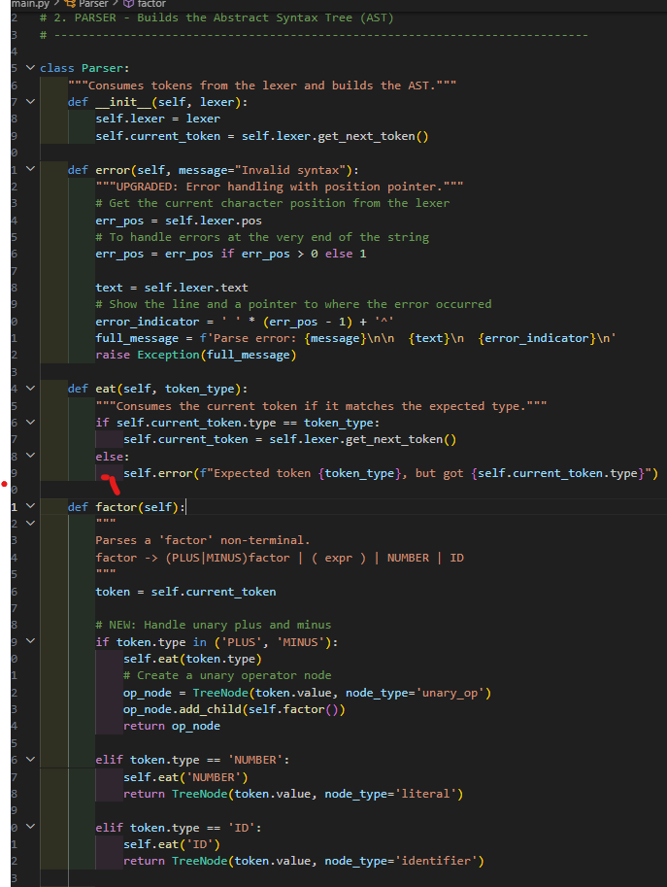
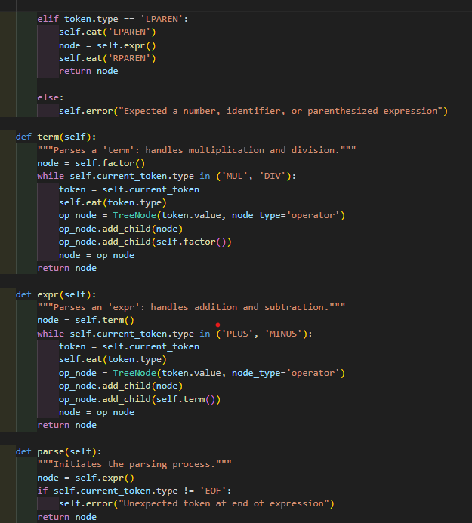
IMPLEMENTATION MODULE-2
🔗 Module 2 – Syntax Tree Construction and Visualization
Language: Python
Library: Graphviz
Use Case:
Graphviz → Renders the tree data structure into a visual diagram.

Slide 12
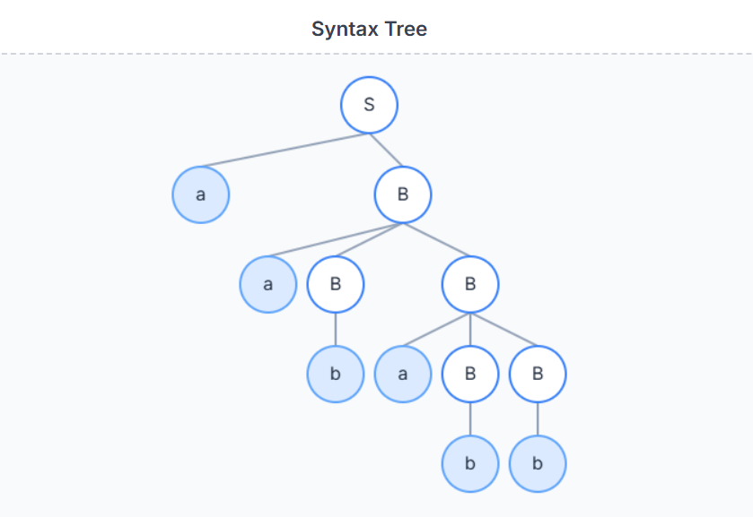
OUTPUT

Slide 13
CONCLUSION
Successfully created a functional tool for parsing and visualizing Context-Free Grammars.
The project meets all core objectives: validating strings, generating syntax trees, and providing a full derivation trace.
Serves as an effective educational aid for understanding the complex concepts of compiler theory.
Transforms abstract grammar rules into tangible, visual results, making learning more intuitive.

Slide 14
FUTURE SCOPE
Implement LL(1) Parser → Improve efficiency and handle complex grammars without backtracking.
Generate Abstract Syntax Trees (ASTs) → Create compact trees like those used in real compilers.
Add Interactive UI → Use Flask (web) or Tkinter (desktop) for a user-friendly interface.
Enhance Error Reporting → Give clear, specific messages about syntax errors and possible fixes.

Slide 15
REFERENCES
Aho, A. V., Lam, M. S., Sethi, R., & Ullman, J. D. (2007). Compilers: Principles, Techniques, and Tools (2nd ed.). Pearson.
Sipser, M. (2012). Introduction to the Theory of Computation (3rd ed.). Cengage Learning.
Grune, D., & Jacobs, C. J. H. (2008). Parsing Techniques: A Practical Guide (2nd ed.). Springer.
Graphviz - Graph Visualization Software. Official Documentation.
https://graphviz.org/documentation/
Python Software Foundation. Python 3 Documentation.
https://docs.python.org/3/

Slide 16
THANK YOU

