Slide 1

Introduction to Amazon Sales Data Analysis
Analyzing Amazon sales data is crucial for understanding market trends and optimizing business strategies.

Slide 2
Importance of Analyzing Amazon Sales Data
Performance Evaluation
Market Trends
Competitor Analysis
Reveals patterns and trends in customer behavior and preferences.
Reviewing sales data aids in evaluating product performance.
Enables comparison with competitors to identify opportunities.

Slide 3
Key Metrics to Consider in Amazon Sales Data Analysis
1
Sales Revenue
2
Customer Acquisition
Measure total revenue generated from Amazon sales.
Assess new customer acquisition through sales analysis.
3
Conversion Rate
4
Inventory Turnover
Track the percentage of visitors who make a purchase.
Analyze how quickly inventory is sold and replaced.

Slide 4
Tools and Techniques for Analyzing Amazon Sales Data
Data Visualization
Machine Learning
Apply algorithms to identify predictive sales patterns.
Use charts and graphs to enhance data interpretation.
Customer Segmentation
Segment customers based on purchasing behavior analysis.

Slide 5
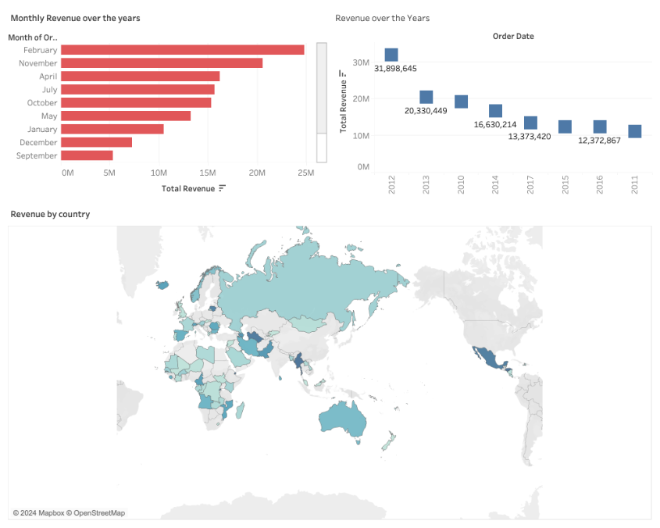
Tableau Design
Dashboard

Slide 6

Common Challenges in Analyzing Amazon Sales Data
1
Data Integration
Bringing together data from diverse sources for analysis.
2
Data Quality
Ensuring accuracy and reliability of the sales data collected.
3
Interpreting Complex Insights
Extracting meaningful insights from large volumes of data.

Slide 7
Best Practices for Interpreting Amazon Sales Data
1
2
3
Data Visualization
Regular Analysis
Continuous Learning

Slide 8

Conclusion and Next Steps
1
Summarize Findings
Conclude key insights to inform future business strategies.
2
Actionable Steps
Develop actionable plans based on the analysis outcomes.

