Slide 1
Fake news detections using python
CAPSTONE PROJECT
Presented By: GOWTHAM.G
Care college of engineering
Mechanical engineering

Slide 2
OUTLINE
Problem Statement
Proposed System/Solution
System Development Approach
Algorithm & Deployment
Result
Conclusion
Future Scope
References

Slide 3
Problem Statement
Fake news do not require any introduction
It is very much easy to spread all the fake information in today’s all-connected world across the internet.
Fake news is sometimes transmitted through the internet by some unauthorized sources, which creates issues for the targeted person and it makes them panic and leads to even violence.
To combat the spread of fake news, it’s critical to determine the information’s legitimacy, which this Data Science project can help with.
To do so, Python can be used, and a model is created using Tfid fVectorizer. Passive Aggressive Classifier can be implemented to distinguish between true and fake news. Pandas, NumPy, and sic-kit-learn are some Python packages suitable for this project, and we can utilize News.csv for the dataset.

Slide 4
Proposed Solution
Detecting fake news can be challenging, but Python offers powerful tools for tackling this problem. Here's a proposed solution using Python:
Data Collection:
Gather a dataset of labeled news articles, where each article is labeled as either real or fake.
Preprocessing:
Tokenize the text: Split the text into individual words or tokens.
Remove stop words: Filter out common words that don't carry much meaning.
Stemming/Lemmatization: Reduce words to their root form to normalize the text.
Feature Extraction:
Bag of Words (Bow): Convert the text data into numerical feature vectors, where each feature represents the frequency of a word in the text.
TF-IDF (Term Frequency-Inverse Document Frequency): Weigh the importance of words based on how frequently they appear in a document compared to the entire dataset

Slide 5
System Approach
A systems approach for fake news detection using Python involves integrating various components into a cohesive system. Here's a structured outline for such a system
Semantic Analysis:
Incorporate semantic analysis techniques to capture the deeper meaning of the text.
Use tools like Natural Language Understanding (NLU) libraries or pre-trained models (e.g., BERT, GPT) for contextual understanding.
User Interface:
Develop a user interface (UI) for users to interact with the system.
Provide functionalities for users to input news articles and receive predictions on their authenticity.
Ensure the UI is user-friendly and intuitive.

Slide 6
Algorithm & Deployment
Algorithm for Fake News Detection:
Data Preprocessing:
Tokenization: Split the text into individual words.
Removing stop words: Filter out common words that don't carry much meaning.
Lemmatization or stemming: Reduce words to their base form.
Feature Extraction:
Utilize TF-IDF (Term Frequency-Inverse Document Frequency) to convert text data into numerical feature vectors.
Optionally, consider using word embedding's such as Word2Vec or Glove to capture semantic relationships between words.
Deployment for Fake News Detection:
Model Serialization:
Serialize the trained model using libraries like pickle or joblib to save its state.
Building a Web Service:
Develop a web service using a Python web framework like Flask or Django.
Create an endpoint where users can submit news articles for classification.

Slide 7
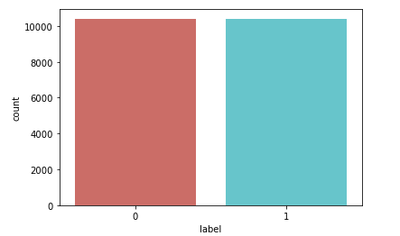
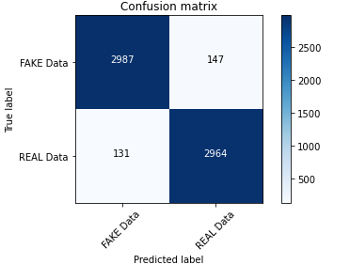
Result

Slide 8
Conclusion
In conclusion, fake news detection using Python is a complex yet achievable task with the right approach and tools. By leveraging various techniques and libraries, we can develop effective solutions to identify fake news articles.
Through preprocessing steps such as tokenization, stop words removal, and lemmatization or stemming, we prepare the text data for analysis, making it more suitable for feature extraction. Feature extraction techniques like TF-IDF and optionally word embedding's such as Word2Vec or Glove allow us to convert text data into numerical representations that capture important information about the content of news articles.
Moreover, deploying machine learning models trained on these features enables us to classify news articles as real or fake. Models like Logistic Regression, Naive Bayes, or Support Vector Machines can be trained on labeled datasets to learn patterns indicative of fake news. Additionally, advanced techniques like deep learning-based models or ensemble methods can further enhance the detection accuracy.

Slide 9
Future scope
The future scope for fake news detection using Python is promising, with several areas showing potential for further advancements and improvements:
Advanced Natural Language Processing (NLP) Techniques
Multimodal Analysis Social Network Analysis
:ross-lingual and Multilingual Approaches:
The future of fake news detection using Python lies in leveraging advanced technologies, interdisciplinary approaches, and ethical considerations to build more effective, transparent, and scalable solutions for combating misinformation in the digital age.

Slide 10
References
For references on fake news detection using Python, you can explore academic papers, online courses, tutorials, and books. Here are some recommended resources:
Academic Papers:
Look for research papers published in peer-reviewed journals and conferences in the fields of natural language processing, machine learning, and information retrieval. Google Scholar and academic databases like IEEE Xplore and PubMed are good places to search for relevant papers.
Online Courses:
Platforms like Coursera, Udemy, and edX offer courses on natural language processing, machine learning, and data science, some of which cover fake news detection as part of their curriculum. Look for courses taught by reputable instructors or institutions.
Books:
Books on natural language processing, machine learning, and data science may include chapters or sections on text classification and sentiment analysis, which are relevant to fake news detection

Slide 11
THANK YOU

