Slide 1
TABLEAU PROJECT DOCUMENTATION
Presented by
S.Gowthami

Slide 2

Sales Dashboard Overview

Slide 3
Abstract
The purpose of this project is to design an interactive Sales Dashboard in Tableau that helps stakeholders monitor key business metrics such as total sales, profit, quantity sold, customer trends, and regional performance. The dashboard aims to simplify decision-making by providing clear visual insights, enabling managers to identify top-performing products, profitable regions, and areas needing improvement.

Slide 4
Data Sources & Description
Data Sources
Primary Dataset : Sales dataset (CSV/Excel/Tableau Extract).
Provided By : Company business analytics team / Kaggle sample dataset / self-created.
Data Period : (Specify: e.g., 2020–2023)
Data Size : Number of rows and columns.
Data Fields Description
Typical fields included in the dataset:
Order Details: Order ID, Order Date, Ship Date, Ship Mode
Customer Information: Customer Name, Segment, Country, Region, State, City
Product Information: Category, Sub-category, Product Name
Sales Metrics: Sales, Quantity, Discount, Profit

Slide 5
Data Cleaning & Preparation
Removed null or missing values in key metrics.
Standardized date formats (converted Order Date to yyyy-mm-dd).
Created calculated fields such as:
Profit Ratio = Profit / Sales
Sales Bucket = Category-wise or region-wise grouping
Joined or blended data if multiple sources were used.

Slide 6
Methodology & Analysis
Approach
Understand business objectives – identify KPIs required by management.
Data cleaning & transformation using Tableau Prep or Tableau Desktop.
Exploratory Data Analysis (EDA) to identify patterns.
Build worksheets (charts) covering different aspects of sales.
Combine the sheets into an interactive dashboard.
Key Analyses Performed
Sales Trend Analysis: Monthly/Yearly trend of Sales and Profit.
Category & Sub-category Performance: Identifying best and worst performing product ranges.
Regional Analysis: Sales by Region, State, and City.
Customer Analysis: Segment-wise performance (Consumer, Corporate, Home Office).
Profitability Analysis: High-profit vs. high-sales products.
Discount Impact Analysis: Effect of discount on profit margins.
Top N Analysis: Top 10 customers, products, or cities by Sales/Profit.

Slide 7
Visualizations Used
Line charts for time series
Bar charts for category, sub-category performance
Maps for regional performance
Pie/Donut charts for segment distribution
Scatter plots for Sales vs Profit relationships
KPI cards for summary numbers (Total Sales, Total Profit, Avg Discount)

Slide 8
Results
Key Findings
(Examples – update based on your actual dashboard output)
1) Sales showed a consistent upward trend, especially during Q4 each year.
2) Technology Category contributed the highest sales, while Furniture had lower profitability.
3) The Western region performed the best, whereas the South region showed low profit margins.
4) High discounts correlated with lower profit, especially in Furniture.
5) Top customers contributed a significant portion of revenue, indicating a power-law distribution.

Slide 9
Insights from Dashboard
1) Stakeholders can identify problem regions quickly.
2) Category managers can track product performance and adjust pricing.
3) Discounts strategy can be optimized to avoid profit loss.
4) Resource allocation can be improved based on region-wise demand.

Slide 10
Recommendations
Business Recommendations
Reduce discounts on low-profit product categories.
Improve marketing in underperforming regions to boost sales.
Focus on high-profit sub-categories such as technology accessories.
Enhance supply chain efficiency for high-demand locations.
Customer retention strategies for top customers to increase lifetime value.
Future Enhancements
Introduce forecasting using Tableau (Sales Forecast, Profit Forecast).
Add dashboard alerts for sudden drops in sales or profit.
Integrate real-time live data connection for dynamic updates.
Build separate dashboards for Retail, Wholesale, and Corporate segments.

Slide 11
Conclusion
This Tableau Sales Dashboard provides a complete visual overview of business performance. It helps stakeholders analyze trends, identify growth opportunities, and make data-driven decisions. With further enhancements, the dashboard can evolve into a powerful analytics tool for strategic planning.

Slide 12
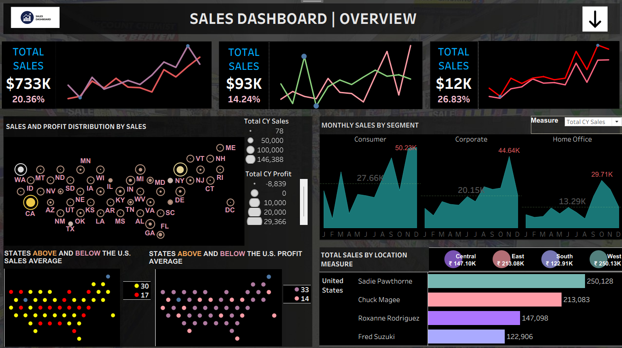

Slide 13
Thank You

