Slide 1


BUSINESS INTELLIGENCE REPORT FOR FRANCIS BROWN
By,
W9529787 Manoj Kumar Gugulothu
W9529921 Rohith Vaddepally
B1326237 Gowthami Nagappan
W9532837 Tomcy Thomas
W9497107 Deepika Guvala

Slide 2

INTRODUCTION Francis Brown

Slide 3
DATASET
Progress data – Customer, Trade, Efficiency, Work order Number, Hrs Booked and planned for a work and Forecast Remaining
Work Order – Work Order Number, Status, Quantity, Work received, started, finished, Material and Labour Cost
Sales Order – Customer ID, Name, Sales order number, date, line number, line quantity, line required, line status
Material Based Stock Issue – Issue date, Issue No, type, quantity, unit cost, subcontract and more

Slide 4

DATA PREPROCESSING
Necessary pre processing of removed unused columns
replaced values
Renamed columns
changed data type and etc.

Slide 5
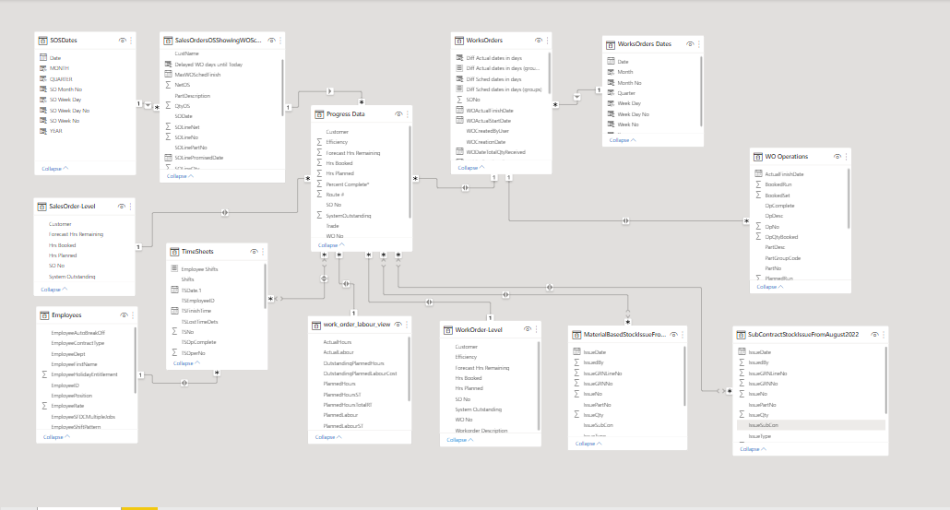
DATA RELATIONSHIP – SNOW FLAKE SCHEMA

Slide 6
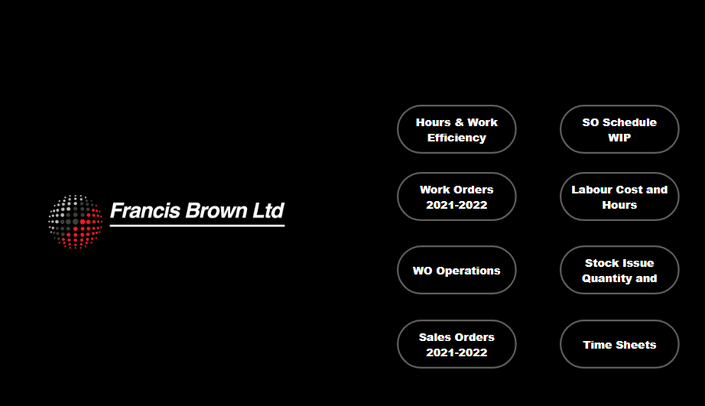
BUSINESS INTELLIGENCE REPORT
HOMEPAGE :

Slide 7
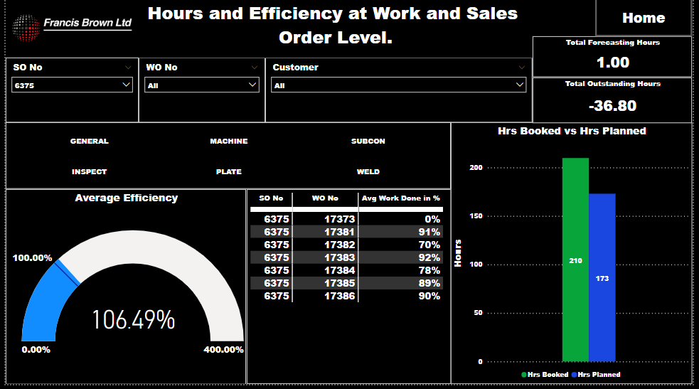
DASHBOARD 1
Hours & Work Efficiency

Slide 8
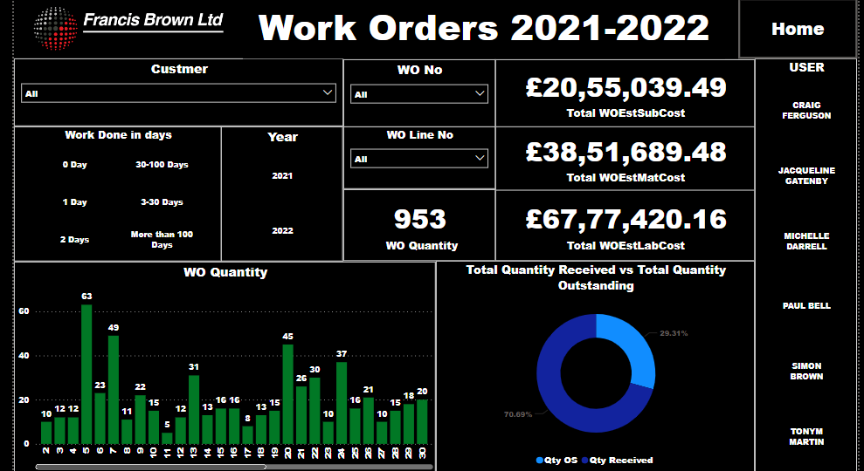
DASHBOARD 2
Work Orders 2021-2022

Slide 9
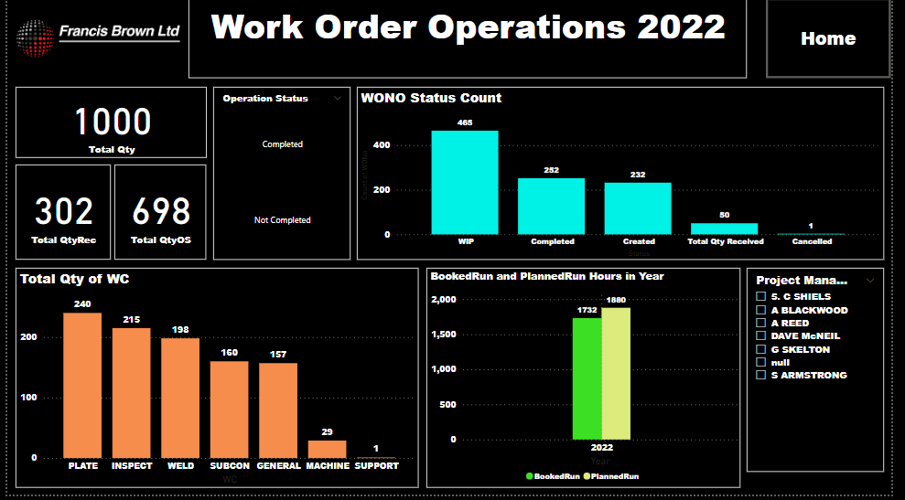
DASHBOARD 3
WO Operations

Slide 10
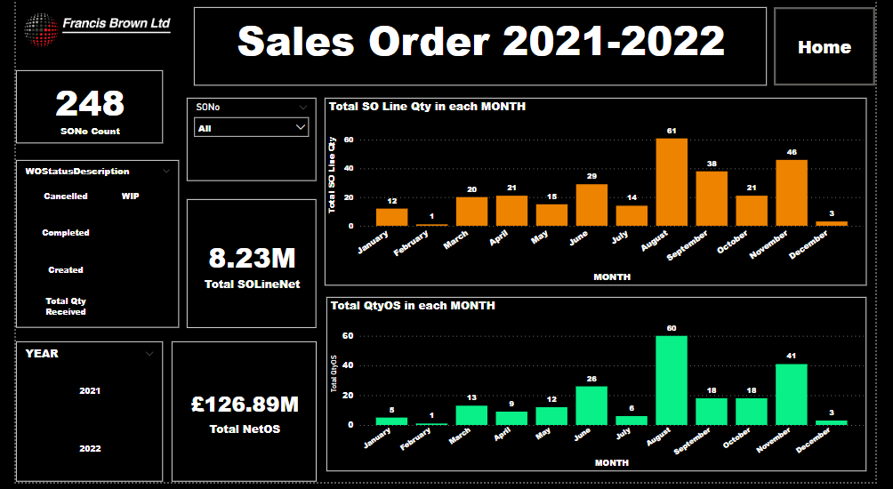
DASHBOARD 4
Sales Order 2021-2022

Slide 11
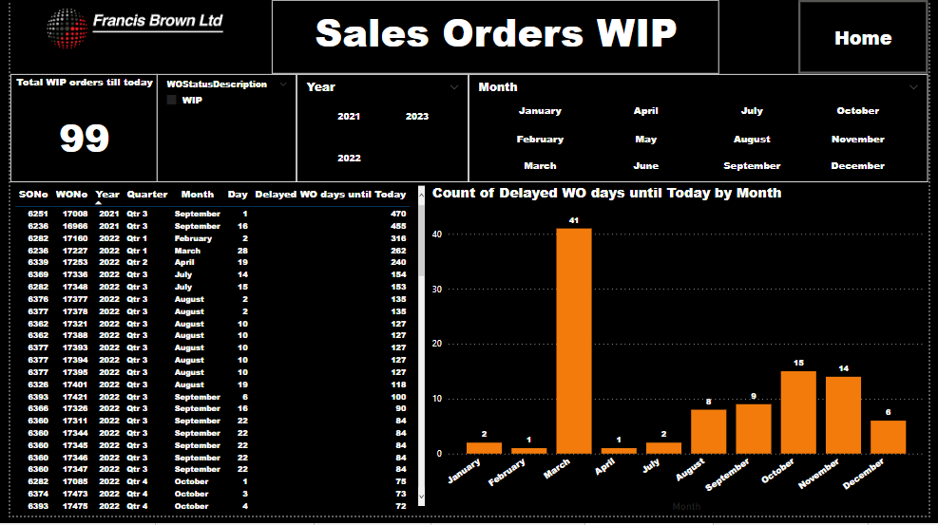
DASHBOARD 5
SO Schedule WIP

Slide 12
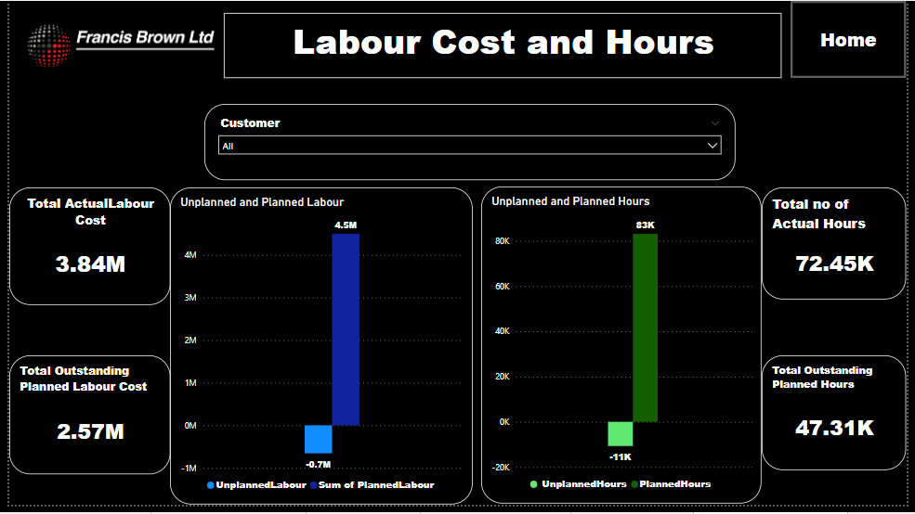
DASHBOARD 6
Labour Cost and Hours

Slide 13
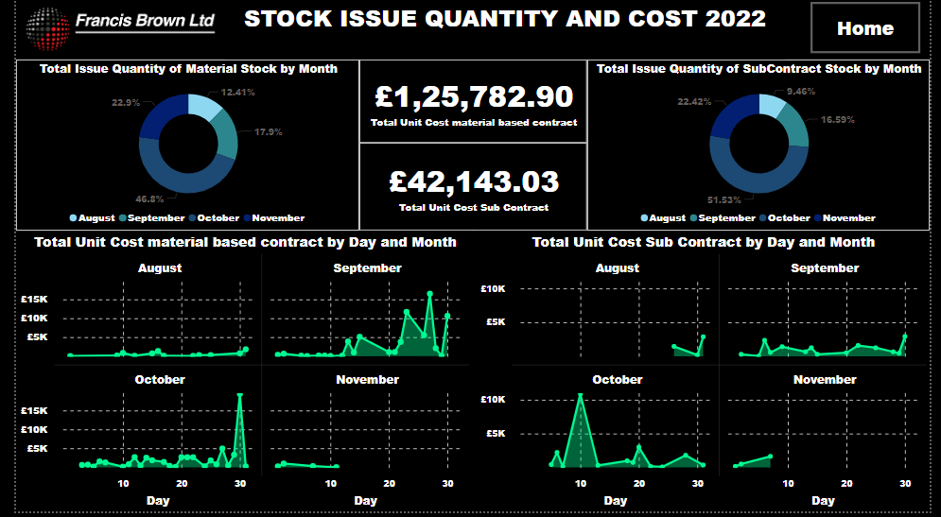
DASHBOARD 7
Stock Issue Quantity and Cost

Slide 14
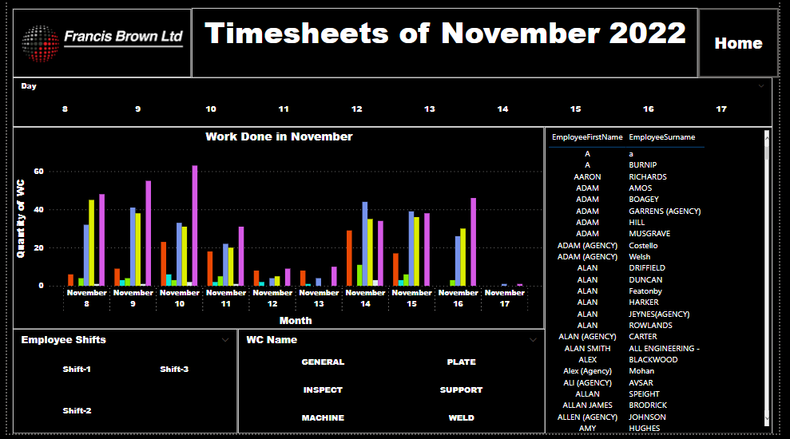
DASHBOARD 8
Time Sheets

Slide 15
REFERENCES
https://www.francisbrown.co.uk/
https://github.com/microsoft/powerbi-visuals-gantt
https://www.researchgate.net/publication/362821671_Data_Visualization_for_Industry_40_Developing_Dashboards_with_Power_BI_-_A_Case_Study_in_a_Pharmaceutical_Company
https://ieomsociety.org/proceedings/2022istanbul/651.pdf

Slide 16


