Slide 1


FORECASTING TELECOM INDUSTRY CUSTOMER ATTRITION USING MACHINE LEARNING TECHNIQUES
Presented by,
GOWTHAMI NAGAPPAN
B1326237@live.tees.ac.uk
Teesside University, UK
Notes:
Good morning and welcome to my presentation on 'Forecasting Telecom Industry Customer Attrition Using Machine Learning Techniques'.
In this presentation, I will be discussing my research on customer attrition in the telecom industry and how machine learning techniques can be used to forecast and provide retention strategies to avoid customer churn.

Slide 2

INTRODUCTION
Customer Attrition is a Challenge in Telecom.
Generic Strategies have not worked
Machine learning is a game changer
Telecom firms need more knowledge in this area
Bridging this gap is crucial for success.

Slide 3

PROBLEM STATEMENT
Attrition reduces profitability and customer base.
Generic loyalty programs don’t work – ML is needed.
ML offers customized plans to retain customers.
This project deploys ML models to estimate and control attrition
Focus is on addressing customer attrition in telecom with ML.

Slide 4
ML identifies key factors behind customer attrition.
Telecom companies can take targeted actions to retain customers using ML insights.
AIM
Customer attrition is important in Telecom industry and can be addressed using ML Algorithms
Best practices in data preparation, modelling and validation are critical for accurate results in customer attrition
Successful real-world applications of ML for customer attrition in telecom business can lead to recommendations for retention strategies and improved profitability.
OBJECTIVES

Slide 5
RESEARCH METHODOLOGY
Feature Transformation
CatBoosting Classifier Gradient Boosting XGBClassifier
AdaBoost Classifier Logistic Regression Random Forest
Decision Tree
K-Neighbors Classifier
Data Cleaning
Feature Encoding & Scaling
SHAP
IBM Telecom Customer Churn Dataset
Data Analysis
Balanced dataset with SMOTE Tomek
Hyperparameter Tuning
FastAPI
Train & Test Split
Result – Best Model
XGB Classifier

Slide 6
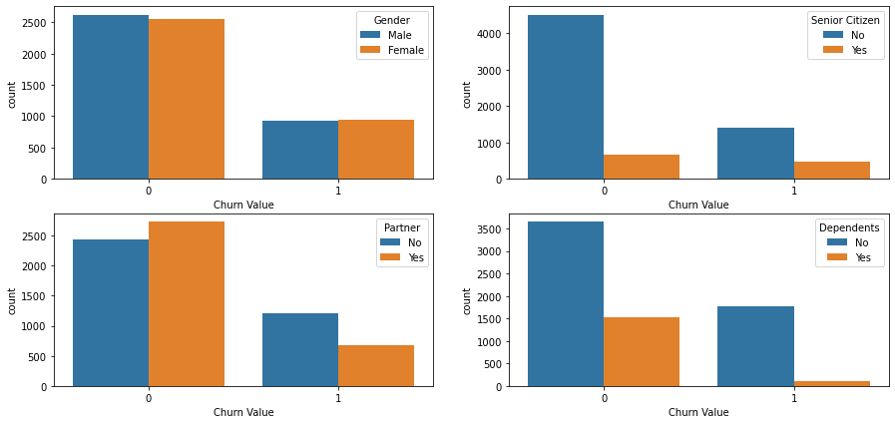
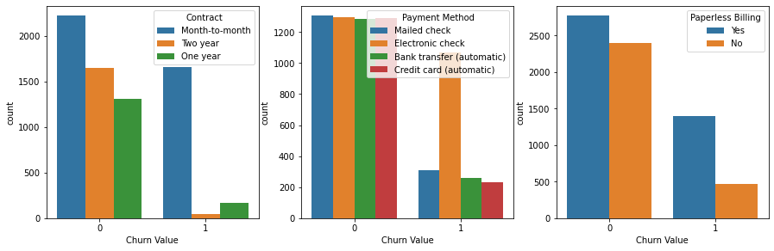
DATA ANALYSIS : KEY FINDINGS

Slide 7
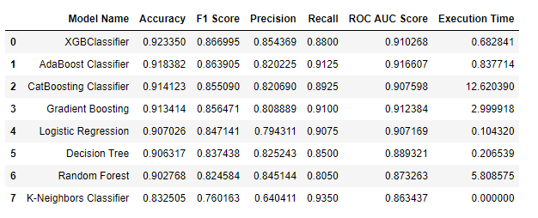
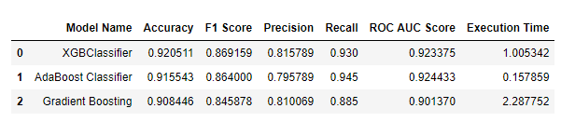
ML PERFORMANCE REPORT
MODELS WITH HYPER PARAMETER TUNING

Slide 8
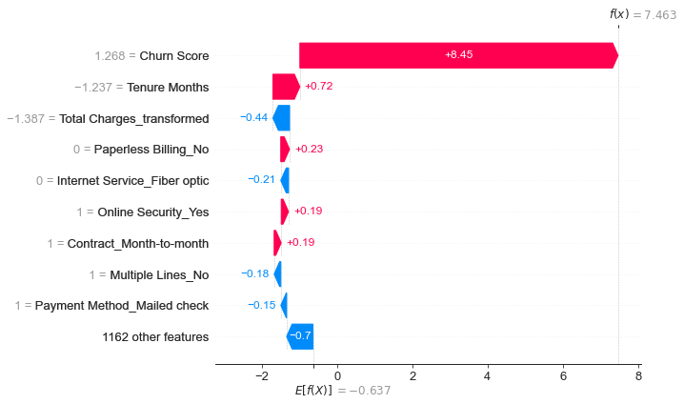
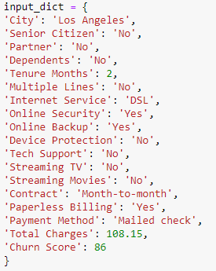
RESULTS
RETENTION RECOMMENDATION

Slide 9
Privacy Concerns
Ethical & legal standards
ETHICAL CONCERNS
Responsible & ethical use
Policies & Guidelines
Bias & Discrimination

Slide 10
CONCLUSION
XGBoost Classifier achieved 92% accuracy, outperforming other models
Churn score and tenure months were identified as key factors influencing customer attrition
XGBoost can be used for customized marketing and retention efforts
The SHAP waterfall model displays factors inducing customer attrition
The web app is flexible for targeting customers with different demographics and service patterns
The model's reliance on user-supplied data could be a weakness.
Changes in customer preferences and competitor offers over time may also have an impact on the model's accuracy.
LIMITATIONS

Slide 11
KEY ACHIEVEMENTS & KNOWLEDGE GAINED
Importance of Exploratory data analysis for ML
Preparation Knowledge for various algorithms for categorization
Hyperparameter tuning for improved performance
Understanding SHAP for model prediction and Feature significance
Experience in developing web application for ML model deployment

Slide 12
FUTURE WORK
Real time dataset addition for improved application.
Advanced ML techniques for imbalanced dataset handling.
Investigating different algorithms for better accuracy
Deploying model for scalability and dependability in real time.
Conducting user research feedback on usefulness.

Slide 13

THANK YOU

