Slide 1


Safe Transferable Regions
Gowtham Kaki
G Ramalingam
Purdue University
Microsoft Research

Slide 2
In this talk …
How do you enforce the safety of off-the-heap memory allocation in a distributed data computation without losing its performance benefits?

Slide 3




The background …
The landscape of “big data” computation
DryadLINQ
Naiad
JVM
.NET CLR
Written in managed high-level languages

Slide 4
A distributed data computation is usually highly structured
Represented implicitly or explicitly as a graph of stateful dataflow operators executed by worker processes (nodes).
Map and Reduce nodes in MapReduce,
SelectVertex or JoinVertex in Naiad
Computation proceeds in stages.
Dataflow Operators
Operators are not tightly coupled; they are event-based.
onArrival(data) do {something;}
A distributed data processing system is a network of independent communicating actors

Slide 5
A distributed data processing system is a network of independent communicating actors

Slide 6


A distributed data processing system is a network of independent communicating actors
Network
Inter-process Communication (IPC)
Each actor is a process
Communicates with other actors through IPC and network.
Runs its own language runtime (e.g., JVM or .NET CLR) that makes independent decisions, including when to perform Garbage Collection (GC).

Slide 7
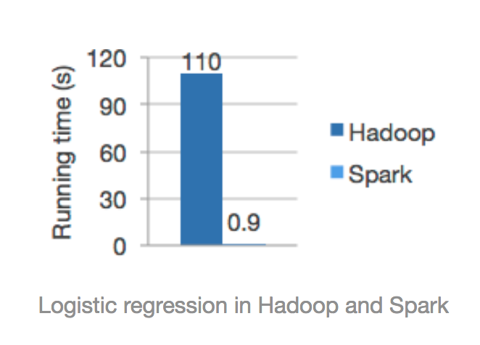
Garbage Collection significantly impacts the running time of a distributed data computation.
Dataflow operators store a lot of data in memory to facilitate fast access.
Upside: Performance, esp. in iterative algorithms that repeatedly access the same data.
Case in the point: Apache Spark: 10-100X faster than Hadoop for iterative computations.

Slide 8
Garbage Collection significantly impacts the running time of a distributed data computation.
Dataflow operators store a lot of data in memory to facilitate fast access.
Downside: Huge heap size => Large GC pauses.
Previous work measures the impact of GC pauses on overall latency of a dataflow computation.
[Gog et. al., HotOS’15]: 20 – 40% for a single actor.
[Maas et. al., HotOS’15]: Additional 15% due to cascading GC pauses involving multiple (8) actors.
This is bad!
Off-heap memory has been proposed as a solution.

Slide 9
Off-heap memory
Memory
Unmanaged memory (i.e., unreachable to GC) to store the “big data”.
Upside: Reduction in GC pauses.
Downside: Lack of any guarantees on off-heap memory.
GC Heap for program data
Program
Off-heap memory for big data
Programmer is responsible for proper allocation/ deallocation discipline.
Violation of memory safety: Dangling pointers and leaks.
Mitigation: Dynamic checking. But…
Checked mode of Scala off-heap that checks every memory access for safety. 1.6-2x slowdown ☹️
Can we do better?

Slide 10
We need …
Broom
A principled approach to off-heap memory that provides strong safety guarantees with low overhead.

Slide 11
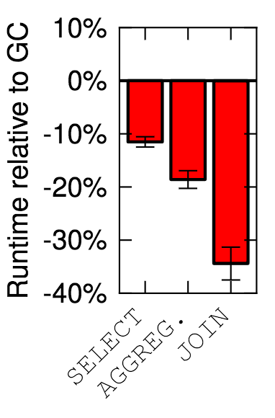
Broom
An extension of C# with off-heap memory. Includes:
Syntactic extensions and APIs to create, manage and destroy off-heap memory.
A type system that enforces the safety of most memory accesses statically.
A lightweight instrumentation to check the safety of remaining accesses at runtime.
Safety enforcement split between static and dynamic components!
Performance of Broom’s off-heap is studied in [Gog et. al., HotOS’15].
Upshot: 10-35% reduction in run-time of Off-heap Naiad vertices compared to GC.
This talk: Safety of Broom’s off-heap.

Slide 12
Broom Regions
Observation: objects storing the (intermediate) results of a dataflow computation (i.e., “big data” objects) have common lifetimes; their memory can be allocated and deallocated together.
Suitable for Region based Memory Management
We found two kinds of regions to be useful in Broom:
First-class dynamic “transferable” regions to store and transfer intermediary results between actors, &
Lexically scoped static regions for actor-local “scratch” memory.
A memory management discipline where memory is allocated and deallocated in terms of large regions.

Slide 13
Transferable Regions in Broom
First class objects
Objects of class Region; Created using new; passed through functions; stored in data structures.
Actor A
r = new Region(new Tree(..))
r.getRoot();
Containers for the constituent objects.
All objects are reachable from a distinguished root object.
Open r {
…
}
r.transfer(B);
Can be “opened” for allocation.
All new objects created under open lexical scope are allocated in the region.
Actor B
Can be transferred to another actor, or freed.
Region’s lifetime (at an actor) ends with transfer() or free().
void onReceive(Region r) {
…
}

Slide 14
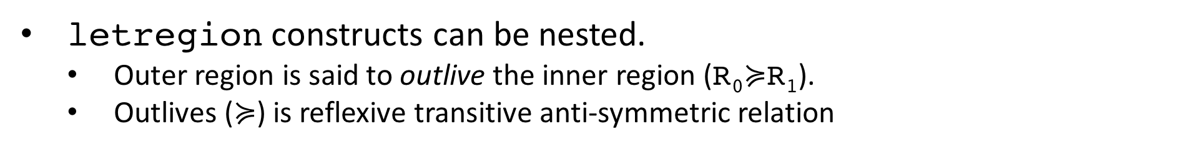
Static Regions in Broom
Created via the letregion syntactic construct.
Actor A
letregion R₀ {
}
R₀
Defines an allocation context.
Any new object under letregion is allocated in that region.
t₁ = new Tree();
t₁.left = …;
t₁.right = …;
letregion R₁ {
t₂ = new Tree();
t₂.left = t₁;
}
Not first class.
cannot be passed around or stored in data structures.
R₁
Lexically delimited lifetimes.
determined by the scope of letregion.
letregion constructs can be nested.
Outer region is said to outlive the inner region (R₀$≽$R₁).
Outlives ($≽$) is reflexive transitive anti-symmetric relation

Slide 15
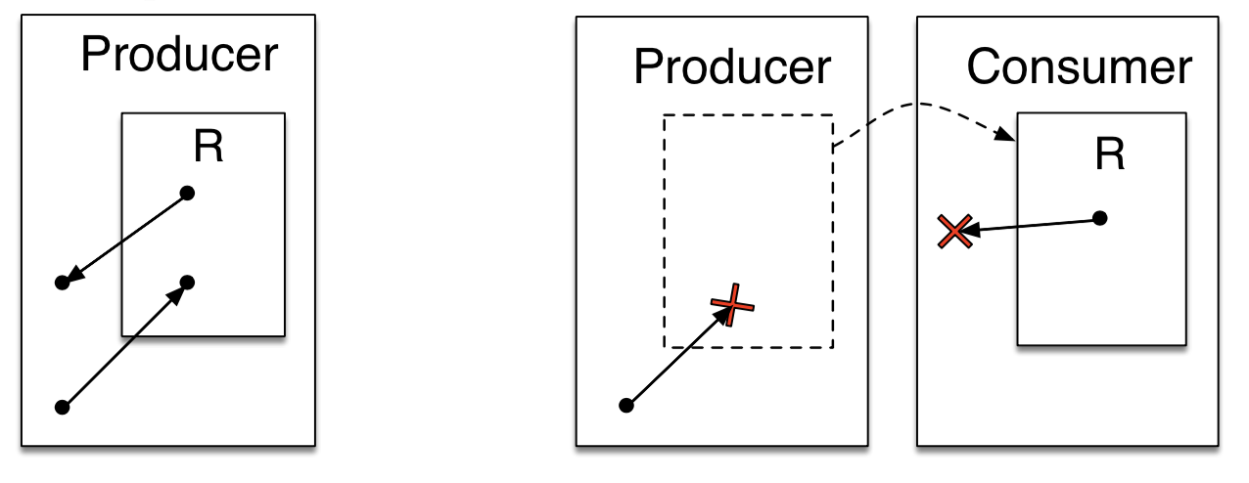
Safety
Broom’s programmer-managed regions may violate safety.
With transferable regions:
References in and out of a transferable region become invalid after the transfer.
(a). Before transfer
(b). After transfer
With static regions:
Outer region
Outer region
References from outer static regions to an inner region become invalid after the lifetime of inner region ends.
Inner region
✕
(a). When both regions are live
(a). When inner region is deallocated

Slide 16
Safety
Crux of the safety problem is to enforce the following invariant:
“If object A refers to object B, then B must exist as long as A exists.”
Broom solves the safety problem through a region type system that enforces* the following invariant:
“If object A refers to object B, then B’s memory region outlives A’s.”
*modulo certain well-defined exceptions

Slide 17

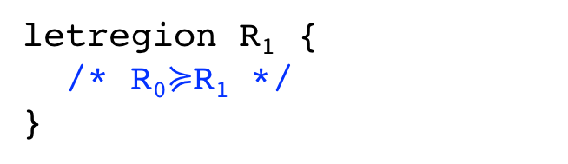

Broom’s Region Type System
1. Allows outlives constraints to be declared
2. Tracks outlives relationships between regions.
Region variable denoting the region where the Pair object is allocated
Region Variables denoting regions where the first and second components are allocated.
letregion R₀ {
}
letregion R₁ {
/* R₀$≽$R₁ */
}
@⍴₀
Class Pair<T₀,T₁>
{
T₀ fst;
T₀ snd;
}
< ⍴₀, ⍴₁, ⍴₂| ⍴₁ $≽$⍴₀ ∧ ⍴₂$≽$⍴₀>
< ⍴₀, ⍴₁, ⍴₂>
3. Propagates outlives constraints, & checks them under various contexts
Captures constraints over region variables as a part of type signature.
@⍴₁
@⍴₂
letregion R₀ {
}
letregion R₁ {
}
Requires that fst and snd objects must live at least as long as the Pair object containing them, otherwise the references become dangling.
new Pair<..><R₀,R₁,R₁> ✗
new Pair<..><R₁,R₀,R₀> ✓
⍴₁ $≽$⍴₀ ∧ ⍴₂$≽$⍴₀

Slide 18
Safety
Broom’s programmer-managed regions may violate safety.
With transferable regions:
References in and out of a transferable region become invalid after the transfer.
(a). Before transfer
(b). After transfer
With static regions:
Outer region
Outer region
References from outer static regions to an inner region become invalid after the lifetime of inner region ends.
Inner region
Prevented by the region type system
✕
(a). When both regions are live
(a). When inner region is deallocated

Slide 19
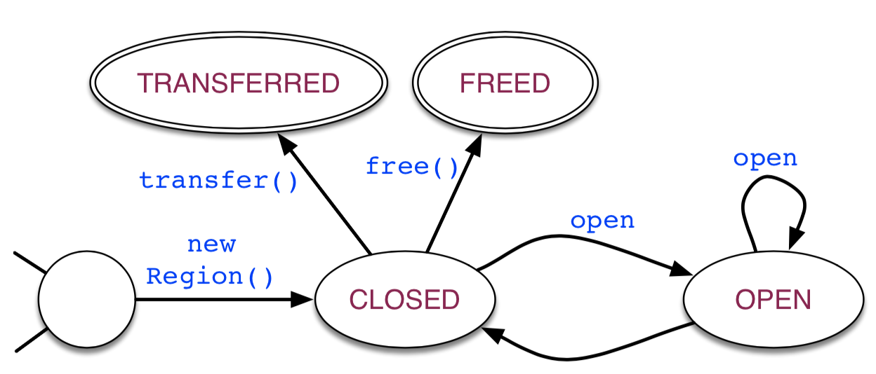
Safety – Transferable Regions
Insight: by imposing a certain typestate hygiene on the usage of transferable regions, we can reuse the region type machinery to enforce overall safety.
An FSM demonstrating typestate hygiene of a transferable region
A transferable region cannot be transferred or freed while it is open.

Slide 20
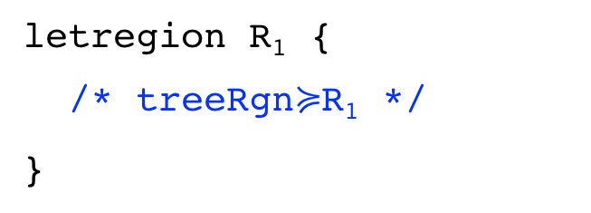
In three steps …
Safety – Transferable Regions
Insight: by imposing a certain typestate hygiene on the usage of transferable regions, we can reuse the region type machinery to enforce overall safety.
1. Preempting unsafe references via syntactic constraints that allow a transferable region’s contents to be accessed only when it is open.
open treeRgn as tree {
…
}
tree = treeRgn.getRoot();
✗
✓
(prohibited)
(allowed)
2. Extending outlives relation to admit safe references into transferable regions.
open treeRgn as tree {
}
Typestate hygiene guarantees that treeRgn will not be freed/transferred as long as it is open.
treeRgn’s open lexical block is larger than R₁’s letregion.
Hence, treeRgn will outlive R₁.
letregion R₁ {
/* treeRgn$≽$R₁ */
}

Slide 21
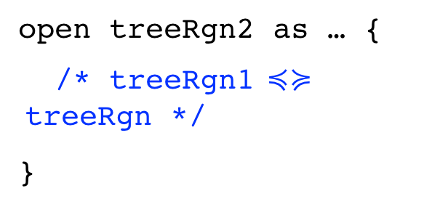
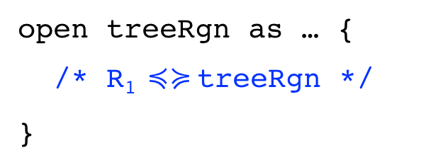
In three steps …
Safety – Transferable Regions
Insight: by imposing a certain typestate hygiene on the usage of transferable regions, we can reuse the region type machinery to enforce overall safety.
1. Preempting unsafe references via syntactic constraints that allow a transferable region’s contents to be accessed only when it is open.
open treeRgn as tree {
…
}
tree = treeRgn.getRoot();
✗
✓
(prohibited)
(allowed)
2. Extending outlives relation to admit safe references into transferable regions.
3. Constraining outlives relation to prevent unsafe references out of transferable regions.
letregion R₁ {
}
open treeRgn1 as …{
}
open treeRgn as tree {
}
open treeRgn2 as … {
/* treeRgn1 $≼≽$treeRgn */
}
letregion R₁ {
/* treeRgn$≽$R₁ */
}
open treeRgn as … {
/* R₁ $≼≽$treeRgn */
}
/
/
/
/

Slide 22
Typestate Hygiene
Enforced dynamically.
Involves checking whether a transferable region is an appropriate state before performing transfer, free or open.
E.g:
An FSM demonstrating typestate hygiene of a transferable region
if (r.state == CLOSED) {
r.transfer(…);
} else raise InvalidRegionOperation
Checks automatically around at region operations.
Typestate checking + type checking ⇒ No need to check each and every memory access for safety.
Region operations are rare relative to memory accesses, so typestate checking is low overhead.

Slide 23
Safety
Broom’s programmer-managed regions may violate safety.
With transferable regions:
References in and out of a transferable region become invalid after the transfer.
Prevented by the region type system
(a). Before transfer
(b). After transfer
With static regions:
Outer region
Outer region
References from outer static regions to an inner region become invalid after the lifetime of inner region ends.
Inner region
Prevented by the region type system
✕
(a). When both regions are live
(a). When inner region is deallocated

Slide 24
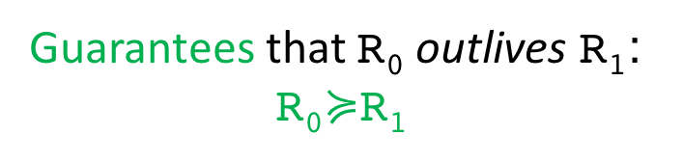
Let us assume, for time being, that we have regions with statically scoped lifetimes.
Guarantees that R₀ outlives R₁: R₀$≽$R₁
Type system can enforce memory safety constraints imposed by static regions.

Slide 26
Safety
Manually managing lifetimes of memory regions is good for performance, but bad for safety.
First-class and dynamic nature of transferable regions makes it hard to enforce safety.
Aliasing is the main culprit.
Linear and ownership types control aliasing, but severely restrict programmers.
Familiar idioms, e.g., iterators, cannot be used.
Other extreme is dynamic enforcement.
Imposes unacceptable overhead.
Our approach to safety: a hybrid of static type checking and dynamic enforcement.

Slide 27
Thank you!

Slide 28
Observe:
Incoming messages (inList objects) are ”transferred” from an upstream actor.
All inList objects can be deallocated at the end of onReceive.
All output messages of timestamp t (map[t] objects) remain live until onNotify(t) event occurs.
All map[t] objects are transferred to a downstream actor en masse at the end of onNotify(t), after which they can be deallocated.

Slide 29
We observe that 2 kinds of regions are useful:
Lexically scoped static regions for actor-local “scratch” memory, &
First-class dynamic “transferable” regions to store and transfer intermediary results between actors.
Actor A
Region {
…..
}
Actor A
Actor B
r = new Region();
…
r.transfer(B);
onRcv(Region r) {
…..
}

Slide 30
Garbage Collection significantly impacts the running time of a distributed data computation.
Dataflow operators store a lot of data in memory to facilitate fast access.
Downside: Huge heap size => Large GC pauses (“GC Storms”).
Moreover, GC pauses may cascade, letting latencies snowball!
Time =t₁
t₂
t₃
t₄
t₅
A
B
= Computing
= Waiting for an actor to respond
= Performing GC

Slide 31
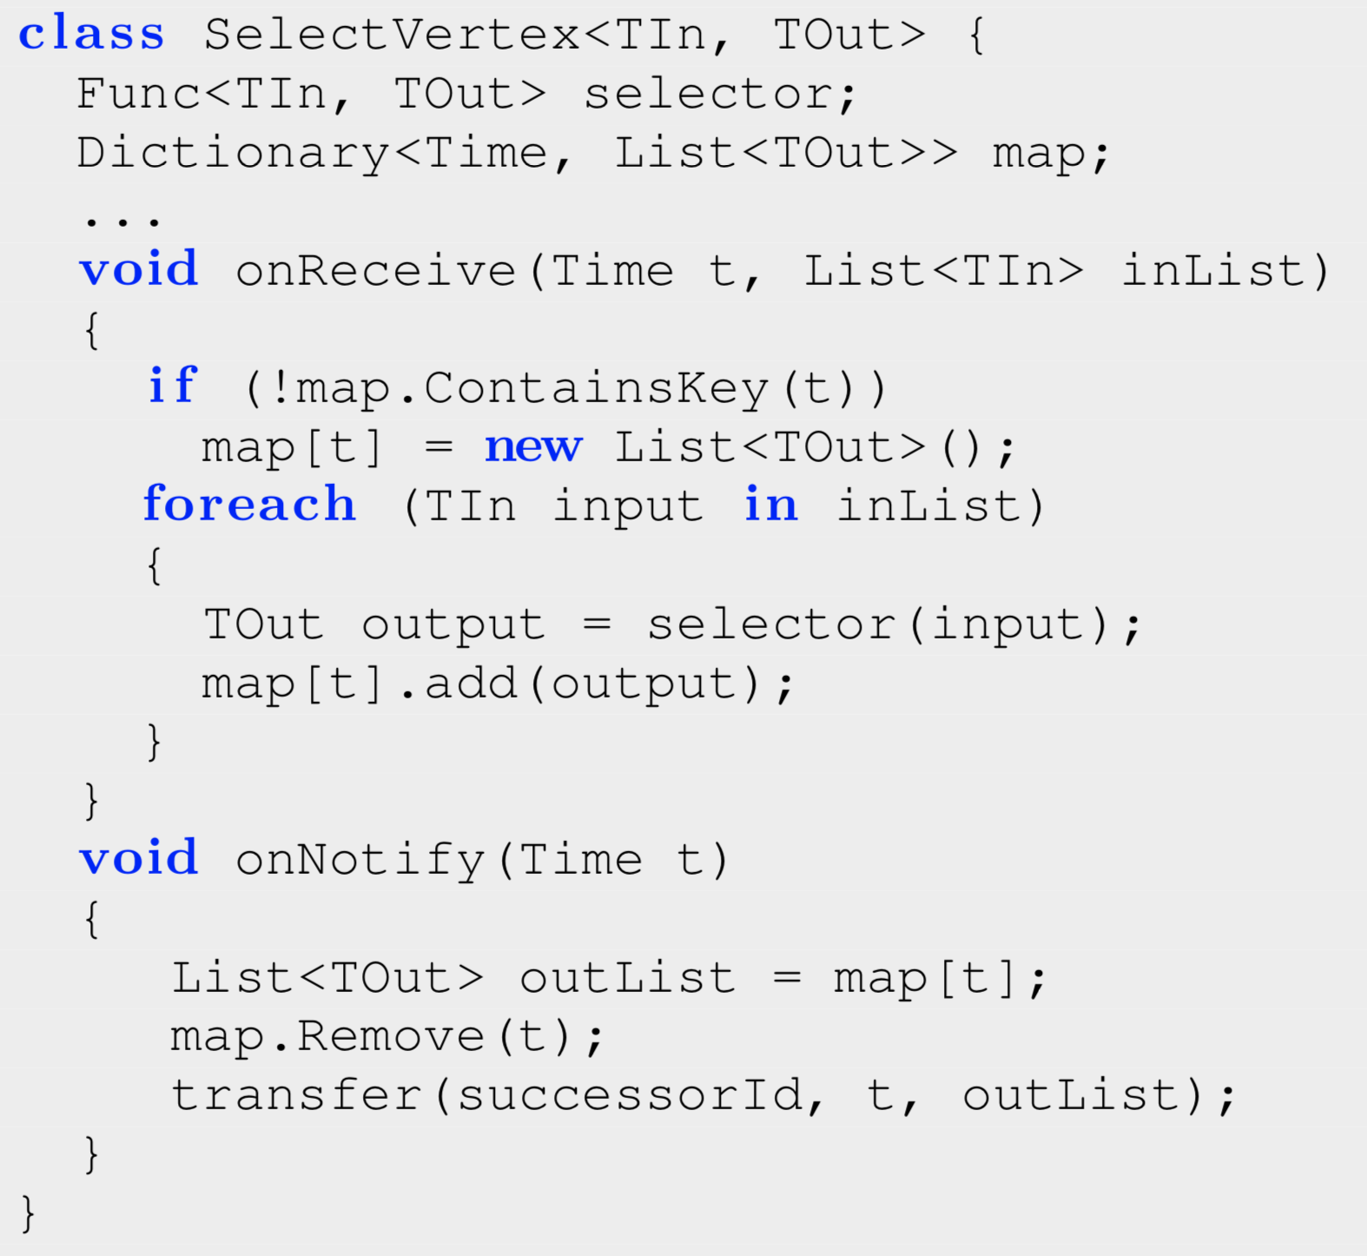

Example – Naiad’s SelectVertex
Selects/projects required fields from incoming messages; sends them downstream.
t₁
X=1; Y=2
t₂
X=2; Y=5
Message Structure
t₁
X=3; Y=7
t₂
X=4; Y=9
t
X=1; Y=2
DONE(t₁)
Logical Timestamp
Content
$$π_{Y}$$
t₁
Y=2
Y=7

Slide 32
Example – Naiad’s SelectVertex
Function that projects the required fields of an incoming message (of type TIn) onto a new output message (of type TOut)
Dictionary of output messages (TOut) indexed by their timestamp.
Intermediate results of a big data computation.
Potentially very large.

Slide 33
Example – Naiad’s SelectVertex
On receiving a list of messages bearing timestamp t …
Create an entry for t in the dictionary, if it doesn’t already exist.
For each message received …
Project required fields of the message to a new output message.
Store output message against t in the dictionary, together with rest of the messages bearing timestamp t.

Slide 34
Example – Naiad’s SelectVertex
On being notified that no more messages with timestamp t will arrive …
Read and remove all output messages indexed by t in the dictionary.
Send the output messages to the downstream actor.

Slide 35

Example – Naiad’s SelectVertex
Observe:
Incoming messages (objects of inList) are all transferred from an upstream actor.
inList objects can all be deallocated at the end of onReceive.
Output messages of timestamp t (map[t] objects) should all remain live until onNotify(t) event.
All map[t] objects are transferred en masse to a downstream actor at the end of onNotify(t), after which they can be deallocated.
Fate-sharing objects with well-defined lifetimes.
$⇐$ Memory Regions
+ transfer semantics
= Transferable Memory Regions in Broom

Slide 36
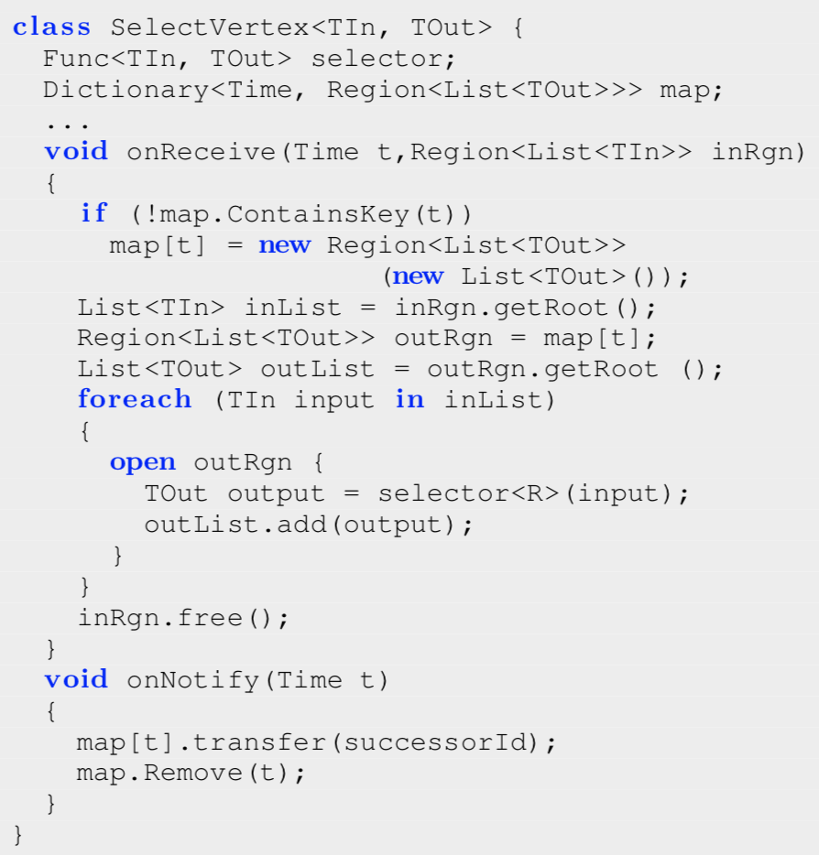
Naiad’s SelectVertex in Broom
map[t] is a memory region containing a list of output messages bearing (logical) timestamp t.
Objects that are transferred together live together in a transferable region.

Slide 37
Naiad’s SelectVertex in Broom
On receiving a region containing a list of messages bearing timestamp t …
Allocate a region for output messages of timestamp t, if it doesn’t already exist.
Read the list of incoming messages from the input region.
Access the output region that contains existing output messages for time t.
Create new output messages and add to the output region.
Deallocate the input Region.

Slide 38
Naiad’s SelectVertex in Broom
When there aren’t going to be any more messages with timestamp t, transfer the corresponding output region.
The region is no longer needed, hence deallocated.

