Slide 1


Inferring Consistency Specifications from Tests
Gowtham Kaki
Suresh Jagannathan
KC Sivaramakrishnan

Slide 2
Why infer specifications?
It is possible to enforce subtle notions of correctness via Quelea’s specification language.
Ok to show incorrect balance, but not ok to show negative balance.
But, Crafting a Quelea specification requires
Intricate knowledge about abstract system model of Quelea, &
Exhaustive reasoning about application semantics under this system model to determine possible anomalies.
We want to reduce the programmer effort required to use Quelea.

Slide 3
Full inference is impossible
Specification inference cannot be fully automated. It is impossible to eliminate programmer involvement.
Only programmer can tell a correct application behavior from an incorrect one.
E.g: incorrect balance is correct behaviour, but negative balance is not.
Is there a less painful way in which programmers can declare correct application behavior?

Slide 4
Full inference is impossible
Specification inference cannot be fully automated. It is impossible to eliminate programmer involvement.
Only programmer can tell a correct application behavior from an incorrect one.
E.g: incorrect balance is correct behaviour, but negative balance is not.
Is there a less painful way in which programmers can declare correct application behavior?
Yes, using unit tests.

Slide 5
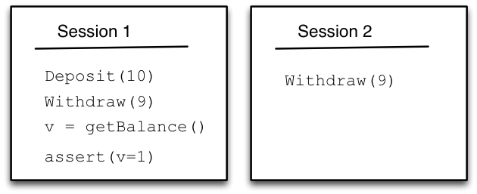
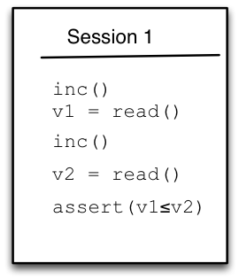
Unit Tests
Unit tests are ubiquitous; programmers write them all the time to verify basic sanity of the application.
Observation: Simple tests are very effective in uncovering anomalies.
Monotonically Increasing Counter
BankAccount RDT

Slide 6
Unit Tests
Unit tests are ubiquitous; programmers write them all the time to verify basic sanity of the application.
Observation: Simple tests are very effective in uncovering anomalies.
However…
Programmers do not write test cases with the intention of exposing anomalies.
Programmers write tests to check whatever they think is the crucial semantics of the application that cannot be compromised at any cost.
The task is to infer a consistency specification to preserve that semantics.

Slide 7
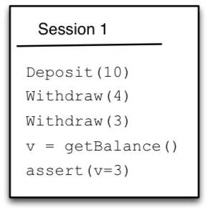
An Example
“If I do a deposit and a couple of withdraws from an ATM terminal, then my balance better reflect the effects of these operations”
Intended specification:

Slide 8
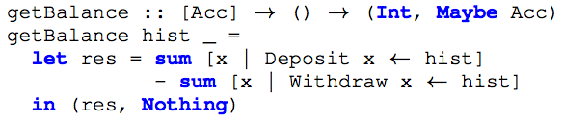
An Example

Slide 9
An Example
A finite program
Can be fully unrolled.
Unrolled definition can be encoded as a formula in an SMT.
Different satisfying assignments are different axiomatic executions.

Slide 10
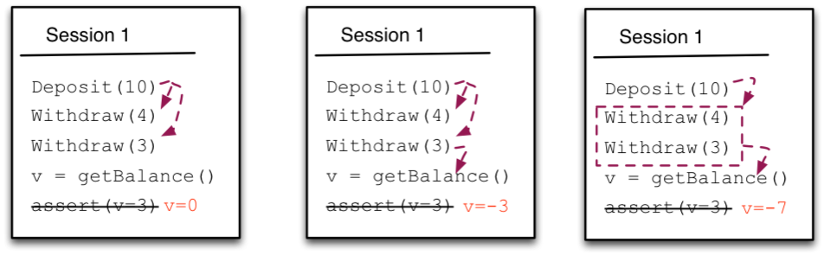
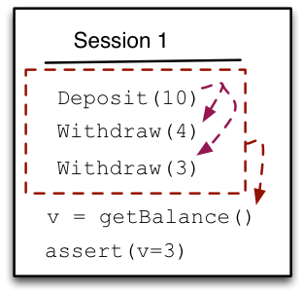
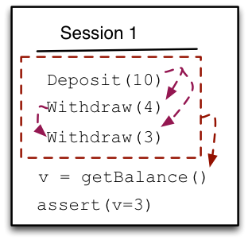
Negative Runs
Positive Runs

Slide 11
Intuitively, a good specification is a formula that characterizes all good states and only good states.

Slide 12
d
w4
w4
gb

Slide 13
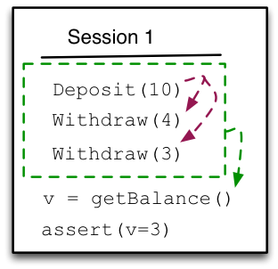
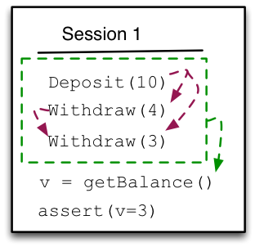
Negative Runs
Positive Runs

Slide 14
Any feasible axiomatic execution of the test case is correct only if ψ_{C} is true.

Slide 15


Can be captured by computing the invariant in all runs of the test case.
Any feasible axiomatic execution of the test case is correct only if ψ_{C} is true.

Slide 17
Any feasible axiomatic execution of the test case is correct only if ψ_{C} is true.

Slide 18
Any feasible axiomatic execution of the test case is correct only if ψ_{C} is true.

Slide 19
We now have a specification!

Slide 20
We now have a specification!
But, it is overfitted to the test case.

Slide 21
We now have a specification!
But, it is overfitted to the test case.
How do we mitigate the overfit?

Slide 22
How do we mitigate the overfit?
More tests.
But, programmer doesn’t know what tests to provide!
Solution: Hypothesize about overfit, and generate test case candidates in such a way that:
If the candidate is truly a test case, then we have one more test case, and we make progress towards reducing the overfit.
If the candidate is not a test case, then our hypothesis about the overfit is wrong. Try another hypothesis, if one exists. Otherwise, stop.

Slide 23
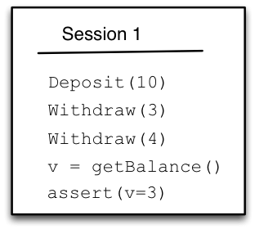
Example
A hypothesis: so(w4,w3) is an overfit.
A candidate that tests the hypothesis

Slide 24
Example
A hypothesis: so(w4,w3) is an overfit.
Q. “Dear programmer, is this a valid test case for your application?”
A. Yes.

Slide 25
Example
A hypothesis: so(w4,w3) is an overfit.
fact
Q. “Dear programmer, is this a valid test case for your application?”
A. Yes.

Slide 26

Example
We have weakened the antecedent, hence (slightly) generalized the specification!

Slide 27
Open Problems
Enumerating a passing/failing run needs a call to the SMT solver.
Do we need to enumerate all passing and failing runs eagerly? Can’t we generate runs on demand?
What is the optimal way of order of formulating hypotheses while generalizing an overfitted spec?
What is the worst-case bounds on number of questions we need to ask the programmer?
How do we generalize this approach to transactions?

Slide 28
Thank you!
http://gowthamk.github.io/Quelea

