Slide 1
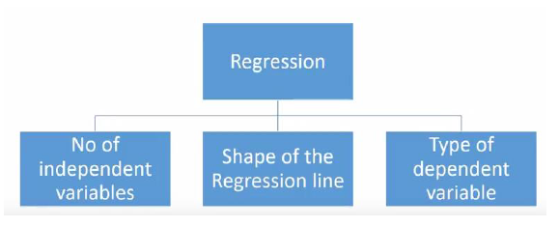
Regression analysis is a form of predictive modelling technique which investigates the relationship between a dependent (target) and independent variable (s) (predictor). This technique is used for forecasting, time series modelling and finding the causal effect relationship between the variables.

Slide 2
Simple Linear Regression
In simple linear regression, each observation consists of two values. One value is for the dependent variable and one value is for the independent variable.
Simple Linear Regression Analysis The simplest form of a regression analysis uses on dependent variable (y) and one independent variable (x). In this simple model, a straight line approximates the relationship between the dependent variable and the independent variable.
A regression line can show a positive linear relationship, a negative linear relationship, or no relationship. If the graphed line in a simple linear regression is flat (not sloped), there is no relationship between the two variables. If the regression line slopes upward with the lower end of the line at the y intercept (axis) of the graph, and the upper end of line extending upward into the graph field, away from the x intercept (axis) a positive linear relationship exists. If the regression line slopes downward with the upper end of the line at the y intercept (axis) of the graph, and the lower end of line extending downward into the graph field, toward the x intercept (axis) a negative linear relationship exists.

Slide 3
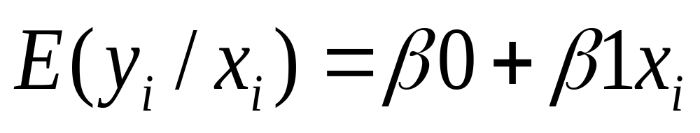
Regression equation…
Expected value of y at a given level of x=

Slide 4
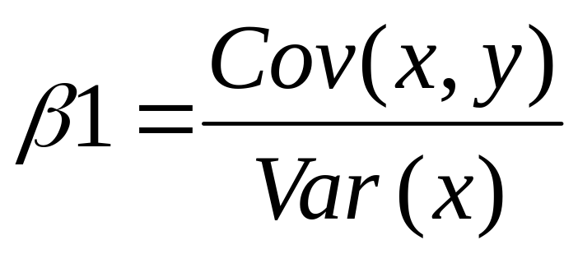
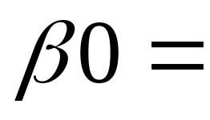


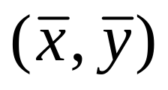
Resulting formulas…
Slope (beta coefficient) =
Intercept=
Regression line always goes through the point:

Slide 5
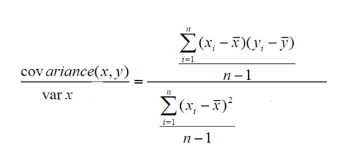
We can start off by estimating the value for B1 as:
B1 = sum( (xi-mean(x)) * (yi-mean(y)) ) / sum( (xi – mean(x) )^2 )
Where mean() is the average value for the variable in our dataset. The xi and yi refer to the fact that we need to repeat these calculations across all values in our dataset and i refers to the i‘th value of x or y.
We can calculate B0 using B1 and some statistics from our dataset, as follows:
B0 = mean(y) – B1 * mean(x)

