Slide 1
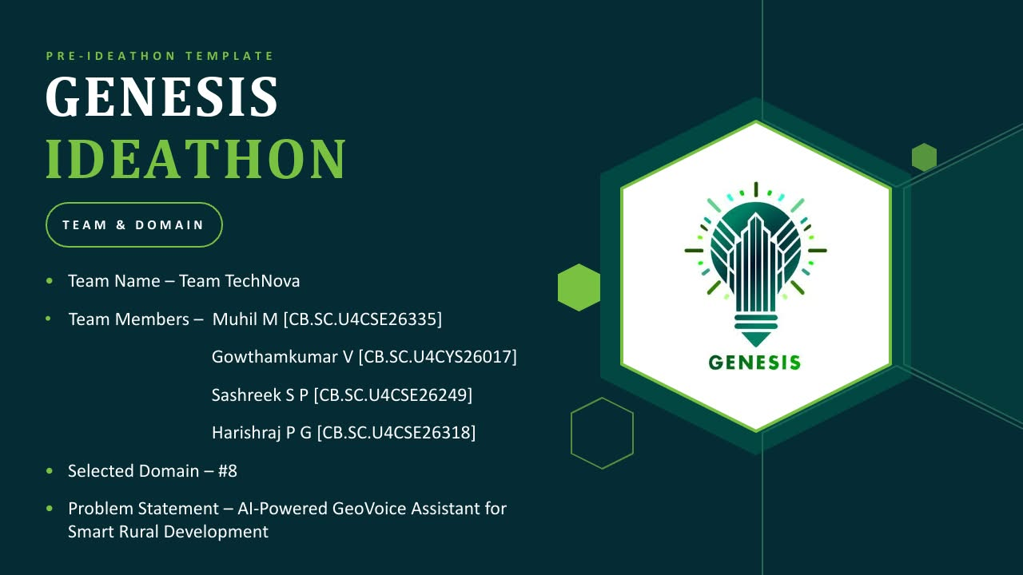

Slide 2
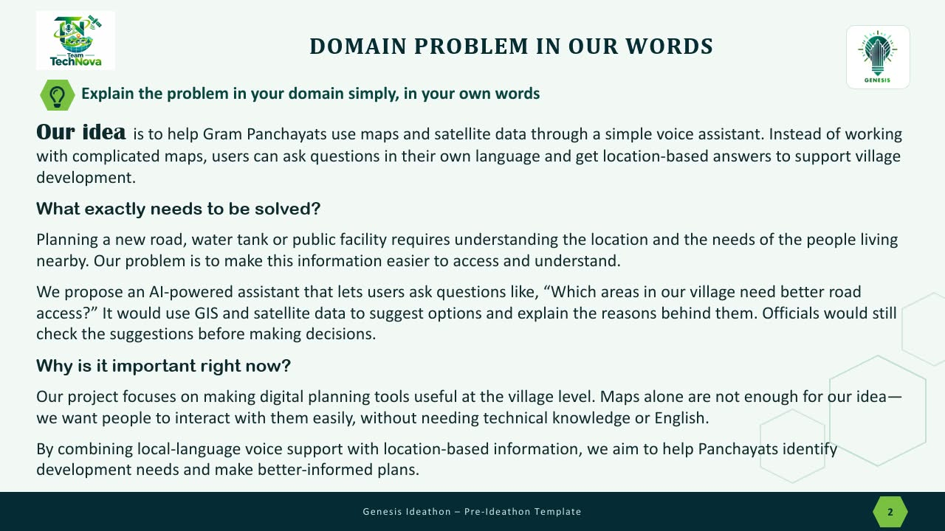

Slide 3


WHO IS AFFECTED?
Target users, stakeholders, beneficiaries
Panchayat planning needs spatial evidence for roads, water, public facilities and assets.
Gram Manchitra already provides GIS-based decision support for GPDP.
Our proposed gap: make relevant map evidence easier to query through local-language voice.
Target users: Panchayat officials, field staff and residents.

Slide 4
CURRENT SITUATION & CONTEXT
Existing scenario, background and how things work today
Rural development planning currently relies on government records, field surveys, and manual inspections.
GIS maps and satellite imagery are available, but data is often scattered across different platforms.
Villagers may face language and technical barriers when accessing development information.
Identifying infrastructure gaps and prioritizing projects can be time-consuming and require expert support.
A unified multilingual AI voice assistant is needed to provide location-based insights and support faster, data-driven decisions at the Gram Panchayat level.

Slide 5
KEY CHALLENGES
Main difficulties, bottlenecks, root causes and consequences
Village-level data is often difficult to access, and maps are hard to understand without technical knowledge.
Language barriers and scattered data make planning more difficult.
Difficulty in identifying suitable locations for roads and public facilities.
Manual surveys and planning take more time.
Lack of local-language support in existing tools.
These problems may delay development projects and lead to poor planning. Some rural communities may continue to lack proper roads, drinking water, and essential public services.
Wastage of time and resources.
Unequal access to public facilities.
Delays in rural development.

Slide 6
EXISTING SOLUTIONS / APPROACHES
What is already being done, and where it falls short
Existing platforms like Gram Manchitra provide village maps, while eGramSwaraj supports Panchayat planning and monitoring. Satellite imagery helps identify roads, buildings, and land features.
However, these tools may require technical knowledge, and data may need regular updates and ground verification. Most do not combine multilingual voice interaction with simple, location-based development recommendations.
Our Solution: An AI-powered voice assistant that makes geographical information easier to access and helps Panchayats make better-informed decisions.

Slide 7
PROBLEM INSIGHTS & OPPORTUNITY AREAS
Resources required to solve the problem
The resources required are
GIS & Satellite Data: ISRO Bhuvan maps and satellite imagery.
Government Records: Panchayat infrastructure and development data.
Population Data: Census records and household statistics.
Weather Data: IMD rainfall, forecasts, and weather alerts.
AI & Voice Tools: Multilingual speech recognition and AI language models.
Technical Infrastructure: GIS software, databases, APIs, and cloud hosting.
Field Resources: Panchayat officials and local surveys to verify data.
#[Voice output + map → official validation → logged planning note]
By integrating satellite imagery, GIS maps, government records, and AI voice technology, we can deliver reliable, location-based insights. These resources enable smarter planning and sustainable rural development at the Gram Panchayat level.

Slide 8
INITIAL DIRECTION & EXPECTED OUTCOME
What Is Your Expected Outcome?
Develop a multilingual AI voice assistant for easy access to village development information.
Provide location-based insights using GIS maps, satellite imagery, and government data.
Identify infrastructure gaps in roads, water supply, drainage, and public facilities.
Recommend suitable locations and priorities for rural development projects.
Improve decision-making, transparency, and accessibility for Gram Panchayat officials and villagers.
Achieve faster, data-driven planning and more efficient use of rural development resources.

