Slide 1
ECE/CS 498 DS HW 1 Spring 2020
Name: Gowtham Kuntumalla
Netid: gowtham4
Registration Status: registered for 4 credits, ECE 498

Slide 2
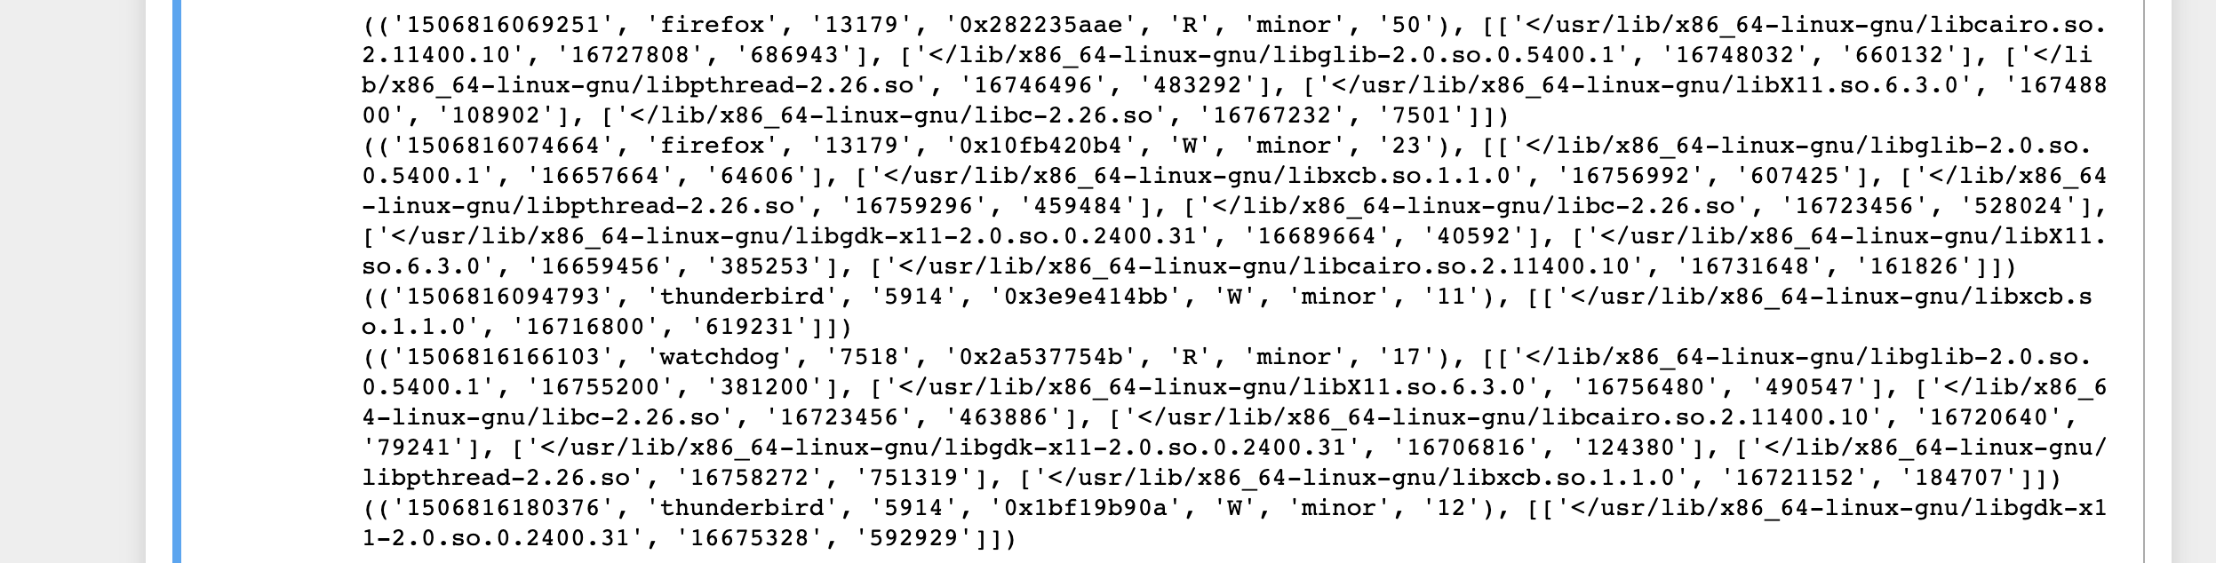
A. Data Structure to Parse Raw Log File
Provide a (i) diagram and (ii) brief explanation of the data structure you used to parse the raw log file
Dictionary to hold a list of backtraces for each pagefault
key = tuple (pagefault details) -- Tuple
value = list (backtraces) -- 2D list

Slide 3
B.a. Time Range Covered By Data
Start Time: 2017-10-01 00:01:09.251000
End Time: 2018-01-07 18:59:50.839000
Total Duration: Timedelta('98 days 18:58:41.588000')

Slide 4
B.b. Unique Processes
The number of unique processes :12
The name of each process: ['firefox' 'thunderbird' 'watchdog' 'auditd' 'subl' 'gitlab-runner' 'sshd' 'google-chrome' 'bash' 'tmux' 'xorg' 'htop']
The number of times each process was executed:
auditd 228982
bash 229904
firefox 233452
gitlab-runner 218405
google-chrome 238107
htop 232215
sshd 246903
subl 245982
thunderbird 237590
tmux 219329
watchdog 234938
xorg 243924

Slide 5
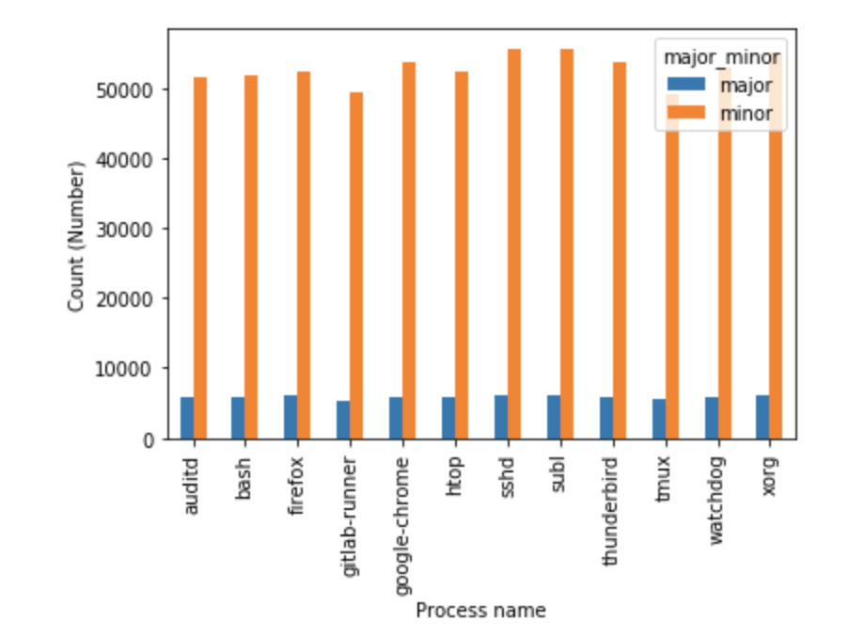
B.c. Major and Minor Page Faults

Slide 6
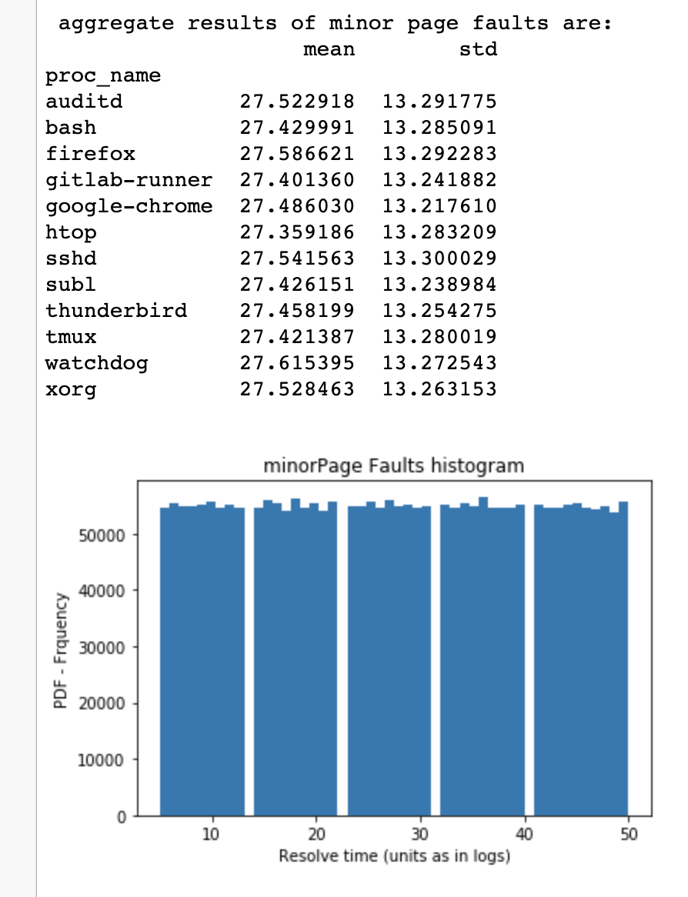
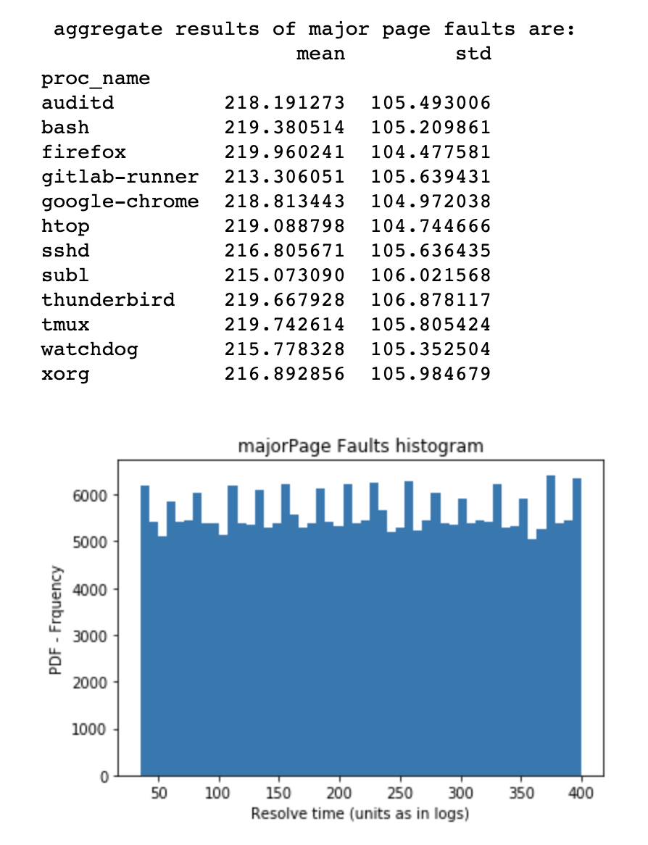
B.d. Time to Resolve Page Faults

Slide 7
C.a. Class Priors
'firefox': | 0.08294107937664348,
'thunderbird': | 0.08451199244140381,
'watchdog': | 0.08372369005202226,
'auditd': | 0.08137016631188317,
'subl': | 0.08786014320352431,
'gitlab-runner': | 0.07761078921306362,
'sshd': | 0.08782456999100709,
'google-chrome': | 0.08480084692704361,
'bash': | 0.08171451500904983,
'tmux': | 0.0777786947761449,
'xorg': | 0.08690108939406013,
'htop': | 0.08296242

Slide 8
C.b. – C.c. : Predictions
Given that the page fault was major, which process was it most likely caused by?
Process that is likely to occur: subl , 0.0921
Given that the page fault was from a read access, which process was it most likely caused by?
Process that is likely to occur: subl , 0.0923

Slide 9
C.d. Appropriate Model
In 2 sentences or less, explain which model taught in class could be used for classifying the process given information about the fault’s (i) severity and (ii) access type.
Ans) We would use Naive Bayes Classifier for classifying. It is a decent first estimate considering the fact: independence of read/write operations and type of fault (major/minor)

