Slide 1
Portfolio Optimization using ML techniques
Graduate Project
ECE/CS 498 DSG
Spring 2020
Team
Akhilesh Somani : somani4
Gowtham Kuntumalla : gowtham4
Manan Mehta : mananm2

Slide 2
Outline
Background
Problem statement
Data (1 min)
Challenges & your Solution (4 mins)
Results and their significance and/or insight (2min?)
Conclusion / Feedback (1 min)

Slide 3
Background
Personal Finance
Investing vs Trading
Wealth generation by means of value investing
Focus: Equity – Stock Market
Risk vs. Returns in a Portfolio
Returns: ≃ 2 times better
Risk: 2008 Housing Bubble Burst
* Why Investing is better than saving.

Slide 4

Problem Statement
How to choose stocks to maximize returns while minimizing risk (aka volatility) over a fixed timeframe?

Slide 5
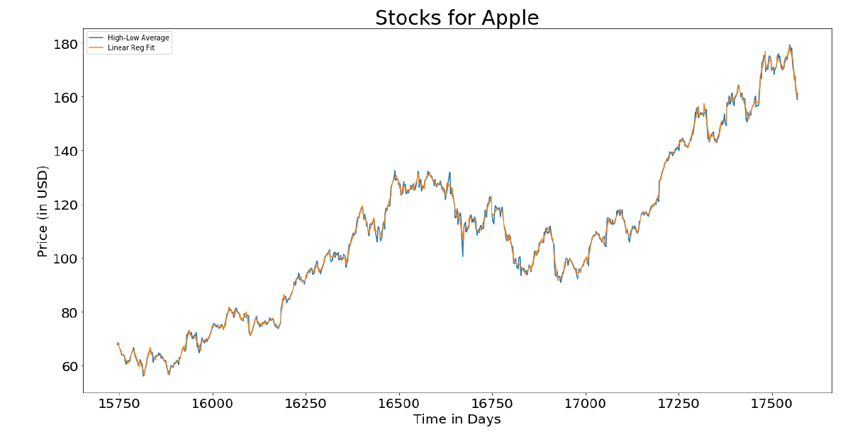
Data
S&P 500 stocks data from 2013 - 2018
≃ 500 exchange traded stocks
Open, High, Low, Close Prices & Volume
Custom Feature Engineering
OHLC – not sufficient to accurately study trends and predict stock changes
Nonlinear features – Technical Indicators
Linear Regression Fit (Apple’s stocks)

Slide 6
Challenges
Huge Time Series Dataset - 1200 data points for each stock - 500 such stocks
Historical prices alone do not guarantee returns - News related events influence prices
Complex interactions b/w stocks – requires clever problem formulation
*****Show results from preliminary data analysis that can highlight the challenges

Slide 7
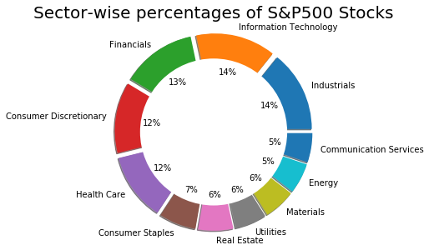
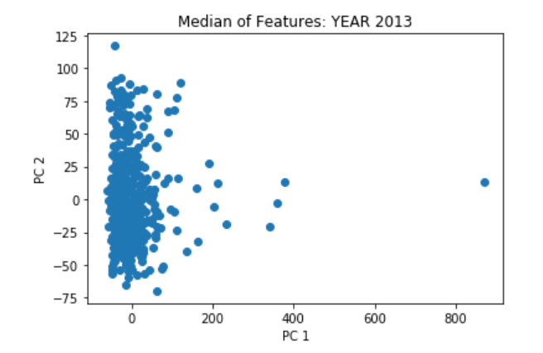
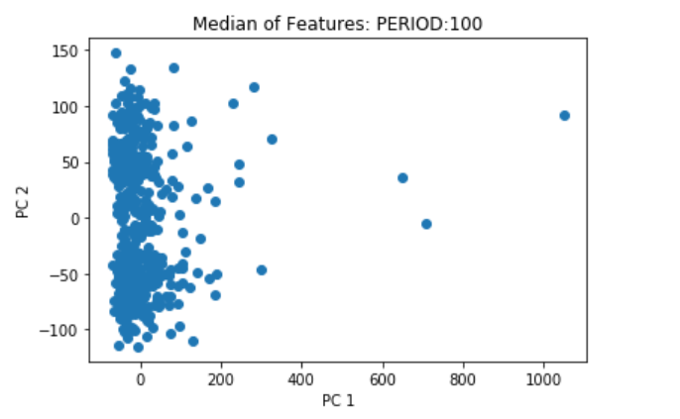
PCA Approach
Novel approach to achieve sector-wise segregation
Challenges: →3D time-series data →PCA works on 2D data
Approach: Condense the time-series data
Results: →PC1 and PC2 cover ~ 90 percent variance

Slide 8
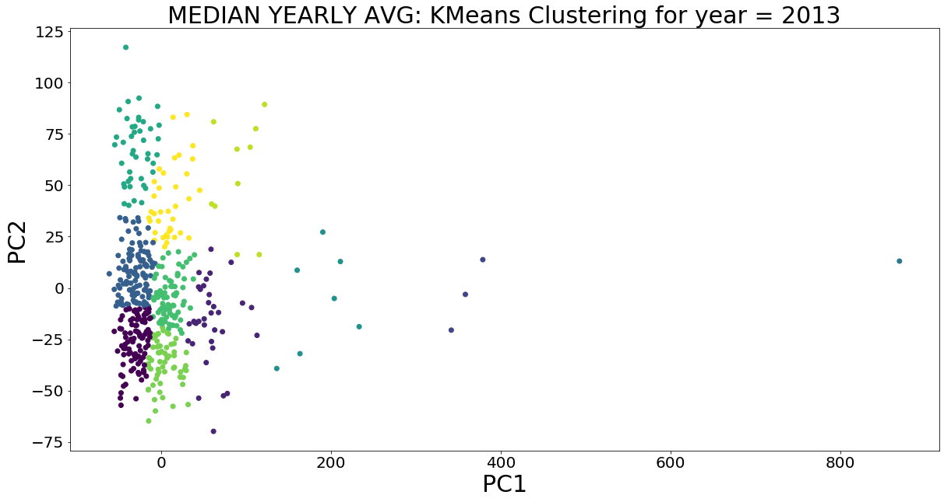
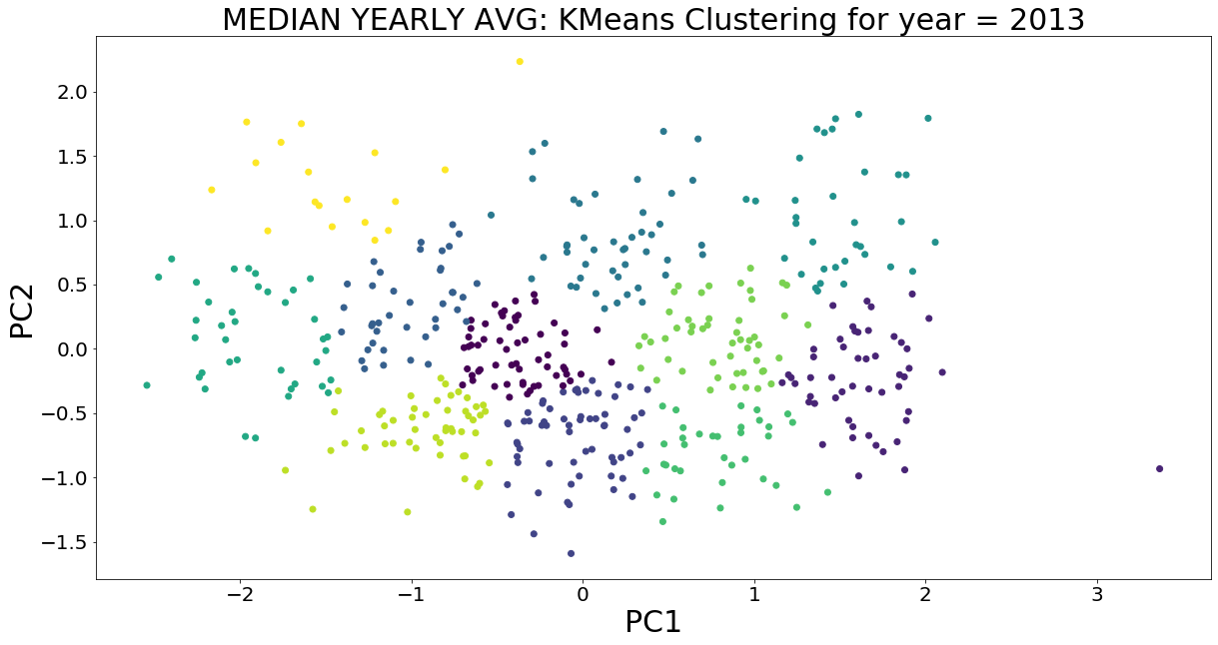
Clustering Approach
KMeans Clustering (using K = 11) on PCA transformed data
KMeans Clustering – Unscaled Data
KMeans Clustering – Scaled Data

Slide 9
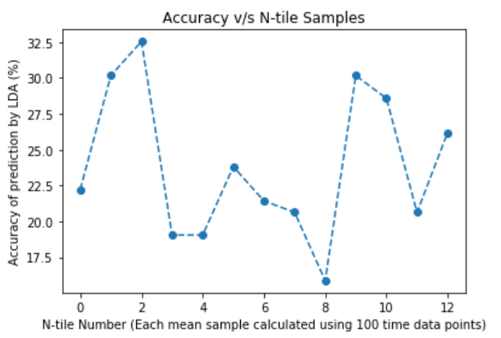
LDA Approach
Linear Discriminant Analysis to reduce dimensions and predict sectors
A supervised way of learning

Slide 10
Stock Prediction using Recurrent Neural Networks
Learn from the training data to predict the price into the future
Test on the testing data
***Gotham City’s plots go here
***Explain why we cannot predict with certainty or why we cannot predict way into the future – news related events cannot be predited. Eg – COVID-19
***Wanna talk about the shortcomings of RNNs (peeking into the future etc)?

Slide 11
Solution approach
Give broad solution approach
Explain how it addresses the problem statement, challenges raised in the previous slides
Give block diagram of your solution/model
Give relevant details about the model for e.g. training, testing, inference etc

Slide 12
Baseline approach – existing methods
Briefly describe the baseline method (existing methods that address your problem statement) you will be comparing your results with

Slide 13
Results
Describe the results of your model and compare it with the baseline
Interpret the results and draw relevant conclusions about the data and method
Any other interesting insights/observations

Slide 14
Conclusion
Conclusions from the analysis
Limitations of the work and how they can be addressed in the future
Feedback for instructors: What worked and what might you suggest we change next time around

Slide 15
Contribution
Akhilesh: Feature Generation, PCA, LDA, Clustering, RNN
Gowtham: Feature Generation, LSTM-RNN, Hierarchical Clustering, Portfolio management technical discussions.
Manan:

