Slide 1
Mini-Project 1 Checkpoint 1 ECE/CS 498DS Spring 2020
Gowtham Kuntumalla (gowtham4), Manan Mehta (mananm2), Akhilesh Somani (Somani4)

Slide 2
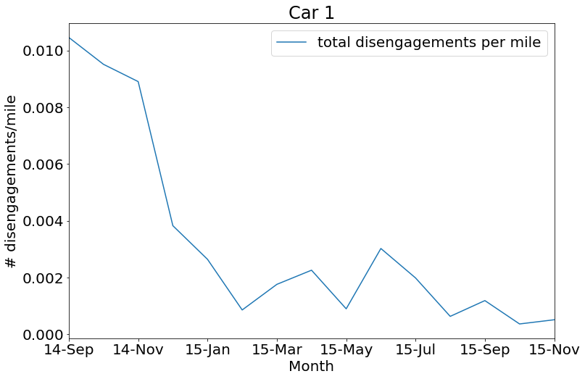
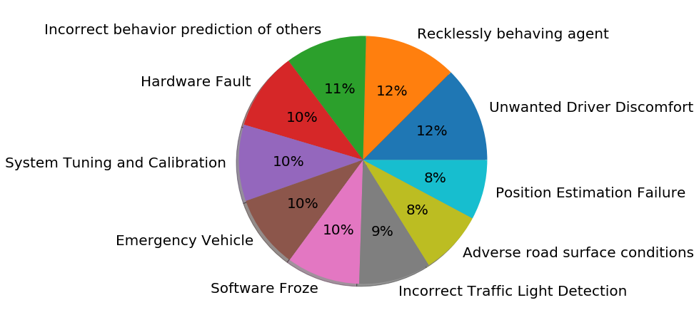
Task 0
Summarize | Answer
2(a) – Total Disengagements | 1024
2(b) - # Unique Months | 15
2(c) – Unique Locations | 2
2(d) - # Unique Causes | 10
2(e) - # Rows with missing values | 532
Qn 4 - Trend of disengagement/mile
Plot:
The AVs are maturing with time
Qn 3 - Causes of AV Disengagement
Pie chart:
Top 2 causes of disengagement: Recklessly behaving agent, Unwanted Driver Discomfort

Slide 3
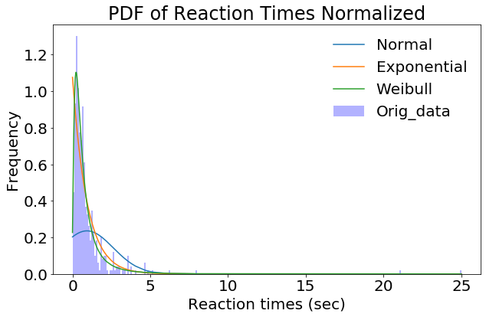
Task 1
Qn 2 – Probability distribution of reaction times
What distribution does it fit and what is the significance?
We see that the weibull distribution fits well.
Parameter 'k' < 1 so the reaction times are largely populated
in the beginning and go down with time.
Qn 1 – Interpreting Distributions
Gaussian – Samples drawn are likely to be close
to the mean. and those far away are less likely.
(b) Exponential – Samples drawn are likely to be close to Zero.
Another key property is memorylessness. i.e. conditional probability
boils down to simple exponentials (only the time period matters not when it starts).
(c) Weibull – It is a generalisation of standard exponential distribution (k = 1).
If X = time-to-failure, then k < 1 indicates failure rate goes down as parts life increases,
i.e. probability that samples fail is very high when X is close to zero and then it decreases. Vice versa for k > 1.
Qn 3 – Average Reaction times
Over entire dataset: 0.93 sec
Over entire dataset per location:
Highway: 1.48 sec
urban-street: 0.93 sec

Slide 4
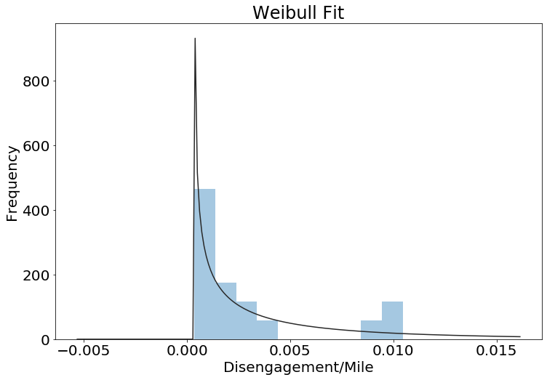
Task 1
Qn 5 – Probability distribution of disengagements/mile
Plot:
What distribution does it fit and what is the significance?
Weibull_min distribution fits well. We see that the number of # of
Occurences of Disengagements/mile parameter goes down.
(parameter k<1: Failure rate decreases over time)
Qn 4 – Hypothesis Testing
State the Null and Alternate Hypothesis
H0 : AV_mean = 1.09 sec
H1 : AV_mean != 1.09 sec
Significance level = 0.05
We will apply a two-tail test assuming H0 is true.
We will test if 0.93 sec is in statistical limits of assumed population mean (= 1.09 sec)
Statistic Value = 0.018
Outcome of the hypothesis test:
Z-score (0.018) < 0.025 (two-tailed test) so we reject the NULL hypothesis.
The means are sufficiently different.

