Slide 1
Mini-Project 1 ECE/CS 498DS Spring 2020
Akhilesh Somani (somani4), Gowtham Kuntumalla (gowtham4), Manan Mehta (mananm2)
Registered for ECE 498 (4-credit hours)

Slide 2
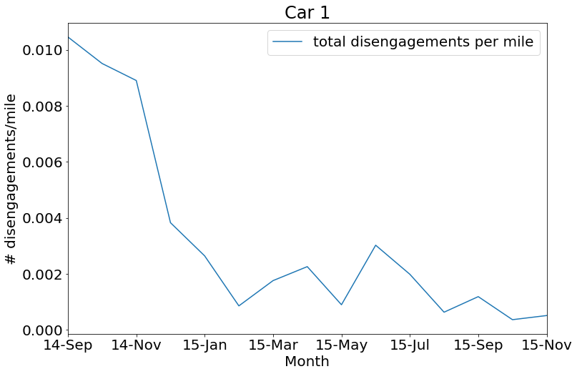
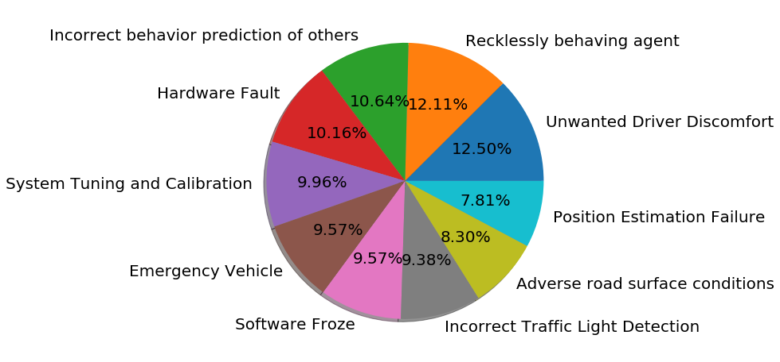
Task 0
Summarize | Answer
2(a) – Total Disengagements | 1024
2(b) - # Unique Months | 15
2(c) – Unique Locations | 2
2(d) - # Unique Causes | 10
2(e) - # Rows with missing values | 532
Qn 4 - Trend of disengagement/mile
Plot:
The AVs are maturing with time
Qn 3 - Causes of AV Disengagement
Pie chart:
Top 2 causes of disengagement: Recklessly behaving agent, Unwanted Driver Discomfort

Slide 3
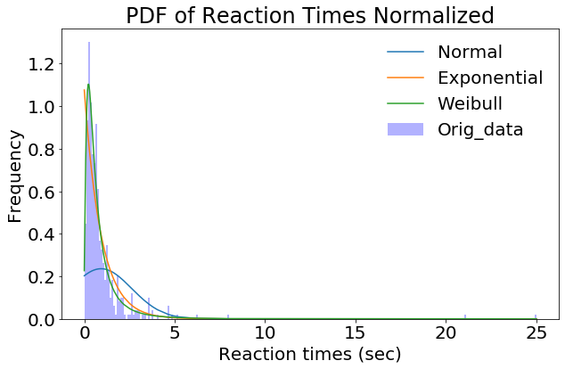
Task 1
Qn 2 – Probability distribution of reaction times
What distribution does it fit and what is the significance?
We see that the weibull distribution fits well.
Parameter 'k' < 1 so the reaction times are largely populated
in the beginning and go down with time.
Qn 1 – Interpreting Distributions
Gaussian – Samples drawn are likely to be close
to the mean. and those far away are less likely.
(b) Exponential – Samples drawn are likely to be close to Zero.
Another key property is memorylessness. i.e. conditional probability
boils down to simple exponentials (only the time period matters not when it starts).
(c) Weibull – It is a generalization of standard exponential distribution (k = 1).
If X = time-to-failure, then k < 1 indicates failure rate goes down as parts life increases,
i.e. probability that samples fail is very high when X is close to zero and then it decreases. Vice versa for k > 1.
Qn 3 – Average Reaction times
Over entire dataset: 0.93 sec
Over entire dataset per location:
Highway: 1.48 sec
urban-street: 0.93 sec

Slide 4
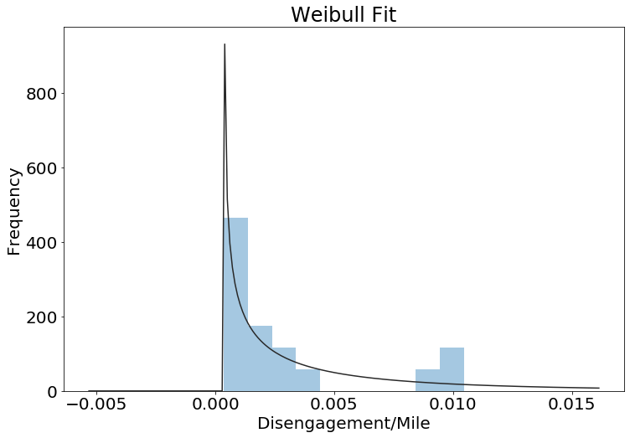
Task 1
Qn 5 – Probability distribution of disengagements/mile
Plot:
What distribution does it fit and what is the significance?
Weibull_min distribution fits well. We see that the number of # of
Occurences of Disengagements/mile parameter goes down.
(parameter k<1: Failure rate decreases over time)
Qn 4 – Hypothesis Testing
State the Null and Alternate Hypothesis
H0 : AV_mean = 1.09 sec
H1 : AV_mean != 1.09 sec
Significance level = 0.05
We will apply a two-tail test assuming H0 is true.
We will test if 0.93 sec is in statistical limits of assumed population mean (= 1.09 sec)
Statistic Value = 0.018
Outcome of the hypothesis test:
Z-score (0.018) < 0.025 (two-tailed test) so we reject the NULL hypothesis.
The means are sufficiently different.

Slide 5
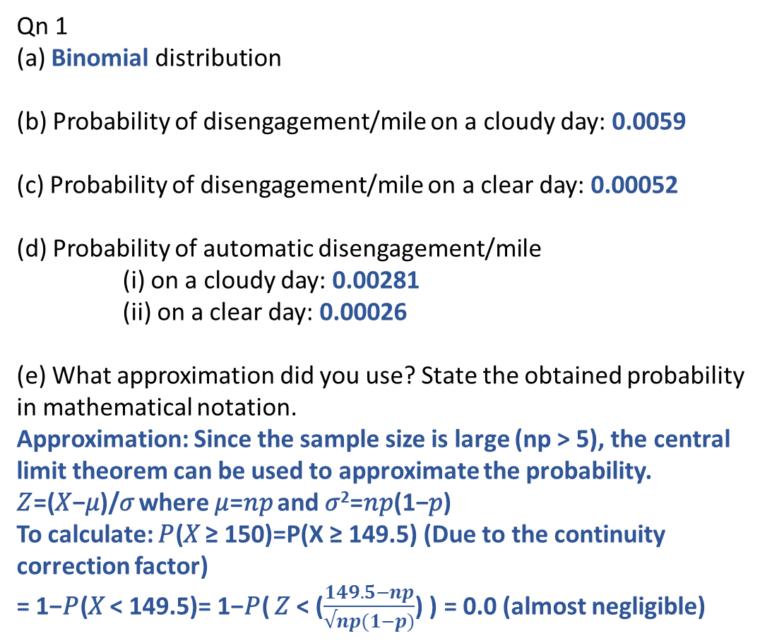
Task 2
Qn 1
(a) Binomial distribution
(b) Probability of disengagement/mile on a cloudy day: 0.0059
(c) Probability of disengagement/mile on a clear day: 0.00052
(d) Probability of automatic disengagement/mile
(i) on a cloudy day: 0.00281
(ii) on a clear day: 0.00026
(e) What approximation did you use? State the obtained probability in mathematical notation.
Approximation: Since the sample size is large (np > 5), the central limit theorem can be used to approximate the probability.
𝑍=(𝑋−𝜇)/𝜎 where 𝜇=𝑛𝑝 and 𝜎²=𝑛𝑝(1−𝑝)
To calculate: 𝑃(𝑋 ≥ 150)=P(X ≥ 149.5) (Due to the continuity correction factor) = 1−𝑃(𝑋 < 149.5)= 1−𝑃( 𝑍 < ($\frac{149.5−np}{√np(1−p)}$) ) = 0.0 (almost negligible)
Qn 2 – Hypothesis Testing Concepts
(a) Normal Distribution represents the probability distribution of the random variable (under observation) of the sample drawn from a bigger population (assuming null hypothesis is true).
(b) No, we reject the null hypothesis due to lack of evidence under certain significance level (α). We conclude that under these conditions alternate hypothesis is statistically probable. In other words, it is likely true. This is not the same as accepting it.

Slide 6
Task 2
Qn 4 – Conditional Probability
(Write both the probability expression and the computed probability value)
(a) P(reaction time>0.6s | weather=cloudy, diseng=auto)
0.474
(b) P(reaction time>0.9s | weather=clear, diseng=auto)
0.281
Qn 3 – Z-test
State the Null and Alternate Hypothesis
Null (H0): Number of disengagements on cloudy days <= Number of disengagements on clear days
Alternate (H1): Number of disengagements on cloudy days > Number of disengagements on clear days
Statistic Value = 38.199
P-value= 0.0
Outcome of the hypothesis test: Hence we reject null hypothesis
Conclusion: It is statistically likely that number of disengagements on a cloudy day are more than a clear day
Qn 5 – Conditional Probability and Total Probability
(Write both the probability expression and the computed probability value)
p(accident) = p(t > 0.6s | autoDiseng , cloudy)* p(autoDiseng | cloudy)* p(cloudy) + p(t > 0.9s | autoDiseng , clear)* p(autoDiseng | clear)* p(clear)
0.00043

Slide 7
Task 2
Qn 6 – Comparing AVs to human drivers
P(accident) for an AV is 4.26 x 10⁻⁴ which is roughly 213 times higher than human drivers (2 x 10⁻⁶). The consequence is that more work has to go in to make AVs as safe as human drivers, so that they can be put on the streets with equal (if not more) confidence.
Qn 7 – KS Test
State the Null and Alternate Hypothesis
Null (H0): The reaction times in cloudy and clear weathers can be drawn from the same continuous distribution Alternate (Ha): The reaction times in cloudy and clear weathers are from different distributions
Statistic Value = 0.051
P value = 0.984
Outcome of the hypothesis test: p-value (0.984) > significance level (0.1)
Do not reject null hypothesis
Conclusion: We can say with high certainty that reaction times in both weathers are drawn from the same continuous distribution.

Slide 8
Task 3
Qn 3 – Conditional Probability Tables for NB classifier
 | urban-street | highway | cloudy | clear | manual | automatic
Perception System | 1 | 0 | 1 | 0 | 0.164 | 0.836
Controller | 1 | 0 | 0.997 | 0.003 | 0.88 | 0.12
Computer System | 0.923 | 0.077 | 0.407 | 0.593 | 0.512 | 0.488
Qn 4 – NB Classifier Accuracy: 79.51 %
Qn 5 – NB Cross Validation Accuracy: 78.34%

Slide 9
Task 3
Qn 6 – Is your NB model doing better than chance? Explain.
Average accuracy of Naïve Bayes model is around 78%, so it classifies roughly 78% data correctly.
If we were to leave the class assignment to chance, the number of correct classifications we could have obtained would be Expectation value, which is 33.3% (probability of correct classification = 1/3).
Hence, the Naïve Bayes model definitely performs better than simple guessing.
Qn 7 – Assumptions in NB in this context of AV safety analysis
The main assumption is that the features: Location, Weather and Type of Trigger are conditionally independent of each other.
Qn 8 – Possible improvements to increase classification accuracy
Possible improvements are: (1) Trying to incorporate more features into the classification study and then applying the Naïve Bayes model
(2) Discarding the assumption that the features are independent, and constructing a Bayesian network to better understand the impact of one feature on another

Slide 10
Insights on AV safety
List some insights on AV safety that you have gained by performing data analysis on the CA DMV dataset
The AVs seem to perform way better on the highways than the urban streets. So, we figured location does not really affect the disengagement – chances are almost all the disengagements will occur in the urban areas.
On performing a chi-squared test on Location and Type Of Trigger features, we found high likelihood that they are dependent.
When we perform Naïve Bayes classification after discarding ‘location’ as a feature, we still get the same accuracy. From the CPT, we see that the location parameters almost always lean towards urban-street, thus the classifier accuracy wasn’t affected. Instead of a generalized location, if we would’ve been provided more specific data like traffic density, infrastructure or LIDAR readings from the location, it would’ve bolstered our model.
The type of trigger for ‘highway’ was almost always ‘manual’, i.e. the AV never felt the need to disengage on highways.
The reaction time data for both cloudy and clear conditions may be drawn from the same distribution (Exponentiated Weibull) (thus verifying KS Test)

Slide 11
Insights on AV safety
Would you ride in an AV based on the data you have analyzed?
No, we would not ride in an AV at this stage. The AVs need more work as the probability of getting in an accident is roughly 213 times higher than that caused by human drivers.
What do you think about the future of AVs and how soon they will be deployed?
We think that there may come a time (typically 5 years) when the AVs will be fully functional, needing no backup driver behind the wheel and open to the public. Plotting the number of disengagements with time suggest that AVs are maturing over time. It would definitely require a lot of work to accomplish this but it is quite feasible.
However, we feel like they would still be limited to less crowded cities and countries like the US (where there are proper road markings, signals and signboards on all the roads). Very big cities like LA, NYC or countries like India might be a challenge for AVs.

Slide 12
Insights on AV safety
What would you change about the MP? What other analysis would you have done? Maybe if there was additional data
An interesting parameter to compare would have been the “time taken by a human to make a decision v/s the reaction time of the AV” (but NOT like in the event of an automatic disengagement).
For example, when a traffic signal turns green, how much time does the AV wait for before actually beginning to move? Or how much time does it take compared to a human driver to make a left turn where there is no traffic signal?
Or how much time does it spend at an all-way STOP compared to a human driver?
This way, the reaction time of the AV could be analyzed. If the reaction times are too high compared to humans, maybe the AVs are extra careful but would have still been fine if they were little quick in taking the action. Or if the reaction times were way too low (and there was no accident), we could understand and explore these situations where an AV is more reliable and efficient over a human driver.

Slide 13
Individual Contributions
Akhilesh Somani –
Tasks 0-3
Final PPT making
Final .ipynb file compilation
Key Insights
Gowtham Kuntumalla –
Tasks 0-3
Checkpoint PPT making
Checkpoint .ipynb file compilation
Manan Mehta –
(1) Tasks 0-3
(2) Key Insights

