Slide 1

Computational analysis of thermochemistry of Aluminium based propellants and ballistic properties of High-nitrogen cage compounds
K. Gowtham
140100091
Guide: Neeraj Kumbhakarna
Department of Mechanical Engineering,
Indian Institute of Technology - Bombay
Mumbai, India-400076

Slide 2
Introduction
Two Projects
HNC - High-nitrogen cage compounds analysis (Dec 2016 - Jan2017)
Computational analysis of ballistic and detonation properties
Better propellants in terms of Specific Impulse (I_{sp}) ?
CRM – Aluminium Nano-particles and Teflon polymer reaction (Jul 2017 – Ongoing)
Formulation of chemical reaction mechanism (CRM)
Theoretical validation of mechanism
Effect of solvents on reaction

Slide 3
Topic 1 High-nitrogen cage compounds (HNC)

Slide 4
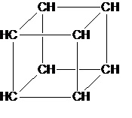
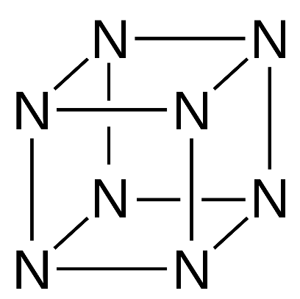
Literature Review - HNC
It is a research collaboration between chemistry department and mechanical department of IITB.
Look at the analogy
Cubane
(solid)
Octazacubane
Cage compounds with carbon majority.
High energy material but stable
Hypothetical Nitrogen Cage

Slide 5
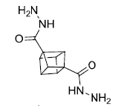
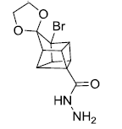
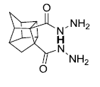

Molecules Under Study
Modifications of cubane cages with addition of nitrogen rich chains
HNC1
HNC2
HNC3
HNC4

Slide 6
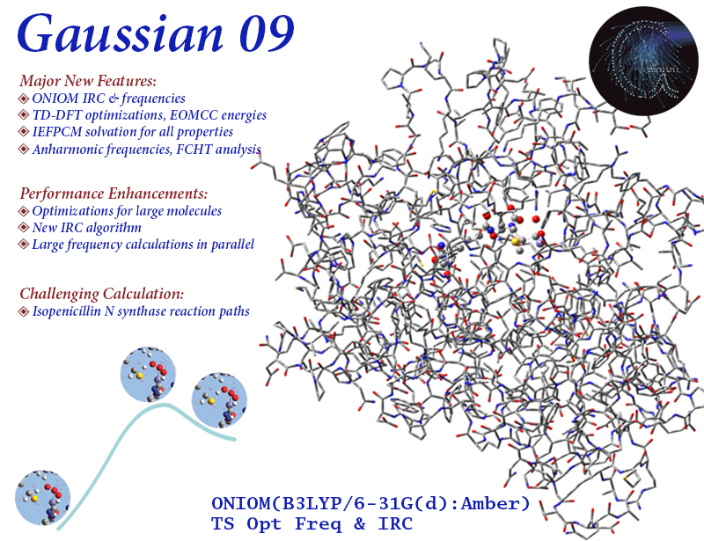
Computational Methods - 1
There are various molecular modelling techniques in computational chemisty (Lewars, 2011).
Molecular Mechanics (MM)
ab initio methods
Semiempirical (SE) methods
Density functional (DFT) calculations
Molecular Dynamics (MD)
Software based on Quantum Chemistry

Slide 7

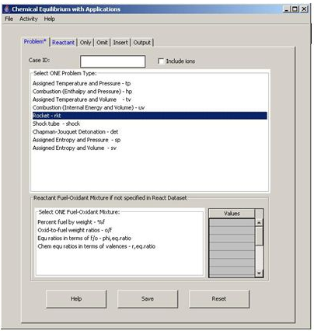
Computational Methods - 2
Software used for calculating propulsive properties. NASA CEA
Specific Impulse (I_{sp})
Density specific impulse (ρI_{sp})
Adiabatic flame temperature

Slide 8
Results & Discussion-1 (HNC)
Notation | Formula | Molecular structure | Heat of Formation (kcal/mol) | Density (gm/cm3)
HNC1 | C₁₀H₁₂N₄O₂ |  | 151.39 | 1.558
HNC2 | C₁₂H₁₃N₂O₃Br |  | 82.64 | 1.80
HNC3 | C₁₂H₁₆N₄O₂ |  | 69.2 | 1.48
HNC4 | C₁₆H₂₀NO₃Br |  | 43.46 | 1.58
Note:- HOF Cubane = 144.2 kcal/mol
a Optimisation done using B3LYP density function theory with 6-311++G(d,p) basis set

Slide 9
Results & Discussion-2 (HNC)
Compound | CCT (K) | I_{sp} (s) | I_{sp,vac}(s)
C₁₀H₁₂N₄O₂ | 3183.92 | 300.31 | 311.32
C₁₂H₁₃N₂O₃Br | 3095.82 | 290.85 | 302.69
C₁₂H₁₆N₄O₂ | 3048.91 | 290.9 | 301.10
C₁₆H₂₀NO₃Br | 3076.49 | 287.94 | 298.4
Compound | CCT (K) | I_{sp} (s) | I_{sp,vac}(s)
C₁₀H₁₂N₄O₂ | 2609.44 | 274.07 | 284.01
C₁₂H₁₃N₂O₃Br | 2622.49 | 272.56 | 282.36
C₁₂H₁₆N₄O₂ | 2542.2 | 271.02 | 281.01
C₁₆H₂₀NO₃Br | 2561.34 | 270.51 | 280.43
Table 1: Performance as Solid Bipropellant with AP as oxidizer
(20% HNC, 80% AP)
Table 2: Performance as additive to AP-HTPB mixture
(80% AP, 15% HTPB, 5%HNC)
AP : Ammonium Perchlorate
HTPB : Hydroxyl terminated polybutadiene
a Optimisation done using B3LYP density function theory with 6-311++G(d,p) basis set

Slide 10
Results & Discussion-3 (HNC)
Compound | O/F Ratio | CCT (K) | Ratio √(Tad/MW) | I_{sp} (s) | I_{sp,vac}(s) | ρI_{sp} (gm.s/cm³) | ρI_{sp,vac} (gm.s/cm³)
C₁₀H₁₂N₄O₂ | 1.14 | 3861.76 | 12.15 | 352.40 | 366.73 | 459.53 | 478.22
C₁₀H₈N₈ | 1 | 3783.29 | 11.62 | 300.39 | 309.46 | 419.95 | 432.63
C₁₂H₁₆N₄O₂ | 1.38 | 3752.51 | 11.82 | 344.85 | 359.40 | 434.81 | 453.15
C₁₆H₂₀NO₃Br | 1.28 | 3756.37 | 11.22 | 331.72 | 346.61 | 430.99 | 450.33
Table 3: Performance as propellant with LOX as oxidizer

Slide 11
Results & Discussion-4 (HNC)
Compound | O/F Ratio | CCT (K) | Ratio √(Tad/MW) | I_{sp} (s) | I_{sp,vac} (s) | ρI_{sp} (gm.s/cm³) | ρI_{sp,vac} (gm.s/cm³)
C₁₀H₁₂N₄O₂ | 2.15 | 3698.2 | 12.04 | 350.97 | 365.96 | 387.49 | 404.05
C₁₂H₁₃N₂O₃Br | 2.11 | 3683.95 | 11.83 | 346.16 | 391.02 | 391.02 | 441.69
C₁₂H₁₆N₄O₂ | 2.22 | 3680.23 | 11.98 | 349.36 | 382.83 | 382.83 | 419.52
C₁₆H₂₀NO₃Br | 2.19 | 3682.27 | 11.86 | 346.77 | 383.83 | 383.83 | 424.85
Table 4 : Performance as additive to RP-1 with LOX as oxidizer
(30% HNC, 70 % RP-1)

Slide 12
Results & Discussion-5 (HNC)
Compound | CCT (K) | Ratio √(Tad/MW) | I_{sp} (s) | I_{sp,vac}(s) | ρI_{sp} (gm.s/cm³) | ρI_{sp,vac} (gm.s/cm³)
C₁₀H₁₂N₄O₂ | 2044.95 | 12.82 | 260.32 | 272.29 | 405.51 | 424.17
C₁₂H₁₃N₂O₃Br | 1701.93 | 10.32 | 209.24 | 219.83 | 377.57 | 396.68
C₁₂H₁₆N₄O₂ | 1417.65 | 10.74 | 219.54 | 230.90 | 323.74 | 340.48
C₁₆H₂₀NO₃Br | 1378.49 | 9.89 | 195.07 | 205.55 | 308.15 | 324.71
Table 5: Performance as Monopropellant

Slide 13
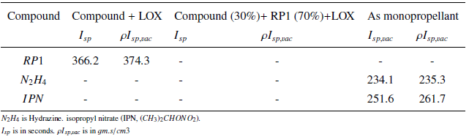
Results & Discussion-6 (HNC)
Compound | HNC+LOX ρI_{sp,vac} (gm.s/cm³) | HNC+RP1+LOX ρI_{sp,vac} (gm.s/cm³) | Mono ρI_{sp,vac} (gm.s/cm³)
C₁₀H₁₂N₄O₂ | 478.22 | 404.05 | 424.17
C₁₂H₁₃N₂O₃Br | 432.63 | 441.69 | 396.68
C₁₂H₁₆N₄O₂ | 453.15 | 419.52 | 340.48
C₁₆H₂₀NO₃Br | 450.33 | 424.85 | 324.71
Table 5: ρI_{sp,vac} from last 3 mixtures
Compare the values
Table 6: Propulsive properties of currently used compounds

Slide 14

Results & Discussion-7 (HNC)
Compound | Detonation Pressure, D (kBar) | Detonation Velocity, V (km/s)
C₁₀H₁₂N₄O₂ | 132.74 | 5.69
C₁₂H₁₃N₂O₃Br | 104.8 | 4.86
C₁₂H₁₆N₄O₂ | 215.99 | 7.43
C₁₆H₂₀NO₃Br | 77.92 | 4.36
where ρ (g/cm3) is the density, M_{av} (g/mol) is the average molecular weight of the
gaseous products, N (mol/g) is the number of moles of gaseous products per gram of
explosive and Q (cal/g) is the mass specific enthalpy of detonation (Mallick et al., 2017).
Table 6: Predicted* detonation properties
* Detonation properties not computed if Q is negative

Slide 15
HNC- Conclusion
Results of propulsive properties under 5 different mixture combinations are presented
As solid bipropellant with AP as oxidiser (80% AP, 20% HNC)
As additive to AP-HTPB mixture (80% AP, 15% HTPB, 5%HNC)
As propellant with LOX as oxidiser
As additive to RP1 with LOX as oxidiser (30%HNC, 70% RP1)
As monopropellant
Detonation properties (Pressure and Velocity) are tabulated.
Specific impulse values show that these HNC compounds are better than currently used compounds by a small factor (compare tables 5 & 6)
I_{sp} values roughly follow the trend
LOX (table3) > RP1, LOX (table4) > Monopropellant(table5) > AP (table1) > HTPB, AP (table2)
Heavier atoms like Br tend to reduce overall effectivity sometimes, though not a sweeping conclusion
The detonation properties are not as good as that of RDX (DP = 35.1Gpa, DV = 8.93 m/s)[*]
[*] Mallick, L., Lal, S., Reshmi, S., Namboothiri, I. N. N., Chowdhury, A., and Kumbhakarna, N., 2017, “Theoretical studies on the propulsive and explosive performance of strained polycyclic cage compounds,” New J. Chem. 41, 920–930.

Slide 16
Topic 2 Chemical Reaction Mechanism (CRM)
PTFE (aka Teflon) + Aluminium Nano-particles in presence of solvents

Slide 17
Literature Review - CRM
PTFE (Polytetrafluoroethylene) and Aluminium Nano particles reaction is of interest [*]
Solvent used in preparation reaction mixtures affects thermal properties. Flame speeds, DSC (differential scanning calorimetry) measurements.
Possible reason : Pre ignition reaction (PIR)
Occurs before primary combustion at ~ 510 °C
Strengthened by MDM (melt dispersion mechanism)
Tiny Al-F layer over the 3nm thick Al₂O₃ shell.
Polar solvents > Non polar solvents > No solvation
observed trend in [*]
Solvent effect
[*] Padhye, R., McCollum, J., Korzeniewski, C., and Pantoya, M. L., 2015, “Examining hydroxyl alumina bonding toward aluminum nanoparticle reactivity,” The Journal of Physical Chemistry C 119, 26547–26553

Slide 18
Computational Methods-1
Gaussian software
Calculation framework:
Basic reactants, products optimisation + frequency using CBSQB3 theory
Scan calculation to find Transition State (TS) of the reaction using simple theory
Transition State (TS) optimisation using same simple theory
Perform IRC (Intrinsic Reaction Coordinate) calculations for both forward & backward iterations starting from the transition state
Transition State optimisation using CBSQB3 theory, which is a high level theory
Find the kinetics, thermochemical parameters (activation energies, G,H, kf ,kb etc) using transition state theory mentioned earlier.

Slide 19
Computational Methods-2
Heat of formation of a compound A_{x} B_{y} H_{z} [*]:
ΔH⁰_{f} (A_{x} B_{y} H_{z} , 298 K) = ΔH⁰_{f}(A_{x}B_{y}H_{z} ,0 K) + [H⁰(A_{x}B_{y}H_{z} ,298 K) - H⁰(A_{x}B_{y}H_{z} ,0 K)]
– x[H⁰(A, 298 K) - H⁰(A, 0 K)]_{st}
– y[H⁰(B, 298 K) - H⁰(B, 0 K)]_{st}
– z[H⁰(H, 298 K) - H⁰(H, 0 K)]_{st}
[*] Lewars, E.G., Computational chemistry: introduction to the theory and applications of molecular and quantum mechanics. 2010: Springer Science & Business Media.

Slide 20
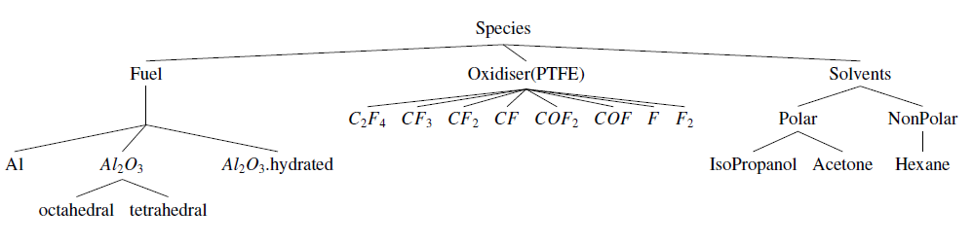
Possible pathways
Suggested reaction categories
Al₂O₃-OH + F containing radical –> Al₂O₃-F + OH⁻ + Other Products
Solvent + F containing radical –> F substituted solvent.
Al₂O₃-OH + F substituted solvent –> Al₂O₃-F + Solvent
Solvent –> Decomposition products
Notes:
Note: This may occur with and without solvent
Note: This occurs specifically with the presence of solvent. Solvent may act as
carrier to the fast moving and highly reactive fluoride radicals.

Slide 21
CRM - Conclusion
Proposed methodology has been verified by trying it out for the reaction
N₂H₄ + NO₂ N₂H₃ + HONO
Possible reactions pathways have been identified for interaction between Alumina and PTFE decomposition products.

Slide 22
Future Work
HNC compound analysis is complete. All the results are available now.
All the reactions from part 2 will be simulated in the next semester. CRM formulation will be finished in BTP 2.

Slide 23
References
Rajkumar, S., Choudhari, R. S., Chowdhury, A., and Namboothiri, I. N., 2013, “Synthesis and pyrolysis studies of bis(nitratomethyl)-1,3-bishomocubane- a high-energy highdensity liquid,” Thermochimica Acta 563, 38 – 45.
Padhye, R., McCollum, J., Korzeniewski, C., and Pantoya, M. L., 2015, “Examining hydroxyl alumina bonding toward aluminum nanoparticle reactivity,” The Journal of Physical Chemistry C 119, 26547–26553
Ochterski, J. W., 2000, “Thermochemistry in gaussian,” http://gaussian.com/thermo/, Accessed: 2017-11-07.
Lewars, E. G., 2011, Computational Chemistry (Springer Netherlands).
Losada, M., and Chaudhuri, S., 2009, “Theoretical study of elementary steps in the reactions between aluminum and teflon fragments under combustive environments,” The Journal of Physical Chemistry A 113, 5933–5941.
Mallick, L., Lal, S., Reshmi, S., Namboothiri, I. N. N., Chowdhury, A., and Kumbhakarna, N., 2017, “Theoretical studies on the propulsive and explosive performance of strained polycyclic cage compounds,” New J. Chem. 41, 920–930.
Mulamba, O., and Pantoya, M. L., 2014, “Exothermic surface chemistry on aluminium particles promoting reactivity,” Applied Surface Science 315, 90 – 94.

Slide 24
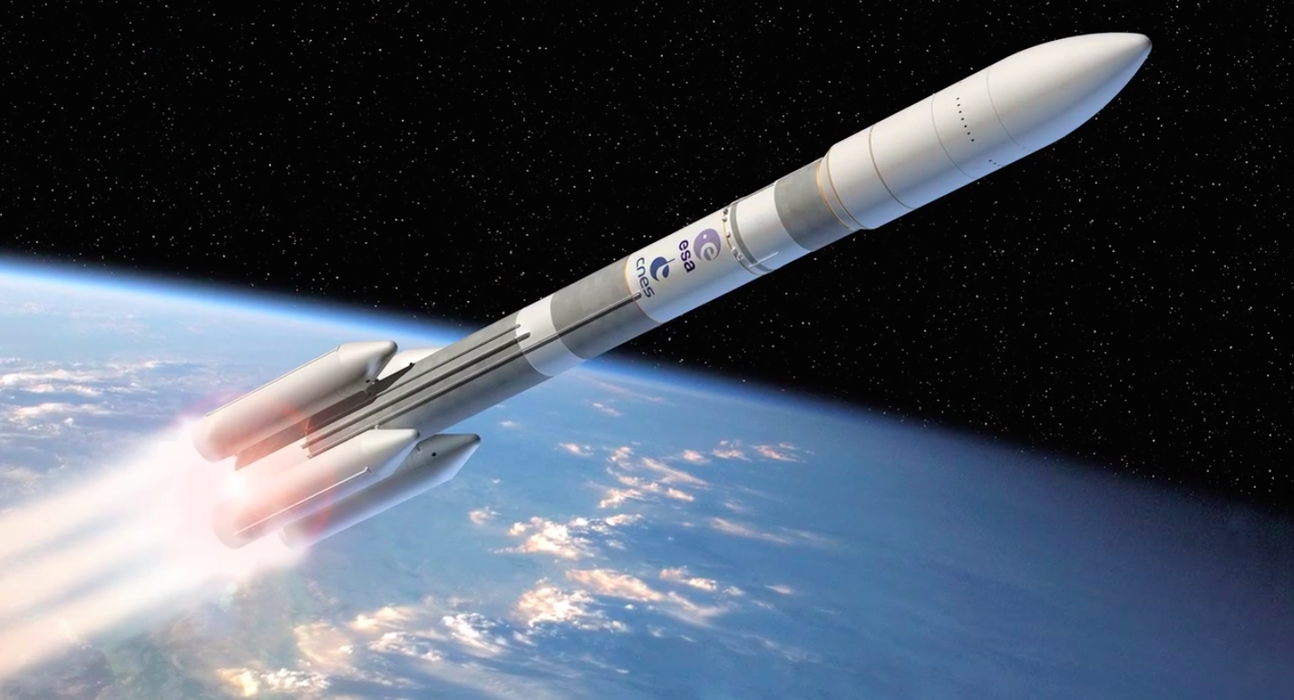
To Infinity and Beyond !
Thank you

