Slide 1
Particle Image Velocimetry
2D Statistical Technique
By :
Gowtham.K & Krishna Sandeep.B

Slide 2
What is PIV?
PIV stands for Particle Image Velocimetry.
It is a Non-intrusive (Imaging) Measurement Technique used for capturing velocity of whole field flow in very short time (fraction of second).
Active research on PIV has started in the 1980s.
This presentation focuses on the digital evaluation, It is of great importance because of the advent of Computer era. It is by far the most used, fast evaluation techniques of the PIV Data.

Slide 3
Structure of PIV
The basic components of any PIV setup are
Flowing Fluid (with Tracer Particles)
Laser (Nd:YAG double phased laser- commonly used)
Optical lens (for creating light sheet)
Camera
Synchroniser
Computer (for evaluation)
Further details can be obtained from any of the abundant references available.

Slide 4
Digital Evaluation
The images obtained from the camera is the raw data used for evaluation in the computer.
Each image is a rectangular 2D array of Pixels. Each pixel is again a rectangular region of color.
There are two types of images
Grayscale (black, white)
RGB (red, blue, green)
Each pixel contains all those colours with different intensities.

Slide 5
Types of digital techniques
S.No | Method | Seeding density
1. | Particle Tracking | low
2. | Statistical Methods (PIV) Auto-Correlation Cross-Correlation | medium
3. | Laser Speckle | high

Slide 6
Correlation
Particle tracking techniques give erroneous results as the particle density increases. They employ computations on individual particles as the fluid flows
Laser Speckle Velocimetry (LSV) and Particle Image Velocimetry are essentially same with just different seeding density.
PIV is a statistical method of evaluation.
“Only the Bulk is important”
Interrogation windows are the group of pixels selected in the region of interest. They may partially overlap with one another to obtain better resolution.
These windows are the representatives of displacements.
Notes:
Super resolution : Subwindow spatial resolution is obtained by statistical methods followed by particle tracking in that window.

Slide 7
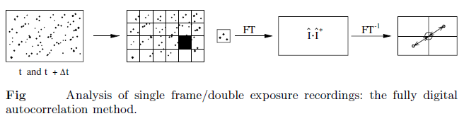
Autocorrelation
The main objective of the statistical evaluation of PIV recordings at medium image density is to determine the displacement (i.e. The Shift) between two patterns of particle images, which are stored as a 2D distribution of gray levels.
Autocorrelation is the cross-correlation of a signal with itself at different points in time (that is what the cross stands for).

Slide 8

Cross Correlation
It is a measure of similarity of two signals as a function of the lag of one relative to the other.
In our present discussion, the time lag gives us two separate images.
Single Exposure/ Double Frame image sets {I, I’} are used for computing cross-correlation function.
I(i,j) represents the grayscale intensity value at point (i,j).

Slide 9
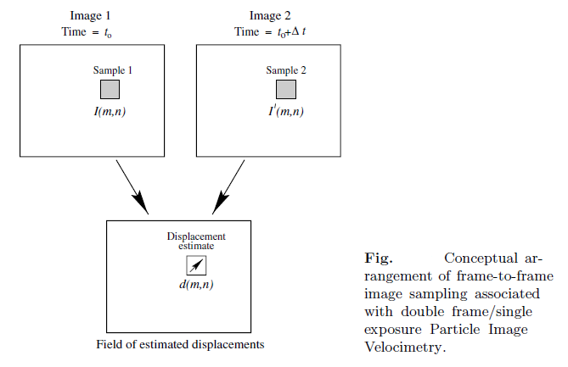

Slide 10
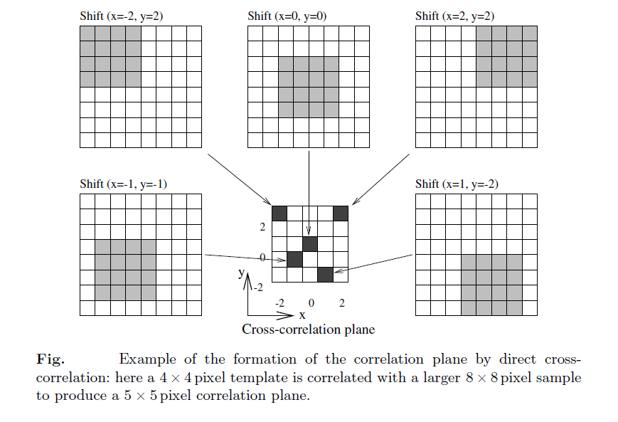

Slide 11
Version 1(direct computation)
OpenCV library is used for the image processing needs of the code.
The correlation coefficient is calculated by directly multiplying the intensities as given by the formula for c_{II}(x,y) in the following slide.
The code outputs the initial and the final points of the respective interrogation window(indexed as the left-top corner of the matrix).
It also creates an image with the velocity vectors drawn with the background as the original image.
The rogue vectors(inevitable due to statistical correlation deficiencies) were not removed or corrected as needed in this version.
The later version will include the use of the FFT algorithm and corrections.

Slide 12
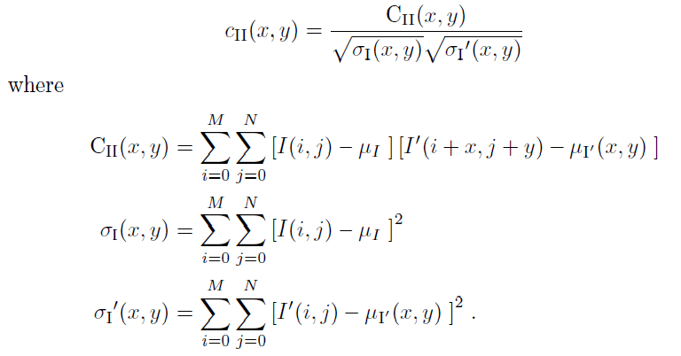
Normalising the correlation coefficient:
The correlation values will have different maximum values for the same amount of overlap if not normalised.
To normalise we use the following equation

Slide 13
FFT based Algorithm
The time complexity of the above mentioned cross-correlation formula is O(N⁴).
This problem can be solved by using frequency domain based calculations. The time complexity becomes O(N² log₂ N).
The savings thus obtained are huge when the size of the image is big (1200 x1200 pixels).
Thus the remainder of this report consists of Fast Fourier Transform (FFT) based algorithm.

Slide 14
A first order approximation to proper normalisation can be done using the following steps
Step 1 : Sample the images at desired locations and compute the mean and standard deviations of each.
Step 2 : Subtract the mean from each of the samples.
Step 3 : Compute the cross-correlation function using 2D FFT.
Step 4 : Divide the cross-correlation values by the standard deviations of the original samples.
Step 5 : Proceed with the correlation peak detection taking into account all artifacts present in FFT based cross-correlation.

Slide 15
References
“ Particle Image Velocimetry , A Practical Guide” by M.Raffel, Christian E. Willert, Steven T. Wereley, J. Kompenhans
OpenCV 2.4.13 documentation

