Slide 1
M.GOWTHAM
KEYLOGGERS SIMULATOR
3/21/2024 Annual Review

Slide 2
PROJECT TITLE
Implementation of keylogger simulator using python
3/21/2024 Annual Review

Slide 3


AGENDA
1. Introduction to keylogger simulator:A keylogger simulator is a tool or software program designed to mimic the behavior of a keylogger without actually logging or recording any keystrokes.
2. Benefits of keylogger simulator:Keylogger simulators offer several benefits for both individuals and organizations interested in cybersecurity education, training, and defense
Education and Awareness, Training Purposes,Testing Security Measures,
3. Best practices for keylogger simulator:When developing or using a keylogger simulator, it's essential to adhere to best practices to ensure its effectiveness, safety, and ethical use. Here are some best practices for keylogger simulators:
4.Conclusion and summary: In conclusion, keylogger simulators serve as valuable tools for cybersecurity education, training, and defense.
3/21/2024 Annual Review

Slide 4

PROBLEM STATEMENT
To develop an keylogger simulator system that can efficiently hide a secret message within an image without compromising the visual quality of the image and ensuring the security of the hidden information.
3/21/2024 Annual Review

Slide 5

PROJECT OVERVIEW
The Keylogger Simulator project aims to develop a software tool that mimics the behavior of real keyloggers in a controlled environment. The simulator will serve as an educational resource for cybersecurity professionals, students, and enthusiasts to understand keylogging threats, enhance skills in detecting and mitigating such threats, and improve overall cybersecurity defenses.
Features:
1.Simulated Keylogging: The simulator will capture keyboard input from users within the simulated environment, mimicking the behavior of real keyloggers.
2.User Interface: The simulator will include a user-friendly interface for interacting with the simulated environment, displaying captured keystrokes, and providing educational resources on keylogging threats and defenses.
3.Customizable Settings: Users will have the option to customize various settings such as the duration of the simulation, the frequency of keylogging events, and the types of keystrokes captured.
3/21/2024 Annual Review

Slide 6

YOUR SOLUTION AND ITS VALUE PROPOSITION
Solution Overview:
The solution is a software tool designed to simulate the behavior of keyloggers in a controlled environment.
It includes features such as capturing keyboard input, displaying captured keystrokes, customizable settings, data visualization, educational resources, security measures, logging and reporting, and integration with learning management systems.
The keylogger simulator provides a user-friendly interface and incorporates security measures to protect user privacy and prevent unauthorized access to captured data.
It aims to enhance cybersecurity education, skill development, and defense strategies by providing practical learning experiences and promoting ethical behaviore
3/21/2024 Annual Review

Slide 7
YOUR SOLUTION AND ITS VALUE PROPOSITION
Improved Defense Strategies: By understanding how keyloggers operate and learning effective mitigation strategies, users can enhance their organization's cybersecurity defenses and protect against real-world attacks.
Ethical Use: The simulator promotes ethical behavior by providing a safe and legal environment for learning about keylogging threats and practicing defense strategies without posing any risk to user privacy or security.
Comprehensive Features: With a range of customizable settings, educational resources, and integration capabilities, the keylogger simulator offers a comprehensive solution for cybersecurity training and awareness.
In summary, the keylogger simulator solution not only provides a realistic simulation environment for understanding keylogging threats but also adds value by empowering users with the knowledge and skills needed to defend against such threats effectively. It promotes ethical behavior and offers a range of features to support cybersecurity education and skill development.
3/21/2024 Annual Review

Slide 8

THE WOW IN YOUR SOLUTION
Realistic Simulation: The simulator accurately replicates the behavior of keyloggers, providing users with a realistic experience of how these threats operate in the wild. This authenticity enhances the learning experience and allows users to grasp the severity of keylogging attacks.
3/21/2024 Annual Review

Slide 9
MODELLING
Modeling in a keylogger simulator involves creating a representation of the keylogging behavior and its impact on the system. Here's how modeling can be incorporated into a keylogger simulator:
Behavior Modeling:
Define the behavior of the simulated keylogger, including how it captures keystrokes, stores data, and interacts with the system.
Model different types of keyloggers, such as hardware-based, software-based, and memory-based, each with its unique characteristics.
Consider factors like stealthiness, persistence, and evasion techniques employed by real-world keyloggers.
Keystroke Capture Model:
Develop algorithms to capture keystrokes from various input devices, including keyboards, virtual keyboards, and on-screen keyboards.
Simulate the capture process, including keylogging triggers, event handling, and data extraction methods.
Model the storage and encoding of captured keystrokes, ensuring accuracy and efficiency.
Data Storage Model:
Design data structures to store captured keystrokes securely, considering factors like data encryption, compression, and access control.
3/21/2024 Annual Review

Slide 10

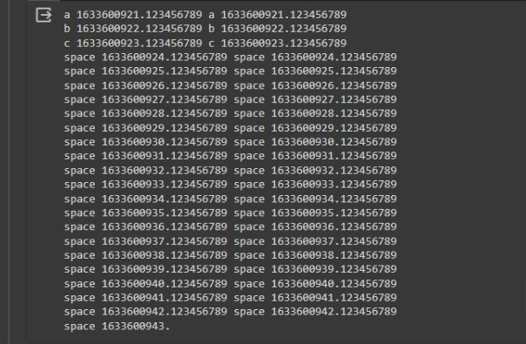
MODELING

Slide 11
RESULTS
In a keylogger simulator, the "result" refers to the output or outcome of the simulation process. Here are some key results that users can expect from a keylogger simulator:
Captured Keystrokes: The primary result of a keylogger simulator is the captured keystrokes. Users can view the keystrokes logged by the simulator, including the characters typed by the user, timestamps of the keystrokes, and any additional metadata associated with the input.
Visualization of Keylogging Activity: The simulator may provide visualizations or reports of keylogging activity, such as charts or graphs showing the frequency of keystrokes over time, the distribution of keystrokes by key type, or patterns in the captured data.
Detection Alerts: If the simulator includes detection mechanisms, users may receive alerts or notifications when keylogging activity is detected. These alerts can help users understand how detection algorithms work and how to respond to potential threats.
Demo Link
3/21/2024 Annual Review

