Slide 1
Mid Project Review
Examining the for–hire vehicle trips in New York City.
--Narendra Yadav Pottipati, Sai Teja Reddy Dundra, Sri Ram Abhinav Reddy Dudi, Srinivas Gowtham Majeti, Vinay Reddy Baddam

Slide 2
Objective
This project aims to gain insights into the demand, supply, and business goals of for-hire vehicle services like Uber and, Lyft, Via. These insights gained from this project can help optimize their operations and improve their services to meet better the needs of their customers in New York City.

Slide 3
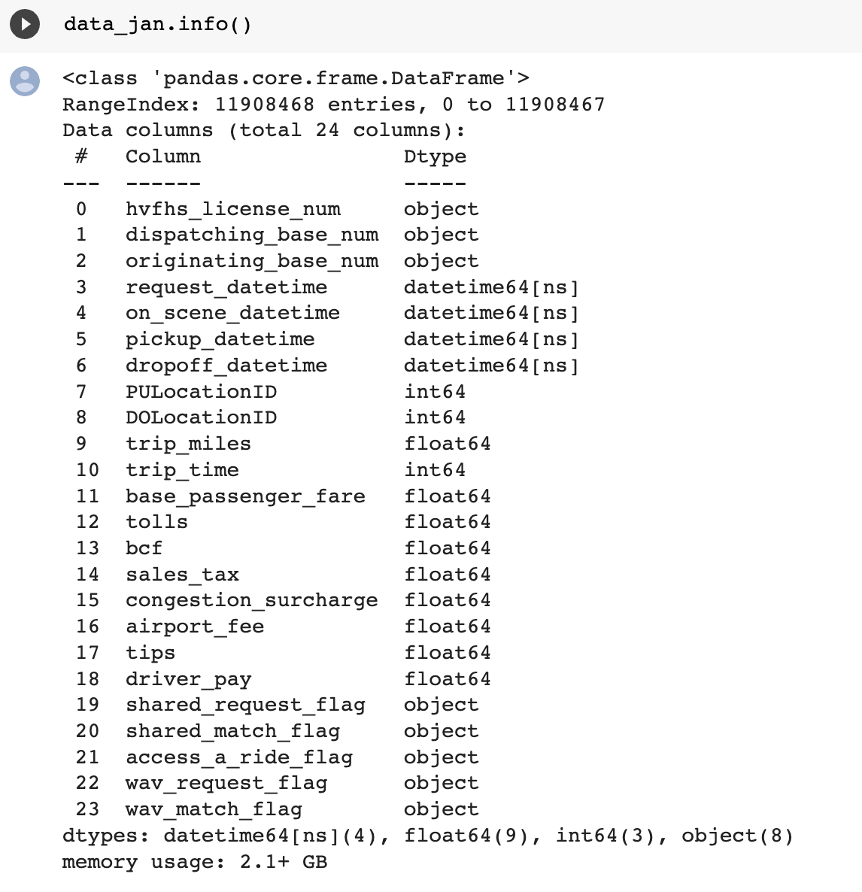
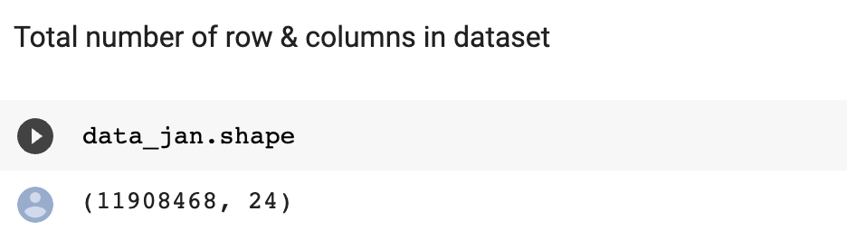
Dataset Info:

Slide 4
Outcomes

Slide 5
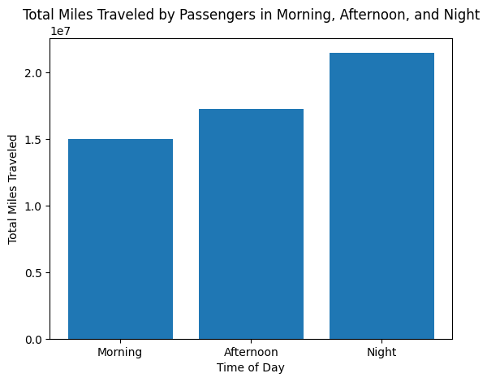
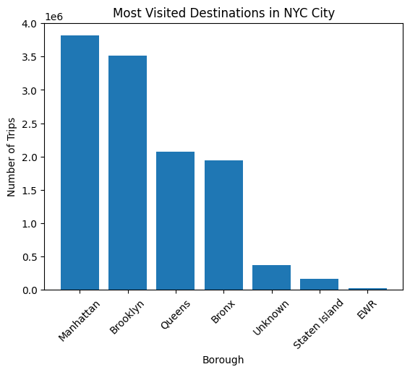
Total miles traveled by passengers in comparison to morning, afternoon, and night in a month (Uber, Lyft, via)?
In a month, the most visited destinations were traveled by passengers in (Uber and Lyft, Via) NYC?

Slide 6
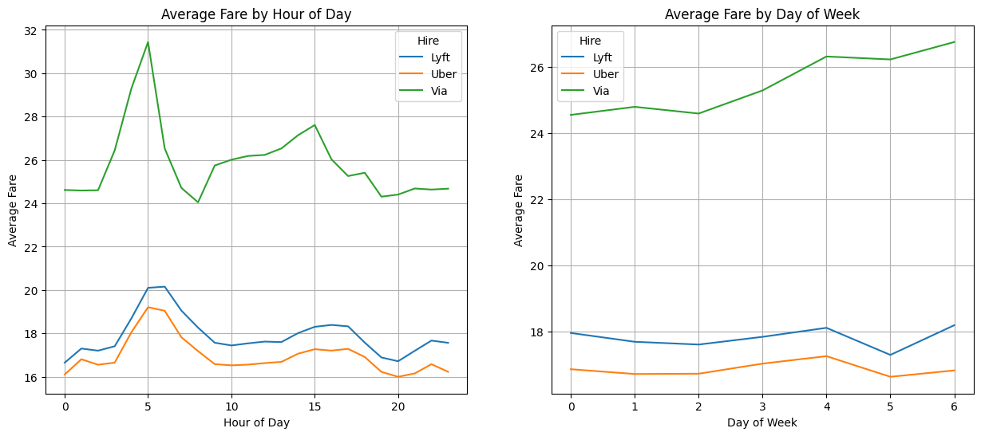
Average passenger fare for each hire vehicle and how it varies by time or day, or week?

Slide 7
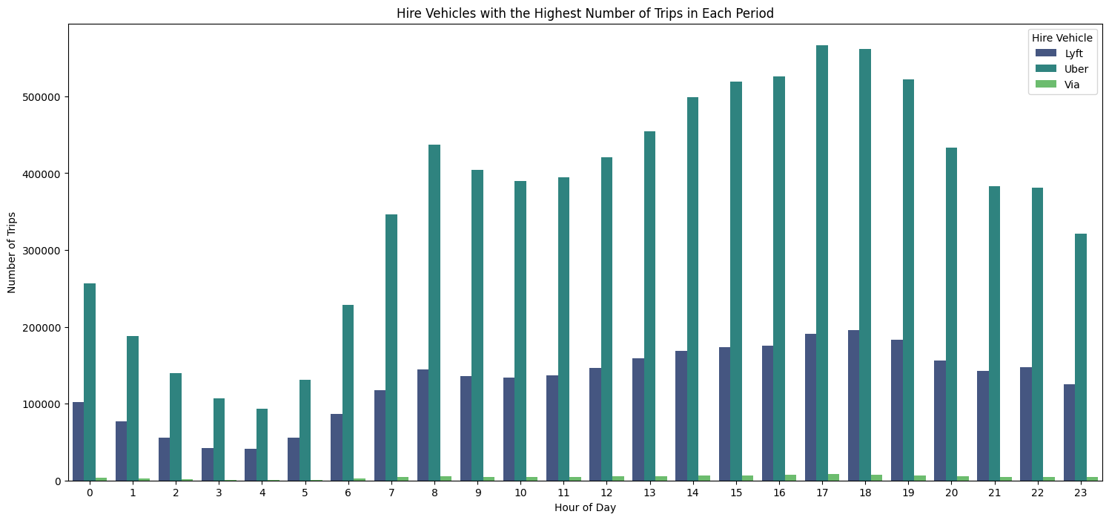
Progress…
Hire Vehicles with the highest number of trips in each period.

Slide 8
Still working on…
What is the overall profitability of each hire vehicle, and how has it changed over time?
For-hire zones with more trips, and if so, which ones?
Drivers' earnings per trip on average and comparison across different hire vehicles?
Preferred pickup and drop-off locations, the average length of their rides, and how long they are willing to wait for a ride.

Slide 9
Thank You

