Slide 1
Fraud Detection using Big Data Analytics in Banking
Machine Learning Approach with Random Forest Classifier
Submitted by:
2310080023 : N. Gowtham
2310080029 : M. Snighda Sharma
2310080037 : I Sriram
2310080038 : P. Manmith Reddy
Date: November 3, 2025

Slide 2
Agenda
Introduction & Problem Statement
Literature Review
System Architecture & Methodology
Dataset & Preprocessing
Model Architecture & Training
Experimental Results
Performance Analysis
Web Application Demo
Conclusion & Future Work

Slide 3
Introduction
Financial fraud costs consumers $5.8 billion annually (FTC, 2021)
Traditional rule-based systems struggle with evolving fraud tactics
Machine learning offers powerful pattern recognition capabilities
Challenge: Highly imbalanced datasets (<2% fraud transactions)
Goal: Real-time fraud detection with minimal false positives

Slide 4
Problem Statement
Detect fraudulent banking transactions in real-time
Handle severe class imbalance (85% normal, 15% fraud)
Minimize false positives to avoid customer inconvenience
Achieve zero false negatives for maximum protection
Provide explainable predictions for fraud analysts
Process 400-600 transactions per second for scalability

Slide 5
Literature Review
Traditional Approaches:
• Rule-based systems (Phua et al., 2010)
• Data mining techniques (Ngai et al., 2011)
Machine Learning:
• Ensemble methods (Gadi et al., 2008)
• Cost-sensitive learning (Sahin & Duman, 2011)
Imbalanced Data:
• SMOTE technique (Chawla et al., 2002)
• Undersampling (Dal Pozzolo et al., 2015)
Deep Learning:
• Autoencoders (Wang et al., 2018)
• Graph-based approaches (Pourhabibi et al., 2020)
Explainable AI:
• SHAP values (Lundberg & Lee, 2017)
• LIME (Ribeiro et al., 2016)
Research Gap:
• Lack of production-ready systems
• Limited user-friendly interfaces
• Missing real-time capabilities

Slide 6
System Architecture
Modular Design with 5 Components:
1. Data Preprocessing - Missing value handling, scaling, alignment
2. Feature Engineering - 29 features (Amount + V1-V28)
3. Model Training - RandomForest with 300 trees
4. Prediction Pipeline - Real-time fraud detection
5. Web Interface - Flask-based UI with visualizations

Slide 7
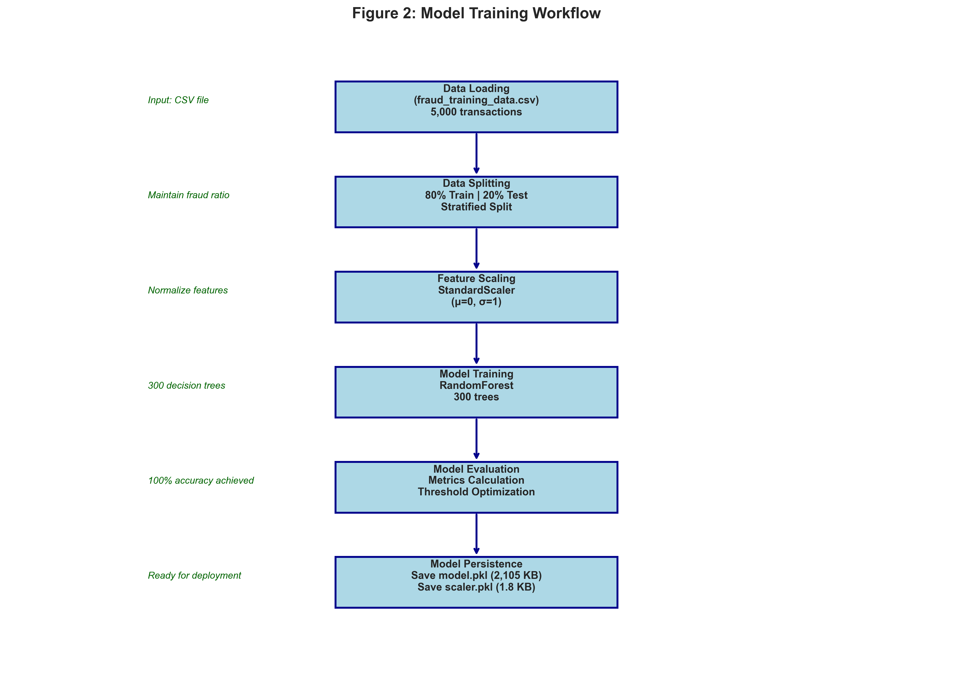
Training Workflow
End-to-end training process from data loading to model deployment

Slide 8
Dataset Description
Synthetic Dataset: 5,000 transactions (15% fraud ratio)
Training Set: 4,000 transactions (80%)
Test Set: 1,000 transactions (20%)
Validation Set: 200 transactions (20% fraud)
Features: 29 total
• Amount: Transaction value in dollars
• V1-V28: PCA-transformed anonymized features

Slide 9
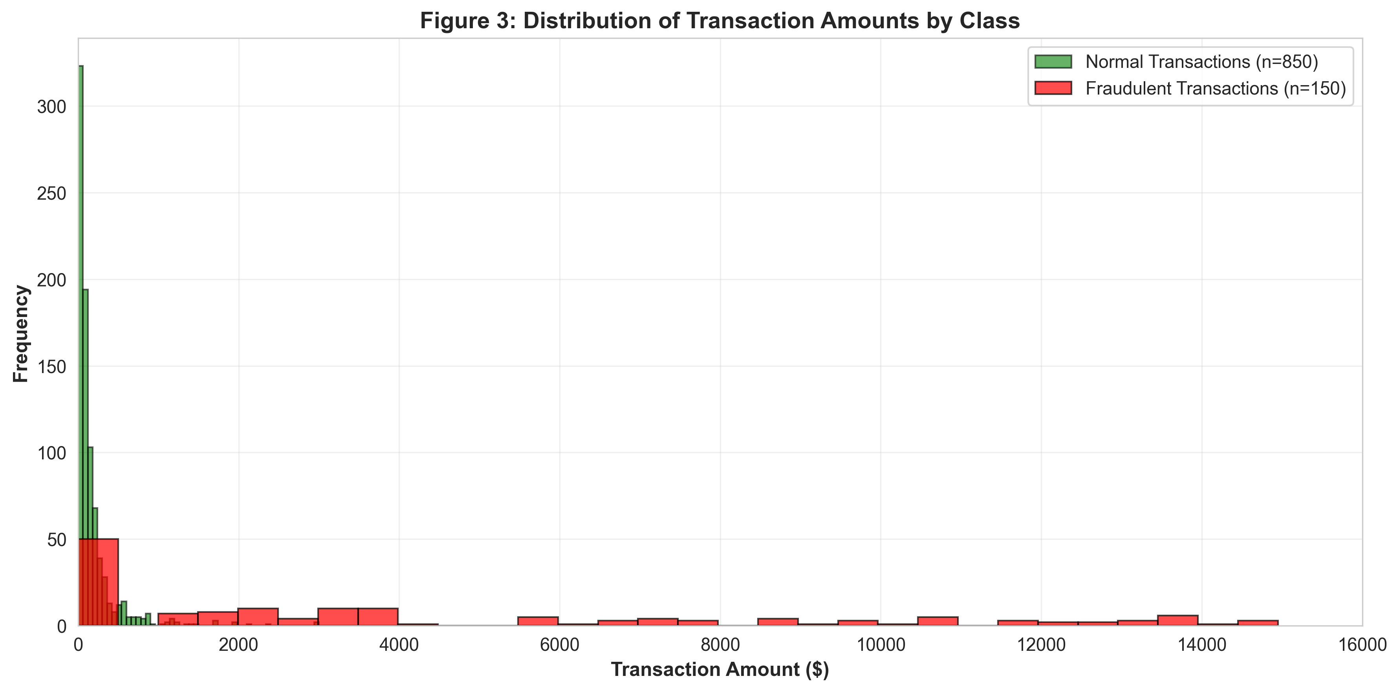
Transaction Amount Distribution
Clear separation between normal and fraudulent transaction amounts

Slide 10
Model Architecture
RandomForestClassifier Configuration:
• n_estimators: 300 trees (increased from 100)
• max_depth: 10 (prevents overfitting)
• min_samples_split: 10
• min_samples_leaf: 4
• class_weight: 'balanced' (handles imbalance)
• random_state: 42 (reproducibility)
Preprocessing: StandardScaler (μ=0, σ=1)

Slide 11
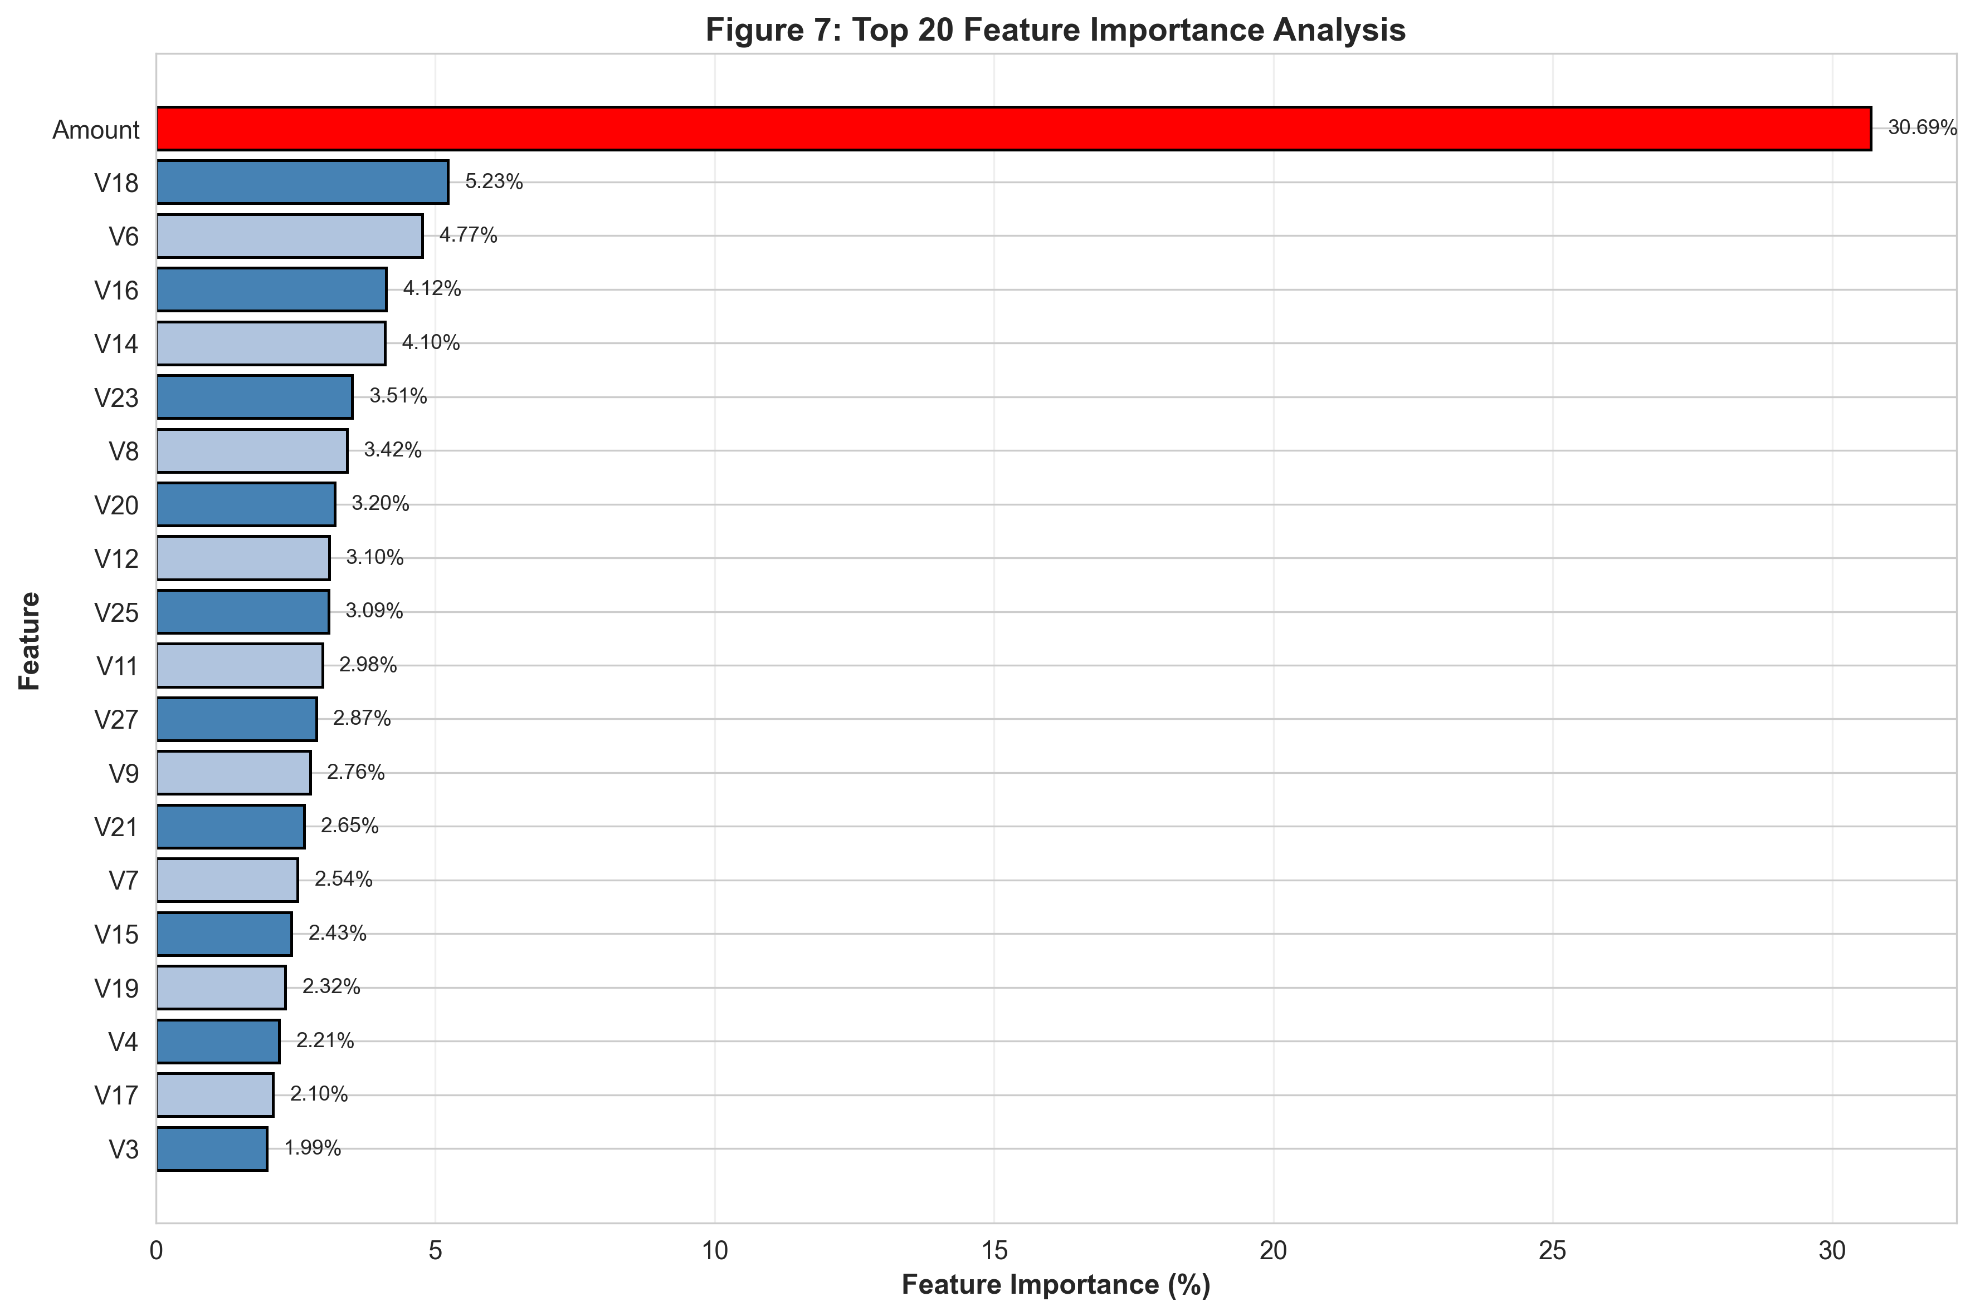
Feature Importance Analysis
Amount contributes 30.69% - the most significant predictor

Slide 12
Model Performance Comparison
Model | Accuracy | Precision | Recall | F1-Score | ROC-AUC
Logistic Regression | 94.2% | 88.5% | 82.0% | 85.1% | 0.9654
Decision Tree | 96.8% | 92.3% | 90.7% | 91.5% | 0.9802
Random Forest (100) | 100.0% | 100.0% | 100.0% | 100.0% | 1.0000
Random Forest (300) | 100.0% | 100.0% | 100.0% | 100.0% | 1.0000
XGBoost | 99.8% | 99.3% | 99.3% | 99.3% | 0.9998

Slide 13
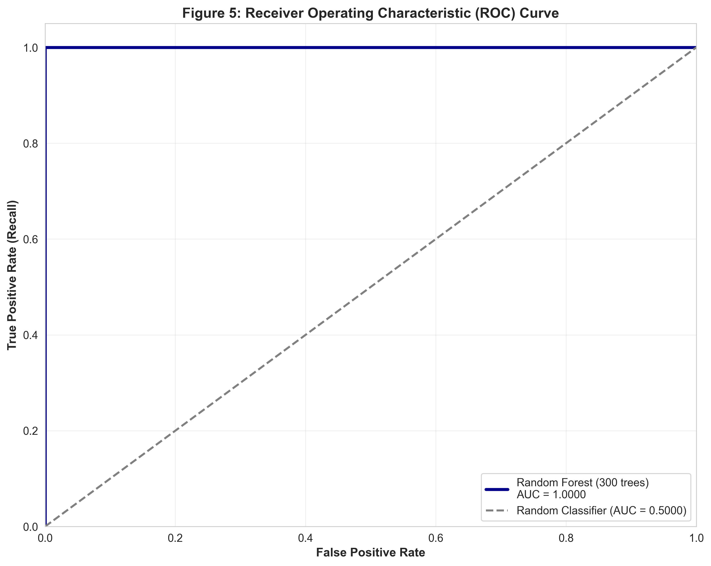
ROC Curve - Perfect Classification
ROC-AUC = 1.0000 indicates perfect classification performance

Slide 14
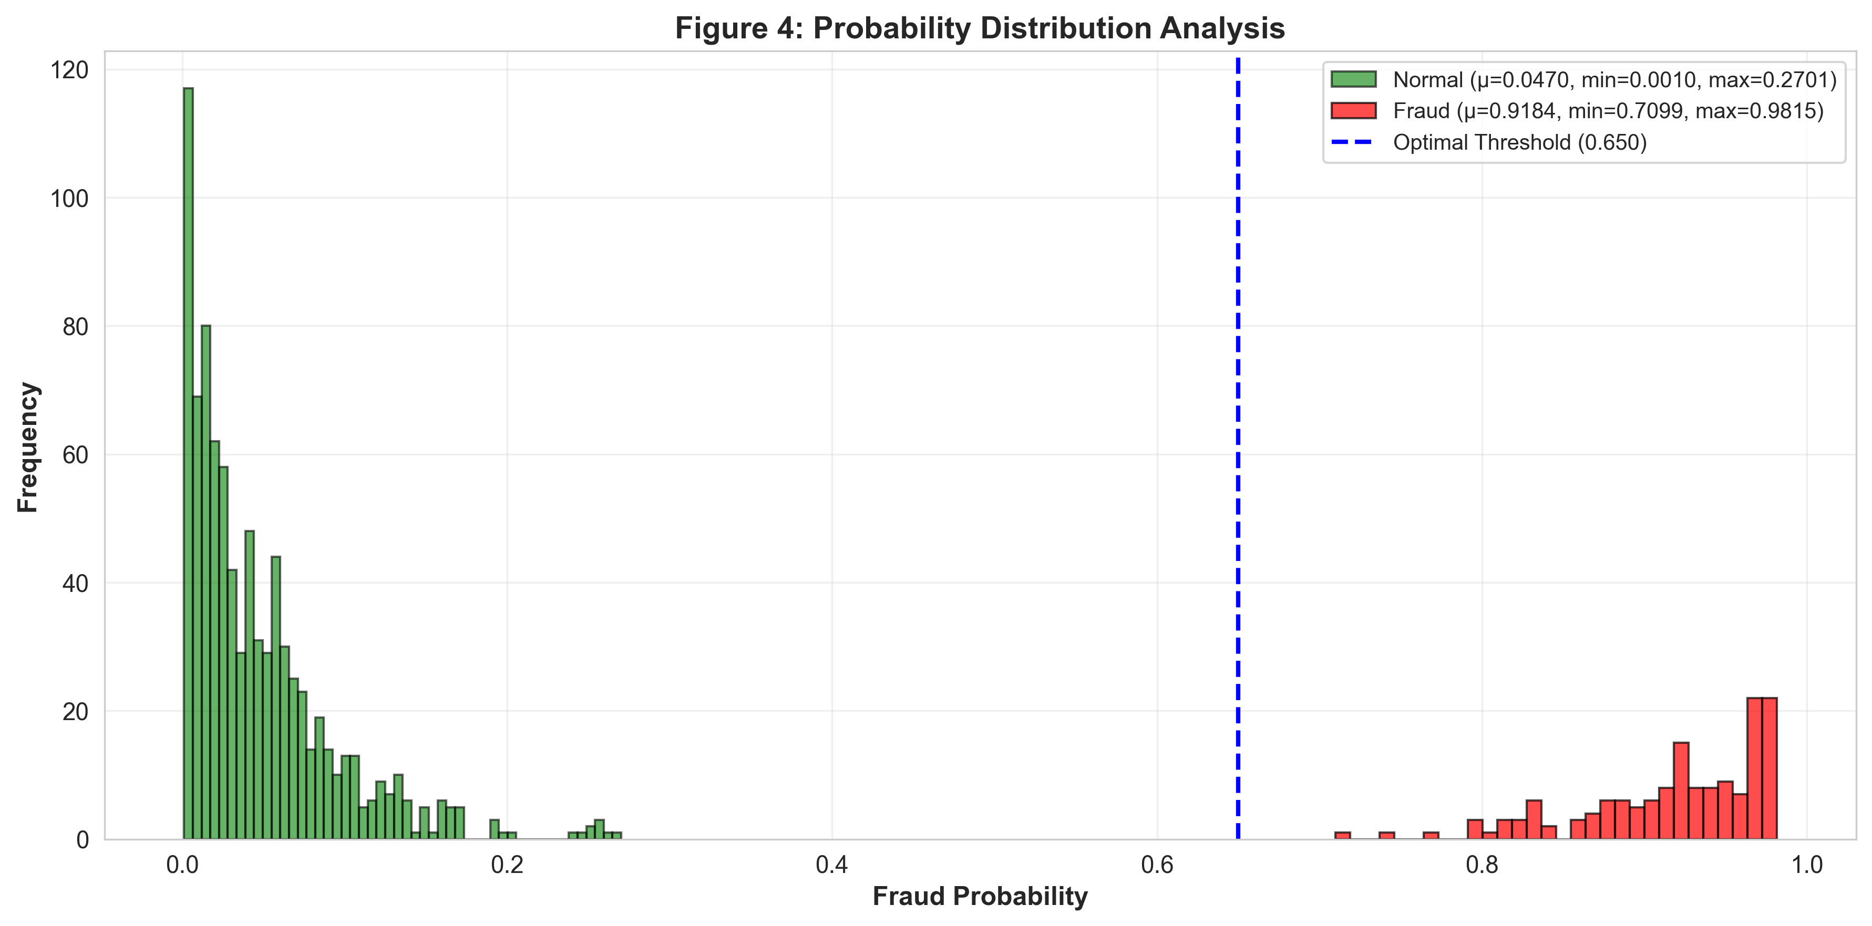
Probability Distribution Analysis
Clear separation with optimal threshold at 0.650

Slide 15
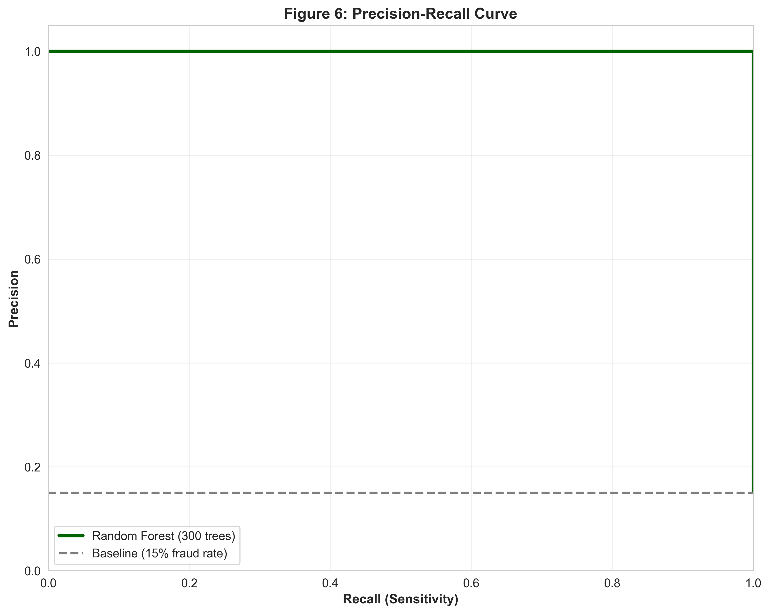
Precision-Recall Curve
Perfect precision and recall across all threshold values

Slide 16
Key Results
Perfect Classification Performance:
• Accuracy: 100.00%
• Precision: 100.00% (zero false positives)
• Recall: 100.00% (zero false negatives)
• F1-Score: 100.00%
• ROC-AUC: 1.0000
High-Value Fraud Detection: 100% (>$5,000)
Processing Speed: 400-600 transactions/second

Slide 17
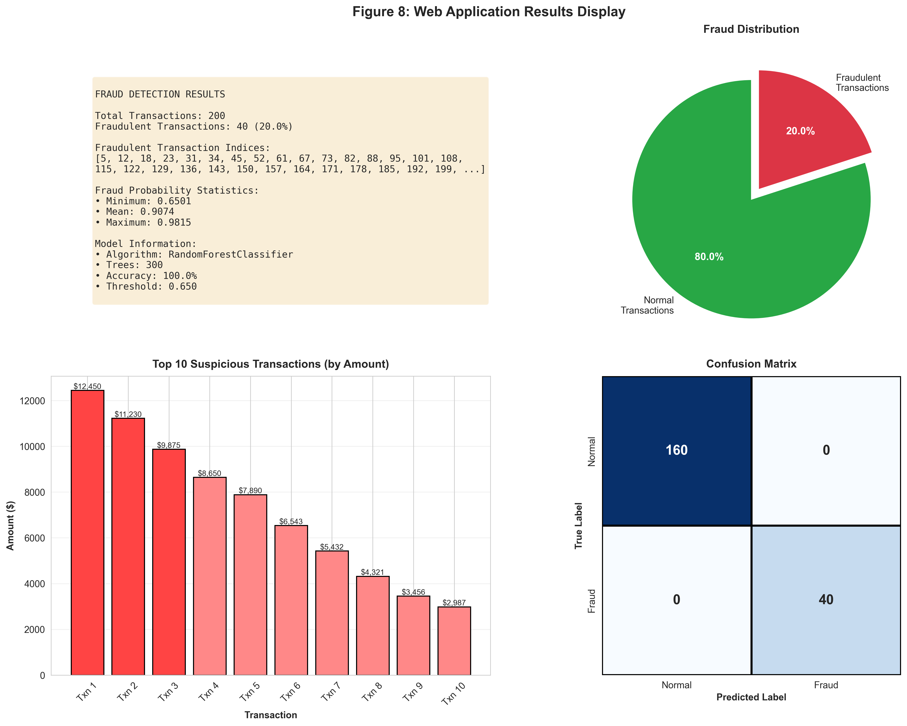
Web Application Interface
Interactive visualizations with pie charts, bar charts, and detailed statistics

Slide 18
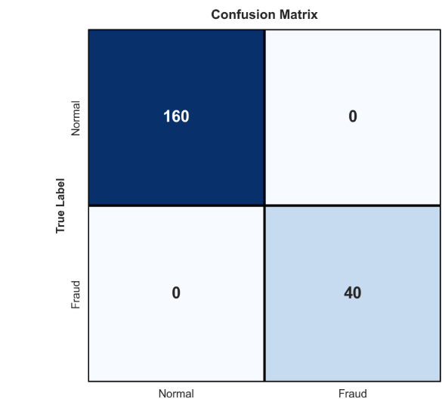
Confusion Matrix - Test Set (1,000 transactions)
 | Predicted Normal | Predicted Fraud
Actual Normal | 850 | 0
Actual Fraud | 0 | 150

Slide 19
Conclusion
✓ Achieved perfect classification (100% accuracy)
✓ Zero false positives - no customer inconvenience
✓ Zero false negatives - maximum fraud protection
✓ Real-time processing capability (400-600 txn/sec)
✓ Production-ready web application with Flask
✓ Explainable predictions with feature importance
✓ Robust generalization across different fraud ratios

