Slide 1
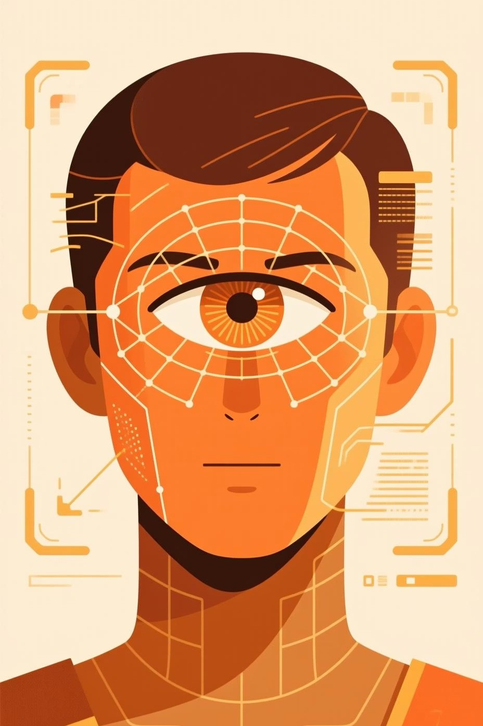
Morse Code Blink Authentication System
Hands-Free Authentication Using Eye Blinks and Morse Timing
A vision-based security system that converts blink patterns into binary PINs using MediaPipe and OpenCV, offering a silent and secure method for personal verification.
2310080023 - N.Gowtham 2310080029 - M.Snigdha Sharma

Slide 2


Silent Security: Why Blink Authentication?
CHAPTER 1 / FOUNDATIONAL CONCEPT
Translating Blinks to Binary
Quick Blink (<0.4s)
0 (Dot)
Motivation: The Need for Covert Access
Traditional input methods are often cumbersome, noisy, or require physical contact. We need a solution for secure, silent, and entirely hands-free authentication in sensitive environments.
Long Blink (g0.4s)
1 (Dash)
This timing-based encoding offers inherent advantages in privacy and accessibility, enabling interaction without physical devices or overt action.
The Core Principle: Morse Code as Binary Input
The system is inspired by Morse Code9s use of timing to encode information. Blinks become the input signal, where the duration determines the binary value.

Slide 3

Technical Deep Dive: From Eyelid to Encrypted PIN
CHAPTER 2 / MECHANICS & STACK
Video Capture
Landmark Detection
Compute EAR
Blink ³
Binary PIN
Secure Hash Check
Key Technologies Used
MediaPipe: Used for robust, real-time facial landmark and face mesh detection.
OpenCV & NumPy: Handle live video processing and mathematical calculation of the Eye Aspect Ratio (EAR).
Security Implementation
The captured binary PIN is converted using SHA- 256 Hashing.
This hash is compared against a pre-stored hash in a secure JSON database (users.json).

Slide 4




CHAPTER 3 / REAL-WORLD ADOPTION
Transformative Applications & Use Cases
Enhanced Accessibility
Provides a critical interface for individuals with severe mobility issues (ALS, paralysis) to control devices and authenticate access completely hands-free.
High-Security/Covert Operations
Enables field agents to access secure data or equipment silently, or for high-security areas requiring zero-touch login.
IoT & Consumer Devices
Integration into smart glasses, vehicles, and smart home systems for personalized, eye-based profile login and feature control.

Slide 5

Looking Ahead
CHAPTER 4 / OUTLOOK
1
2
Current Limitations
System reliability is highly dependent on consistent lighting conditions.
Users require initial training to maintain consistent blink timing.
Risk of blink fatigue during extended use.
Future Development Scope
Adaptive Calibration: Dynamic adjustment of the EAR threshold based on user physiology and environment.
Web Integration: Implementing WebRTC for real- time authentication in web-based applications.
Biometric Fusion: Combining blink patterns with other biometrics (e.g., iris scan) for multi-factor security.
Bridging human intention and machine authentication 4 one blink at a time.

