Slide 1


Sprint 3
Gowtham Raj K R

Slide 2
AGENDA
SOURCE CONTROL MANAGEMENT
GITHUB vs BITBUCKET
POWERSHELL
DOS(DISK OPERATING SYSTEM)
POWERSHELL vs CMD

Slide 3
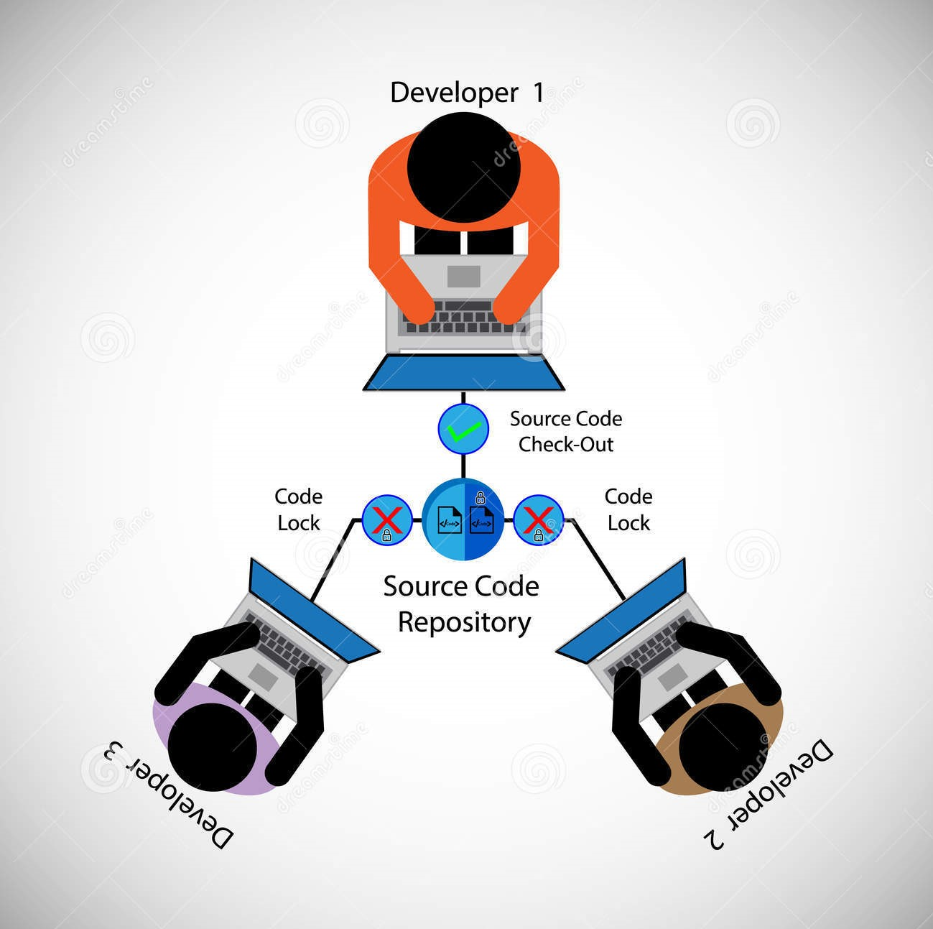
What is Source Control Management

Slide 4

GitHub vs BitBucket

Slide 5

PowerShell Execution Policy

Slide 6

PowerShell and Why We Need PowerShell

Slide 7
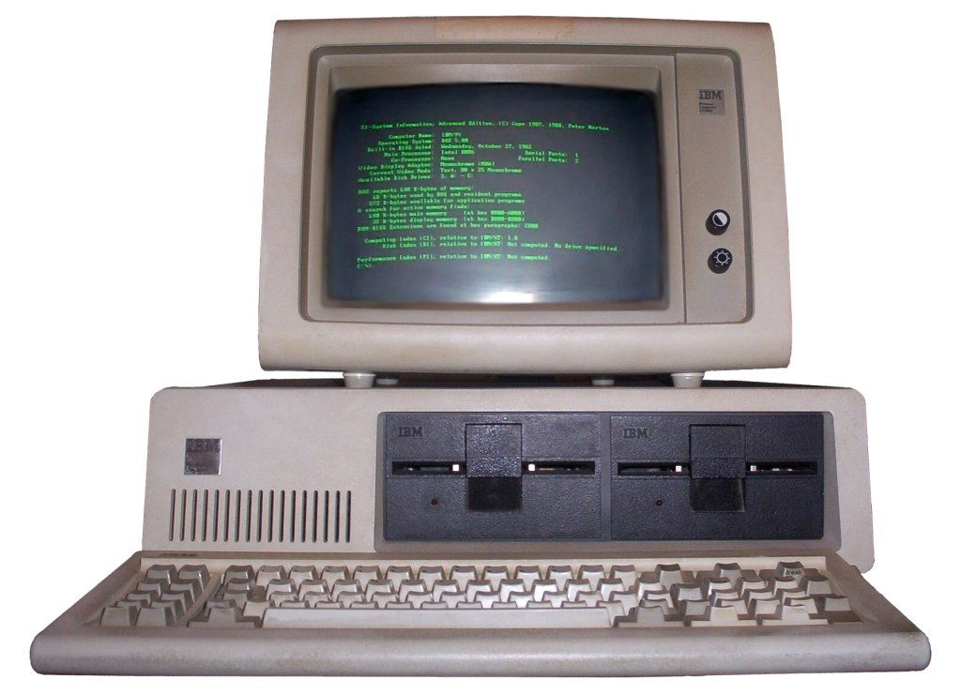

DOS (Disk Operating System)

Slide 8
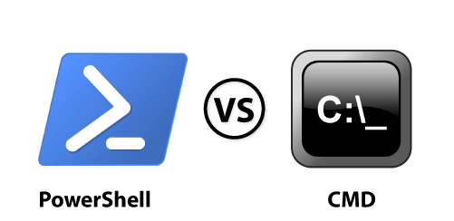
PowerShell vs CMD

Slide 9


