Slide 1
Docker
By Gowtham And Nawaz

Slide 2


Agenda
What is Docker?
Why we need Docker?
IT Industry Before and After Docker
Main Components of Docker
Architecture of Docker
Workflow of Docker File to Docker Container
Basic Docker Commands
Demo on Docker

Slide 3
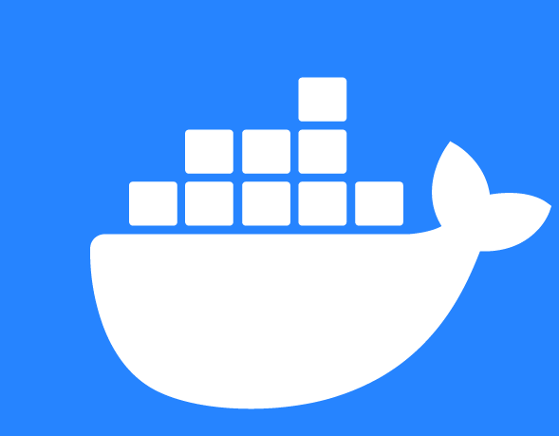
What is Docker?

Slide 4
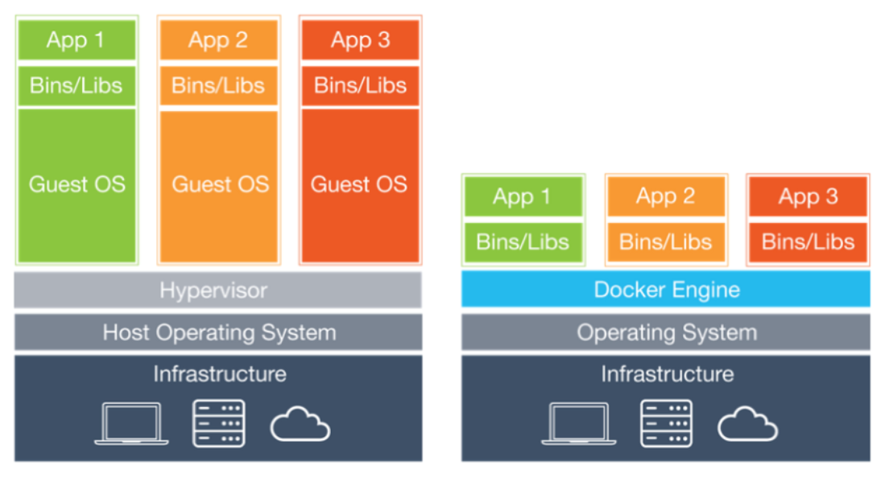
Why we need docker?

Slide 5
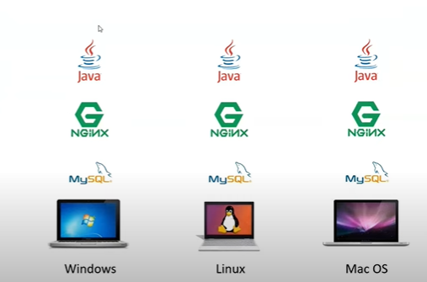
IT Industry Before Docker

Slide 6
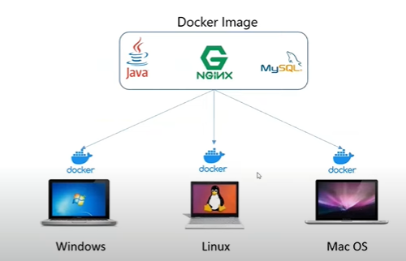
IT Industry After Docker

Slide 7
Main Components of Docker
Docker Client
Docker File
Docker Image
Docker Engine/Daemon/Server
Docker Container
Docker Host
Docker Registry/Hub

Slide 8
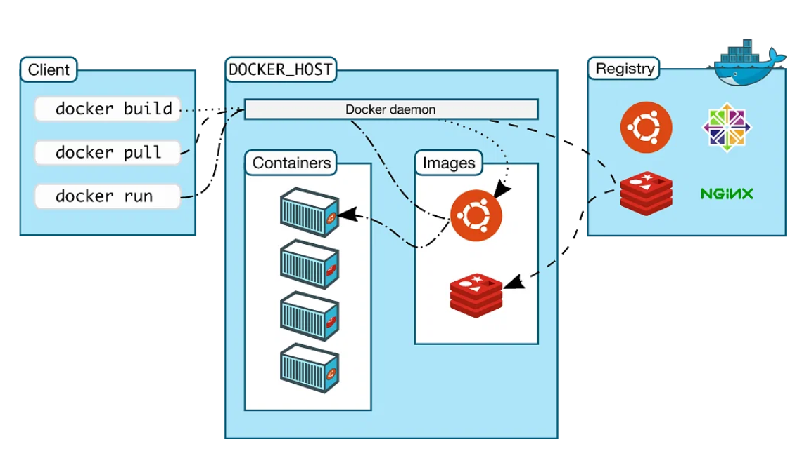
Architecture of Docker

Slide 9
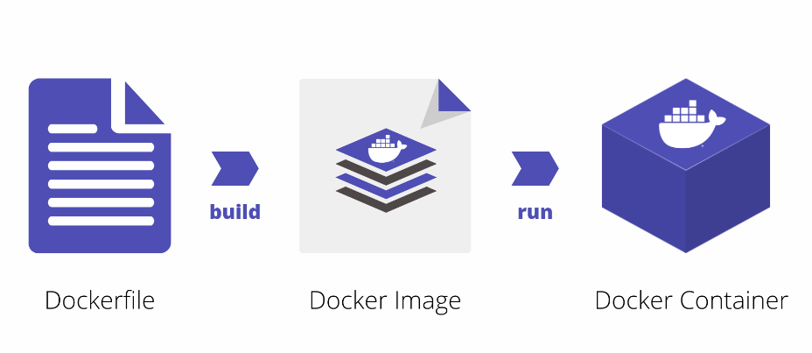
Workflow of Docker file to Docker Container

Slide 10
Basic Docker Commands
To see all images present in your local machine → docker images
To download image from docker hub to local machine → docker pull <image name>
To create container → docker run –it --name <container name>
To start container → docker start <container name>
To stop container → docker stop <container name>
To go inside container → docker attach <container name>
To see all containers → docker ps –a
To see only running containers → docker ps

Slide 11
Basic Docker Commands
To create image to container → docker run –it --name <container name> <image name>
To convert docker file to image → docker build –t <image name> .
To container to image → docker commit <container name> <name of image>
To connect docker hub to CLI → docker login
To push image to docker hub → docker push <docker hub_username>/<image name>
To run image → docker run –itd –p <port number> <image name>
To delete a image → docker rmi <image name>

Slide 12


