Slide 1
DETECTION OF VULNERABILITY IN WEB APPPLICATION BY GOKUL GOWTHAMRAJ NARESHMOORTHY

Slide 2
SPECIAL THANKS TO
DR T. V. GEETHA
Dean
Department of Computer
Science and Engineering
College of Engineering, Guindy
Anna University
DR. D. MANJULA
Professor and Head
Department of Computer
Science and Engineering
College of Engineering, Guindy
Anna University
DR T. RAGUVEERA
SR. Assistant Professor
Department of Computer
Science and Engineering
College of Engineering, Guindy
Anna University
D. NAVEEN RAJU
Rsearch Scholar
Department of Computer
Science and Engineering
College of Engineering, Guindy
Anna University

Slide 3
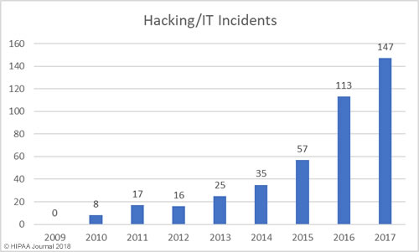
HISTORY
$1 billion stolen- bank
176% increase in attack from 2010
600 000 facebook accounts compromised
99% of computer are vulnerable

Slide 4
IS OUR DATA SAFE?
IOT
BIG DATA
CLOUD COMPUTING
MACHINE LANGUAGE
CRYPTOCURRENCY
SOCIAL MEDIA
BLOCK CHAIN

Slide 5
INTRODUCTION
Hacking is any technical effort to manipulate the normal behavior of network connections and connected systems.
Types- website, network, email, password, computer.
Hacking is the act of finding the possible entry points that exist in a computer system or a computer network and finally entering into them.
Hacking is usually done to gain unauthorized access to a computer system or a computer network, either to harm the systems or to steal sensitive information available on the computer.

Slide 6

Types of hackers
White hat hackers
Black hat hackers
Grey hat hackers
Miscellaneous hackers

Slide 7
TYPES OF ATTACKS
SQL injection
Phishing attack
Malware
DoS and DDoS attack
Man in the middle attack
Credential reuse
Cross Site Scripiting

Slide 8
PROS & CONS
To recover lost information, especially in case you lost your password.
To perform penetration testing to strengthen computer and network security.
To put adequate preventative measures in place to prevent security breaches.
To have a computer system that prevents malicious hackers from gaining access.
Massive security breach.
Unauthorized system access on Private information.
Privacy violation.
Hampering system operation.
Denial of service attacks.
Malicious attack on the system.

Slide 9
TOOLS - BURP SUITE
Graphical tool to test the security of the website
Target
Proxy
Spider
Intruder
Scanner
Repeater
Comparator
Sequencer

Slide 10
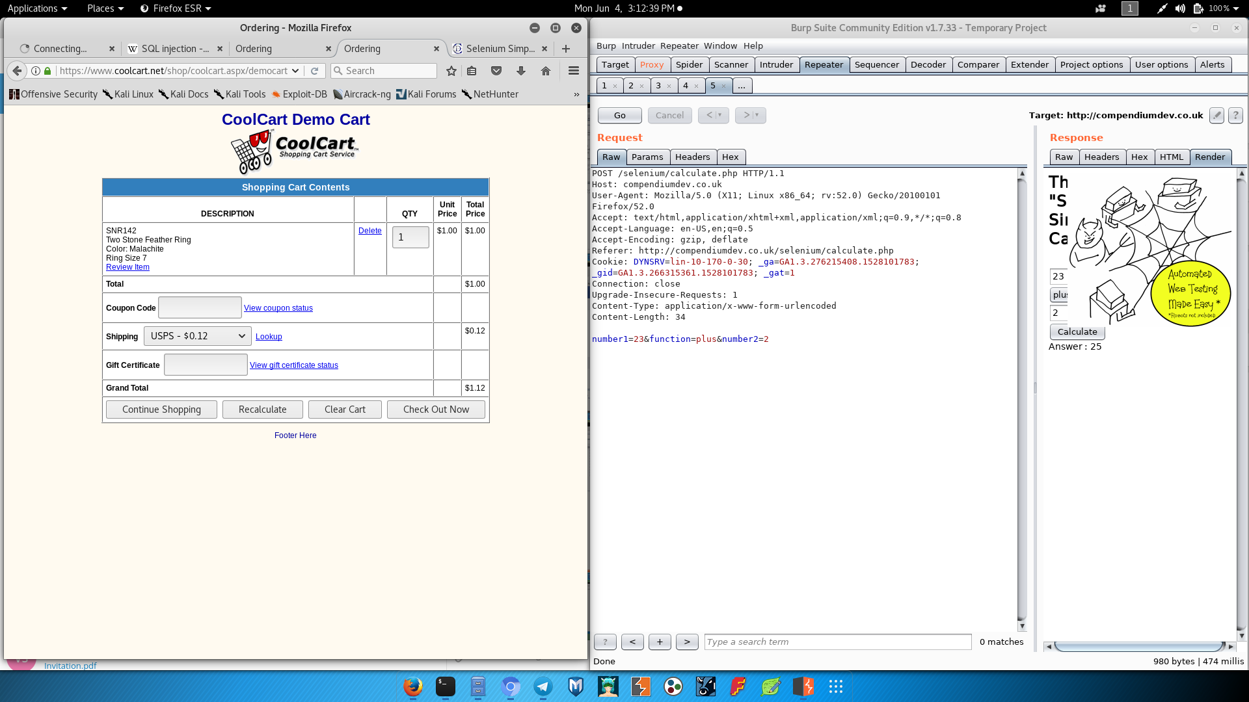
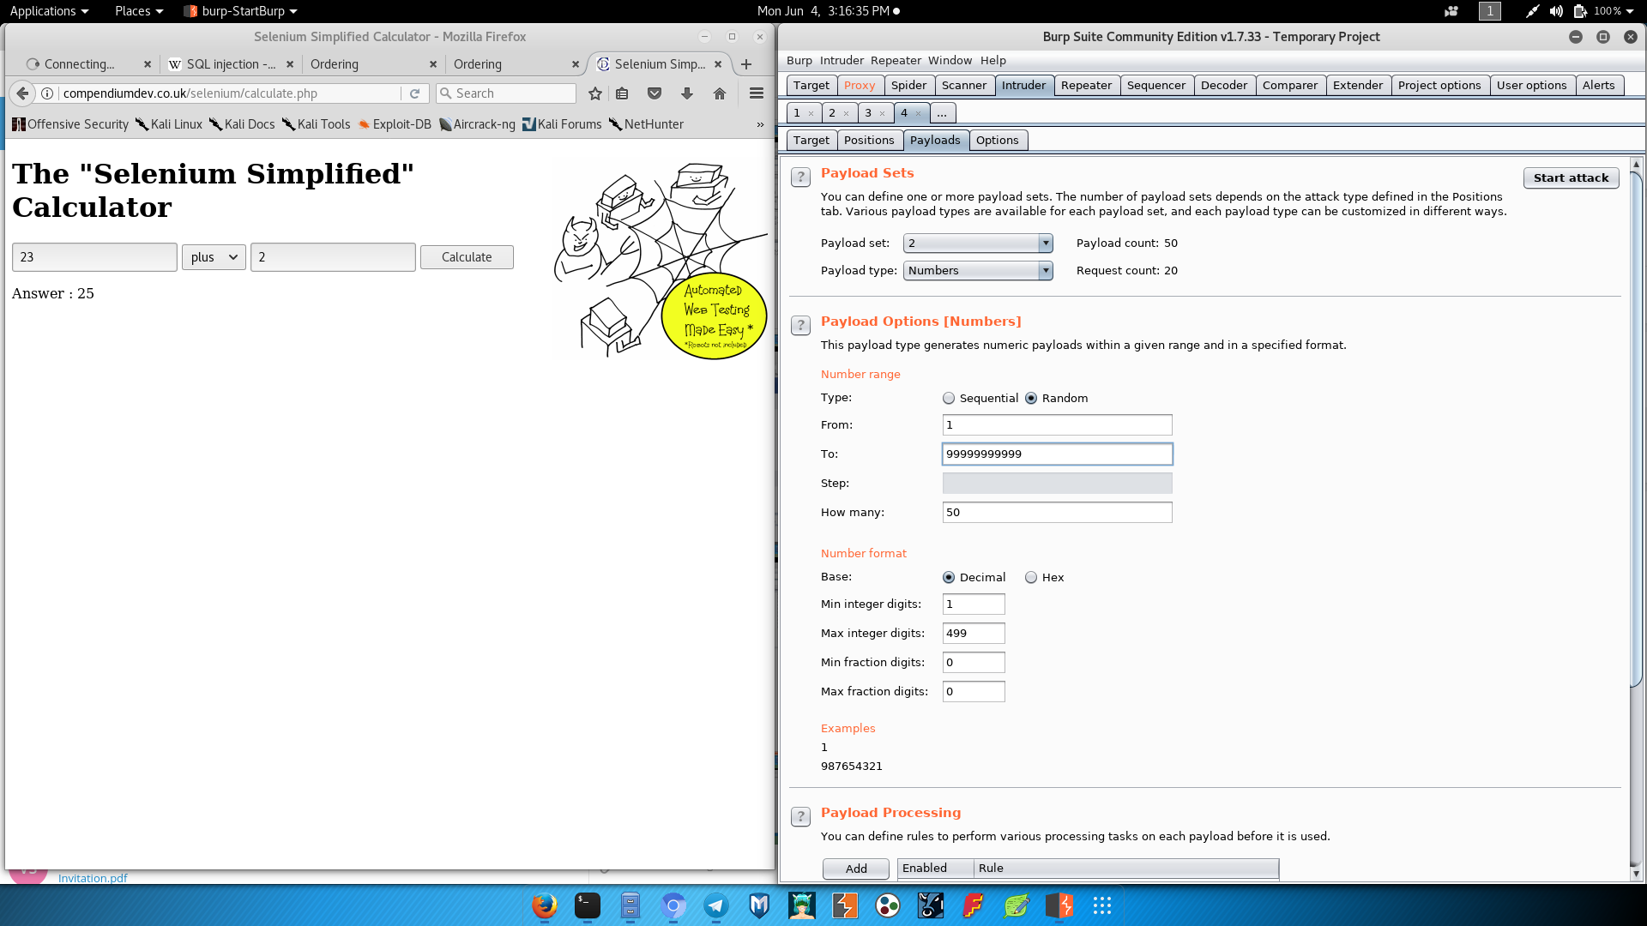
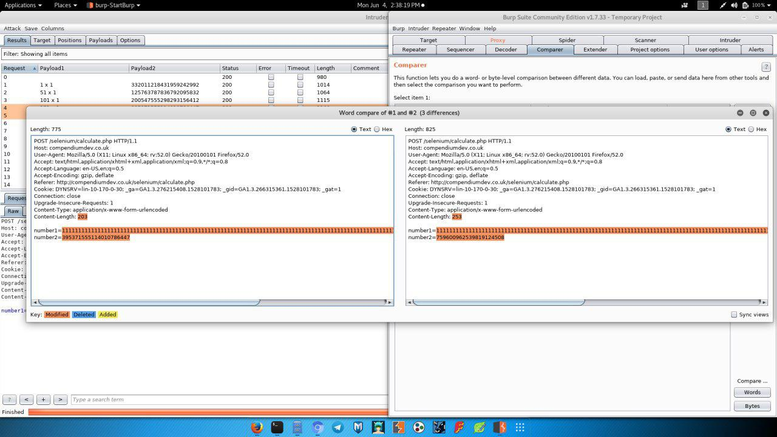

Slide 11
Work Flow
Creation of Web app & Server
Database connection
Blockchain is created
DoS attack

Slide 12
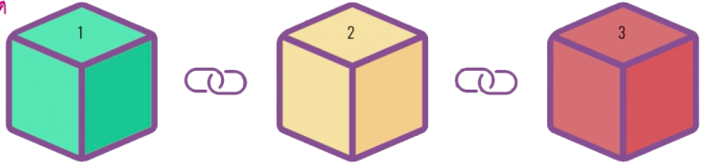
Block chain

Slide 13
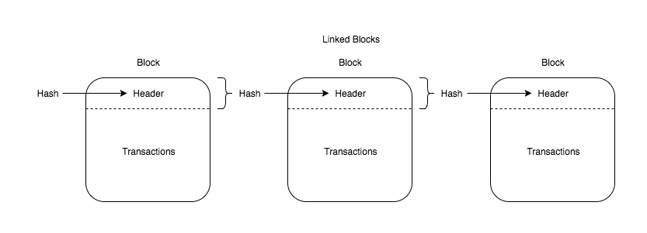
A digital ledger in which transactions made in bitcoin or another cryptocurrency are recorded chronologically and publicly. Cryptography secures the records in a blockchain transaction, and each transaction is tied (in the chain) to previous transactions or records.

Slide 14
Why blockchain secure?
Decentralized ledger
Transactional record and the chain links them.
Distributed nature
To alter a chain, one would need to take control of more than 51% of computers in the same distributed ledger

Slide 15
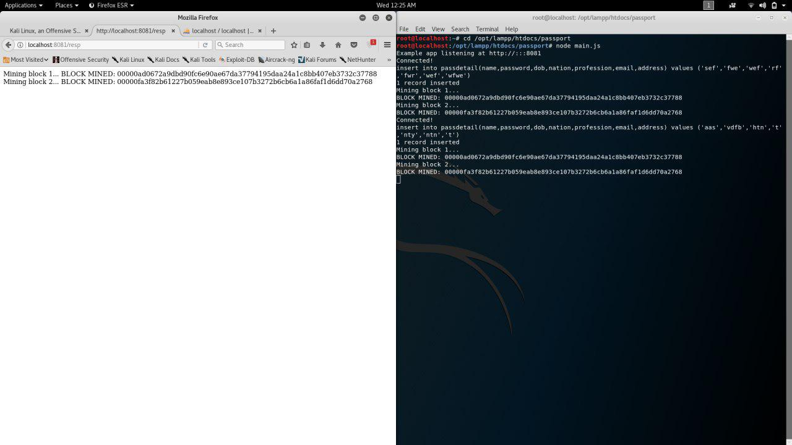

Slide 16
PHISHING ATTACK
The criminals register a domain name that appears very similar to the actual company domain.
The recipient believes the WEB is authentic, clicking on a LOGIN and engaging with the criminals. The phishing net has now been cast.

Slide 17
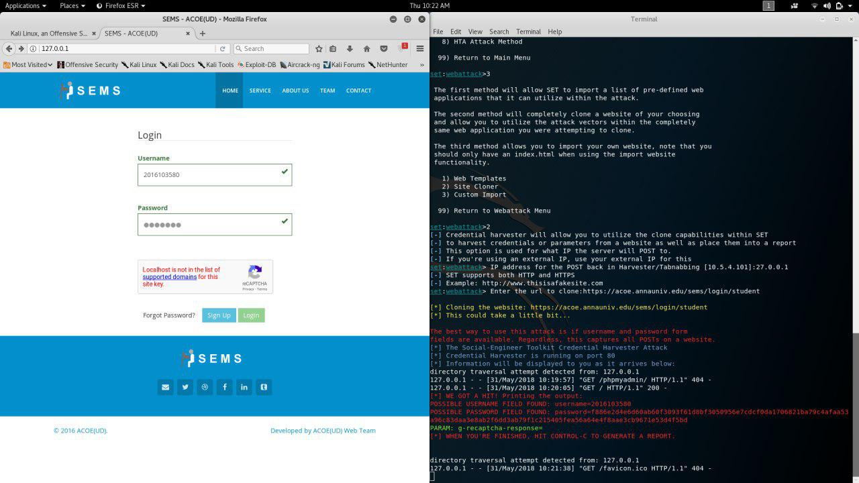

Slide 18
CONCLUSION
The database is created for the use of storing the information of the user.
For the successful login the web app create the hash code for the created blockchain.
The hash code is displayed in the front for the referral purpose.
The denial of service attack is performed on it using slowloris tools. It create multiple request to the terminal and thus it slow down or affect the localhost.

Slide 19
WHAT WE GAINED THROUGH THIS PROJECT:
Experience
Hacking basics
Docs and presentation

Slide 20
REFERENCES
For installation of burpsuite:
https://support.portswigger.net/customer/portal/topics/718317-installing-and-configuring-burp/articles
For CA certificate:
https://portswigger.net/burp/help/proxy_options_installingcacert
For dvwa setup:
https://cloudup.com/iHWKaT9dxbj
For blockchain code:
https://github.com/SavjeeTutorials/SavjeeCoin/tree/master/src
For SET tool:
https://github.com/trustedsec/social-engineer-toolkit/
For change the order value:
https://www.coolcart.net/jewelrystore.html

Slide 21
THANK YOU

