Slide 1



Image Proccssing and Computer Vision
Presended by:
Dr. R. Vengateshkumar
Mr.M. Panneerselvam
R. Gowtham(I B.Sc(CS)’C’)
T. Shanmuga Priyan(I B.Sc(CS)’C’)
-
-

Slide 2
Abstract
Image processing is the technique of using computers to analyze, enhance, and modify digital images by improving quality, removing noise, detecting edges, and adjusting brightness or color.
Tools like OpenCV help build real-time vision systems for various fields such as healthcare, security, and automation.
keywords: opencv, Augmented Reality, jawline, Generative Adversarial Networks (GANs)

Slide 3
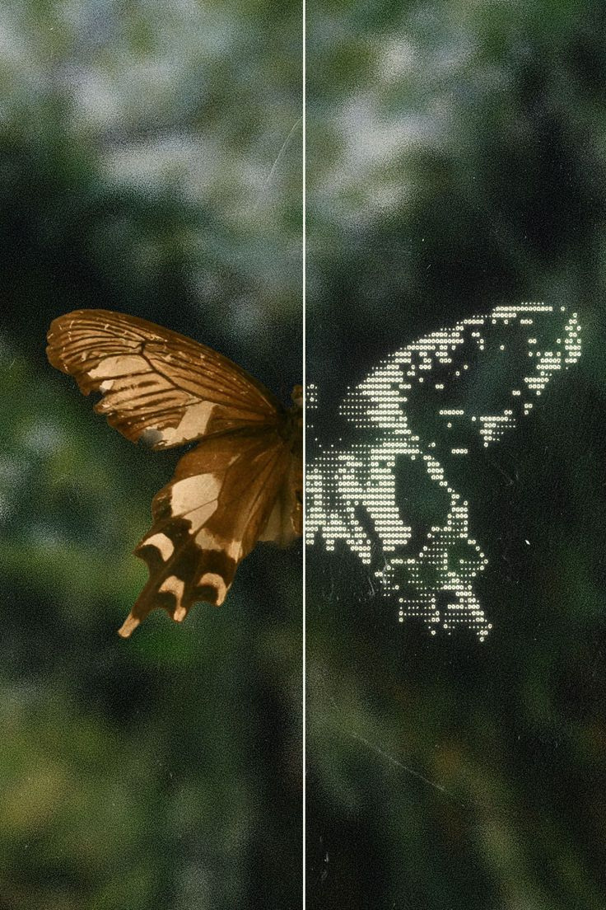
image
processing
Image processing is a method of using a computer to analyze, improve, or change an image.
Example:
Mobile gallery editing, remini(app).

Slide 4
AI image
EXAMPLE:
Face unlock in mobile phones
Instagram and Snapchat filters
Google Photos search
Medical scanning
processing
AI image processing means using Artificial Intelligence to help computers understand, analyze, and improve images.

Slide 5




AI image processing
Advantages
Dis-Advantages
High Accuracy
Faster Processing
Automation
Security & Surveillance
Privacy Issues
High Cost
System Failures
Ethical Issues

Slide 6
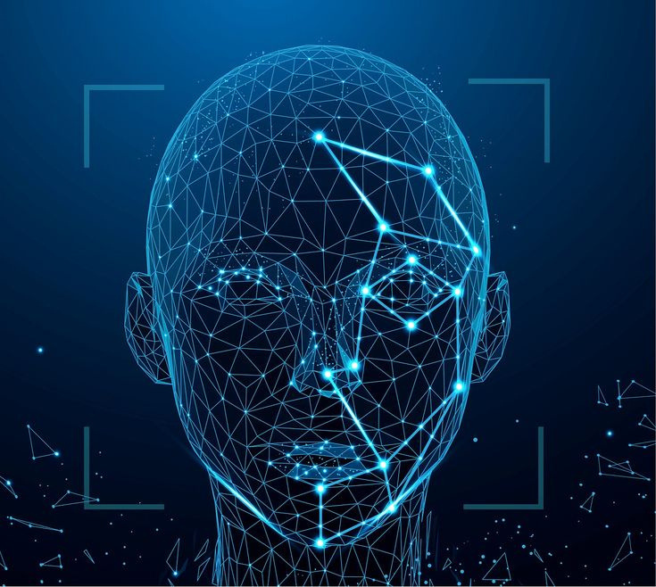
Types of image
processing
Image Classification
Object Detection
Image Generation
Face Recognition
Pose Estimation

Slide 7
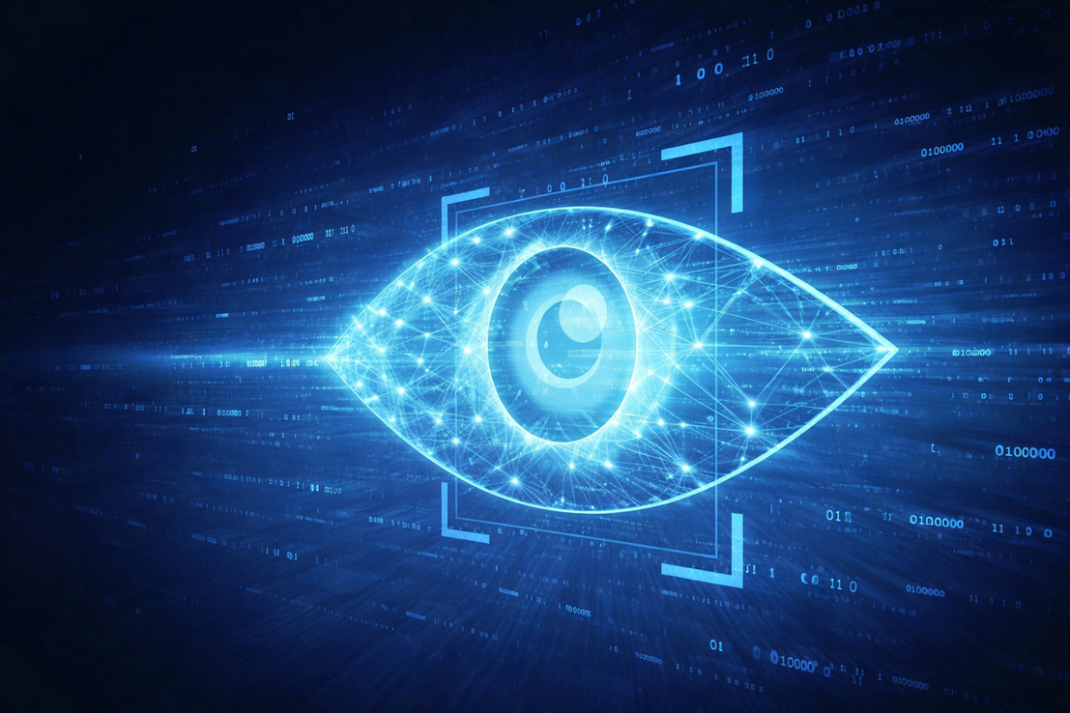
Computer Vision
It is a technology that helps computers see and identify objects using cameras, images, and videos.
It allows computers to understand visual information like humans.

Slide 8
AI on Computer Vision
AI in Computer Vision refers to the use of Artificial Intelligence, especially Machine Learning and Deep Learning, to enable computers to automatically understand, analyze, and make decisions from images and videos.
AI in Computer Vision = intelligent vision systems that can learn from images and improve over time .

Slide 9
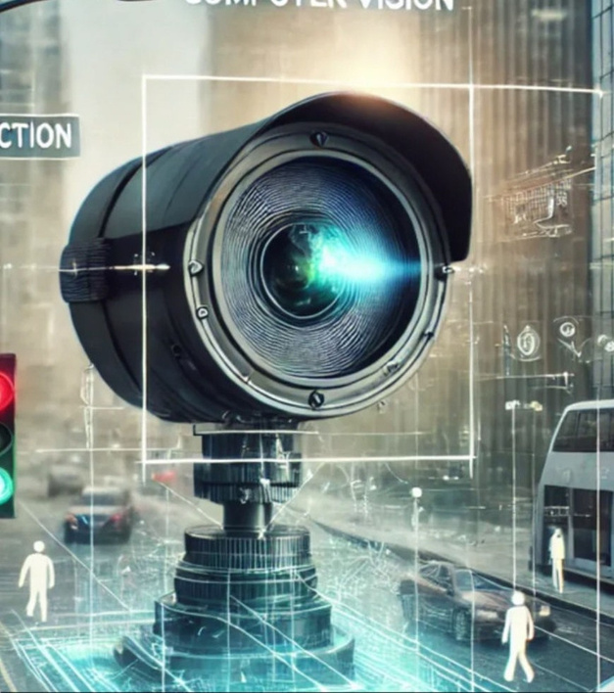
Collect image or video data
Train AI models using datasets
Use neural networks to learn pattern
Detect and classify objects
Make decisions based on visual information
How AI Works in Computer Vision

Slide 10
Opencv(Open Source Computer Vision Library)
OpenCV (Open Source Computer Vision Library) is a popular software library used for image processing and computer vision tasks.
It helps computers to:
Read images and videos
Process them
Detect objects and faces
Build real-time vision applications

Slide 11
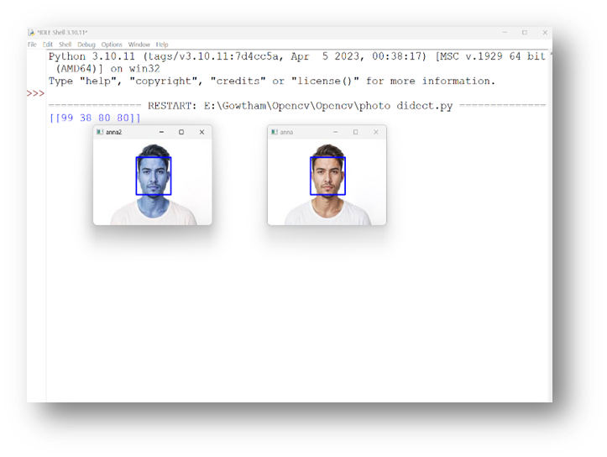
Image detection
Finding and identifying objects, faces or features within an image.

Slide 12
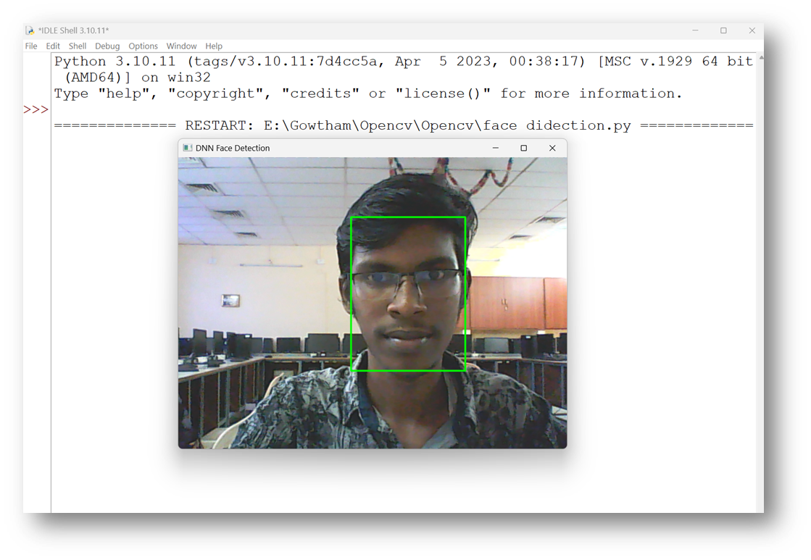
Face detection
·Face detection is a vision technique that identifies and locates faces in an image or video.

Slide 13
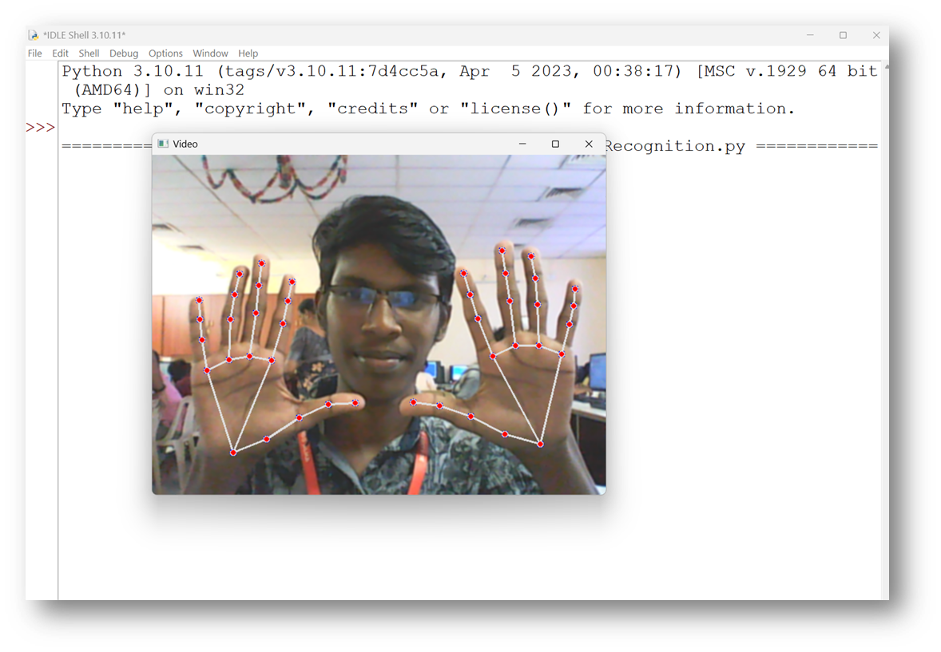
Hand Detection
Hand detection identifies and locates and locates a hand image or video, while hand recognition analyzes the detected hand to interpret its identify, gesture, or sign(such as counting fingers or recognizing sign languages).

Slide 14
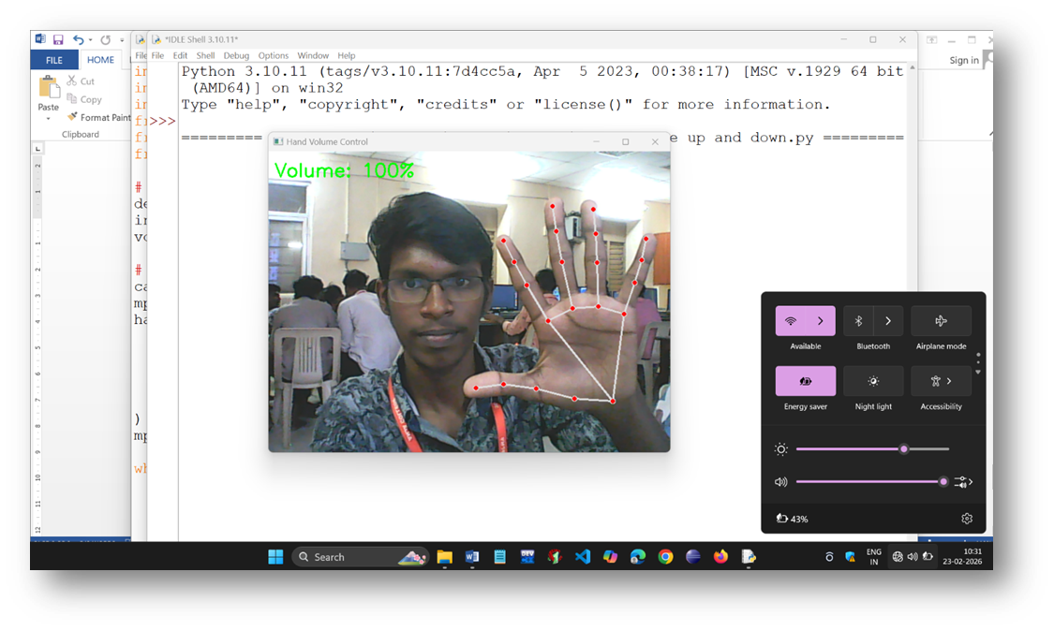
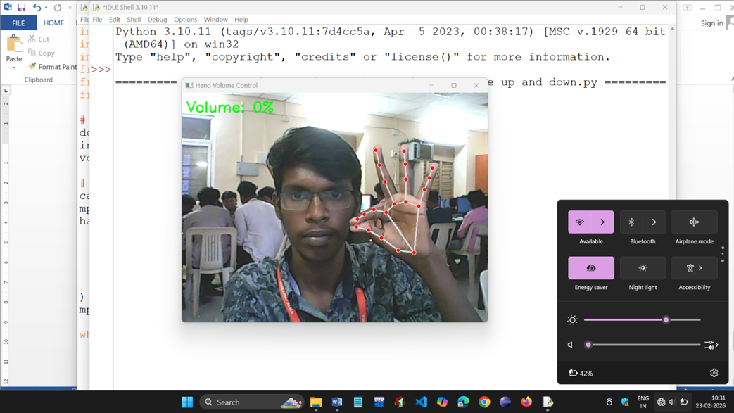
Hand volume up and down
·Hand volume up and down uses hand gesture recoganation to increases or decrease system volume based on specific finger movements dedected by a camera.

Slide 15
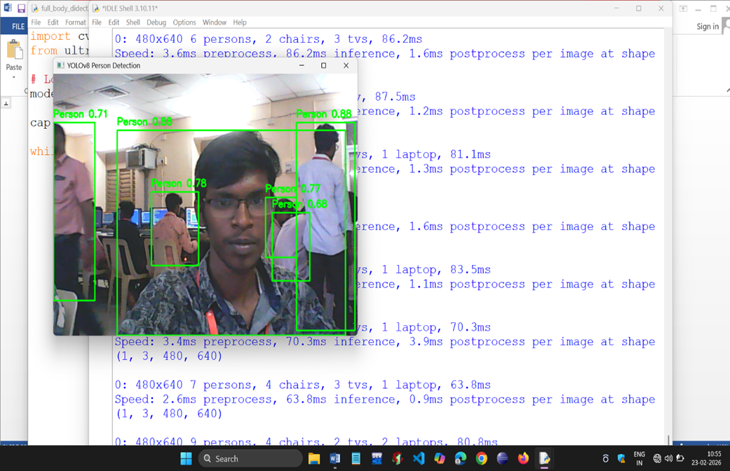
Human detection or full body detection
·Full body detection is a computer vision technique that identies and locates the entire human body in an image or video, typecally by drawing a bounding box or ditrcting body keypointes.

Slide 16
conclusion
image processing and computer vision play a vital role in enabling machines to see, interpret, and understand the visual world.
They are no longer just research concepts but essential tools in everyday life, making machines smarter and more capable of interacting with humans and the environment.

Slide 17
Thank
You
-
-

