Slide 1
NoSQL
ACE Data Training
Duration: 1 – 1.5 hrs Format: Theory + Hands-on

Slide 2
Session Agenda
01
What is NoSQL?
02
Evolution & History
Definition, motivation, SQL vs NoSQL comparison
From RDBMS to web-scale distributed systems
03
NoSQL Data Models
04
Famous NoSQL Databases
Document, Key-Value, Wide-Column, Graph
MongoDB, Redis, Cassandra, Neo4j & more
05
CAP Theorem
06
When to Use NoSQL?
Consistency, Availability, Partition Tolerance
Decision framework & real-world use cases
07
Hands-on Lab
MongoDB & Redis

Slide 3
What is NoSQL?
NoSQL = "Not Only SQL" databases designed to handle large volumes of unstructured or semi-structured data that don't fit neatly into relational tables.
Relational (SQL)
NoSQL
Fixed schema - tables, rows, columns
Schema-less design
ACID transactions
Eventual consistency
Vertical scaling (scale-up)
Horizontal scaling (scale-out)
Excellent for relational data with joins
Handles unstructured & big data
SQL as the universal query language
Query language varies by DB type

Slide 4
Evolution of NoSQL
1970s
Edgar Codd's relational model. SQL databases (Oracle, MySQL) dominate enterprise computing.
Relational Era
1990s
Internet boom. Web apps needed to store billions of rows - RDBMS started showing cracks at scale.
Web Explosion
2004
Wide-column store powering Search, Maps & Gmail at massive scale. Inspired many NoSQL systems.
Google Bigtable Paper
2007
Introduced key-value store with eventual consistency and high availability over strong consistency.
Amazon Dynamo Paper
2009
Term 'NoSQL' popularised. MongoDB, Redis, Cassandra released. Open-source movement takes off.
NoSQL Goes Open Source
2010s
AWS DynamoDB, Azure CosmosDB. Every tech company adopts at least one NoSQL database.
Cloud & Mainstream
2020s
CockroachDB, PlanetScale, FaunaDB. SQL semantics with NoSQL scalability.
Multi-Model & NewSQL

Slide 5
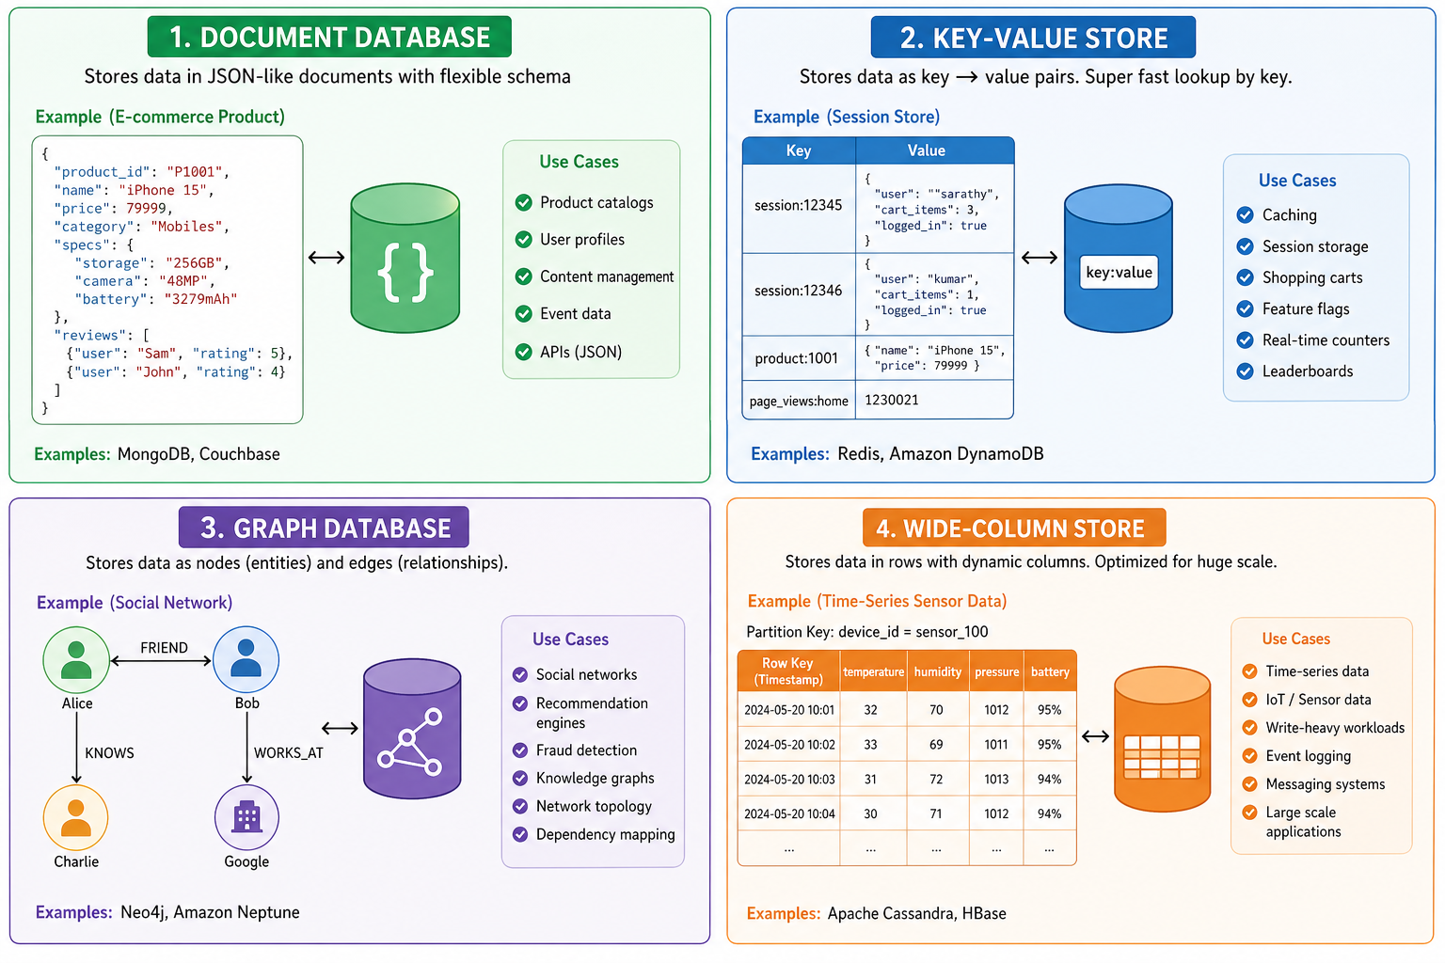
NoSQL Data Models
Key-Value Store

Slide 6
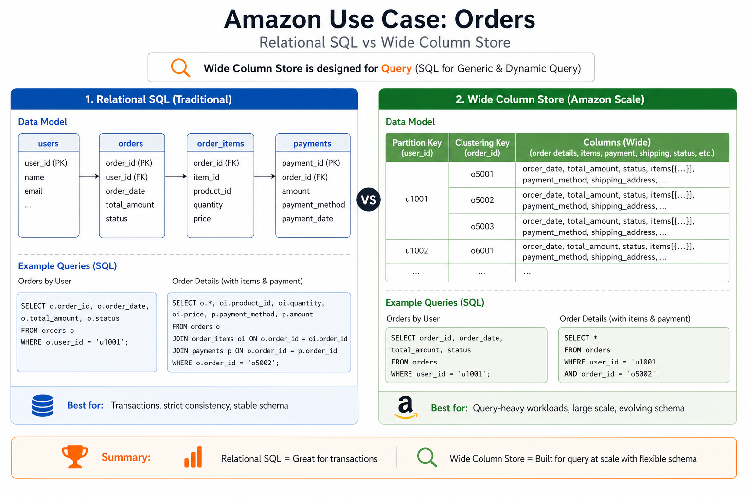
Key-Value Store

Slide 7
Famous NoSQL Databases
MongoDB
Redis
Cassandra
Document
Key-Value
Wide-Column
#1 NoSQL DB
In-memory speed
Massive scale
Flexible JSON documents, rich query language, Atlas cloud platform
Sub-millisecond latency, pub/sub, streams, Lua scripting
Linear scalability, no single point of failure, write-heavy workloads
Used by: Airbnb, eBay, Adobe
Used by: Twitter, GitHub, Shopify
Used by: Netflix, Apple, Instagram
Neo4j
DynamoDB
Elasticsearch
Graph
Key-Value
Document
#1 Graph DB
Serverless AWS
Full-text search
Cypher query language, ACID compliant, native graph storage
Fully managed, single-digit ms latency, on-demand pricing
REST API, inverted index, near real-time search and analytics
Used by: LinkedIn, NASA, Walmart
Used by: Amazon, Lyft, Nike
Used by: Wikipedia, GitHub, Uber

Slide 8
CAP Theorem & Trade-offs
A distributed system can guarantee at most 2 of these 3 properties simultaneously.
C - Consistency
A - Availability
P - Partition Tolerance
Every read receives the most recent write or an error.
Every request receives a response (not guaranteed latest).
System continues despite network failures between nodes.
e.g. MongoDB, HBase
e.g. Cassandra, DynamoDB
e.g. Redis Cluster
In practice — pick any two:
CA (Consistency + Availability)
No partition tolerance — works only in single-node systems. PostgreSQL, MySQL.
CP (Consistency + Partition Tolerance)
May reject requests to stay consistent. MongoDB, HBase.
AP (Availability + Partition Tolerance)
Returns best-effort data; eventual consistency. Cassandra, DynamoDB, CouchDB.

Slide 9
When to Use NoSQL?
Use NoSQL When…
Stick with SQL When…
✓ Schema changes frequently (agile teams)
✕ Data is highly relational with frequent joins
✓ Need horizontal scaling across many servers
✕ ACID compliance is non-negotiable
✓ Handling millions of requests per second
✕ Transactions span multiple entities
✓ Data is document-like, hierarchical, or graph
✕ Team has deep SQL expertise already
✓ Sub-millisecond latency needed (cache, sessions)
✕ Regulatory compliance requires strict consistency
✓ Real-time event streams or time-series data
✕ Primary use case is BI reporting & analytics

Slide 10
Real-World Use Cases
Netflix
Cassandra
Uber
Redis + MySQL
Stores viewing history & preferences for 200M+ users. Handles 1M+ writes per second with no downtime.
Redis tracks real-time driver/rider locations. MySQL handles trips, billing, and account data.
LinkedIn
Espresso + Voldemort
Airbnb
MongoDB
Member profiles and connections at 900M+ users. Custom NoSQL systems built in-house for scale.
Flexible listing data — each listing has different attributes. Schema-free design is a perfect fit.
Twitter
Redis + Cassandra
WhatsApp
Mnesia (Erlang KV)
Timelines cached in Redis for speed. Tweet storage and search powered by Cassandra and Elasticsearch.
Custom distributed key-value store. Billions of messages with low-latency, without SQL overhead.

Slide 11
Quick Reference — NoSQL Cheat Sheet
Database
Type
Best For
Query Language
Managed Cloud
MongoDB
Document
Flexible APIs, CMS
MongoDB Query Language (MQL)
Atlas (MongoDB)
Redis
Key-Value
Cache, sessions, queues
Redis Commands (SET/GET…)
Redis Cloud, ElastiCache
Cassandra
Wide-Column
High write throughput
CQL (Cassandra Query Lang.)
Astra DB (DataStax)
Neo4j
Graph
Relationships, traversal
Cypher
AuraDB (Neo4j)
DynamoDB
Key-Value
Serverless on AWS
DynamoDB API / PartiQL
AWS DynamoDB
Elasticsearch
Document
Full-text search, logs
REST / Query DSL
Elastic Cloud

Slide 12
Hands-on
Thank you!

