Slide 1

Hindusthan College of Engineering and Technology (An Autonomous Institution, Affiliated to Anna University, Chennai) Valley Campus, Pollachi Highway, Coimbatore – 641 032
DEPARTMENT OF AERONAUTICAL ENGINEERING
NEW DRONE TECHNOLOGY ERA
Team Members:
Dheepakraj S
Kalidhasan P
Gowtham S
Mentor
Mr. Arulmozhinathan T
Assistant Professor

Slide 2
PROBLEM IDENTIFICATION
The drone technology is increasingly being adopted across industries in India and abroad. but these drone cannot able to do customized activities like drone delivery, Asset Integrity Inspection.
While Flying the drone, pilot errors will occurs such as vary of velocity, direction and altitude of the drone.
Without human eyes to help, a drone can not able to handle traffic and obstacle avoidance.
Lack of communication between the ground station and drone system.
More complicate of getting analytical feedback in real-time from drone.
Till now all the drone supporting application belongs to other countries.
Drone swarming is too difficult to achieve with normal drones.

Slide 3
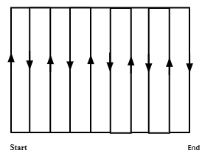
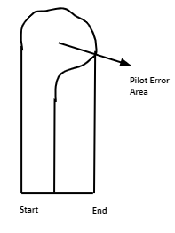
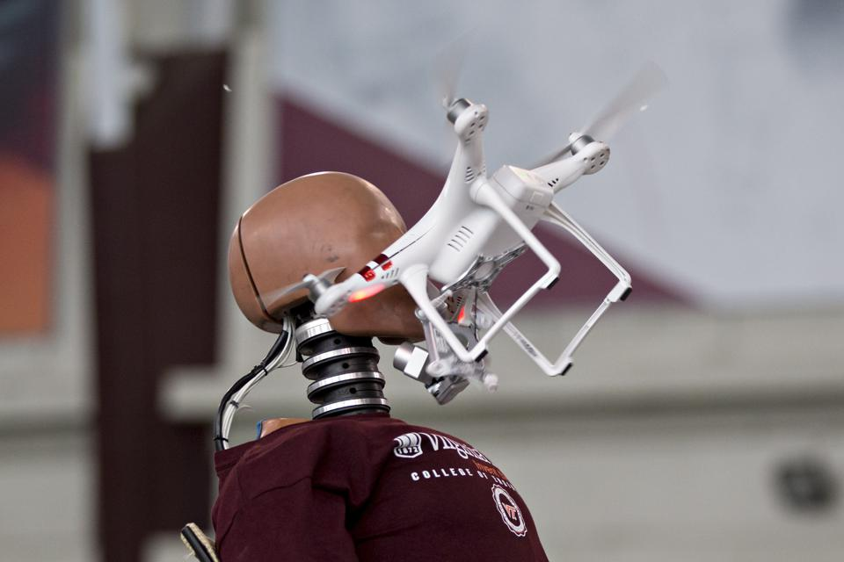
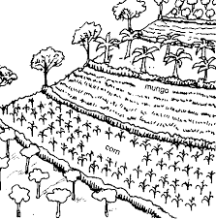
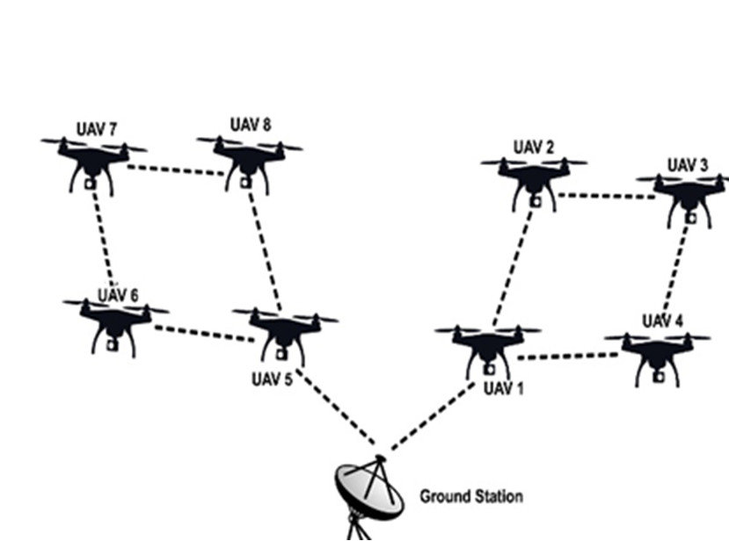
Pilot Error
Collisions
Sudden vary of Altitude
Lack of Communication

Slide 4
OBJECTIVES
To implement the Artificial Intelligence system with in the drone.
To make the drone which able to do multiple task like delivery drone, surveillance drone, Asset Integrity Inspection (Windmills, Oil Pipelines etc.)
To increase the communication strength between the system.
To reduce the piloting errors in manually operate mode and zero errors in autonomous mode.
To develop own application and open source drone to achieve multiple tasks.
To provide analytical feedback in real-time from drone.

Slide 5
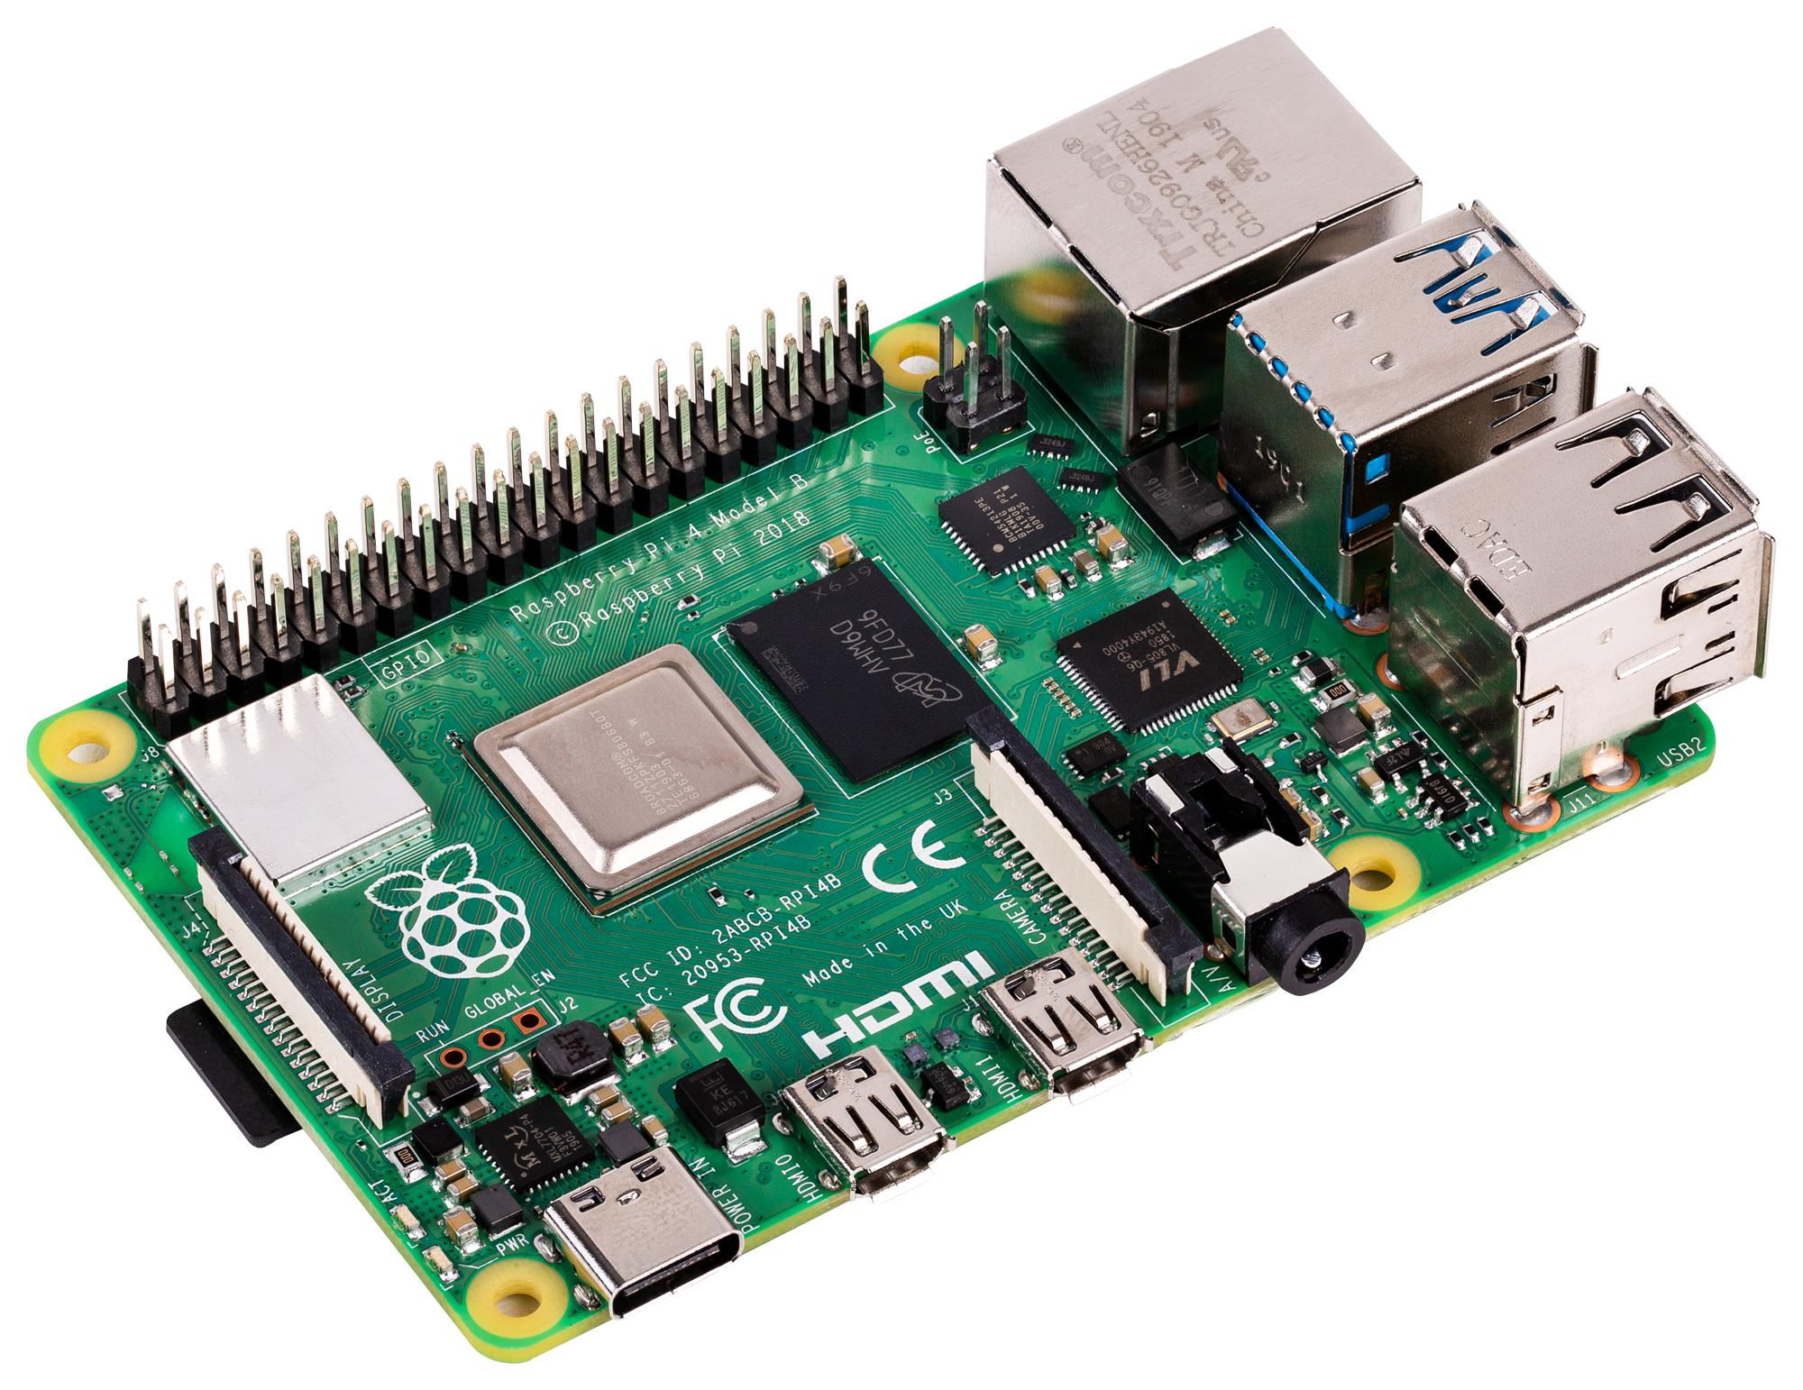
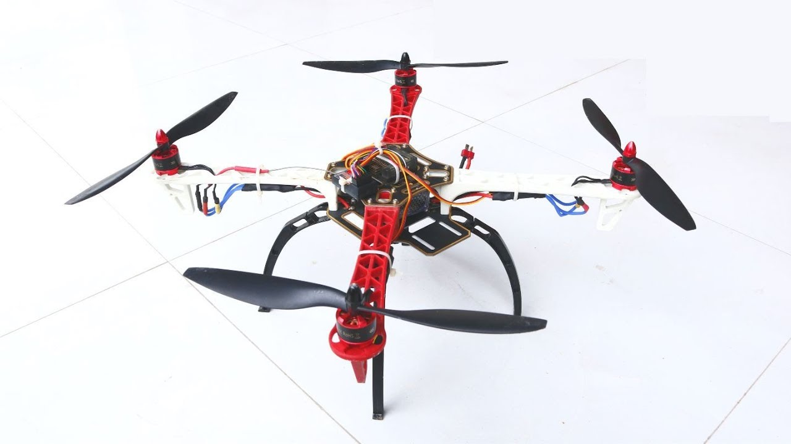
SOLUTION
Raspberry Pi Drone

Slide 6
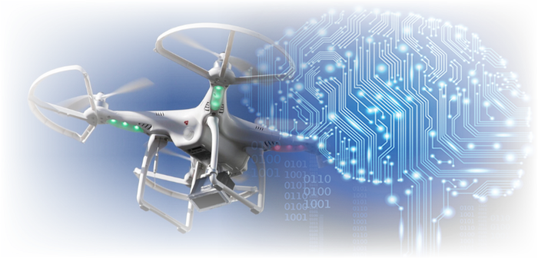
SOLUTION
These issues can be overcome by developing Raspberry Pi Drone which run by our own developed application.
The advantage of the Raspberry Pi is mainly that it can process some artificial vision algorithms for features that require the drone to be ''smart‘’.
By incorporate Artificial Intelligence with drone which operate precisely and overcome errors.

Slide 7
METHODOLOGY
Developing an algorithm for autonomous drone
(Using PYTHON)
Getting drone status at ground station
Interconnect between the system
Implementing AI to the drone
Implementing algorithm into the drone
Testing
Src. Google Map, mission Planner
Mapping the field and border points.

Slide 8
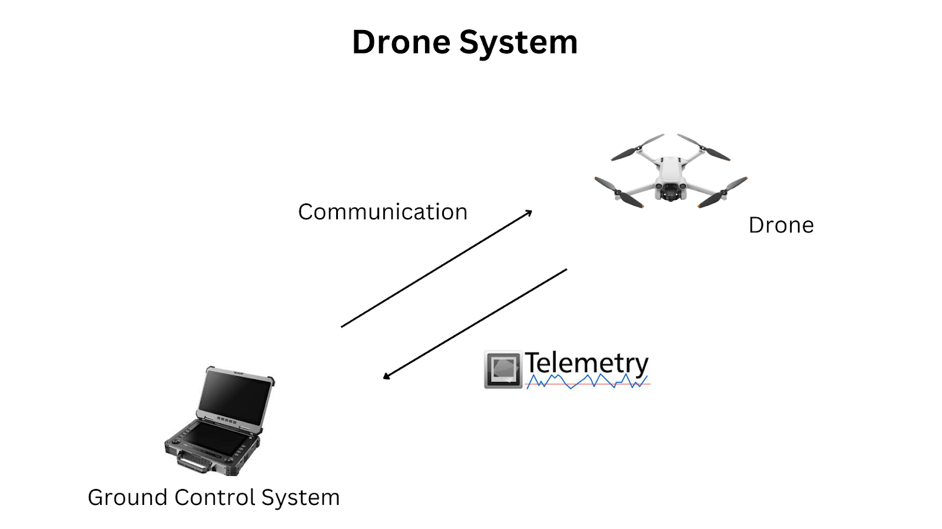
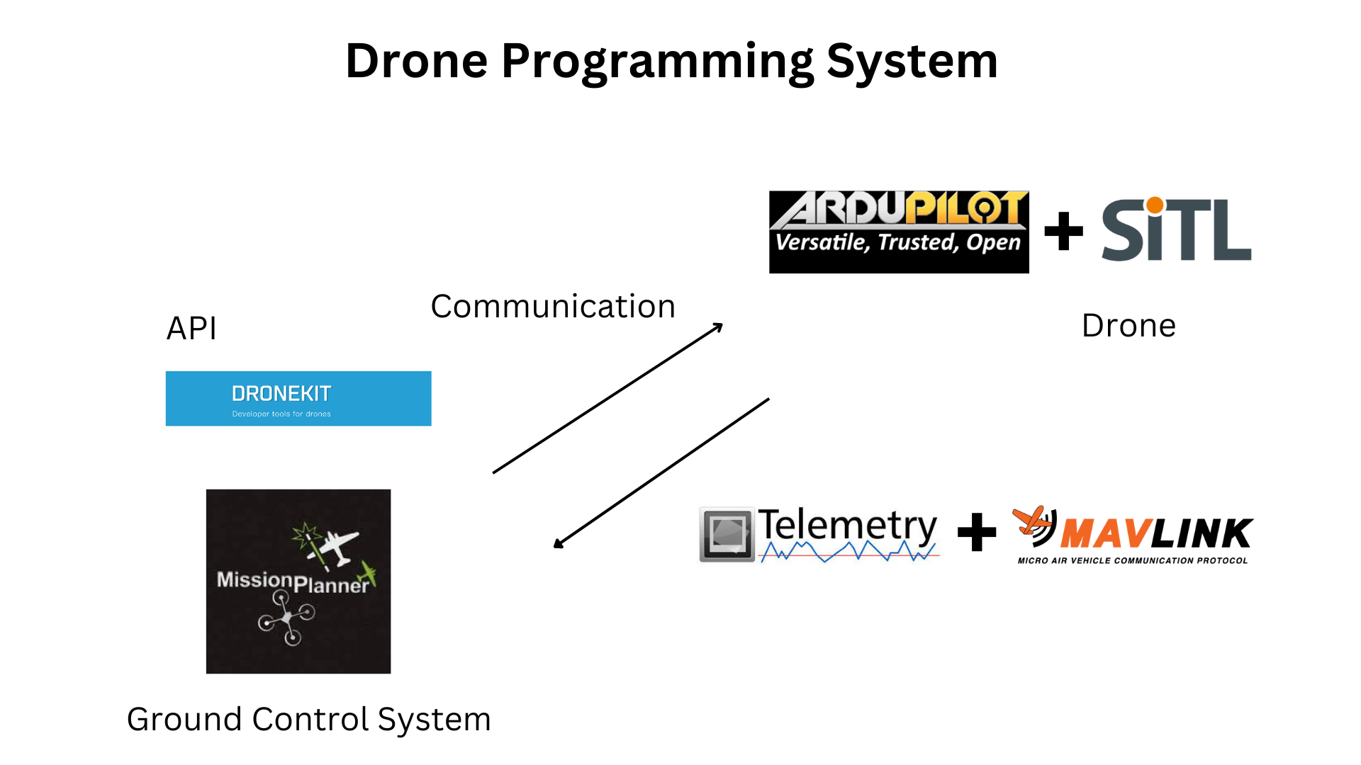
COMPARISON OF TWO SYSTEM

Slide 9
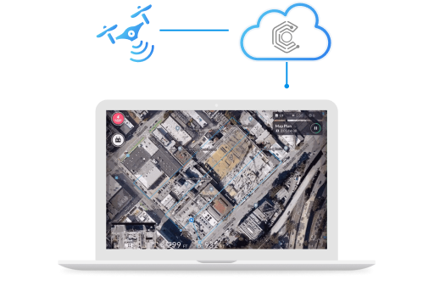
HOW ITS WORK
It is an Internet of Drones [IoD] derivative of the Internet of Things [IoT]
Modular Enterprise Drone Automation Concepts
The System is built on cloud infrastructure
Where the drones are connected to the cloud server via LTE protocols at all times.
Accustomed to the machine interfaces present in the work environment.

Slide 10
MISSIONS
Auto Landing
Precision landing technology enables drones to autonomously and accurately land on the Charging Pads or Docking Stations.
Fast Charging
Securely store the drones and charge them to prepare for the next autonomous BVLOS mission.
Unlimited Range
The connectivity over 4G/LTE/5G enables the remote drone operators to manage and control a fleet of drones and docking stations in real-time from a distance through the cloud.
Live Video Streaming
Subject Matter Experts (SMEs) can see the live status of the fleet, analyze real-time video feed from the drone cameras, access device status, battery and charging data, and make use of advanced drone battery features.

Slide 11
UNIQUE SELLING PROPOSITION
Till now all the drone supporting application belongs to other countries, here we developing our own application.
We are creating open source drone for several mission like Drone Delivery, environmental monitoring, etc.,…
Artificial Intelligence Drone System with good communication system.

Slide 12
SCOPE OF THIS PROJECT
Agriculture
Drone Delivery
Making beaches safe from sharks.
Making the earth greener.
Surveying dangerous or toxic environments.
News and Media.(Live video stream)

Slide 13
BUDGET
Hardware – RS. 1,00,000
Software – RS. 50,000
Working charges – RS. 10,000
ESTIMATED AMOUNT – RS. 2,00,000

Slide 14
THANK YOU…

