Slide 1
AIVIDA TELEHEALTH PLATFORM
Healthcare Simplified for Everyone
A Non-Technical Guide: How Patients and Doctors Connect Seamlessly from Booking to Prescription.
• Patient Care Portal | • Doctor Clinical Portal | • Happy Path Flow | • Interactive Block Diagram

Slide 2
OVERVIEW FOR EVERYONE
The Big Picture: What is AIvida?
Bridging the gap between home comfort and clinical expertise without delays or paperwork.
PILLAR 01
No Waiting Rooms
Patients connect directly with top-rated medical specialists from their phone, tablet, or PC in seconds.
Key Layman Benefit:
Consult right from your living room without sitting in traffic.
PILLAR 02
Clinical Precision
Doctors have a full digital cockpit: live vital statistics, patient history, and 1-click video consultations.
Key Layman Benefit:
Physicians spend more time caring and less time typing.
PILLAR 03
Zero Lost Paperwork
Digital prescriptions, diagnosis summaries, and consultation records are stored securely and accessible forever.
Key Layman Benefit:
No fading paper slips; pharmacy can read electronic orders directly.

Slide 3
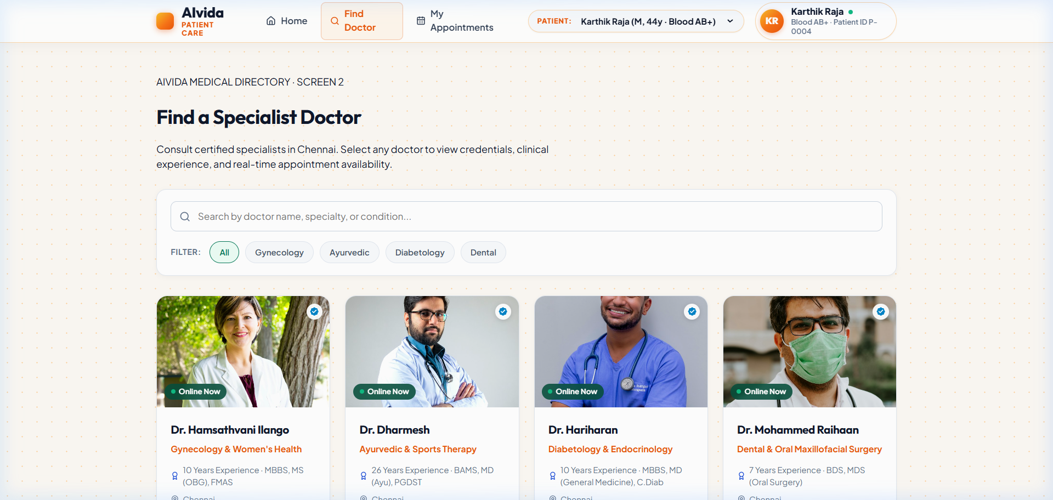
APP 1: PATIENT CARE EXPERIENCE
The Patient Care Portal (localhost:3001)
Designed for utmost simplicity: find doctors, schedule appointments, and join calls with zero confusion.
What Can a Patient Do Here?
• Find the Right Doctor: Browse verified physicians with specialization, availability, and qualifications clearly displayed.
• Pick Convenient Times: Select morning, afternoon, or evening slots with 1-click confirmation.
• No Apps or Downloads: Video calls launch straight in the browser with crystal clear audio & video.
• Health History & Prescriptions: View past consultations, active medication instructions, and upcoming checkups.

Slide 4
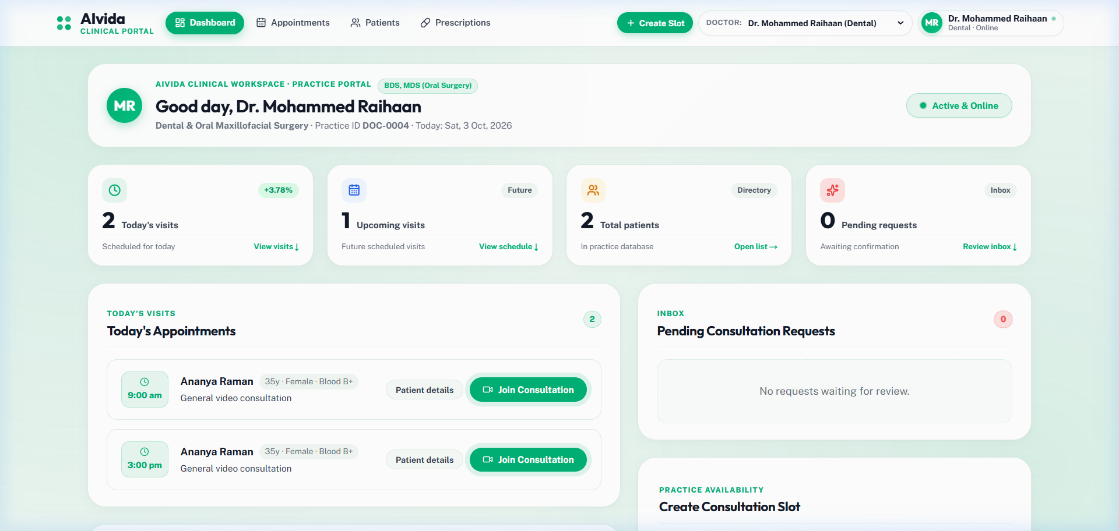
APP 2: PRACTICE WORKSPACE
The Doctor Clinical Portal (localhost:3000)
A powerful clinical command center that organizes the doctor's entire day into a single organized screen.
What Can a Doctor Do Here?
• Practice Availability Toggle: Go online/offline instantly with a single button to accept or pause walk-in telehealth slots.
• At-a-Glance Telemetry: Review daily appointments, patient counts, vital statistics, and clinical telemetry cards.
• Live Patient Queue: Organized consultation schedule with direct 'Start Call' buttons for scheduled time slots.
• Digital Prescription Pad: Generate verified medical prescriptions with dosage, frequency, and instructions in seconds.

Slide 5
END-TO-END USER EXPERIENCE
The Happy Path: From Sickness to Prescription
A seamless 5-step journey that takes less than 15 minutes from start to finish.
Step 1
Step 2
Step 3
Step 4
Step 5
Search & Select
Patient opens portal, searches doctor by specialty, and reviews credentials.
Involved App:
Patient Portal
Book & Confirm
Selects an available slot. Database instantly reserves slot and sends confirmation.
Involved App:
Cloud Server
Join Call
Both patient and doctor tap 'Join Consultation'. Video call launches instantly in HD.
Involved App:
Both Portals
Live Telemetry
Doctor reviews live health telemetry, discusses symptoms, and gives medical counsel.
Involved App:
Doctor Portal
Rx Delivered
Doctor signs digital prescription; patient receives medicine plan instantly on screen.
Involved App:
Both Portals

Slide 6
UNDER THE HOOD (MADE SIMPLE)
Working Block Diagram: How Information Flows
No complex engineering jargon — see how data, video, and medical records travel safely.
PATIENT PORTAL
(localhost:3001)
AIVIDA CORE SERVER
(localhost:8080)
WEBRTC GATEWAY
(Live Video Engine)
DOCTOR PORTAL
(localhost:3000)
• Patient Web App
• Doctor Directory
• Booking Engine
• Prescription Viewer
• Go Telehealth API
• Slot Management
• Database (SQLite/SQL)
• Auth & Patient Records
• Peer-to-Peer Video
• Encrypted Audio Stream
• Low-Latency Signaling
• In-Call Chat
• Clinical Command Cockpit
• Real-Time Telemetry
• Digital Rx Generator
• Practice Online Toggle
How The 3 Flows Operate In Real-Time:
1. Booking Flow: Patient selects slot -> Core Server confirms -> Doctor dashboard schedule updates instantly.
2. Video Flow: Signaling negotiates encrypted room -> WebRTC streams direct patient-doctor video with zero lag.
3. Prescription Flow: Doctor clicks 'Issue Rx' -> Saved securely to database -> Available on Patient Portal immediately.

Slide 7
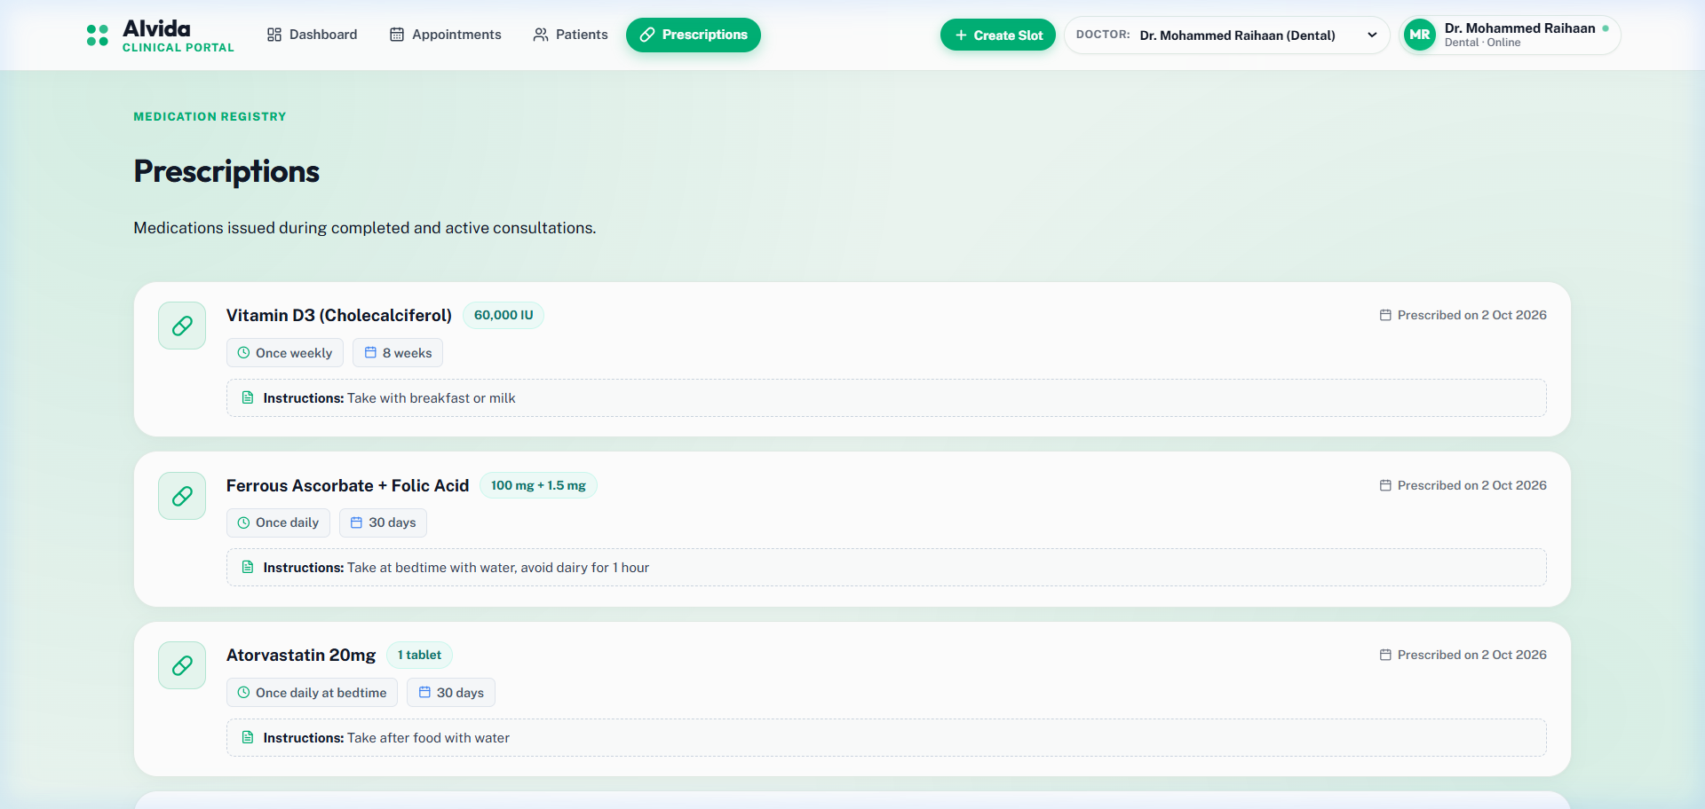
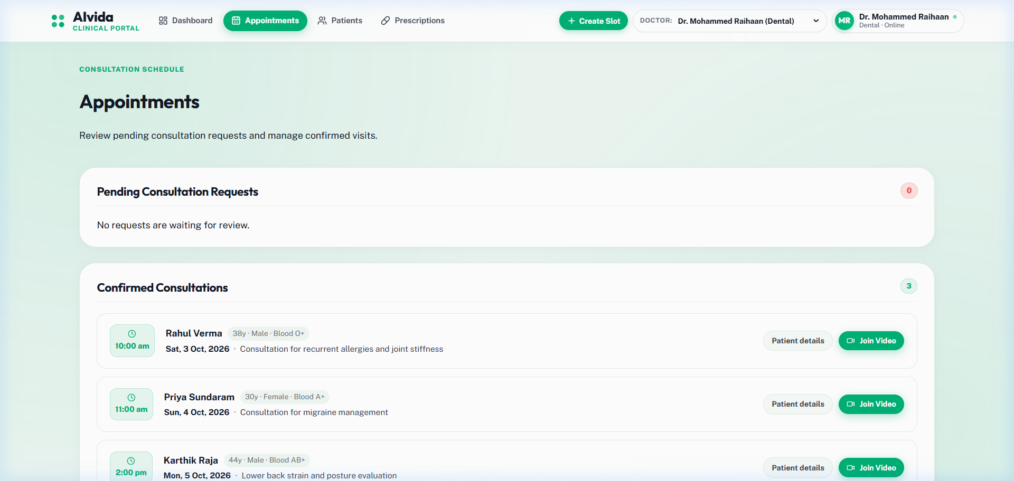
VISUAL EVIDENCE
Inside the Live System: Appointments & Prescriptions
Live captures from the running AIvida portals showing clean typography and medical hierarchy.
Left: Digital Prescriptions with distinct medication rows, dosage tags, and clear instructions.
Right: Consultation Schedule with Practice Availability toggle, time slots, and patient status badges.

Slide 8
SUMMARY & IMPACT
Why AIvida Transforms Telehealth
Key advantages for patients, healthcare professionals, and medical practices.
For Patients
For Doctors
For Practices & Clinics
✓ Access certified care in minutes
✓ Zero commuting, zero waiting rooms
✓ Automatic digital prescriptions
✓ Total privacy & medical data safety
✓ One-stop clinical command center
✓ Flexible practice online/offline control
✓ Instant electronic health records
✓ Reduced burnout & automated scheduling
✓ 100% paperless workflow
✓ Higher patient retention & satisfaction
✓ Standardized clinical telemetry
✓ Scalable microservice architecture

