Slide 1
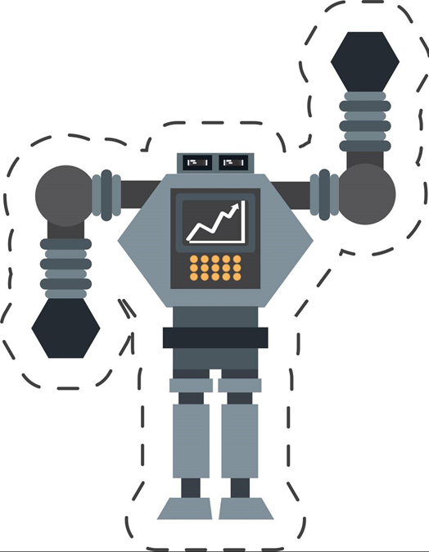

CNC Machine Health Monitoring and Predictive Maintenance Using IoT and Machine Learning

Slide 2

Content

Slide 3
Project Overview
Brief Introduction to the project
Domain relevance (e.g., Healthcare, IoT, Robotics, etc.)
Purpose of combining Embedded Systems with ML

Slide 4
Problem Statement
What real-world problem are you solving?
Why is it important?

Slide 5
Project Goal & Objectives
Main project goal
2–4 measurable objectives

Slide 6
Proposed Solution
System Architecture diagram
How embedded system + ML are integrated

Slide 7
Resources Utilized
Hardware: (e.g. Raspberry Pi, sensors, etc.)
Software & Tools: (e.g., Python, Arduino IDE)
Datasets/ML Models Used: (Mention source, type, size)

Slide 8
System Design
Block Diagram or Flowchart
ML workflow (training, inference)
Embedded interaction (inputs/outputs)

Slide 9
Implementation Details
Steps in project development
Screenshots/code snippets if relevant

Slide 10
Results & Observations
Accuracy of the model
Performance of the embedded system

Slide 11
Advantages & Limitations
Key benefits of your solution
Any constraints (e.g., power, cost, speed)

Slide 12
Future Scope
How the project can be scaled or improved
Any real-world deployment possibilities

Slide 13
Conclusion
Summary of learnings
Key achievements

Slide 14
Thank you

