Slide 1


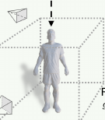
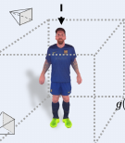










Back Propagation
Back Propagation
DMTET
normal z₀ⁿ
Add noise
“A photo of Messi, [b], [v]”
depth z₀ᵈ
DMTET
normal z₀ⁿ
Add noise
color x₀
Multi-denoise
(a) Geometry Generation
(b) Texture Generation
Notes:
[Sources]
- https://openaccess.thecvf.com/content/CVPR2024/html/Huang_HumanNorm_Learning_Normal_Diffusion_Model_for_High-quality_and_Realistic_3D_CVPR_2024_paper.html
[/Sources]

