Slide 1










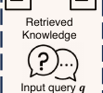




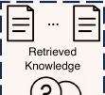
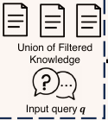






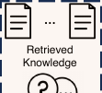




Input query q
Knowledge
Base
Retrieved
Knowledge
LLM
LLM Response
External Knowledge
Augmented Query q_in
Input query q LLM LLM Response Internal Knowledge
Augmented Query q_in
External Knowledge Augmentation
Internal Knowledge Augmentation
Query Generation
Blending
Knowledge Filtering
Answer Generation
Notes:
[Sources]
- https://aclanthology.org/2024.emnlp-main.58/
[/Sources]

