Slide 1
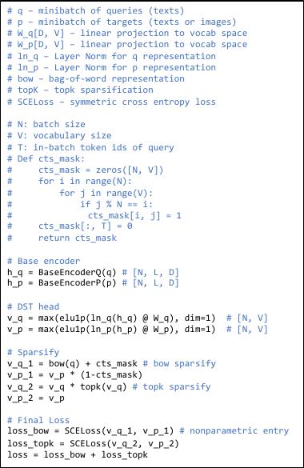
Training
Base
Encoder
Q
DST
Head
Text
Q
Contrastive
Loss
CTS
Mask
Base
Encoder
P
DST
Head
Data
P
Inference
Base
Encoder
P
Embed
Corpus
DST
Head
Data
P
Option1:
Parametric
Inference
Option2:
Nonparametric
Inference
Base
Encoder
Q
DST
Head
Query
Q
Query
Q
Tokenizer
Notes:
[Sources]
- https://openreview.net/forum?id=ZlQRiFmq7Y
[/Sources]

