Slide 1
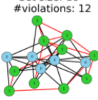
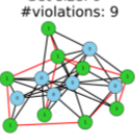
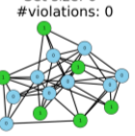
Forward Process
Xᵀ
Xᵀ⁄₂
X₀
Set size: 10
#violations: 12
Set size: 9
#violations: 9
Set size: 6
#violations: 0
···
···
Reverse Process
Notes:
[Sources]
- https://proceedings.mlr.press/v235/sanokowski24a.html
[/Sources]

