Slide 1


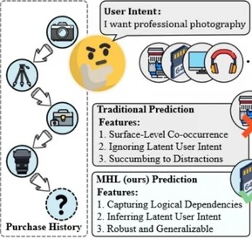
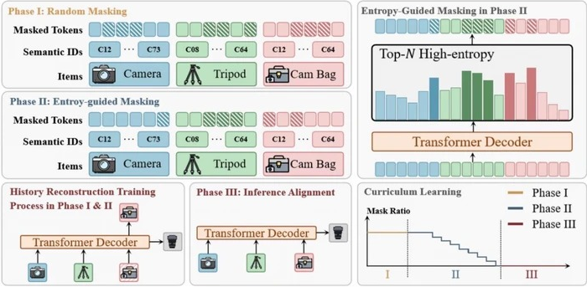
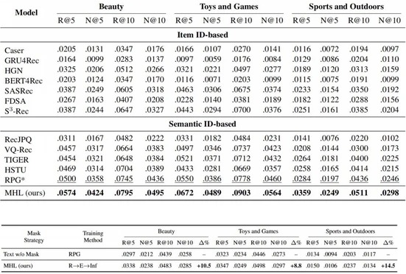
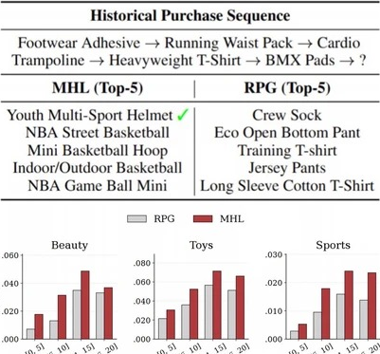
From Past To Path: Masked History Learning for
Next-Item Prediction in Generative Recommendation
Kaiwen Wei¹*, Kejun He¹*, Xiaomian Kang², Jie Zhang³, Yuming Yang¹,
Li Jin⁴, Zhenyang Li⁵, Jiang Zhong¹†, He Bai³, Junnan Zhu²†
¹College of Computer Science, Chongqing University
²MAIS, Institute of Automation, Chinese Academy of Sciences
³Independent Researcher
⁴Aerospace Information Research Institute, Chinese Academy of Sciences
⁵Department of Computer Science, City University of Hong Kong
Introduction
Generative recommendation has recently emerged as a promising paradigm by leveraging pre-trained language models to directly generate semantic item identifiers. Compared with traditional sequential recommenders, it provides greater flexibility in modeling user preferences and recommendation paths. However, existing generative recommenders are predominantly trained with an autoregressive next-item prediction objective. This left-to-right paradigm emphasizes local transitions and recent interactions, while overlooking deeper dependencies hidden in the entire user history. As a result, models often rely on recency bias and struggle to capture the latent intent that drives a user’s behavior sequence.
Main Contributions
(1) Entropy-Guided Masking. We selectively mask high-entropy items—those appearing in diverse behavioral contexts—to focus reconstruction on the most informative and critical historical junctions.
(2) Curriculum Learning Scheduler. We progressively transition from an initial random masking warmup to a high-ratio entropy-guided masking phase, then gradually reduce the ratio to adapt the model’s deep contextual understanding to the inherent causal structure of autoregressive generation.
Mask History Learning
We propose Masked History Learning (MHL), which augments generative recommendation models with an auxiliary objective of reconstructing masked historical items. By jointly optimizing next-item prediction and history reconstruction, MHL shifts the focus from local transitions to deep path comprehension and latent intent understanding. We introduce entropy-guided masking to selectively target high-entropy items for reconstruction, and an adaptive curriculum scheduler that progressively transitions from random masking to high-ratio entropy masking, then gradually reduces the ratio to align deep contextual understanding with autoregressive generation.
Performance comparisons
Conclusion
Performance comparisons demonstrate MHL’s effectiveness across dimensions. MHL consistently outperforms state-of-the-art baselines across all datasets. The generalization study validates significant improvements over RPG on text token sequences. The case study shows MHL generates recommendations that align more closely with the user’s true subsequent sequence, revealing deeper latent intent behind the historical path. The cold-start comparison confirms superior performance across all item frequency bins, including low-frequency items. In summary, MHL achieves substantial gains in accuracy, generalizability, intent-awareness, and cold-start performance by deeply understanding user historical paths.
Notes:
[Sources]
- User-provided image: 宣传一下我们被ACL 2026录用oral的工作
[/Sources]

