Slide 1
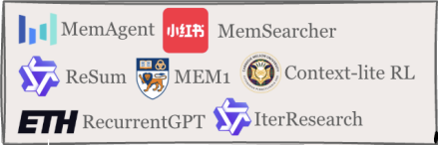
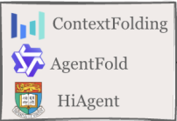

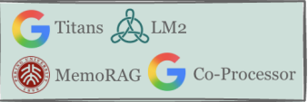
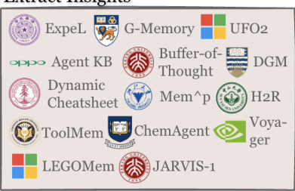
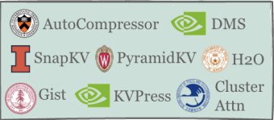
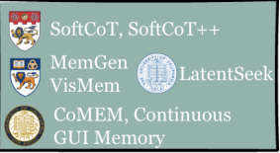
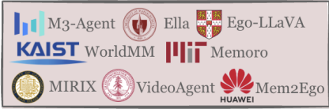
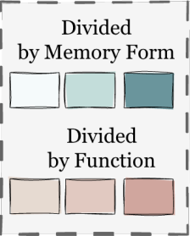
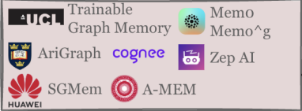
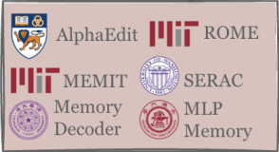
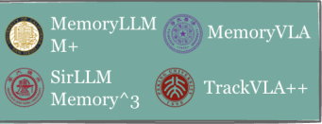
Context Condensation
Context Branching
Internalizing Experiences
KV Generation
Extract Insights
KV Reuse/Compression
🐇
KV Generation
⚙
💭
KV Reuse/
Compression
Latent Memory Generation
🤖
🖼
🧩
Multimodal RAG
↪
🗄
Previous
Traj.
🏅
Working
Memory
Knowledge Graph
🕸
Experiential
Memory
Short-term
🗄
📖
📚
Model & Knowledge Editing
Vector
Database
Latent
Repository
Factual
Memory
Long-term
Latent Repository
Model & Knowledge
Editing
Token-level
Memory
Parametric
Memory
Latent
Memory
Diverse Memory Forms
Figure 1
Overview of agent memory organized by the unified taxonomy of forms (Section 3), functions (Section 4), and dynamics (Section 5). The diagram positions memory artifacts by their dominant form and primary function. It further maps representative systems into this taxonomy to provide a consolidated landscape.
Notes:
[Sources]
- User-provided screenshot: 截屏2026-07-31 13.46.26.png
[/Sources]

