Slide 1

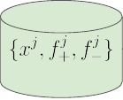




Revisions from Student
Simulator
Scoring Revisions for
Preference Pair Selection
Initial Writings
Generating Feedback
Preference Relations
DPO
Mₜ
S
Model for next iteration
Notes:
[Sources]
- Closing the Loop: Learning to Generate Writing Feedback via Language Model Simulated Student Revisions, EMNLP 2024, Figure 1: https://aclanthology.org/2024.emnlp-main.928/
[/Sources]

