Slide 1
Artificial Intelligence & Prolog Programming
CSL 302

Slide 2
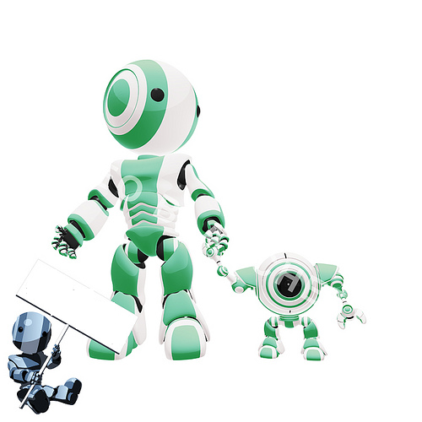

Artificial Intelligence

Slide 3
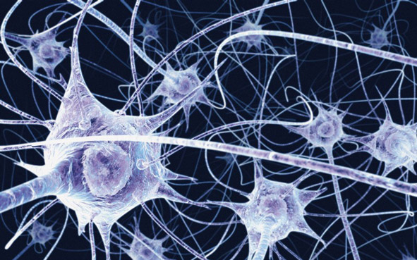
What is Intelligence???
Intelligence is the ability to learn ,
Understand & think.

Slide 4
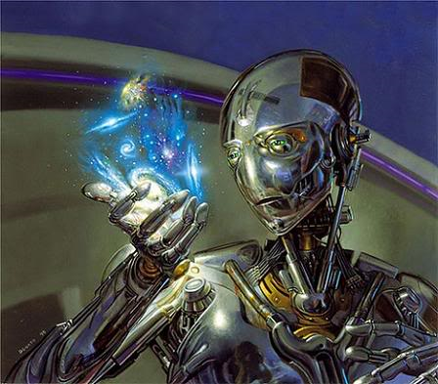
What Is Artificial Intelligence???
Artificial Intelligence (AI) is a branch of computer science concerned with the study & creation of computer systems that exhibit some form of intelligence.
A.I deals with the:
Systems that learn new concepts & tasks .
Systems that can reason & draw conclusions about the world around us.
Systems that can understand natural language or perceive and comprehend a visual scene.

Slide 5
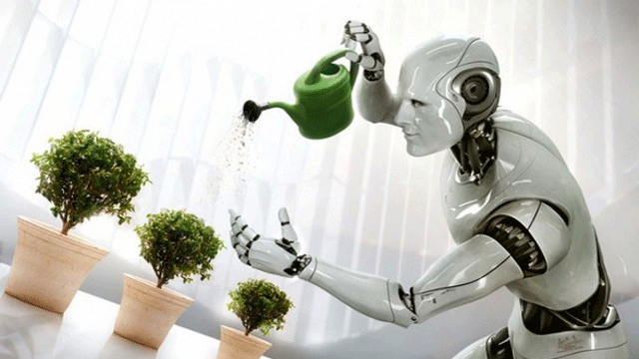
Machine Learning!
Machine learning is a scientific discipline concerned with the design and development of algorithms that allow machines to mimic human intelligence.

Slide 6
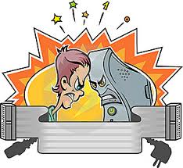
Human Intelligence VS Artificial Intelligence

Slide 7
Human Intelligence VS Artificial Intelligence
Pros
Human Intelligence
Artificial Intelligence
Intuition, Common sense, Judgement, Creativity, Beliefs etc
The ability to demonstrate their intelligence by communicating effectively
Plausible Reasoning and Critical thinking
Ability to simulate human behavior and cognitive processes
Capture and preserve human expertise
Fast Response. The ability to comprehend large amounts of data quickly.
Notes:
The important aspects of human intelligence seem to following the use of intuition, common sense, judgment, creativity, goal directedness, plausible reasoning, knowledge and beliefs.
Meaning of intelligence is not human brain’s information processing ability but the ability of humans to demonstrate their intelligence by communicating effectively.

Slide 8
Human Intelligence VS Artificial Intelligence
Cons
Human Intelligence
Artificial Intelligence
  Humans are fallible
  They have limited knowledge bases
  Information processing of serial nature proceed very slowly in the brain as compared to computers
Humans are unable to retain large amounts of data in memory.
No “common sense”
Cannot readily deal with “mixed” knowledge
May have high development costs
Raise legal and ethical concerns

Slide 9
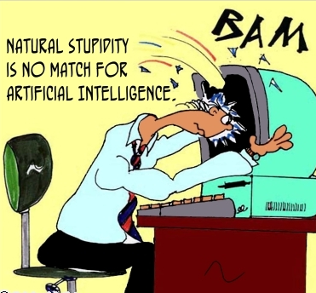
Human Intelligence VS Artificial Intelligence
We achieve more than we know. We know more than we understand. We understand more than we can explain (Claude Bernard, 19th C French scientific philosopher)

Slide 10
Unit 1
Introduction
Foundations of AI
Criteria for Success :Turing Test
AI Problems
AI Task Domain
Underlying Assumption
What is an AI Technique?

Slide 11
1. Introduction
Intelligence: “ability to learn, understand and think” (Oxford dictionary)
AI is the study of how to make computers make things which at the moment people do better.
Examples: Speech recognition, Face, Object, Intuition, Inferencing, Learning new skills, Decision making, Abstract thinking

Slide 12
AI is a branch of computer science concerned with the study and creation of computer systems that exhibit some form of intelligence:
Systems that learn new concepts and tasks
Systems that can reason and draw conclusions about the world around us
Systems that can understand natural language or perceive and comprehend a visual scene
& systems that perform other types of feats that require human types of intelligence

Slide 13
The State of the Art
Computer beats human in a chess game.
Computer-human conversation using speech recognition.
Expert system controls a spacecraft.
Robot can walk on stairs and hold a cup of water.
Home appliances use fuzzy logic.
......

Slide 14
The Foundations of AI
Philosophy (423 BC − present):
− Logic, methods of reasoning.
− Mind as a physical system.
− Foundations of learning, language, and rationality.
Mathematics (c.800 − present):
− Formal representation and proof.
− Algorithms, computation, decidability, tractability.
− Probability.

Slide 15
The Foundations of AI
Psychology (1879 − present):
− Adaptation.
− Phenomena of perception and motor control.
− Experimental techniques.
Linguistics (1957 − present):
− Knowledge representation.
− Grammar.


Slide 16



Criteria for Success: The Turing Test
Alan Turing (1912-1954)
“Computing Machinery and Intelligence” (1950)
Imitation Game
Human
Human Interrogator
AI System

Slide 17
To pass Turing Test computer needs..
Natural language processing
Knowledge Representation
Automated Reasoning
Machine learning
Computer Vision
Robotics

Slide 18
AI Problems
1) Common sense knowledge problem
i) AI system only knows what explicitly it has been told
ii) Like if we tell the system “car is in the garage”, it is common sense that tires are in the car i.e. Tires are also in the garage.
iii) But in AI system we have to feed tires are in the garage
2) Making Simple Problems complex
i) A simple task for humans such as navigating a room is very complex for an AI system

Slide 19
3) Lack of Intuition
i) When a AI system has to make a guess it relies on algorithm or some
random number generation
ii) Thus it lacks ability to use intuition

Slide 20
AI Task Domains
Mundane Tasks:
  Perception
    Vision
    Speech
  Natural Languages
    Understanding
    Generation
    Translation
  Common sense reasoning
  Robot Control
Formal Tasks
  Games : chess, checkers etc
  Mathematics: Geometry, logic,Proving properties of programs
Expert Tasks:
  Engineering ( Design, Fault finding, Manufacturing planning)
  Scientific Analysis
  Medical Diagnosis
  Financial Analysis

Slide 21

Applications Of Artificial Intelligence
Expert Systems!!
An expert system is a computer program that is designed to hold the accumulated knowledge of one or more domain experts
It reasons with knowledge of some specialist subject with a view to solving problems or giving advice
They are tested by being placed in the same real world problem solving situation

Slide 22
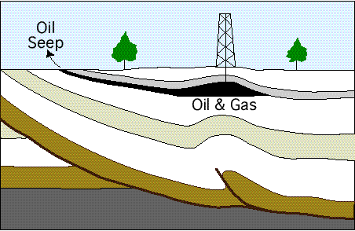

Applications of Expert Systems
PUFF:
Medical system
for diagnosis of respiratory conditions
PROSPECTOR:
Used by geologists to identify sites for drilling or mining

Slide 23
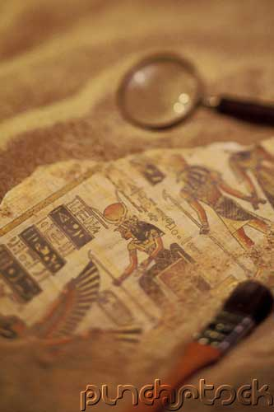
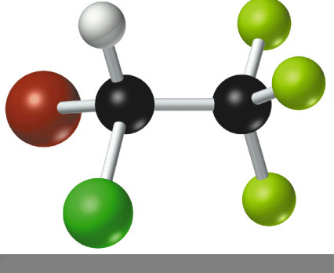
Applications of Expert Systems
DENDRAL: Used to identify the structure of chemical compounds. First used in 1965
LITHIAN: Gives advice to archaeologists examining stone tools

Slide 24
Tic Tac Toe
Three programs are presented :
  Series increase
  Their complexity
  Use of generalization
  Clarity of their knowledge
  Extensability of their approach

Slide 25
Introductory Problem: Tic-Tac-Toe
X |  | X
 | o

Slide 26
Introductory Problem: Tic-Tac-Toe
Program 1:
Data Structures:
Board: 9 element vector representing the board, with 1-9 for each square. An element contains the value 0 if it is blank, 1 if it is filled by X, or 2 if it is filled with a O
Movetable: A large vector of 19,683 elements ( 3^9), each element is 9-element vector.
Algorithm:
1. View the vector as a ternary number. Convert it to a
decimal number.
2. Use the computed number as an index into
Move-Table and access the vector stored there.
3. Set the new board to that vector.

Slide 27
Introductory Problem: Tic-Tac-Toe
Comments:
This program is very efficient in time.
1. A lot of space to store the Move-Table.
2. A lot of work to specify all the entries in the
Move-Table.
3. Difficult to extend.

Slide 28
Introductory Problem: Tic-Tac-Toe
1 | 2 | 3
4 | 5 | 6
7 | 8 | 9

Slide 29
Introductory Problem: Tic-Tac-Toe
Program 2:
Data Structure: A nine element vector representing the board. But instead of using 0,1 and 2 in each element, we store 2 for blank, 3 for X and 5 for O
Functions:
Make2: returns 5 if the center sqaure is blank. Else any other balnk sq
Posswin(p): Returns 0 if the player p cannot win on his next move; otherwise it returns the number of the square that constitutes a winning move. If the product is 18 (3x3x2), then X can win. If the product is 50 ( 5x5x2) then O can win.
Go(n): Makes a move in the square n
Strategy:
Turn = 1 Go(1)
Turn = 2 If Board[5] is blank, Go(5), else Go(1)
Turn = 3 If Board[9] is blank, Go(9), else Go(3)
Turn = 4 If Posswin(X) ≠ 0, then Go(Posswin(X))
.......

Slide 30
Introductory Problem: Tic-Tac-Toe
Comments:
1. Not efficient in time, as it has to check several
conditions before making each move.
2. Easier to understand the program’s strategy.
3. Hard to generalize.

Slide 31
Introductory Problem: Tic-Tac-Toe
8 | 3 | 4
1 | 5 | 9
6 | 7 | 2
15 − (8 + 5)

Slide 32
Introductory Problem: Tic-Tac-Toe
Comments:
1. Checking for a possible win is quicker.
2. Human finds the row-scan approach easier, while
computer finds the number-counting approach more
efficient.

Slide 33
Introductory Problem: Tic-Tac-Toe
Program 3:
1. If it is a win, give it the highest rating.
2. Otherwise, consider all the moves the opponent
could make next. Assume the opponent will make
the move that is worst for us. Assign the rating of
that move to the current node.
3. The best node is then the one with the highest
rating.

Slide 34
Introductory Problem: Tic-Tac-Toe
Comments:
1. Require much more time to consider all possible
moves.
2. Could be extended to handle more complicated
games.

Slide 35
Introductory Problem: Question Answering
“Mary went shopping for a new coat. She found a red
one she really liked. When she got it home, she
discovered that it went perfectly with her favourite
dress”.
Q1: What did Mary go shopping for?
Q2: What did Mary find that she liked?
Q3: Did Mary buy anything?

Slide 36
Introductory Problem: Question Answering
Program 1:
1. Match predefined templates to questions to generate
text patterns.
2. Match text patterns to input texts to get answers.
“What did X Y” “What did Mary go shopping for?”
“Mary go shopping for Z”
Z = a new coat

Slide 37
Introductory Problem: Question Answering
Program 2:
Structured representation of sentences:
Event2: Thing1:
instance: Finding instance: Coat
tense: Past colour: Red
agent: Mary
object: Thing 1

Slide 38
Introductory Problem: Question Answering
Program 3:
Background world knowledge:
C finds M
C leaves L C buys M
C leaves L
C takes M

