Slide 1
Heuristic Search
Chapter 3

Slide 2
Outline
Generate-and-test
Hill climbing
Best-first search
Problem reduction
Constraint satisfaction
Means-ends analysis

Slide 3
Generate-and-Test
Algorithm
Generate a possible solution.
Test to see if this is actually a solution.
Quit if a solution has been found.
Otherwise, return to step 1.

Slide 4
Generate-and-Test
Acceptable for simple problems.
Inefficient for problems with large space.

Slide 5
Generate-and-Test
Exhaustive generate-and-test.
Heuristic generate-and-test: not consider paths that seem unlikely to lead to a solution.
Plan generate-test:
− Create a list of candidates.
− Apply generate-and-test to that list.

Slide 6
Generate-and-Test
Example: coloured blocks
“Arrange four 6-sided cubes in a row, with each side of
each cube painted one of four colours, such that on all four
sides of the row one block face of each colour is showing.”

Slide 7
Generate-and-Test
Example: coloured blocks
Heuristic: if there are more red faces than other colours
then, when placing a block with several red faces, use few
of them as possible as outside faces.

Slide 8
Hill Climbing
Searching for a goal state = Climbing to the top of a hill

Slide 9
Hill Climbing
Generate-and-test + direction to move.
Heuristic function to estimate how close a given state is to a goal state.

Slide 10
Simple Hill Climbing
Algorithm
Evaluate the initial state.
Loop until a solution is found or there are no new operators left to be applied:
− Select and apply a new operator
− Evaluate the new state:
goal → quit
better than current state → new current state

Slide 11
Simple Hill Climbing
Evaluation function as a way to inject task-specific knowledge into the control process.

Slide 12
Simple Hill Climbing
Example: coloured blocks
Heuristic function: the sum of the number of different
colours on each of the four sides (solution = 16).

Slide 13
Steepest-Ascent Hill Climbing (Gradient Search)
Considers all the moves from the current state.
Selects the best one as the next state.

Slide 14
Steepest-Ascent Hill Climbing (Gradient Search)
Algorithm
Evaluate the initial state.
Loop until a solution is found or a complete iteration produces no change to current state:
− SUCC = a state such that any possible successor of the
current state will be better than SUCC (the worst state).
− For each operator that applies to the current state, evaluate
the new state:
goal → quit
better than SUCC → set SUCC to this state
− SUCC is better than the current state → set the current
state to SUCC.

Slide 15
Hill Climbing: Disadvantages
Local maximum
A state that is better than all of its neighbours, but not
better than some other states far away.

Slide 16
Hill Climbing: Disadvantages
Plateau
A flat area of the search space in which all neighbouring
states have the same value.

Slide 17
Hill Climbing: Disadvantages
Ridge
The orientation of the high region, compared to the set
of available moves, makes it impossible to climb up.
However, two moves executed serially may increase
the height.

Slide 18
Hill Climbing: Disadvantages
Ways Out
Backtrack to some earlier node and try going in a different direction.
Make a big jump to try to get in a new section.
Moving in several directions at once.

Slide 19
Hill Climbing: Disadvantages
Hill climbing is a local method:
Decides what to do next by looking only at the “immediate” consequences of its choices.
Global information might be encoded in heuristic functions.

Slide 20
Hill Climbing: Disadvantages
Start
A
Goal
D
D
C
C
B
B
A
Blocks World

Slide 21
Hill Climbing: Disadvantages
Start
A
Goal
D
0
4
D
C
C
B
B
A
Blocks World
Local heuristic:
+1 for each block that is resting on the thing it is supposed to be resting on.
−1 for each block that is resting on a wrong thing.

Slide 22
Hill Climbing: Disadvantages
0
A
2
D
D
C
C
B
B
A

Slide 23
Hill Climbing: Disadvantages
D
2
C
B
A
A
0
0
D
C
C
D
C
0
B
B
A
B
A
D

Slide 24
Hill Climbing: Disadvantages
Start
A
Goal
D
−6
6
D
C
C
B
B
A
Blocks World
Global heuristic:
For each block that has the correct support structure: +1 to every block in the support structure.
For each block that has a wrong support structure: −1 to
every block in the support structure.

Slide 25
Hill Climbing: Disadvantages
D
−3
C
B
A
A
−6
−2
D
C
C
D
C
−1
B
B
A
B
A
D

Slide 26
Hill Climbing: Conclusion
Can be very inefficient in a large, rough problem space.
Global heuristic may have to pay for computational complexity.
Often useful when combined with other methods, getting it started right in the right general neighbourhood.

Slide 27
Best-First Search
Depth-first search: not all competing branches having to be expanded.
Breadth-first search: not getting trapped on dead-end paths.
⇒ Combining the two is to follow a single path at a time, but switch paths whenever some competing path look more promising than the current one.

Slide 28
Best-First Search
A
A
A
B
C
D
B
C
D
3
5
1
3
5
E
F
4
6
A
A
B
C
D
B
C
D
5
5
G
H
E
F
G
H
E
F
6
5
4
6
6
5
6
I
J
2
1

Slide 29
Best-First Search
OPEN: nodes that have been generated, but have not examined.
This is organized as a priority queue.
CLOSED: nodes that have already been examined.
Whenever a new node is generated, check whether it has been generated before.

Slide 30
Best-First Search
Algorithm
OPEN = {initial state}.
Loop until a goal is found or there are no nodes left in OPEN:
− Pick the best node in OPEN
− Generate its successors
− For each successor:
i) If it has not been generated before , evaluate it, add it to OPEN and record its parent.
ii)If it has been generated before, change the parent if this new path is better than the previous one. In that case, update the cost of getting to this node and to any successors that this node may already have.

Slide 31
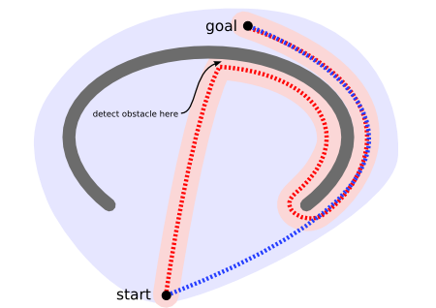
Using Best First Search

Slide 32
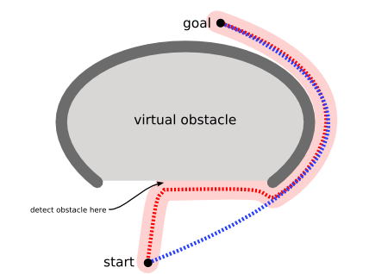
A* for PATHFINDING

Slide 33
Best-First Search
Greedy search:
h(n) = estimated cost of the cheapest path from node n to a goal state.

Slide 34
Best-First Search
Uniform-cost search:
g(n) = cost of the cheapest path from the initial state to node n.

Slide 35
Best-First Search
Greedy search:
h(n) = estimated cost of the cheapest path from node n to a goal state.
Neither optimal nor complete

Slide 36
Best-First Search
Greedy search:
h(n) = estimated cost of the cheapest path from node n to a goal state.
Neither optimal nor complete
Uniform-cost search:
g(n) = cost of the cheapest path from the initial state to node n.
Optimal and complete, but very inefficient

Slide 37
Best-First Search
Algorithm A* (Hart et al., 1968):
f(n) = g(n) + h(n)
h(n) = cost of the cheapest path from node n to a goal state.
g(n) = cost of the cheapest path from the initial state to node n.

Slide 38
Best-First Search
Algorithm A*:
f*(n) = g*(n) + h*(n)
h*(n) (heuristic factor) = estimate of h(n).
g*(n) (depth factor) = approximation of g(n) found by A* so far.

Slide 39
A STAR ALGORITHIM ( example https://en.wikipedia.org/wiki/A*_search_algorithm)
Initialize OPEN list
Initialize CLOSED list
Create goal node; call it node_goal
Create start node; call it node_start
Add node _start to the OPEN list
while the OPEN list is not empty
{
Get node n off the OPEN list with the lowest f(n)
Add n to the CLOSED list
if n is the same as node_goal we have found the solution; return Solution(n)
Generate each successor node n' of n
for each successor node n' of n
{
Set the parent of n' to n
Set h(n') to be the heuristically estimate distance to node_goal
Set g(n') to be g(n) plus the cost to get to n' from n
Set f(n') to be g(n') plus h(n')
if n' is on the OPEN list and the existing one is as good or better then discard n' and continue
if n' is on the CLOSED list and the existing one is as good or better then discard n' and continue
Remove occurrences of n' from OPEN and CLOSED
Add n' to the OPEN list
} }
return failure (if we reach this point we have searched all reachable nodes and still havent found the solution, therefore one does not exist)

Slide 40

Romania with step costs in km

Slide 41

A* search example
Open List:
Arad
We start with our initial state Arad. We make a node and add it to the open list. Since it’s the only thing on the open list, we expand the node.
Think of the open list as a priority queue (or heap) that sorts the nodes inside of it according to their g()+h() score.

Slide 42

A* search example
Open List:
Sibiu
Timisoara
Zerind
We add the three nodes we found to the open list.
We sort them according to the g()+h() calculation.

Slide 43

A* search example
Open List:
Rimricu Vicea
Fagaras
Timisoara
Zerind
Arad
Oradea
We’ve been to Arad before. Don’t list it again on the open list.
When we expand Sibiu, we run into Arad again. But we’ve already expanded this node once; so, we don’t add it to the open list again.

Slide 44
A* search example
Open List:
Rimricu Vicea
Fagaras
Timisoara
Zerind
Oradea
We see that Rimricu Vicea is at the top of the open list; so, it’s the next node we will expand.

Slide 45

A* search example
Open List:
Fagaras
Pitesti
Timisoara
Zerind
Craiova
Sibiu
Oradea
When we expand Rimricu Vicea, we run into Sibiu again.
But we’ve already expanded this node once; so, we don’t add it to the open list again.

Slide 46
A* search example
Open List:
Fagaras
Pitesti
Timisoara
Zerind
Craiova
Oradea
Fagaras will be the next node we should expand – it’s at the top of the sorted open list.

Slide 47

A* search example
Open List:
Pitesti
Timisoara
Zerind
Bucharest
Craiova
Sibiu
Oradea
When we expand Fagaras, we find Sibiu again. We don’t add it to the open list.
We also find Bucharest, but we’re not done. The algorithm doesn’t end until we “expand” the goal node – it has to be at the top of the open list.

Slide 48
A* search example
Open List:
Pitesti
Timisoara
Zerind
Bucharest
Craiova
Oradea
It looks like Pitesti is the next node we should expand.

Slide 49

A* search example
Open List:
Bucharest
Timisoara
Zerind
Craiova
Rimricu Vicea
Oradea
We just found a better value for Bucharest; so, it got moved higher in the list. We also found a worse value for Craiova – we just ignore this.
And of course, we ran into Rimricu Vicea again. Since it’s already been expanded once, we don’t re-add it to the Open List.

Slide 50
A* search example
Open List:
Bucharest
Timisoara
Zerind
Craiova
Oradea
Now it looks like Bucharest is at the top of the open list…

Slide 51
A* search example
Open List:
Bucharest
Timisoara
Zerind
Craiova
Oradea
Now we “expand” the node for Bucharest.
We’re done! (And we know the path that we’ve found is optimal.)

Slide 52
Problem Reduction
Goal: Acquire TV set
Goal: Steal TV set
Goal: Earn some money
Goal: Buy TV set
AND-OR Graphs
Algorithm AO* (Martelli & Montanari 1973, Nilsson 1980)

Slide 53
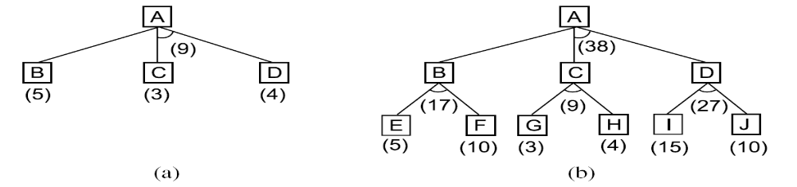
AND-OR Graphs
59

Slide 54
Problem Reduction: AO*
A
A
6
5
9
B
C
D
3
4
5
A
9
A
11
9
12
B
C
D
10
B
6
C
D
10
3
4
4
E
F
G
H
E
F
4
4
5
7
4
4

Slide 55
Algorithm : Problem Reduction
Initialize the graph to the starting node.
Loop until the starting node is labeled SOLVED or until its cost goes above FUTILITY:
(a) Traverse the graph, starting at the initial node and following the current best path, and accumulate the set of nodes that are on that path and have not yet been expanded or labeled as solved.
(b) Pick one of these unexpanded nodes and expand it. If there are no successors, assign FUTILITY as the value of this node. Otherwise, add its successors to the graph and for each of them compute f ′ If of any node is 0, mark that node as SOLVED.
(c) Change the f ′ estimate of the newly expanded node to reflect the new information provided by its successors. Propagate this change backward through the graph. If any node contains a successor arc whose descendants are all solved, label the node itself as SOLVED. At each node that is visited while going up the graph, decide which of its successor arcs is the most promising and mark it as part of the current best path.
60

Slide 56
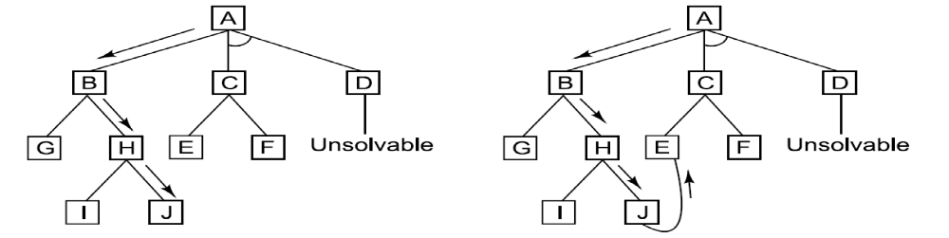
Some limitations of AO*:
A Longer Path May Be Better
62

Slide 57
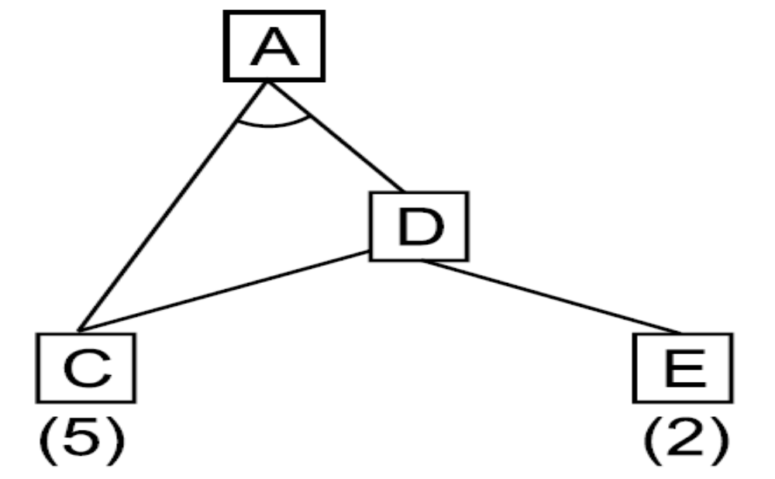
Interacting Subgoals
63

Slide 58
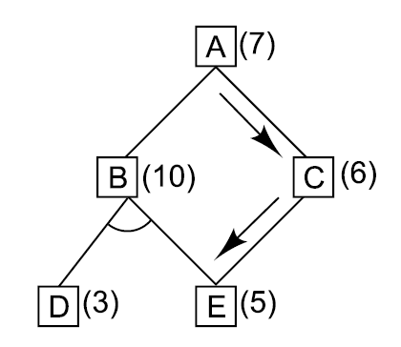
An Unnecessary Backward Propagation
64

Slide 59
Constraint Satisfaction
Many AI problems can be viewed as problems of constraint satisfaction.
Cryptarithmetic puzzle:
SEND
MORE
MONEY
+

Slide 60
Constraint Satisfaction
As compared with a straightforard search procedure, viewing a problem as one of constraint satisfaction can reduce substantially the amount of search.

Slide 61
Constraint Satisfaction
Operates in a space of constraint sets.
Initial state contains the original constraints given in the problem.
A goal state is any state that has been constrained “enough”.

Slide 62
Constraint Satisfaction
Two-step process:
1. Constraints are discovered and propagated as far as possible.
2. If there is still not a solution, then search begins, adding new constraints.

Slide 63
Initial state:
No two letters have
the same value.
The sum of the digits
must be as shown.
M = 1
S = 8 or 9
O = 0
N = E + 1
C2 = 1
N + R > 8
E ≠ 9
SEND
MORE
MONEY
+
E = 2
N = 3
R = 8 or 9
2 + D = Y or 2 + D = 10 + Y
C1 = 0
C1 = 1
2 + D = Y
N + R = 10 + E
R = 9
S =8
2 + D = 10 + Y
D = 8 + Y
D = 8 or 9
D = 8
D = 9
Y = 0
Y = 1

Slide 64


Slide 65
Constraint Satisfaction
Two kinds of rules:
1. Rules that define valid constraint propagation.
2. Rules that suggest guesses when necessary.

Slide 66
Homework
Exercises 1-14 (Chapter 3 – AI Rich & Knight)
Reading Algorithm A*
(http://en.wikipedia.org/wiki/A%2A_algorithm)

