Slide 1
Capability Maturity Model (CMM)

Slide 2
What is CMM?
Also called as SEI-CMM
Developed by the Software Engineering Institute (SEI) of the Carnegie Mellon University
Framework that describes the key elements of an effective software process
Provides guidance on how to gain control of processes for developing and maintaining software
Many commercial organisations began to adopt CMM as a framework for their own Internal improvement initiatives.

Slide 3
SEI CMM can be used in two ways—
capability evaluation and software process assessment
Capability evaluation provides a way to assess the software process capability of an organisation.
software process assessment is used by an organisation with the objective to improve its own process capability.

Slide 4
What are the CMM Levels?
Maturity level indicates level of process capability:
Initial
Repeatable
Defined
Managed
Optimizing

Slide 5
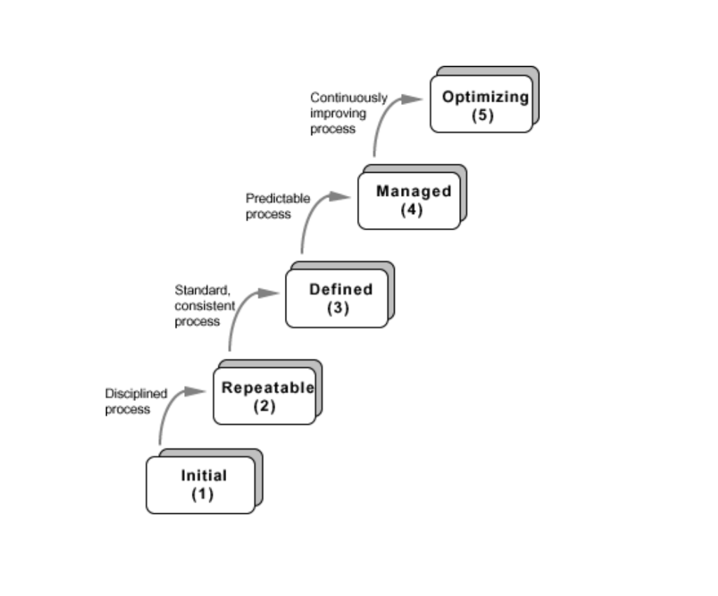

Slide 6
Initial
The software process is characterized as ad hoc, and occasionally even chaotic.
Few processes are defined, and success depends on individual effort.
Products developed are often over budget
Wide variations in cost, schedule, functionality and quality targets

Slide 7
Repeatable
Basic process management processes are established to track cost, schedule, and functionality.
Realistic project commitments based on results observed on previous projects .
Software project standards are defined and faithfully followed
Processes may differ between projects
Process is disciplined

Slide 8
Defined
The software process is documented, standardized, and integrated into a standard software process for the organization.
All projects use an approved, tailored version of the organization’s standard software process for developing an maintaining software.

Slide 9
Managed
Detailed measures of the software process and product quality are collected.
corrective action can be taken
Quantifiable and predictable
predict trends in process and product quality

Slide 10
Optimizing
Continuous process improvement is enabled by feedback from the process and from innovative ideas and technologies.
Goal is to prevent the occurrence of defects
Causal analysis
Data on process effectiveness used for cost benefit analysis of new technologies and proposed process changes

Slide 11
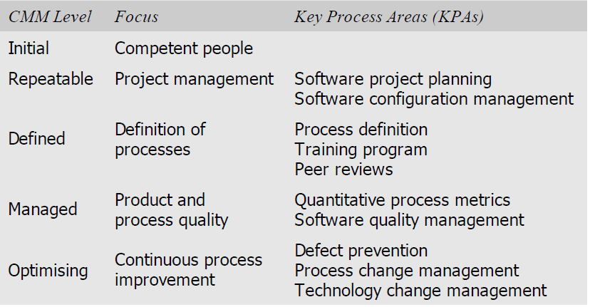

Slide 12
CMM Shortcomings:
The most frequent complaint by organisations while trying out the
CMM-based process improvement initiative is that they understand
what is needed to be improved, but they need more guidance about
how to improve it.
Thicker documents, more detailed information, and longer meetings are
considered to be better.
Getting an accurate measure of an organisation’s current maturity level
is also an issue.

Slide 13
Capability Maturity Model Integration (CMMI)
successor of (CMM).
2002 - CMMI Version 1.1 was released.
2006 - Version 1.2
aimed to improve the usability of maturity models by integrating many different models into one framework.
used in many domains.
Problems – overlap ,inconsistencies , and integrating the models.

Slide 14
Software Process Improvement and Capability Determination (SPICE)
SPICE stands for Software Process Improvement and Capability determination.
It distinguishes different kinds of processes—engineering process, management process, customer-supplier, support.
6 capability maturity levels.
It integrates existing standards to provide a single process reference model

Slide 15
Personal Software Process (PSP)
PSP is based on the work of David Humphrey
PSP is a scaled down version of industrial software process .
Suitable for individual use.
SEI CMM does not tell software developers how to analyse, design, code, test document software products.
PSP recognises that the process for individual use is different from that necessary for a team.
helps engineers to measure and improve the way they work.
It helps in developing personal skills and methods by estimating, planning, and tracking performance.

Slide 16
SIX SIGMA
General Electric (GE) corporation began Six Sigma in 1995 .
The purpose of Six Sigma is to improve processes to do things better, faster, and at lower cost.
It can be used to improve every facet of business, from production, to human resources, to order entry, to technical support.
Can be used for any activity that is concerned with cost, timeliness, and quality of results.
Applicable to virtually every industry.
Means striving for near perfection.
A disciplined, data-driven approach to eliminate defects in any process – from manufacturing to transactional and from product to service.
To achieve Six Sigma, a process must not produce more than 3.4 defects per million opportunities.

Slide 17
Total number of Six Sigma opportunities is then the total number of chances for a Defect.
Accomplished through the use of two Six Sigma sub-methodologies—
DMAIC process - define, measure, analyse, improve, control is an improvement system for existing processes falling below specification and looking for incremental improvement.
DMADV process - define, measure, analyse, design, verify is an improvement system used to develop new processes or products at Six Sigma quality levels.

