Slide 1
Software Quality
A Presentation by Yash Yadav

Slide 2

Measures For Quality
Traditional measures
Fitness of purpose: Fitness of purpose is that the software is
satisfying all the requirements laid down in the SRS document.
Modern View
Portability
Usability
Reusability
Correctness
Maintainability

Slide 3
Quality Management System
A quality management system is the principal methodology used by organizations to ensure that the products they develop have the desired quality. A quality system consists of the following:
Managerial Structure and Individual Responsibilities
Every organization has a separate quality department to perform several quality system activities
Quality System Activities
Auditing of projects
Review of the quality system
Development of standards, procedures

Slide 4
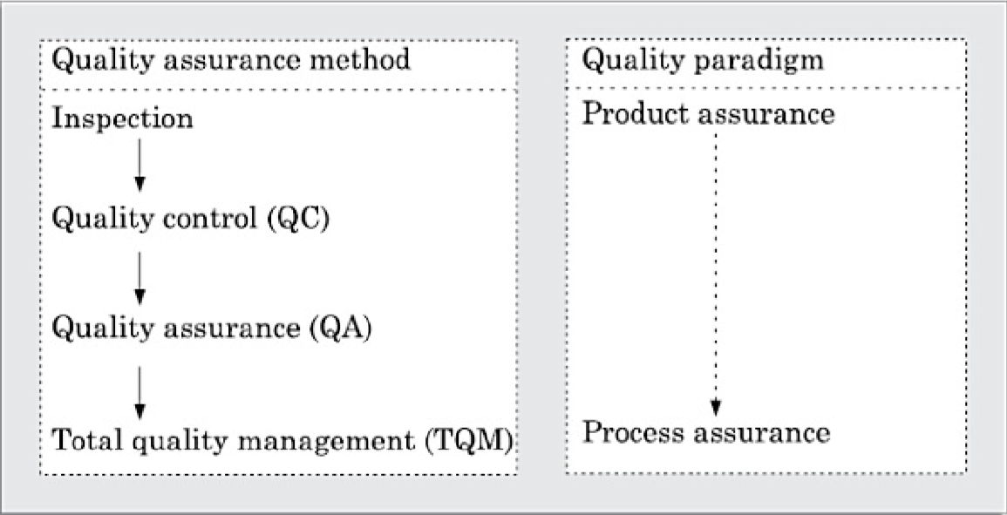
Evolution Of Quality
Time line
Before World war II
90’s
Modern time
Approach for quality assurance
Quality Control (QC)
Total quality management (TQM)

Slide 5

ISO 9000
ISO 9000 certification
Types of 9000 quality standards
9001 (Used in Software Engineering)
9002
9003
Software products VS Other products
Software is intangible in nature
Raw materials

Slide 6
Need for ISO 9000
Confidence of customers
ISO 9000 requires a well-documented software production process
Process focused, efficient, and cost-effective
Points out the weak points
Sets the basic framework for TQM

Slide 7

ISO 9001 Standards
Management Responsibility (4.1)
Contract Reviews (4.3)
Design Control (4.4)
Document Control (4.5)
Purchasing (4.6)
Process Control (4.9)
Inspection and Test Status (4.12)
Quality Audits (4.17)

Slide 8
How to get ISO 9000 Certification?
Application stage
Pre-assessment
Document review and adequacy audit
Compliance audit
Registration
Continued surveillance

Slide 9
Salient features of ISO 9001
Configuration management system in an organization
Prepare proper plans
Important documents should be checked independently
Product testing
Organization aspects

Slide 10
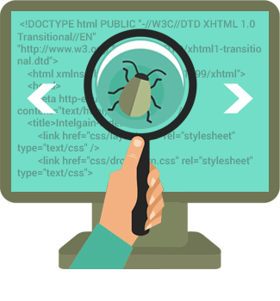
Shortcomings
Certification process is not fool proof
TQM is not ensured
Organization downplaying domain expertise
Doesn’t provide specific guidelines for defining particular processes

Slide 11
THANK YOU

